Slide 1
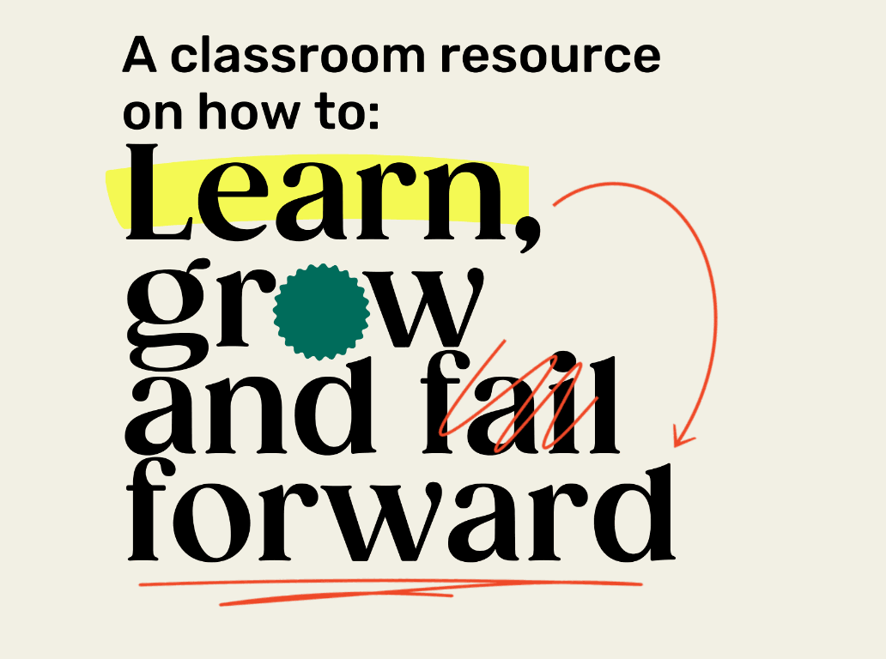
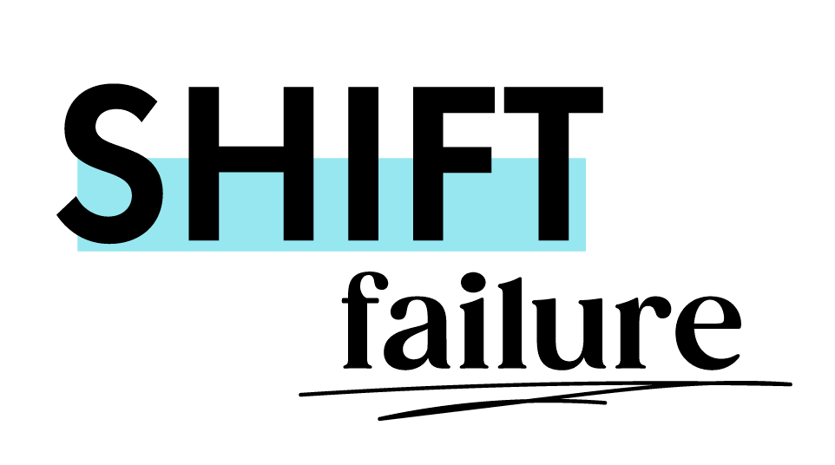
SHIFT FAILURE · A CLASSROOM RESOURCE
GRADES 5–8
Lesson Package · Lessons 1–5 · grounded in experiential and social-emotional learning.
MIIGWECH · MERCI · THANK YOU
Notes:
Shift Failure — a free, bilingual classroom resource that helps students in Grades 5–8 learn, grow and fail forward.

Slide 2
BEFORE WE BEGIN
We invite you to learn whose land your school is on.
Find your territory at native-land.ca . This resource honours Canada's Truth and Reconciliation journey and centres Indigenous voices, stories, and ways of knowing throughout.
Miigwech. Merci. Thank you.
Notes:
PDF p.5. Learn and share your school-specific land acknowledgement before Lesson 1. Find your territory at native-land.ca; see TRC Call to Action 62.

Slide 3
FOR EDUCATORS · BEFORE YOU TEACH FAILURE
Every student's story matters — failure is not equally distributed.
·
SENSITIVITY
Discussions of failure may carry deeper meaning for some students. Personal sharing is never required — silence is a valid form of participation.
·
Indigenous knowledge is knowledge.
·
Newcomers and English Language Learners belong here.
·
No student should feel their identity is a failure.
DIVERSITY · EQUITY · INCLUSION
Notes:
PDF p.4 & p.7. Every student's story matters; failure is not equally distributed; Indigenous knowledge is knowledge; newcomers and ELLs belong; no student should feel their identity is a failure. Discussions of failure may carry deeper meaning for some students — never require personal sharing; silence is a valid form of participation.

Slide 4
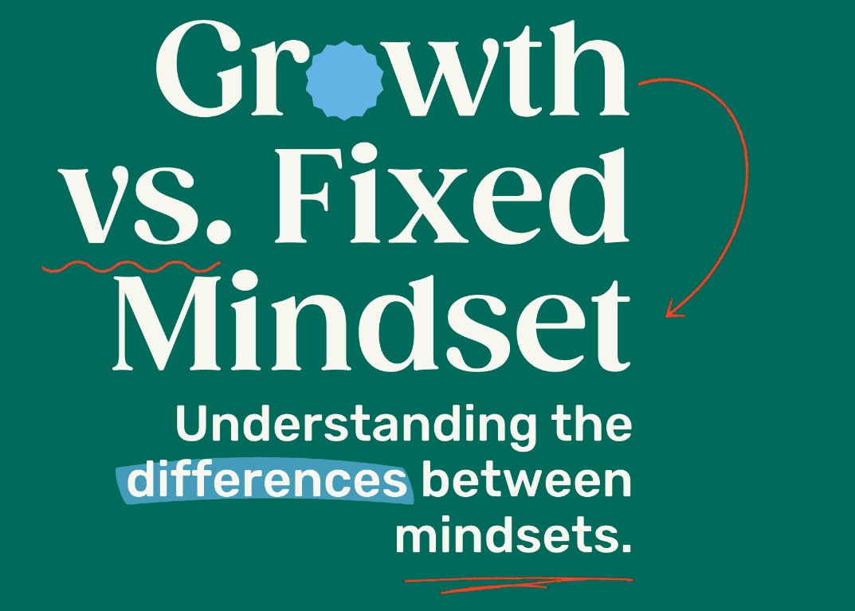
LESSON ONE
LESSON ONE
Notes:
Lesson 1: Growth vs. Fixed Mindset. Estimated time 60 minutes.

Slide 5
LESSON 1 · GROWTH VS. FIXED MINDSET
Learning Goals
1
Understand and articulate the differences between a “growth” and “fixed” mindset.
2
Reflect on how failing is an opportunity to grow and learn.
3
Identify times in your life where you failed and how this became an opportunity to learn.
4
Reflect on how personal challenges impact community and relationships, and how collective support aids growth.
LESSON ONE
Notes:
PDF p.10. Four learning goals — the fourth is the relational/community goal.

Slide 6
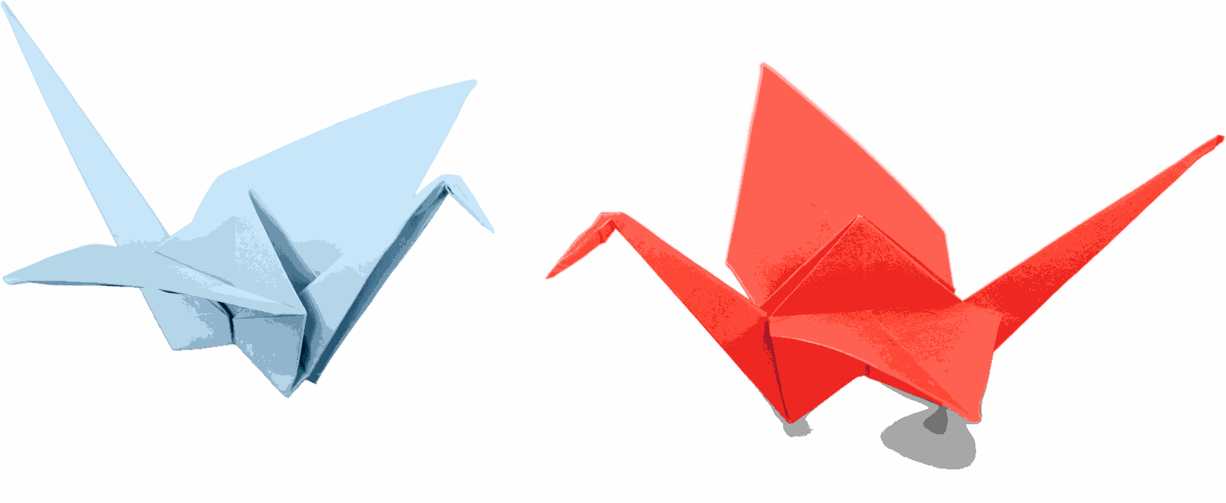
LESSON 1 · ACTIVITY
Investigate & Learn
Use the picture to help you fold an origami swan or crane, or another culturally meaningful shape.
No instructions yet — just use the image. Try your best.
5 minute timer
LESSON ONE
Notes:
Investigate & Learn. Students recreate the origami from an image only, no instructions. Invite a culturally meaningful shape — Indigenous ribbon-work patterns or rangoli designs — as the reference image. Learning through trial and observation is itself a valued form of knowledge in many Indigenous and oral traditions.

Slide 7
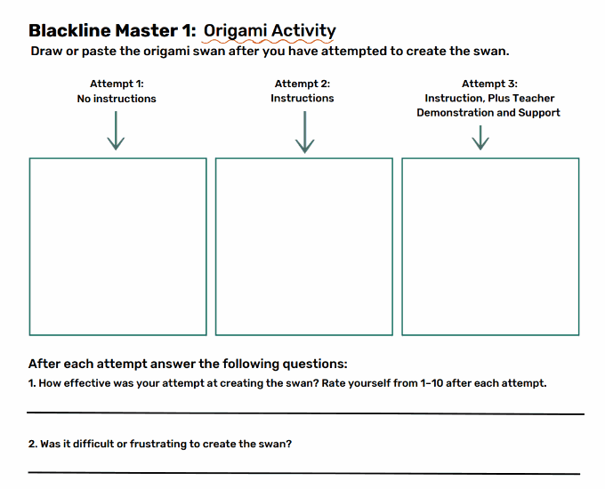
LESSON 1 · REFLECT
Record your first attempt
How did you feel while trying to recreate the origami?
What could have made the process more achievable?
Ask a partner — what did they do? Was their approach different? Are you willing to try their way?
LESSON ONE
Notes:
Reflection Moment: discuss frustrations about the process and what could have made it more achievable.

Slide 8
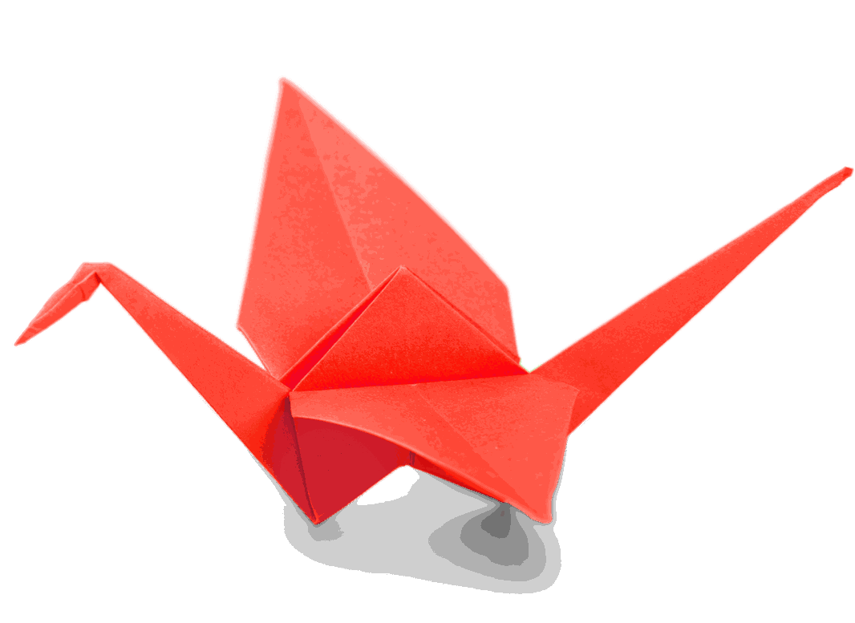
LESSON 1 · ACTIVITY
Try again!
Improve on your first design. Try a new approach.
5 minute timer
LESSON ONE
Notes:
Second piece of paper — improve on the first design.

Slide 9
LESSON 1 · REFLECT
Record your second attempt
How did you feel this time?
What could have made the process more achievable?
Ask a partner what went well for them. Are you willing to try their way?
LESSON ONE
Notes:
Repeat the reflection. Ask a partner what went well for them.

Slide 10
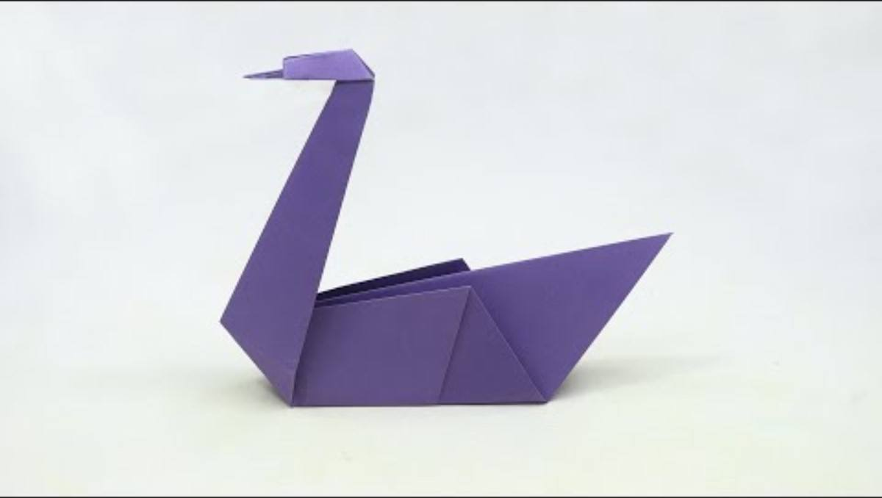
LESSON 1 · WATCH
Let's try together!
Watch the video — don't make it yet. We'll watch it twice, then try again with instructions and a teacher demonstration.
10 minute timer
Origami Swan - Paper Swan instructions
LESSON ONE
Notes:
Third round: provide clear instructions + teacher demonstration. Reference origami swan: https://youtu.be/iLthkCU-92U

Slide 11
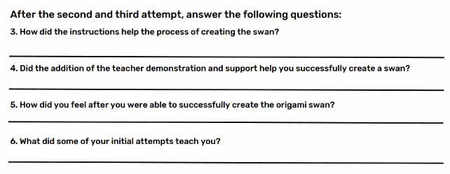
LESSON 1 · REFLECT
How did it go?
How did listening to instructions or observing your peers change your relationship with the task?
How can we share our “failures” to help the whole class grow?
LESSON ONE
Notes:
Did instructions and observing peers change your relationship with the task? How can we share our 'failures' to help the whole class grow?

Slide 12
LESSON ONE
Learning to do something is a process. You have to be open to trying — even if you fail.
LESSON ONE
Notes:
Encourage students to consider that learning to do something is a process — you have to be open to trying, even if you fail.

Slide 13
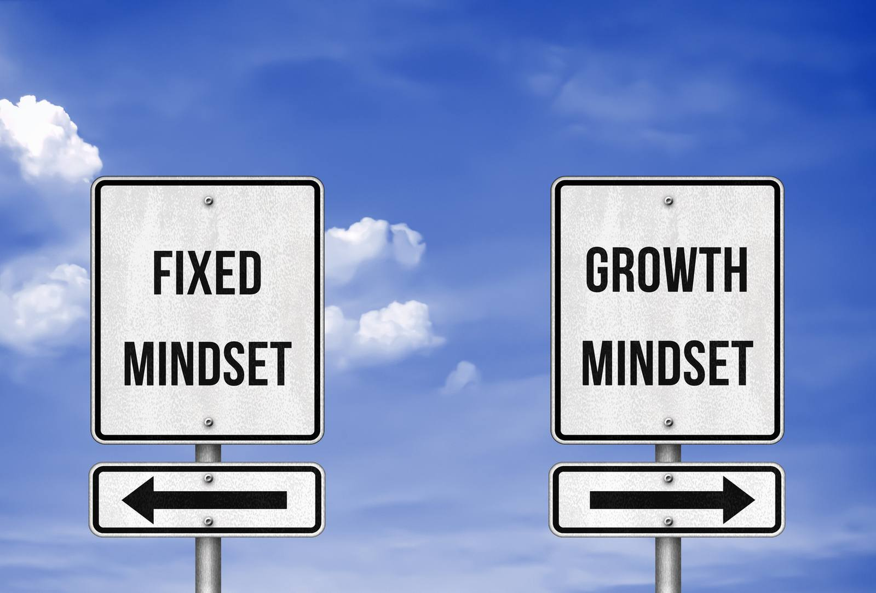
LESSON 1 · DISCUSS
What is a mindset?
LESSON ONE
Notes:
Brainstorm: what is a mindset?

Slide 14
LESSON 1 · MINDSET
Mindset
A set of beliefs that shape how you make sense of the world and yourself.
The mind
can change the way you look, move and think about the world around you.
It influences how you think, feel and behave.
How our growth contributes to the health of our community.
LESSON ONE
Notes:
A mindset is a set of beliefs that shape how you make sense of the world and yourself. In a relational context, mindset also involves understanding how our growth contributes to the health of our community.

Slide 15
LESSON ONE
What you believe about yourself impacts your success and failure.
LESSON ONE
Notes:
What you believe about yourself impacts your success and failure.

Slide 16
LESSON 1 · BRAINSTORM
Fixed Mindset
Growth Mindset
What is a fixed mindset?
What is a growth mindset?
Are there any similarities?
LESSON ONE
Notes:
Create a Venn diagram. Ask: what does a fixed mindset mean? a growth mindset? Are there similarities? What are the differences?

Slide 17
LESSON 1 · EXAMPLES
Fixed vs. Growth Mindset
Fixed Mindset
Growth Mindset
Either I'm good at it or I'm not.
I can learn to do anything I want.
That's just who I am. I can't change it.
I'm a constantly evolving work in progress.
If you have to work hard, you don't have the ability.
The more you challenge yourself, the smarter you become.
People like me don't succeed at things like this.
My background and identity are strengths I bring to every challenge.
LESSON ONE
Notes:
Fixed vs. Growth mindset examples (PDF p.12), including the identity/background row.

Slide 18
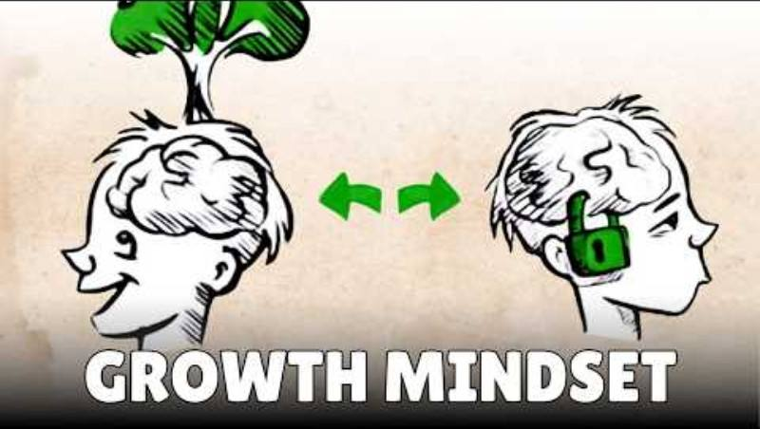
LESSON 1 · WATCH
What is Growth Mindset?
As you listen, think about how you can adopt a growth mindset in your life.
LESSON ONE
Notes:
Video: “What is Growth Mindset?” As you listen, think about how you can adopt a growth mindset in your life.

Slide 19
LESSON 1 · TURN AND TALK
Turn and Talk
How does one change their mindset from fixed to growth?
How does a growth mindset allow for continual development?
How does embracing challenges enable learning?
Is failure important? How does failing lead to learning?
LESSON ONE
Notes:
Turn and Talk discussion questions after the video.

Slide 20
LESSON 1 · CULTURAL PERSPECTIVES
Cultural Perspectives on Growth and Learning
Growth mindset comes from Western psychology and focuses on the individual. Many cultures have their own frameworks — companions to growth mindset, not alternatives.
Indigenous relational learning
Ubuntu — Southern/Central Africa
Learning happens with Elders, the land, and community. Mistakes are part of a longer conversation with shared knowledge.
“A person is a person through other people.” Growth is never purely personal.
East Asian traditions
South Asian traditions
Persistent effort through difficulty is a form of respect for family and community.
“Jugaad” — creative problem-solving with limited resources; innovation born from constraint.
Notes:
PDF p.13. Growth mindset (Carol Dweck, Western psychology) is a companion to other cultural frameworks, not the only valid frame.

Slide 21
LESSON 1 · DISCUSS
Your turn
Failure in your culture
Does your family or cultural background have its own way of thinking about mistakes, learning, and trying again?
Are there words, sayings, or stories in your home language or tradition that speak to this?
LESSON ONE
Notes:
PDF p.13 discussion prompt. Treat student contributions as valuable knowledge, not just personal anecdotes.

Slide 22
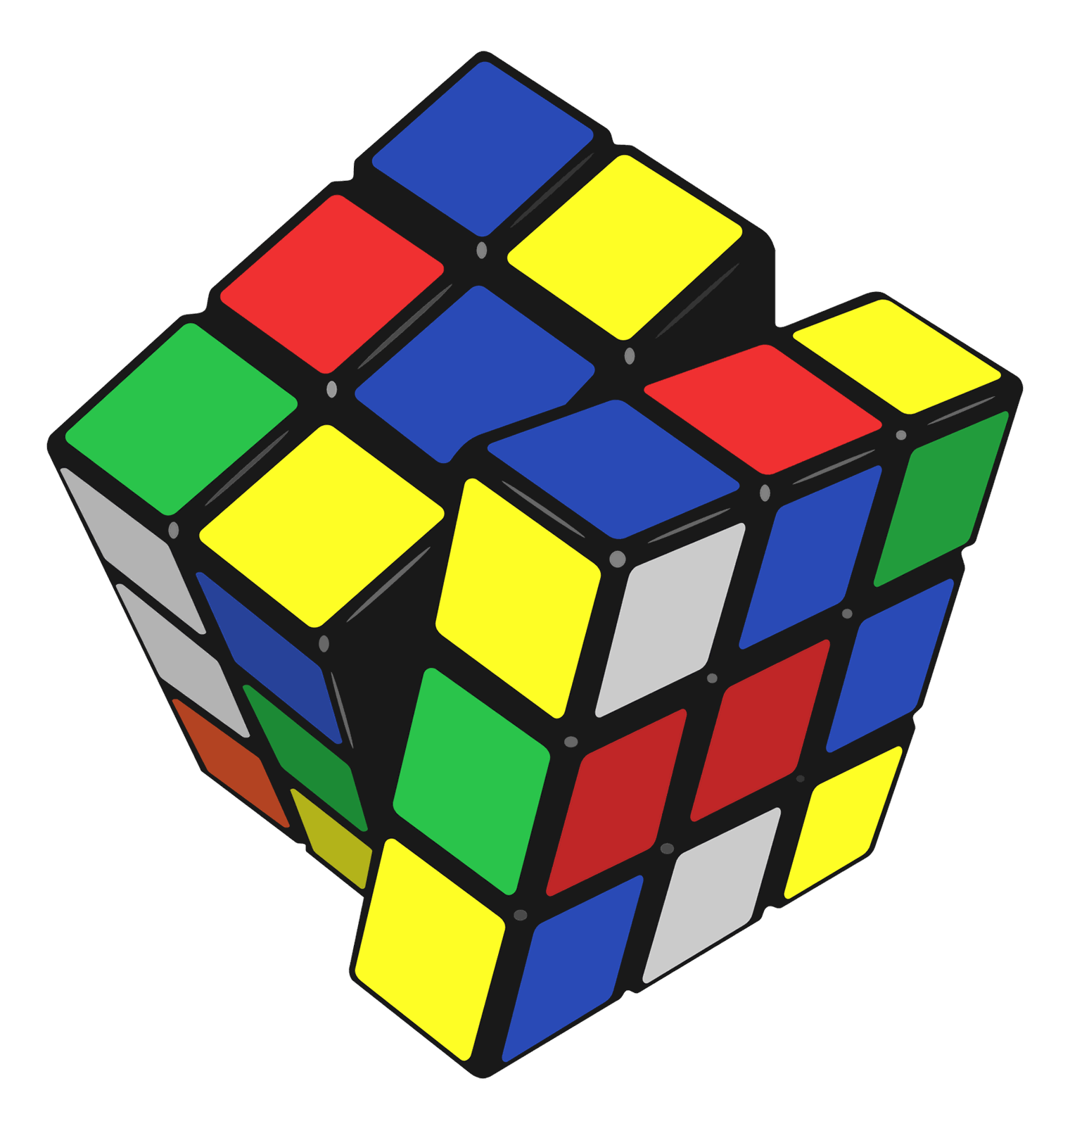
LESSON 1 · MINDSET SCENARIO #1
Charlie wanted to challenge themselves with the Rubik's cube. After an hour they got frustrated and thought, “This is too difficult, maybe I should stick with puzzles I can already solve.”
Discuss
How can Charlie shift from a fixed mindset to a growth mindset?
LESSON ONE
Notes:
Reflect as a class: how can Charlie shift from a fixed mindset to a growth mindset?

Slide 23
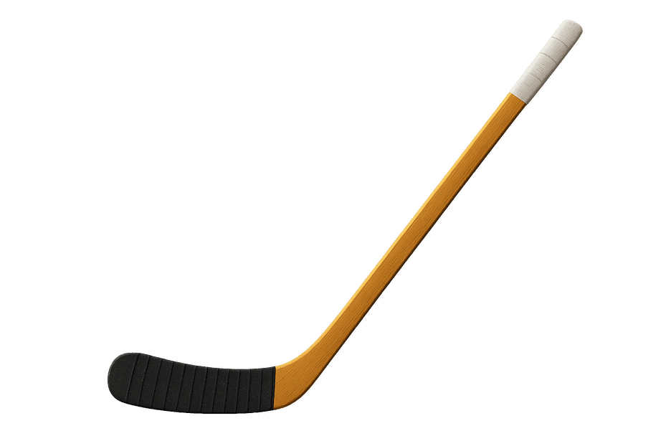
LESSON 1 · MINDSET SCENARIO #2
Ashraf wants to try out for the ice hockey team but has never played. On the ice, hitting a puck is hard. Ashraf thinks, “I'm never going to be able to do this, so why even try.”
Discuss
How can Ashraf shift from a fixed mindset to a growth mindset?
LESSON ONE
Notes:
How can Ashraf shift from a fixed mindset to a growth mindset?

Slide 24

LESSON 1 · MINDSET SCENARIO #3
Discuss
Jessie needs A's in science and math to join the science club. They have an A in science but find some math difficult. Jessie thinks, “I'm so stupid, I'll never achieve my dream.”
How can Jessie shift from a fixed mindset to a growth mindset?
LESSON ONE
Notes:
How can Jessie shift from a fixed mindset to a growth mindset?

Slide 25
LESSON 1 · MINDSET SCENARIO #4
Maya is learning her grandmother's Cree language. She keeps making mistakes and feels embarrassed in front of her family. She thinks, “I'll never sound right — maybe this language just isn't for me anymore.”
Discuss
How can Maya shift her thinking? Why does it matter that she keeps trying?
LESSON ONE
Notes:
PDF p.14. How can Maya shift her thinking? Why does it matter that she keeps trying?

Slide 26
LESSON 1 · REFLECTION
Think of a time you failed or were unsuccessful at something.
How big was the failure? Are you still pursuing the activity?
If so, why did you continue — and what was the outcome? If not, what feelings made you abandon it?
What did you learn about the process itself, even if you didn't reach a “successful” outcome?
You are never required to share something personal aloud. You may write privately, or simply listen.
LESSON ONE
Notes:
PDF p.14. Students are never required to share aloud — they may write on a sticky note and keep it private, or simply listen.

Slide 27
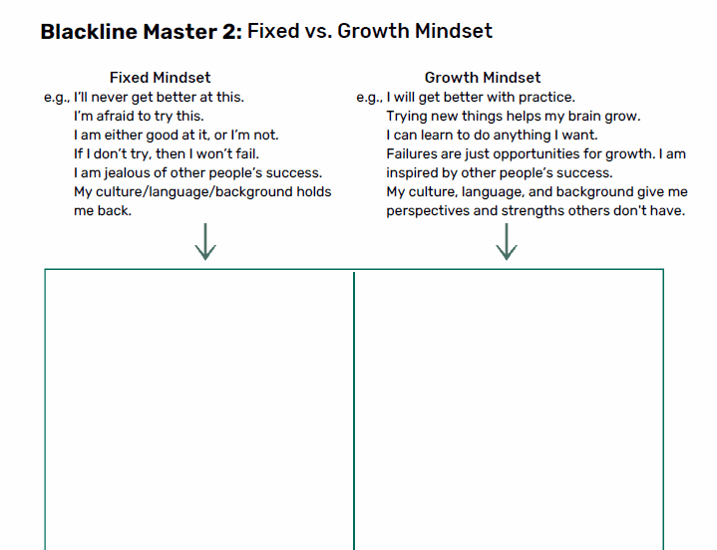
LESSON 1 · ACTIVITY
Shift your Mindset!
Think of some common phrases you use that are a fixed mindset — and shift them into growth-mindset thinking.
LESSON ONE
Notes:
Blackline Master 2. Students write down fixed-mindset phrases and shift them into growth-mindset thinking.

Slide 28
LESSON 1 · REFLECT
Failure can help me by…
Add your thoughts on a sticky note and put it up on the board.
LESSON ONE
Notes:
Complete the sentence: “Failure can help me by…” and add it to the board.

Slide 29

LESSON 1 · CANADIAN CONNECTION
One of Canada's youngest hockey superstars, Connor Bedard faced enormous pressure and was told he was too small and not ready. He stayed focused, worked tirelessly, and turned every setback into motivation, showing that perseverance and self-belief matter as much as talent.
“You learn more from a bad game than a perfect one.”
Connor Bedard
LESSON ONE
Notes:
PDF p.15. Connor Bedard.

Slide 30
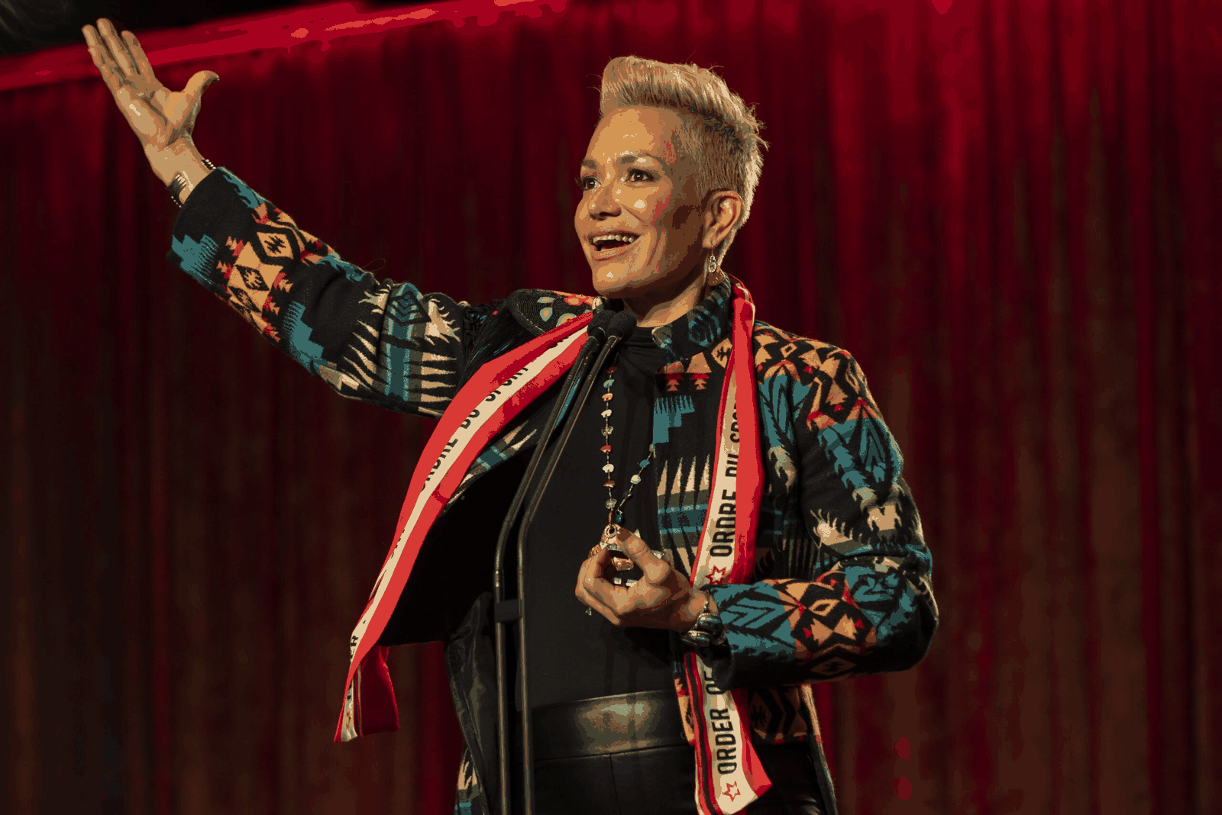
LESSON 1 · CANADIAN CONNECTION
A Mohawk woman from Akwesasne, Waneek Horn-Miller co-captained Canada's first Olympic water polo team in 2000. Seriously injured as a teenager during the 1990 Oka Crisis, she used sport as healing, showing that perseverance can be an act of cultural pride and survival.
“Sport saved my life. It gave me purpose when everything felt broken.”
Waneek Horn-Miller
LESSON ONE
Notes:
PDF p.15. Waneek Horn-Miller.

Slide 31
LESSON ONE
“If you fail, it's not the end. It's just another step. You learn, and you get better.”
— MrBeast
LESSON ONE
Notes:
Closing reflection quote.

Slide 32
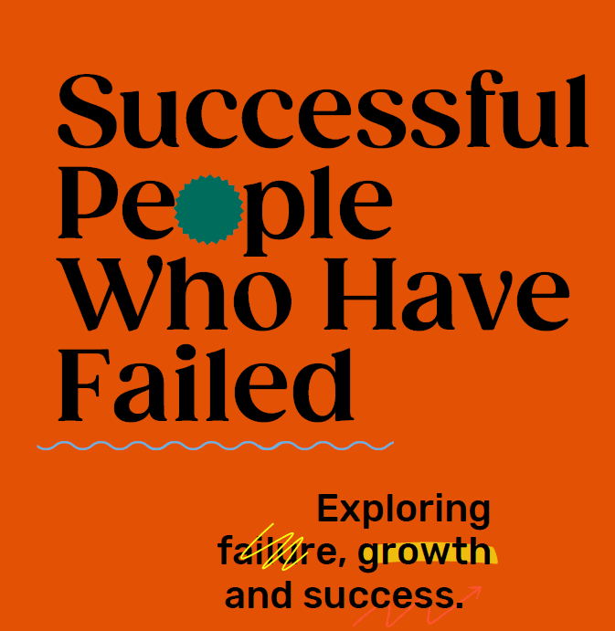
LESSON TWO
LESSON TWO
Notes:
Lesson 2: Successful People Who Have Failed. Estimated time 75 minutes.

Slide 33
LESSON 2 · SUCCESSFUL PEOPLE WHO HAVE FAILED
75 MIN
Learning Goals
1
Understand that failure is not a negative, but an opportunity to learn and grow.
2
Examine the experiences of well-known figures whose failures led to later success.
LESSON TWO
Notes:
PDF p.19.

Slide 34
LESSON 2 · INDIVIDUAL & COLLECTIVE
Resilience is personal, and collective
Famous individuals show resilience. So do entire communities — often across generations and without recognition.
Indigenous communities have kept languages, ceremonies, and knowledge alive despite colonial policies designed to erase them.
Newcomer and refugee families have rebuilt entire lives in a new country and language.
Racialized communities have organized and persisted for rights and recognition.
Think about:
What community in your life has faced setbacks together and kept going? That is also failing forward.
Notes:
PDF p.19. Resilience is not only a personal trait — entire communities demonstrate it, often across generations and without recognition.

Slide 35
LESSON 2 · DISCUSS
Exploring Failure, Growth & Success
What does it feel like when you receive a poor grade?
When you're unsuccessful at a task or goal you set, how do you feel?
How do you feel when your sports team loses a game?
LESSON TWO
Notes:
Open with feelings around failure.

Slide 36
LESSON 2 · REFLECT
Failure may be tied to…
Self-worth
Self-esteem
Self-acceptance
An internal sense of being good enough and worthy of loving and belonging.
Confidence in one's own worth, abilities or morals.
Embracing every part of yourself — all your attributes, positive or negative.
The expectation we fail to meet may be the one we created in our own mind.
LESSON TWO
Notes:
Often the expectation we fail to meet is the one we created in our own mind.

Slide 37
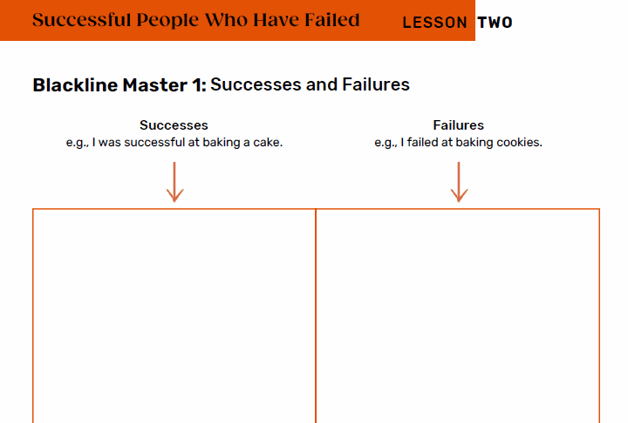
LESSON 2 · ACTIVITY
Successes and Failures
Write down all the ways you have failed or been unsuccessful over the past week.
How does it make you feel to write out everything you haven't managed to achieve?
LESSON TWO
Notes:
Blackline Master 1. Then circle the failures you tried again — how did it feel to try again?

Slide 38
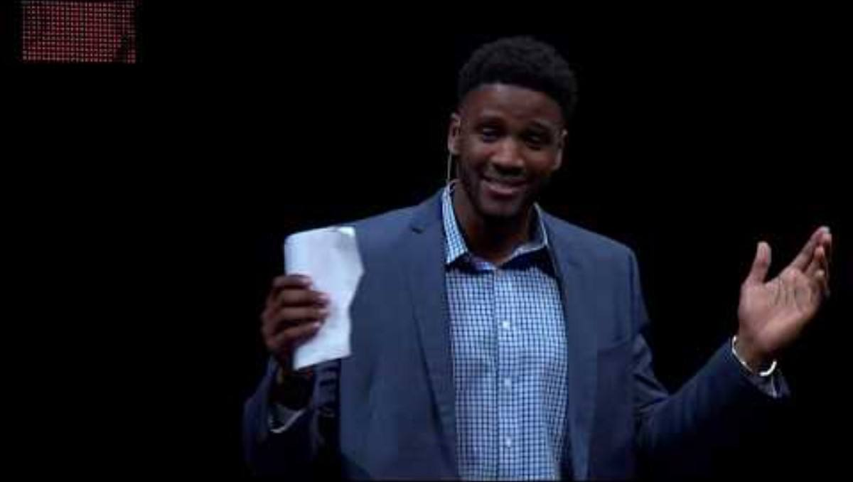
LESSON 2 · WATCH
As you listen, think about how failure enables growth.
LESSON TWO
Notes:
TED Talk: “Failure is Necessary | Courtney Johnson | TEDxEvansville.”

Slide 39
LESSON 2 · TURN AND TALK
Turn and Talk
·
How did failure enable growth in the characters or person in the video?
·
Why is failure a necessary component to growth?
·
How can failure enable success?
LESSON TWO
Notes:
Small-group discussion after the video.

Slide 40
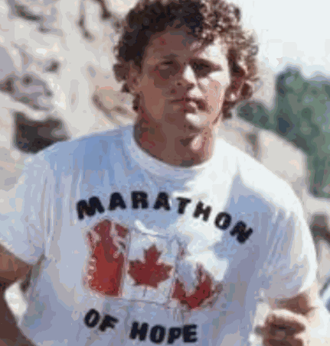
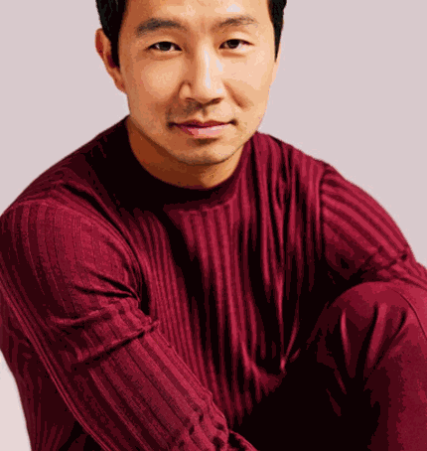

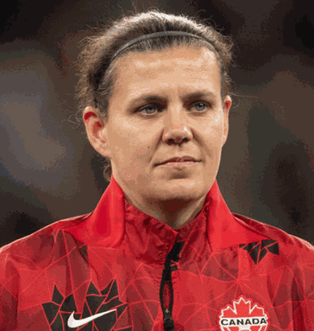
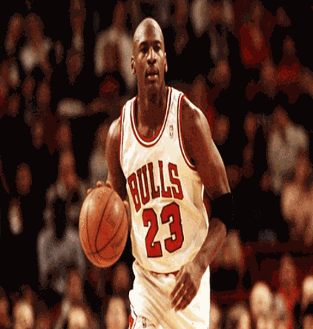



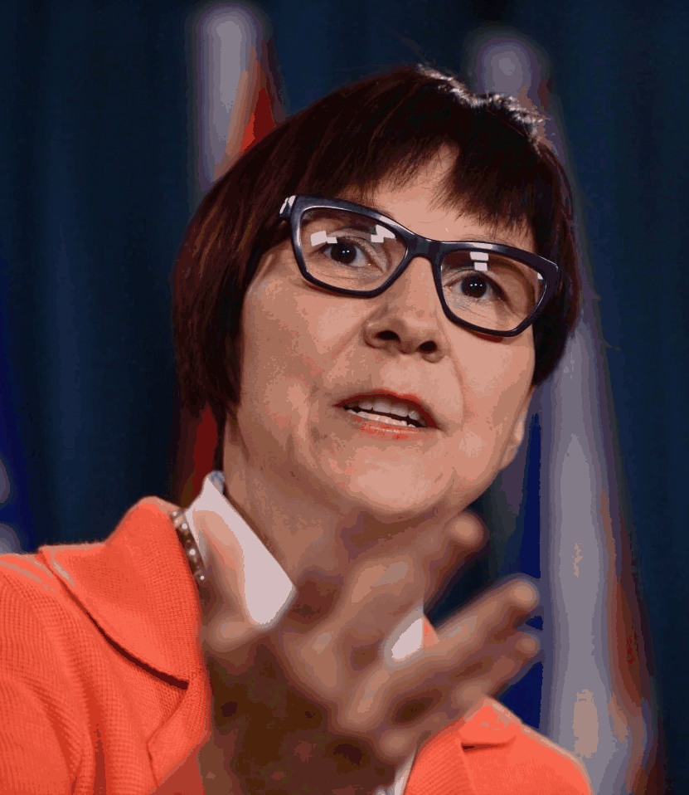
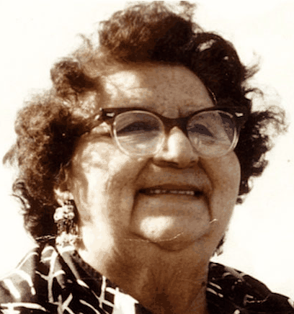

LESSON 2 · FAMOUS FAILURES
What do these individuals have in common?
Terry Fox
Simu Liu
Alessia Cara
Christine Sinclair
Michael Jordan
Lady Gaga
Simone Biles
Waneek Horn-Miller
Cindy Blackstock
Mary Two-Axe Earle
Dwayne “The Rock” Johnson
LESSON TWO
Notes:
PDF p.20. Write these names on the board. Ask: what do they have in common?

Slide 41
LESSON 2 · FAMOUS FAILURES
Each achieved greatness through hard work and pursuing their goals.
Terry Fox
Simu Liu
Alessia Cara
Christine Sinclair
Michael Jordan
Lady Gaga
Simone Biles
Waneek Horn-Miller
Cindy Blackstock
Mary Two-Axe Earle
Dwayne “The Rock” Johnson
LESSON TWO
Notes:
PDF p.20. Write these names on the board. Ask: what do they have in common?

Slide 42
LESSON 2 · FAMOUS FAILURES
Each has had some form of failure they've had to work to overcome.
Terry Fox
Simu Liu
Alessia Cara
Christine Sinclair
Michael Jordan
Lady Gaga
Simone Biles
Waneek Horn-Miller
Cindy Blackstock
Mary Two-Axe Earle
Dwayne “The Rock” Johnson
LESSON TWO
Notes:
PDF p.20. Write these names on the board. Ask: what do they have in common?

Slide 43
LESSON 2 · GROUP WORK
Time to create — a 3-minute presentation on the famous person you chose.
What is this person famous for achieving? What is their story?
What failures did they encounter — and how did they overcome them?
Why do you think this failure led to their eventual success?
What would you have done? What advice would you give them?
How did their work create a positive collective impact, or support the wellbeing of their community and the land?
LESSON TWO
Notes:
PDF p.21. Groups create a 3-minute presentation on 1–2 famous people. The final question (collective impact / wellbeing of community and land) is the new addition.

Slide 44
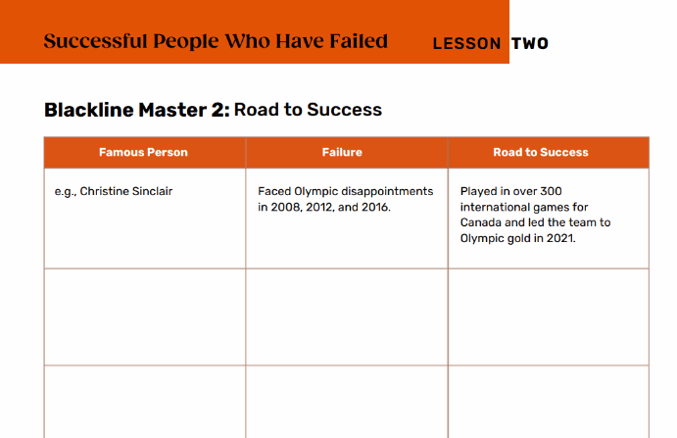
LESSON 2 · PRESENTATIONS
During the presentations
·
Take notes and fill in the table: the failure each person encountered and how they overcame it.
·
After the presentations, add yourself to the table and reflect on your own personal failures.
LESSON TWO
Notes:
Blackline Master 2: Road to Success. After, add yourself to the table and reflect on your own failures.

Slide 45
LESSON 2 · SELF REFLECTION
How can you grow your failures into success stories?
No failure is too big to grow from.
LESSON TWO
Notes:
Remind students no failure is too big to grow from.

Slide 46
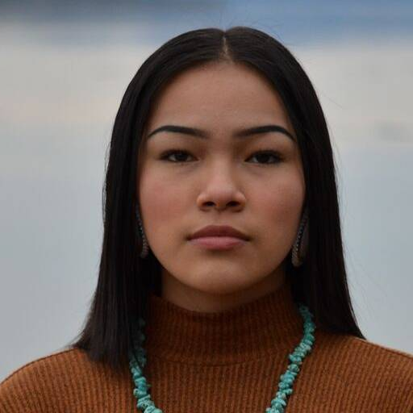
LESSON 2 · CANADIAN CONNECTION
Autumn Peltier
An Indigenous water-rights advocate from Wiikwemkoong First Nation, now Chief Water Commissioner of the Anishinabek Nation. She has spoken many times at the United Nations and been nominated three times for the International Children's Peace Prize.
SYSTEMIC NOTE
Many First Nations communities in Canada still don't have safe drinking water. Some failures are not hers — they belong to others.
“Keep going, don't look back, and if you have an idea, just do it.”
LESSON TWO
Notes:
PDF p.22. Autumn Peltier — note that many First Nations communities still lack safe drinking water; some failures belong to governments, not to her.

Slide 47
LESSON TWO
“I failed a lot. I've made a lot of mistakes. But that's how I learn.”
— Billie Eilish
LESSON TWO
Notes:
Closing reflection quote.

Slide 48

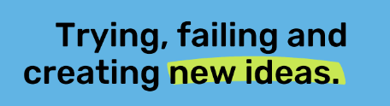
LESSON THREE
LESSON THREE
Notes:
Lesson 3: From Failure to Innovation. Estimated time 75 minutes + 45 minutes (second day).

Slide 49
LESSON 3 · FROM FAILURE TO INNOVATION
Learning Goals
1
Understand the concept of innovative thinking.
2
Reflect on how failure can lead to innovation.
3
Demonstrate critical thinking in the design-thinking process.
LESSON THREE
Notes:
PDF p.26.

Slide 50
LESSON 3 · INVESTIGATE & LEARN
Great ideas are sometimes created from bad or weird ones.
Innovation is about trying new things and taking risks — which inevitably involves mistakes. Many people fear the consequences of failure.
Indigenous peoples have been innovating for thousands of years — developing medicines, agricultural systems, navigation tools, and governance structures.
Innovation is not new, and it doesn't belong to any one culture.
LESSON THREE
Notes:
PDF p.26. Innovation is not new, and it does not belong to any one culture.

Slide 51
LESSON 3 · BRAINSTORM
Bad Ideas
Usually we search for good ideas. Let's flip it — what makes a really bad idea for a product, a food, a game, or a household item?
Then go further: what's a bold, imperfect first idea for solving a real problem in your community?
What would a first messy attempt look like?
LESSON THREE
Notes:
A creative twist — brainstorm deliberately bad ideas, then extend to real community challenges.

Slide 52
LESSON 3 · GROUP WORK
Come up with one really bad idea
·
Why is this product so bad?
·
Is there a group of people who might actually like this idea?
“It's fine to celebrate success, but it's more important to heed the lessons of failure.” — Bill Gates
LESSON THREE
Notes:
In small groups, come up with one really bad idea.

Slide 53
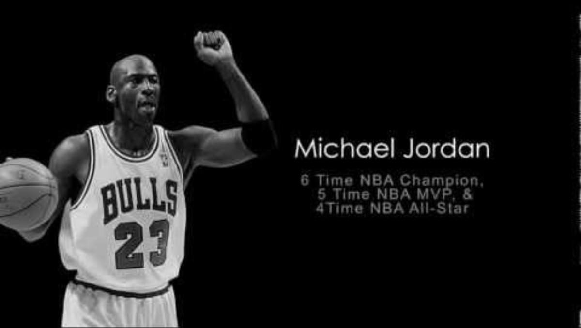
LESSON THREE
How failure leads to success
LESSON THREE
Notes:
Video: “Famous Failures.”

Slide 54
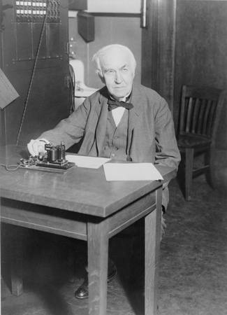

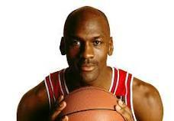
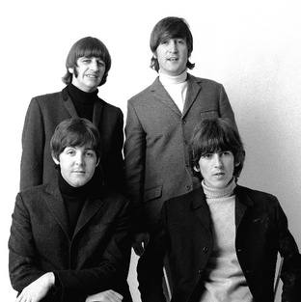


LESSON 3 · RESEARCH
Research
·
Why were they considered a failure? How did it make them feel?
How did they move beyond their failure? What was their first step toward success?
·
Thomas Edison
Oprah Winfrey
Michael Jordan
·
Did they continue to gain success? How?
The Beatles
Leo Messi
Steve Jobs
LESSON THREE
Notes:
Blackline Master 1: Famous Failures. In pairs, research one individual from the video.

Slide 55
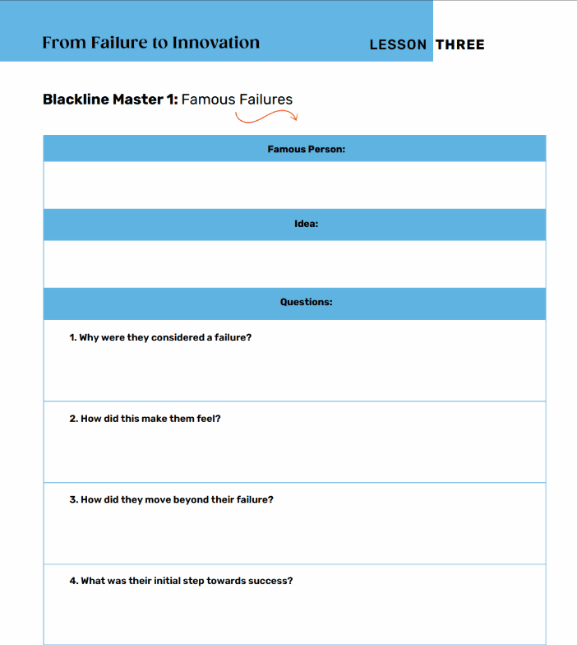
LESSON 3 · DISCUSS
As we share our research…
What were the similarities?
What did each person do to continue their success?
LESSON THREE
Notes:
Class discussion of similarities across the famous failures.

Slide 56
LESSON 3 · REFLECT
Each person kept creating even though they encountered failure.
They made many bad ideas before one great idea emerged. Each had an innovative mindset.
LESSON THREE
Notes:
Each person tried and continued to create even though they encountered failure — they had an innovative mindset.

Slide 57
LESSON 3 · INDIGENOUS INNOVATION
Thousands of years of failing forward
Three Sisters agriculture
Inuit kayak design
Corn, beans, and squash grown together — refined over countless seasons of trial and error.
Refined over thousands of years for Arctic waters; still among the most efficient watercraft ever made.
Haudenosaunee Confederacy
Traditional Ecological Knowledge
The Great Law of Peace — governance built on diplomacy, consensus, and accountability.
Systems for managing fisheries, forests, and waterways that Western science now studies and adopts.
Notes:
PDF pp.27–28. Documented, living knowledge — the same try–fail–learn–improve cycle this lesson teaches.

Slide 58
LESSON 3 · DISCUSSION
Whose innovation gets celebrated?
What innovations from your own cultural background can you identify — food, medicine, building, navigation, language, governance?
·
·
Who in your family or community has solved problems creatively without being recognized publicly?
·
If innovation has happened across all cultures for thousands of years, why do we celebrate only certain kinds? What does that tell us about whose knowledge gets valued?
LESSON THREE
Notes:
PDF p.28 discussion prompts.

Slide 59
LESSON 3 · INNOVATIVE MINDSET
Innovative thinking…
Approaches problems and opportunities with an open mind.
Seeks out new and better ways of doing things.
Uses experimentation and trial and error — observing, trying, reflecting, and adapting in relationship with community and environment.
LESSON THREE
Notes:
What we call 'design thinking' echoes values that are ancient and cross-cultural.

Slide 60
LESSON THREE · GROUP WORK
You're going to build a catapult!
Work together to design a catapult that launches a ping pong ball the furthest.
LESSON THREE
Notes:
Blackline Master 2: Design a Catapult. Groups of three design a catapult to launch a ping pong ball the furthest.

Slide 61
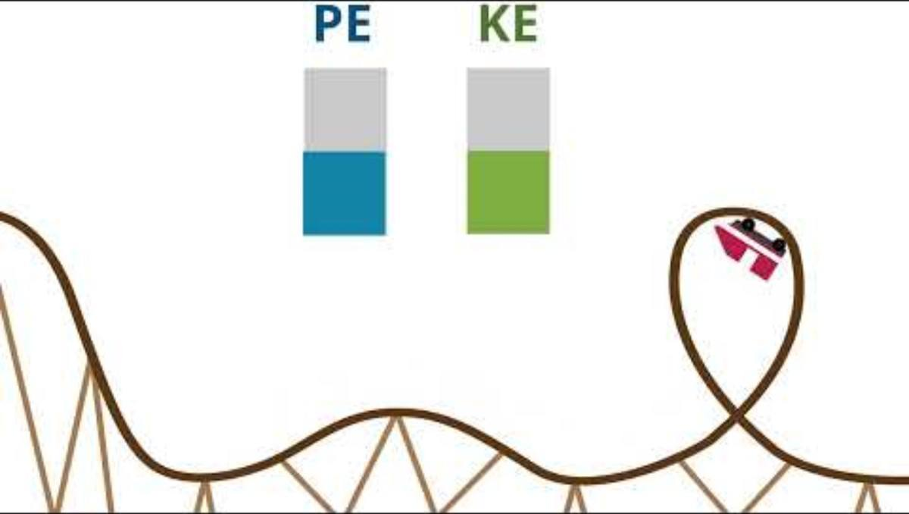
LESSON 3 · STEM
Kinetic and Potential Energy
The science behind the launch — potential energy, kinetic energy, gravity, force and elasticity.
LESSON THREE
Notes:
Optional STEM extension: potential energy, kinetic energy, gravity, force and elasticity.

Slide 62
LESSON 3 · DESIGN PROCESS
Design Process
1
2
Create your design on paper.
Decide how the catapult will hold the ping pong ball.
3
4
Consider the distance required to launch the ball.
Think about how effectively it will launch the ball.
LESSON THREE
Notes:
Design the catapult on paper before building.

Slide 63
LESSON 3 · CREATE & TEST
Build & test
Update the design
Launch again
Did the catapult work? Can it be improved?
Record what changes you're making on paper, and why they'll be more effective.
How many times did you try? How did you find the process of redesigning?
LESSON THREE
Notes:
Build, test, reflect, update and launch again.

Slide 64
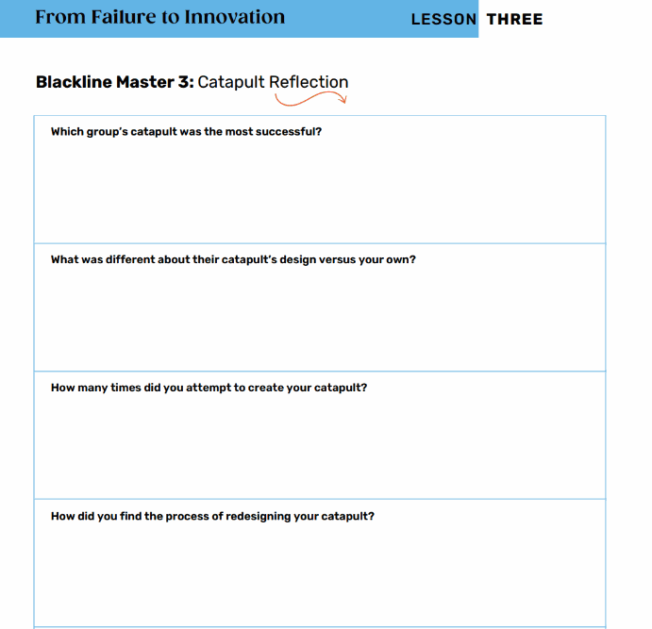
LESSON THREE
Why is it important to keep designing, reflecting, testing and upgrading?
LESSON THREE
Notes:
Reflection on the iterative process.

Slide 65
LESSON 3 · REFLECT
Each time you redesigned, you reflected on a potential failure and changed your design to make it better.
Trying, failing and creating new ideas — that's innovation!
LESSON THREE
Notes:
Trying, failing and creating new ideas — that's innovation.

Slide 66
LESSON 3 · SHOWCASE
Design Fair
Demo your catapult. Vote on categories like “Most Creative Fix” and “Best Lesson Learned.”
Quick Poll:
How many redesigns did it take before it worked?
LESSON THREE
Notes:
PDF p.30. Run a Design Fair and quick poll.

Slide 67
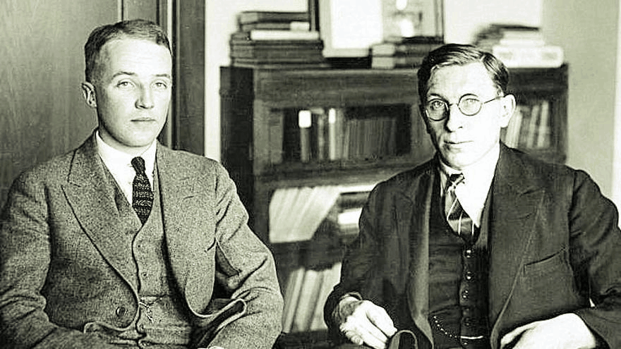
LESSON 3 · CANADIAN CONNECTION
Banting & Best — the discovery of insulin
After more than 400 failed attempts, two Canadian scientists used every failed experiment as a lesson — and discovered insulin in 1921, saving millions of lives.
“Insulin belongs to the world, not to me.” — Dr. Frederick Banting
LESSON THREE
Notes:
PDF p.30. Banting & Best discovered insulin after more than 400 attempts. Note the systemic-equity reflection on who innovation reaches.

Slide 68
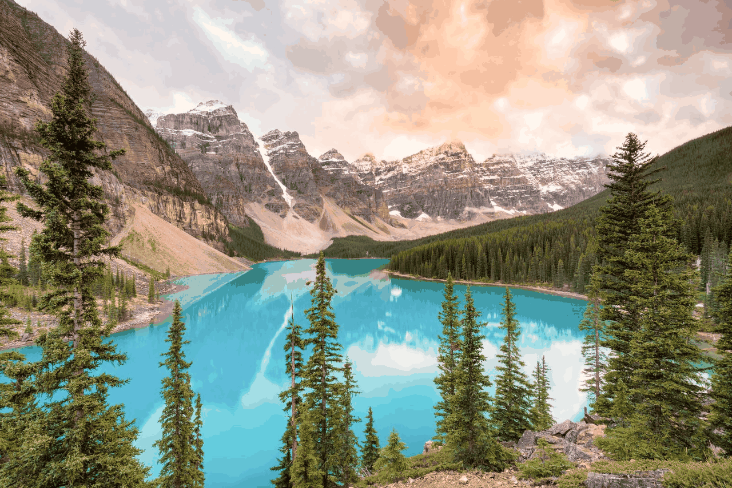
LESSON THREE
“Every mistake is just part of getting better. You learn, you adjust, and you keep going.”
— Connor McDavid
LESSON THREE
Notes:
Closing reflection quote.

Slide 69
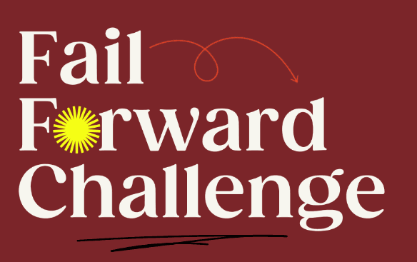
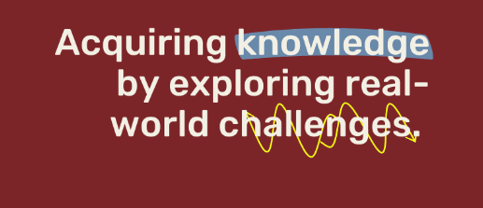
LESSON FOUR
LESSON FOUR
Notes:
Lesson 4: Fail Forward Challenge. Total time approximately 13 hours.

Slide 70
LESSON 4 · FAIL FORWARD CHALLENGE
~13 HOURS
Learning Goals
1
Listen to and understand a current challenge within the school community.
2
Co-create a collaborative approach with community members.
3
Implement and adapt the approach through ongoing relationship-building.
4
Reflect on how relational feedback guides the cycle of learning.
LESSON FOUR
Notes:
PDF p.37. Goals written in relational, community-centred language.

Slide 71
LESSON 4 · INVESTIGATE & LEARN
What challenges does our school face?
Can everyone learn in a way that works for them?
Does everyone feel safe and free to express their opinions?
Are classrooms the right temperature, with seating that supports learning?
How can we make our school welcoming for students and families who are newcomers to Canada or learning English?
How can we respect the Indigenous history of the land our school is built on,
and help Indigenous students feel they truly belong?
LESSON FOUR
Notes:
PDF p.37. Brainstorm school challenges — the last two (newcomers/ELL and Indigenous belonging) are the inclusion-focused additions.

Slide 72

LESSON 4 · THE CHALLENGE
Choose one challenge in your school and do your best to solve it.
It may be hard, and you may be unsuccessful the first few times — but you'll learn from each failure.
LESSON FOUR
Notes:
Each group chooses one challenge to solve.

Slide 73
LESSON 4 · EXAMPLE PROJECT
Example: The Clean Air Challenge
Students notice classrooms get hot and stuffy, making focus hard. In teams they research how temperature affects learning, interview classmates and teachers, and test small prototypes using sustainable ideas — plants, recycled fans, window coverings. They record what didn't work, reflect on how failure improved their design, and present solutions to school leaders.
LESSON FOUR
Notes:
PDF p.38. A worked example for students who struggle to pick a challenge.

Slide 74
LESSON 4 · RESEARCH PROCESS
Need-to-know questions
What do you need to know to understand the issue in depth?
What research do you need to conduct to learn more?
Try to come up with at least 5 questions.
LESSON FOUR
Notes:
Create 'need-to-know questions' to understand the issue in depth.

Slide 75
LESSON 4 · RESEARCH
Conducting research
Books
Students & teachers
Internet
Experts in the field
LESSON FOUR
Notes:
Research sources.

Slide 76
LESSON 4 · RESEARCH PROCESS
Creating an outline
Outline a step-by-step process for how you'll solve the challenge.
What obstacles do you think you might encounter?
You may fail the first few times — reflect and adapt based on what you learned.
LESSON FOUR
Notes:
Outline a step-by-step process. You may fail the first few times — reflect and adapt.

Slide 77
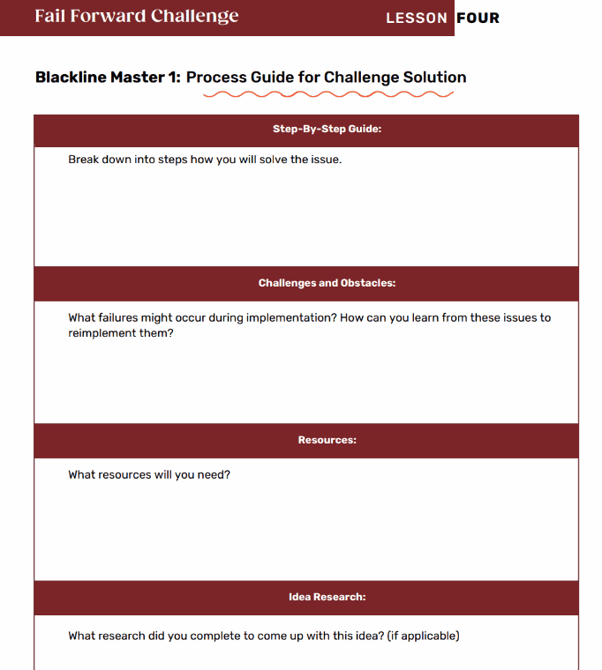
LESSON 4 · MAKE IT WORK
Make a plan
Can your solution be implemented in school? Is it realistic?
LESSON FOUR
Notes:
PDF p.39. A 'feasible' solution is one built on mutual respect and shared success — prioritize relational accountability over technical complexity.

Slide 78
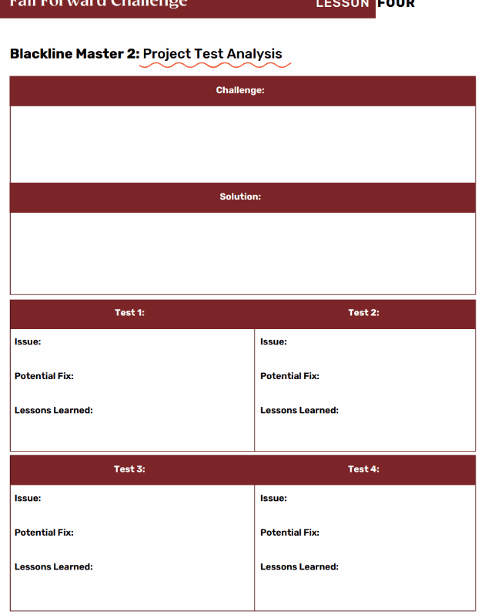
LESSON 4 · MAKE IT WORK
Let's do it!
Are there any more resources you need? Is the result what you wanted? Remember — you may not succeed the first or second time.
LESSON FOUR
Notes:
Over a week, implement the solution. Complete a test analysis each attempt.

Slide 79
LESSON 4 · PRESENT
Presenting your research
Create a 5-minute presentation using any method your group agrees on:
PowerPoint / Sway
Prezi
Poster
TikTok video
Blog post
Play / Mock Debate
LESSON FOUR
Notes:
Create a 5-minute presentation using any method the group agrees on.

Slide 80
LESSON 4 · PRESENT
What to include
What challenge did you choose? What solution did you create?
What issues came up? Were they in line with what you expected?
Did the solution work the first time? What did you learn each attempt?
Did you update your idea after learning from each attempt?
How does failing create an opportunity to learn and grow?
LESSON FOUR
Notes:
Presentation questions (PDF p.40).

Slide 81
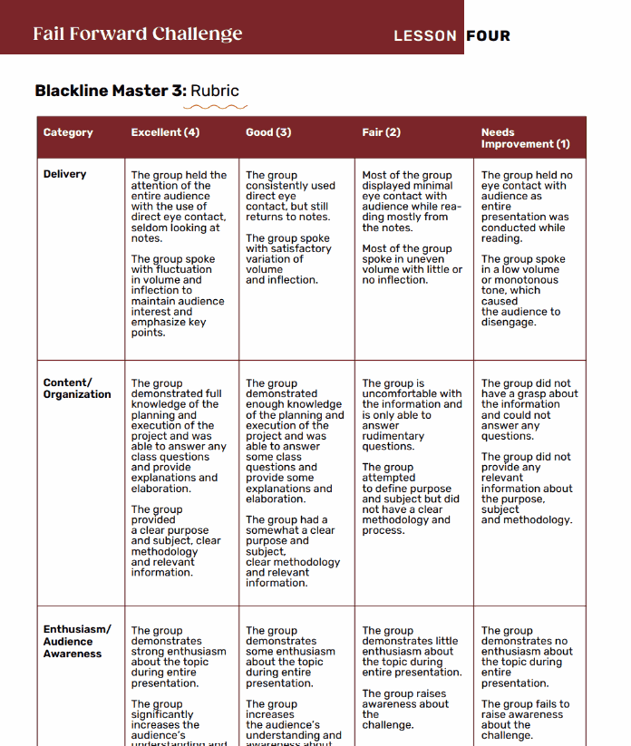
LESSON 4 · ASSESSMENT
What makes a successful presentation?
Delivery
Content / Organization
Enthusiasm / Audience Awareness
LESSON FOUR
Notes:
Blackline Master 3: Rubric — what makes a successful presentation.

Slide 82
LESSON 4 · REFLECT
Learning from others
As you listen to other groups present: what did each group learn from the failure of their initial attempt?
LESSON FOUR
Notes:
As you listen to other groups present.

Slide 83

LESSON 4 · CANADIAN CONNECTION
One of Canada's top tennis players, Bianca Andreescu won the U.S. Open in 2019 — then faced injuries and long breaks that tested her confidence. She used reflection, mindfulness, and perseverance to rebuild, showing that success is not about avoiding failure, but learning from it.
“Every setback is a setup for a comeback.”
Bianca Andreescu
LESSON FOUR
Notes:
PDF p.40. Bianca Andreescu.

Slide 84
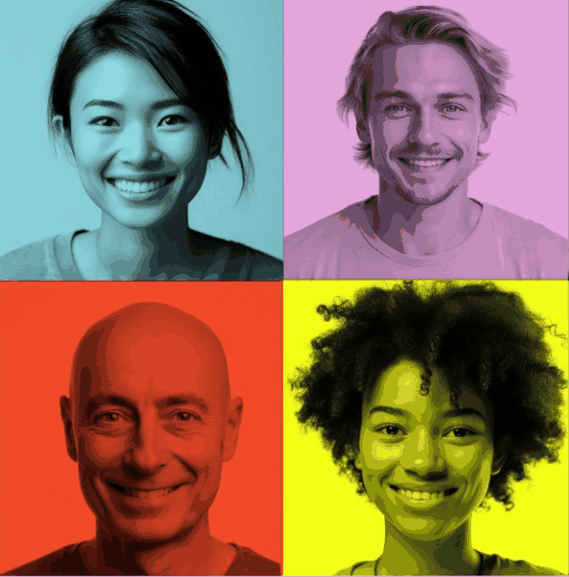
LESSON FOUR
“You grow the most in the uncomfortable places — the moments when things don't go as planned.”
— Sandra Oh
LESSON FOUR
Notes:
Closing reflection quote.

Slide 85

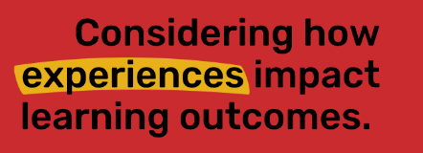
LESSON FIVE
LESSON FIVE
Notes:
Lesson 5: The Power of Reflection. Estimated time 60 minutes.

Slide 86
LESSON 5 · THE POWER OF REFLECTION
60 MIN
Learning Goals
1
Understand that failure is not always negative.
2
Reflect on how your own failures can become successes.
3
Consider how experiences impact learning outcomes.
LESSON FIVE
Notes:
PDF p.45.

Slide 87
LESSON 5 · NAMING FAILURE
Two Kinds of Failure
PERSONAL FAILURE
SYSTEMIC FAILURE
Falling short of a goal or challenge within your own ability to influence. You tried out for a team and didn't make it — yet . A growth mindset is a powerful tool here.
Being failed by institutions, policies, or systems because of your identity, background, or circumstances. These require systemic solutions , not just a better mindset.
Why it matters:
Both kinds can be grown from — but naming which one you face is the first, most important step.
Notes:
PDF pp.45–46. The core distinction this lesson now hinges on.

Slide 88
LESSON 5 · DISCUSSION
Name the failure
Think about a setback you've experienced. Was it personal (within your control) — or was part of it systemic , connected to something outside of you?
How does naming that difference change how you feel? What would “failing forward” look like in each case?
LESSON FIVE
Notes:
PDF p.46 discussion prompt. If students name systemic failures, do not redirect toward personal responsibility — acknowledge and validate, then explore collective action.

Slide 89
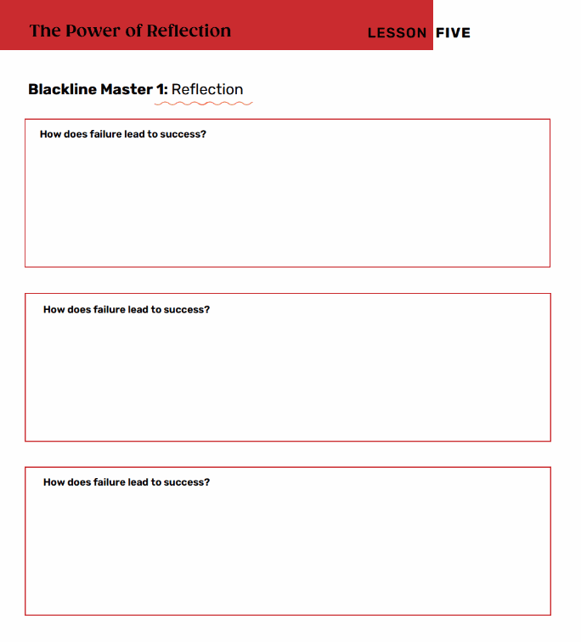
LESSON 5 · REFLECT
How does failure lead to success?
Take a moment to respond on your own, then we'll share in small groups.
LESSON FIVE
Notes:
Blackline Master 1: Reflection entry ticket.

Slide 90
LESSON 5 · SHARE
Share with your group
Read your reflection exactly as you wrote it.
As a group: what is the process to move from failure to success?
What steps do you need to take?
LESSON FIVE
Notes:
In groups of four, read your response verbatim, then answer collectively.

Slide 91
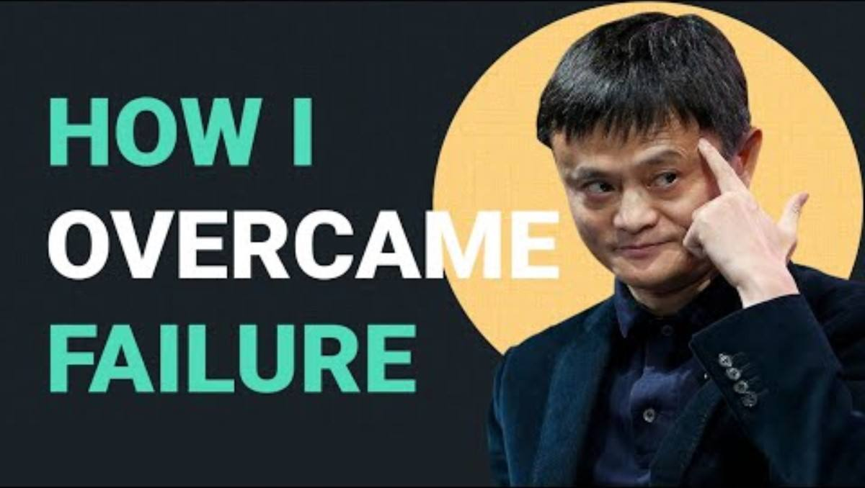
LESSON FIVE · WATCH
How I Overcame Failure
A story of persistence — Jack Ma.
LESSON FIVE
Notes:
Video: “How I Overcame Failure | Jack Ma.”

Slide 92
LESSON 5 · DISCUSS
Discuss
How did Jack Ma overcome his failures?
Why does he feel that failure led to his greatest success?
How can failure lead to growth and success in your own life?
LESSON FIVE
Notes:
Blackline Master 2: Failure to Success – Jack Ma.

Slide 93
LESSON 5 · FAILING FORWARD, CANADIAN STYLE
Cindy Blackstock, a Gitxsan social worker, spent over a decade fighting the Canadian government for equity in First Nations child welfare — and won.
Her story shows that failing forward can mean refusing to accept a system's answer of “no.”
Cindy Blackstock
LESSON FIVE
Notes:
PDF p.46. A Canadian-rooted companion to the Jack Ma story.

Slide 94
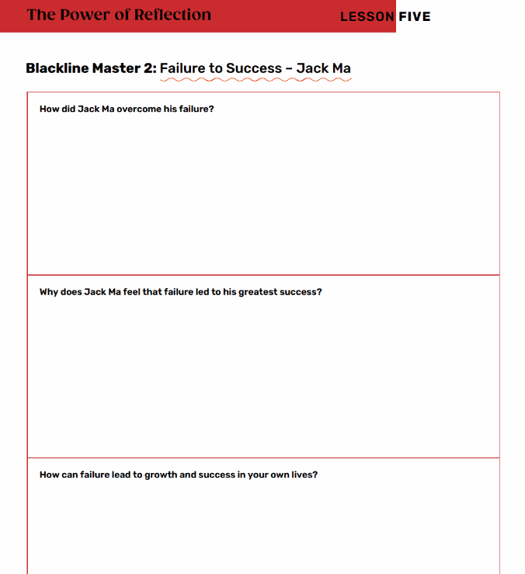
LESSON 5 · WITH A PARTNER
Think about what you just learned in the video.
LESSON FIVE
Notes:
Pair reflection on the video.

Slide 95
LESSON FIVE
15 Steps to Failing Forward
by John C. Maxwell — let's see how these steps can help you change failure to success.
LESSON FIVE
Notes:
15 Steps to Failing Forward by John C. Maxwell.

Slide 96
LESSON 5 · 15 STEPS
CHOOSE 1–2
Pick 1-2 of the 15
1
Realize there's one major difference between average people and achieving people.
2
Learn a new definition of failure.
3
Remove the “you” from failure.
11
If at first you do succeed, try something harder.
4
Take action and reduce your fear.
12
Learn from a bad experience and make it a good one.
5
Change your response to failure by accepting responsibility.
13
Work on the weakness that weakens you.
6
Don't let failure from the outside get inside you.
14
Understand there's not much difference between failure and success.
7
Say goodbye to yesterday.
8
Change yourself and your world changes.
15
Get up, get over it, and get going.
9
Get over yourself and start giving to others.
10
Find the benefit in every bad experience.
LESSON FIVE
Notes:
Choose 1–2 from each slide.

Slide 97
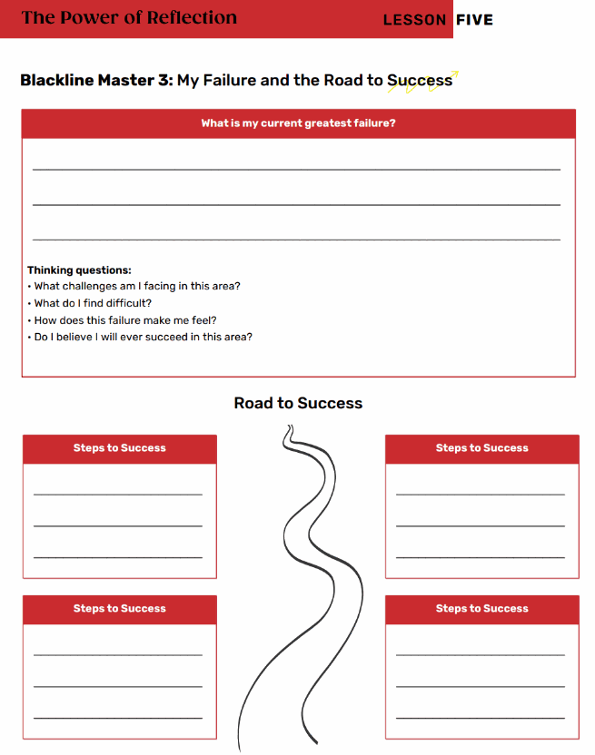
LESSON 5 · YOUR TURN
Select 3–5 Steps to Failing Forward
Outline the steps you will take to change your failure into a success.
LESSON FIVE
Notes:
Select 3–5 of the Steps to Failing Forward and outline how you'll change your failure to success.

Slide 98
LESSON 5 · APPLY
Apply
How can you apply the step to your own way of thinking?
How can your failure move to a success?
What will you need to do to grow and learn from this challenge?
LESSON FIVE
Notes:
Form a circle and share current failures and roads to success. Just because you have failed at something does not mean you are a failure.

Slide 99

LESSON FIVE
“Failure is the key to success; each mistake teaches us something.”
— Morihei Ueshiba
LESSON FIVE
Notes:
Closing reflection quote.

