Slide 1
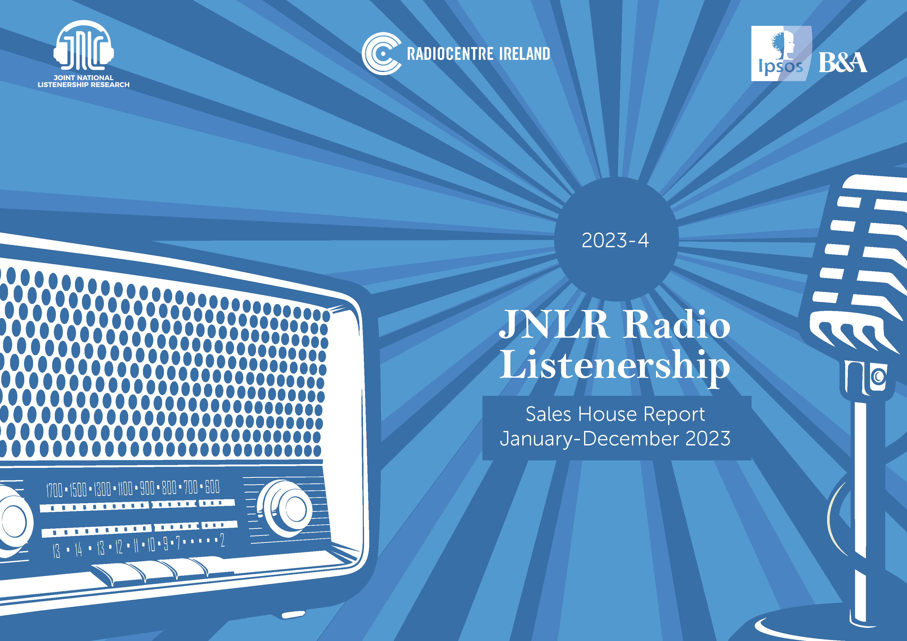

Slide 2
Note to the Reader …
The following charts outline Weekly Reach and 7am-7pm (PT) share for January to December 2023 (2023-4), across key demographics.
Definitions:
HKWK label is updated to read SHWK (shopper + dependent children (any age). This is a label change only as housekeeper was always defined as main shopper.
Universe estimates and sample size – refer to 2023-4 data.
See Appendix for Sales house composition
This report is based on the 12-month period January to December 2023. Reach data is compared, year on year, to the 2022-4 report.

Slide 3


Radio Today

Slide 4
Radio Today
More than 3.3 million Irish adults listen to radio on an average day
PAST WEEK
DAILY
15+
15-34
35+
15+
3,400,000
923,000
2,477,000
3,824,000
On average listeners tune into 1.5 radio stations daily
Av. Mins*
244
186
265
Source: JNLR Sales House Report-Weekly Reach
Source: JNLR National Report 2023-4 * Average time spent among listeners 7am-midnight

Slide 5
Radio Today
While most listening happens on the AM/FM radio, 532,000 listen daily on digital non-FM platforms
SHARE OF TIME SPENT
15+
15-34
Source: JNLR/MediaStar Platform Data 2023-4
* Based on share of minutes 7am-midnight, to Irish stations

Slide 6

National

Slide 7
Weekly Reach – National & National Sales Houses
National Stations
All Adults 000’s
SHWK 000’s
Sales Houses
Universe: 4,197
Sample: 12,422
Universe: 1,176
Sample: 3,569
* Media Central Group 2023 now includes Red FM

Slide 8
Weekly Reach – National & National Sales Houses
15-34 000’s
National Stations
25-44 000’s
Sales Houses
Universe: 1,301
Sample: 3,747
Universe: 1,431
Sample: 4,385
* Media Central Group 2023 now includes Red FM

Slide 9
Weekly Reach – National & National Sales Houses
35-54 000’s
National Stations
45+ 000’s
Sales Houses
Universe: 1,516
Sample: 4,374
Universe: 2,104
Sample: 6,258
* Media Central Group 2023 now includes Red FM

Slide 10
PT Market Share National & Sales Houses
All Adults %
National Stations
SHWK %
All Adults %
Sales Houses
SHWK %
Sample: 9,861
Sample: 2,895
* Media Central Group 2023 now includes Red FM

Slide 11
PT Market Share National & Sales Houses
15-34 %
National Stations
25-44 %
15-34 %
Sales Houses
25-44 %
Sample: 2,594
Sample: 3,367
* Media Central Group 2023 now includes Red FM

Slide 12
PT Market Share National & Sales Houses
35-54 %
National Stations
45+ %
35-54 %
Sales Houses
45+ %
Sample: 3,529
Sample: 5,354
* Media Central Group 2023 now includes Red FM

Slide 13
Dublin

Slide 14
Weekly Reach – Dublin & Dublin Sales Houses
All Adults 000’s
Dublin Stations
SHWK %
Sales Houses
Universe: 1,212
Sample: 2,944
Universe: 318
Sample: 753

Slide 15
Weekly Reach – Dublin & Dublin Sales Houses
15-34 000’s
Dublin Stations
25-44 000’s
Sales Houses
Universe:408
Sample: 933
Universe: 476
Sample: 1.118

Slide 16
Weekly Reach – Dublin & Dublin Sales Houses
35-54 000’s
Dublin Stations
45+ 000’s
Sales Houses
Universe: 454
Sample: 1,059
Universe: 550
Sample: 1,392

Slide 17
PT Market Share Dublin & Sales Houses
All Adults %
Dublin Stations
SHWK %
All Adults %
Sales Houses
SHWK %
Sample: 2,166
Sample: 560

Slide 18
PT Market Share Dublin & Sales Houses
15-34 %
Dublin Stations
25-44 %
15-34 %
Sales Houses
25-44 %
Sample: 580
Sample: 789

Slide 19
PT Market Share Dublin & Sales Houses
35-54 %
Dublin Stations
45+ %
35-54 %
Sales Houses
45+ %
Sample: 790
Sample: 1,141

Slide 20
Cork

Slide 21
Weekly Reach – Cork & Cork Sales Houses
All Adults 000’s
Cork Stations
SHWK %
Sales Houses
Universe: 476
Sample: 1,003
Universe: 132
Sample: 293
* Media Central Group 2023 now includes Red FM

Slide 22
Weekly Reach – Cork & Cork Sales Houses
15-34 000’s
Cork Stations
25-44 000’s
Sales Houses
Universe: 145
Sample: 277
Universe: 159
Sample: 353
* Media Central Group 2023 now includes Red FM

Slide 23
Weekly Reach – Cork & Cork Sales Houses
35-54 000’s
Cork Stations
45+ 000’s
Sales Houses
Universe: 170
Sample: 381
Universe: 243
Sample: 523
* Media Central Group 2023 now includes Red FM

Slide 24
PT Market Share Cork & Sales Houses
All Adults %
Cork Stations
SHWK %
All Adults %
Sales Houses
SHWK %
Sample: 805
Sample: 243
* Media Central Group 2023 now includes Red FM

Slide 25
PT Market Share Cork & Sales Houses
15-34 %
Cork Stations
25-44 %
15-34 %
Sales Houses
25-44 %
Sample: 202
Sample: 271
* Media Central Group 2023 now includes Red FM

Slide 26
PT Market Share Cork & Sales Houses
35-54 %
Cork Stations
45+ %
35-54 %
Sales Houses
45+ %
Sample: 312
Sample: 440
* Media Central Group 2023 now includes Red FM
* Media Central Group 2023 now Red FM

Slide 27
Regional

Slide 28
Weekly Reach – Regional
All Adults
Universe: 2,465 Sample: 6,088 | Universe: 1,485 Sample: 3,629 | Universe: 661 Sample: 2,399 | Universe: 445 Sample: 1,845 | Universe: 469 Sample: 1,849 | Universe: 809 Sample: 1,909

Slide 29
PT Market Share Regional – 2023-4
All Adults

Slide 30
Local Area

Slide 31
Weekly Reach – Local Areas
All Adults
Uni: 227 Sample: 483 | Uni: 282 Sample: 469 | Uni: 214 Sample: 482 | Uni: 173 Sample: 480 | Uni: 115 Sample: 480 | Uni: 130 Sample: 472 | Uni: 114 Sample: 482 | Uni: 132 Sample: 483
Uni: 195 Sample: 479 | Uni: 137 Sample: 801 | Uni: 118 Sample: 479 | Uni: 134 Sample: 482 | Uni: 125 Sample: 473 | Uni: 104 Sample: 483 | Uni: 113 Sample: 483 | Uni: 104 Sample: 493 | Uni: 92 Sample: 471

Slide 32
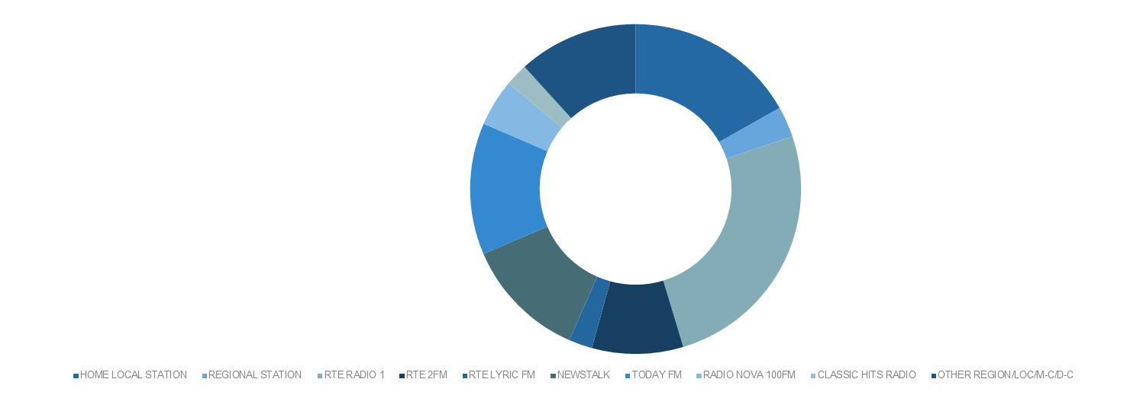
PT Share Local Areas - All Adults

Slide 33
PT Share Local Areas - All Adults

Slide 34
PT Share Local Areas - shoppers & Children
Small Sample Sizes

Slide 35
PT Share Local Areas - shoppers & Children
Small Sample Sizes

Slide 36
Radio & Social Media

Slide 37
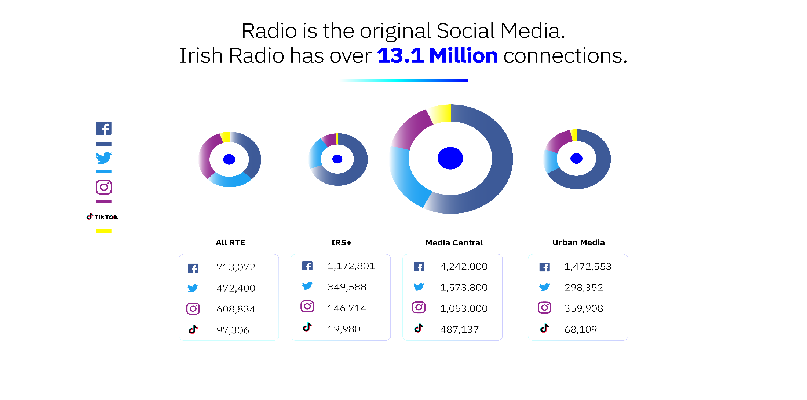

Source: Radio Sales House Data
Source: Radio Sales House Data

Slide 38
Appendix

Slide 39
Sales House Composition
RTE
RTE Radio 1, RTE 2FM and RTE Lyric FM
KFM, KCLR, Midlands Radio 3, South-East Radio, East Coast Radio, Tipp FM, Clare FM, Radio Kerry, MWR, Shannonside, Northern Sound, Ocean FM, Highland Radio, Sunshine 106.8 and Radio Nova
Media Central Group
Today FM, Newstalk, 98FM, Spin 1038, Spin South-West, iRadio North-West, iRadio North-East, Beat 102-103, Classic Hits Radio and Red FM.
Urbanmedia
IRS +
FM104, Q102, Cork’s 96FM, C103, LMFM, Live 95FM, Galway Bay FM and WLR FM

