Slide 1
Introductory Training for Establishing and Maintaining Local Professional Development Committees
Center for the Teaching Profession ∙ October 2015
Notes:
Have resource guide available

Slide 2

Local Professional Development Committees
  Review coursework and other professional development activities for educator license renewal
Notes:
Introducing Local Professional Development Committees - In 1996, the Ohio General Assembly authorized the establishment of Local Professional Development Committees (LPDC) by September 1998 to review coursework & other professional development activities for educator license renewal(ORC 3319.22)
Throughout this presentation, Local Professional Development Committees will be abbreviated as “LPDC.”

Slide 3
Role of ODE
Implement Ohio Educator Standards and Standards for Professional Development
Evaluate, process and issue licenses
Provide technical assistance and resources for support

Slide 4
LPDC Regional Support Team
Statewide group of experienced, committed LPDC members designated to regions
Goal: Provide technical assistance, training, resources and communication to LPDCs at a regional level
Notes:
LPDC Regional Support Team
Organized in 2006
Statewide group of experienced, committed LPDC members designated to regions
Goal: Provide technical assistance, training, resources and communication to LPDCs at a regional level

Slide 5
Process
Begins when an educator obtains a Professional License
Educators must obtain LPDC approval of the Individual Professional Development Plan (IPDP) before engaging in professional development for licensure renewal.

Slide 6
Responsibilities of the LPDC
Be informed
Establish, update and abide by Operating Procedures
Educate and assist all members

Slide 7
Responsibilities of the LPDC
Communicate clearly
and maintain records
Operate under “Sunshine Laws”
Maintain and update roles
in online system

Slide 8
Responsibilities of the Educator
Be informed of license expiration date and renewal requirements
Abide by LPDC procedures and timelines
Pursue quality learning experiences

Slide 9
Responsibilities of the Educator
Maintain records and documentation
Communicate with the LPDC
Request a verification form
for educators exiting the LPDC

Slide 10

Who must work with the LPDC?
  All teaching and non-teaching school personnel who hold a professional license/certificate, a senior license or a lead license, and are employed full or part-time in the district or agency represented by the LPDC and who wish to fulfill license renewal requirements.

Slide 11
Who may work with the LPDC?
  An LPDC may develop criteria and procedures to serve educators with standard certificates or professional licenses who substitute teach on a regular basis in the district or school represented by the LPDC.

Slide 12
Who is exempt from working with the LPDC?
  Resident Educators and Alternative Resident Educator license holders
  Career-Technical educators working on the 24 hour program
  Educators working on the two-year Alternative Educator license
  Educators working on the one-year Supplemental or Out-of-State license
  Professional Pupil Services license holders (i.e., school nurse, treasurer, school psychologist)
  Permanent certificate license holders

Slide 13
Licensure Renewal Requirements

Slide 14
Licensure Renewal Requirements
Current state standards require
  Six semester hours of college coursework, OR
  18 CEUs from other professional development activities, OR
  Combination of coursework and professional development activities that equal 18 CEUs
Notes:
Licensure Renewal Requirements

Slide 15
Professional Development
Must be Completed
After the issue date of the license/certificate
After IPDP approval by the LPDC
Notes:
Licensure Renewal Requirements

Slide 16
Requirements
Same professional development may be used to renew multiple licenses
Coursework must be completed at:
    An Ohio college/university approved by the Ohio Board of Regents to grant the baccalaureate or associate degree, or
    A college/university approved by an equivalent authority in another state (as listed in the Higher Education Directory)
Renewal requirements are not reduced by year of experience

Slide 17
Questions Addressed
What is the purpose of the LPDC?
What are the requirements of the LPDC?
What are the functions of the LPDC?
How do the Professional Development Standards impact the LPDC?

Slide 18
Assist educators with license renewal requirements
Purpose of the LPDC
Establish high quality professional development criteria
Assist educators in defining their own professional development that connects locally with student needs, the CCIP and other district initiatives

Slide 19
Requirements and Functions of the
Local Professional Development Committee

Slide 20
Requirements
Review and approve Individual Professional Development Plans (IPDP)
Set criteria for and foster high quality professional development
Verify completion of licensure requirements through implementation of the IPDP

Slide 21
Requirements
Communicate with educators
Reflect and improve LPDC operations
Register the LPDC in the online system and update roles as necessary

Slide 22
Functions
Organize the LPDC
Develop and implement
a plan of operation
Review IPDPs and completion of professional development activities

Slide 23
Functions
Communicate with educators
Manage and document information
Provide opportunity
for reconsideration or appeal

Slide 24
Professional Development Standards
Delineate characteristics of high quality professional development
Support quality professional development linked to daily practice
Advocate for the involvement of all educators engaging in professional development
Advance the leadership capacity of educators

Slide 25
Topics Addressed
Organizing the Local Professional Development Committee
Committee Membership
Plan of Operation
Individual Professional Development Plan
Equivalent Other Activities
Reciprocity
Appeals

Slide 26

Organizing the LPDC
State of Ohio requires at least five total members:
  At least 3 teacher members (always a majority of teacher members)
  One administrator member
  One member appointed by the district superintendent / administrator

Slide 27
Committee Membership
  Teacher members are selected by the union representative or elected by the teachers to be represented*
  Administrator members are elected by a majority vote of administrators
  Whenever an administrator’s plan is under consideration the LPDC shall, at the request of the administrator, reduce the number of teacher members and cause the majority of the LPDC to consist of administrative members
*Within the terms of any existing collective bargaining agreement

Slide 28
Plan of Operation
Philosophy and Purpose
Standards for professional development activities
Composition of members
Procedures and forms
Processes for LPDC reflection and revision
Communication

Slide 29
Plan of Operation
  What is our vision of quality professional development?
  Why is quality professional development important?
  What values will guide our LPDC?
Philosophy and Purpose

Slide 30
Plan of Operation
  Delineate the characteristics of high quality professional development
  Support the belief that quality professional development is linked to daily practice
  Advocate for the involvement of all educators in planning, implementing and sustaining professional development
  Advance the leadership capacity of educators
Standards for Professional Development

Slide 31
Plan of Operation
LPDC decides
    Who will be the chairperson
    If other officers are needed and which members will serve
    How officers will be elected; term length
    What rules and process checks will govern the conduct of meetings
    Meeting schedule
Composition of Members

Slide 32
Plan of Operation
LPDC Documentation
  Keep accurate records of all actions
    Meeting minutes
    All approval/disapproval decisions
    Communication with educators
    Appeals
    IPDP templates
    Pre-Approval
    PD Summary
    Verification Form for Educators leaving the LPDC
Procedures and Forms

Slide 33
Plan of Operation
  Consider the views of district educators regarding the effectiveness of the committee’s work, procedures, and criteria
  Use self-assessment to redesign the Plan of Operation as necessary
Reflection and Revision

Slide 34
Plan of Operation
  Provide information on LPDC guidelines and licensure standards
  Continue ongoing communication
  Post meeting dates
  Keep accurate records
  Answer questions
  Operate under “Sunshine Laws”
Communication

Slide 35
Individual Professional Development Plan
  Plan identifies an educator’s goals for learning; the process of preparing and submitting an IPDP requires educators to:
  Examine their practice;
  Determine individual priorities and goals;
  Complete the IPDP according to LPDC policy; and
  Obtain pre-approval from LPDC (per district policy).

Slide 36
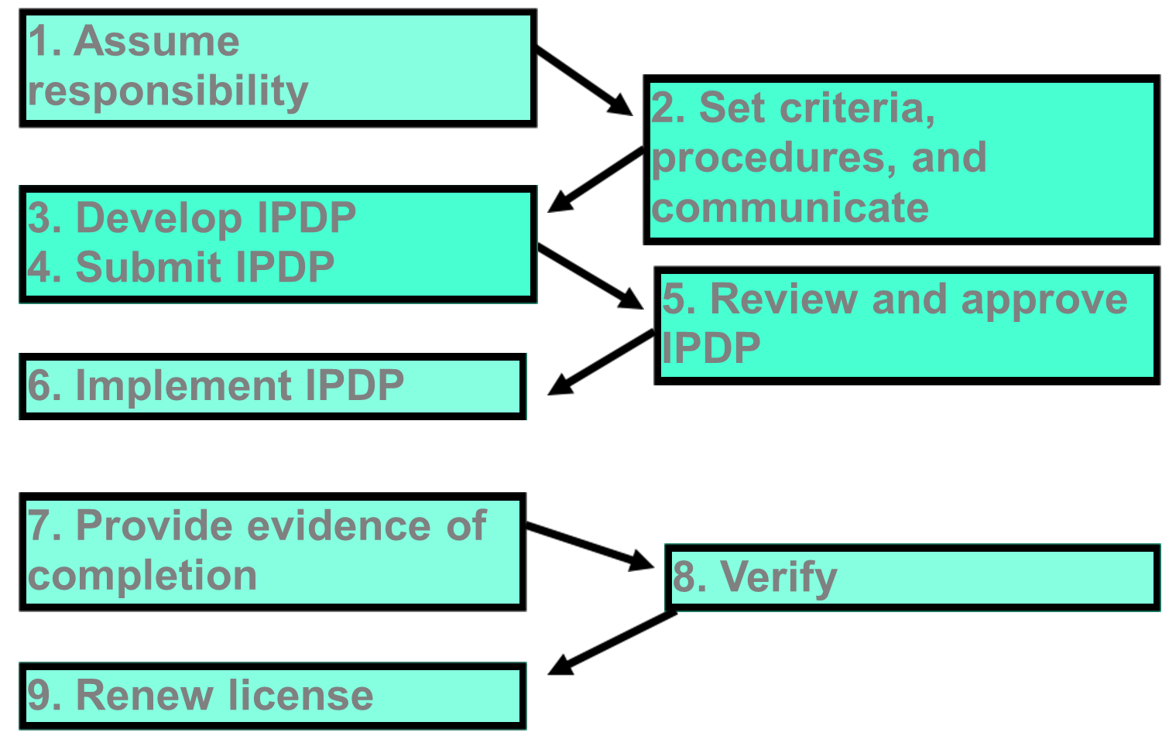
Educator
LPDC

Slide 37
Equivalent Other Activities
  Individual LPDCs set criteria for EOAs
  Equivalent Other Activities should be:
  Relevant to an educator’s learning goals
  Aligned with the Ohio Educator Standards
  Aligned with the Ohio Educator Standards for Professional Development
  Intentional and planned
  Carried out in a systematic way
  Able to be documented

Slide 38
Equivalent Other Activities Must Be Pre-Approved
  Job-embedded activities
  Self-directed learning activities
  Collaborative learning activities

Slide 39
Reciprocity
  LPDCs should honor the efforts of educators who move into a district with a current IPDP approved by their prior LPDC
  Educators should use the Verification Form for Educators Leaving the LPDC.

Slide 40
Appeals
  Educators have the right to appeal a LPDC decision.
  The basis for appeal may be:
  Rejection of an IPDP or a revision
  Rejection of an EOA or other PD activity
  Rejection of any pre-approval decision
  The number of CEUs assigned to an EOA
  Rejection of evidence of completion
  Others

Slide 41
Appeal Process
  Afford due process and fairness to the educator
  Result in a learning experience for the educator and the LPDC
  Provide information for improving LPDC criteria, procedures, operations
  State-Level Review: Unless an LPDC includes this step in their operating procedures, educators cannot appeal LPDC decisions beyond a third-party review.

Slide 42
Appeal Process
ODE recommends a 2-part process
  Reconsideration
    LPDC listens to educator’s case in an effort of mutual resolution
  Third party review
    An independent panel reviews the decision for resolution

Slide 43
Reconsideration
The LPDC may:
Affirm a decision
Change a decision
Offer the educator an opportunity to address a concern, change a decision or find a mutual resolution

Slide 44
Third Party Review Panel
One educator selected by the LPDC
1
One educator selected by the educator making the appeal
2
3
One educator approved by both the LPDC and the educator
Notes:
Third Party Review
One method for third-party review is for the LPDC to convene a panel of three licensed educators:
1. One educator selected by the LPDC;
2. One educator selected by the educator making the appeal; and
3. One educator approved by both the LPDC and the educator.

Slide 45

Ohio Law
Professional development: Required for continued licensure for all educators.
Notes:
Ohio Administrative Code 3301-24-06 Professional development states:
“Professional development shall be required for continued licensure for all educators. It shall be guided by the learning needs of all students and the axiom that all students can learn. It shall include current theory on the learning needs of educators and shall incorporate a planned progression for improvement on a continuing basis.”

Slide 46
Resources
For additional resources, visit education.ohio.gov
Search keywords: Local Professional Development Committees

Slide 47

education.ohio.gov

Slide 48





Social Media
Ohio Families and Education
Ohio Teachers’ Homeroom
ohio-department-of-education
storify.com/ohioEdDept
@OHEducation
@suptrichardross
OhioEdDept

