Slide 1


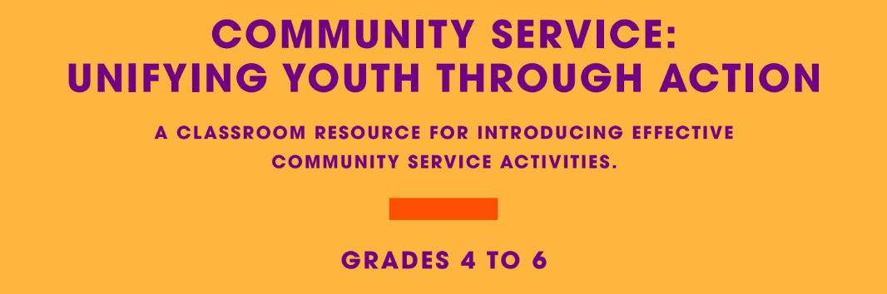

Slide 2


F r Teachers
Use this slide deck to help you through the lesson package.
More resources are available on www.realizethedream.org
We recommend that you maintain a log of the service activities and hours along the way. Once the class is finished, you can use this form to submit the hours and your story.
Be sure to take photos and videos of students’ service—
we want to highlight their stories of service on our platforms!
Realize the Dream Service Hour & Story Form

Slide 3
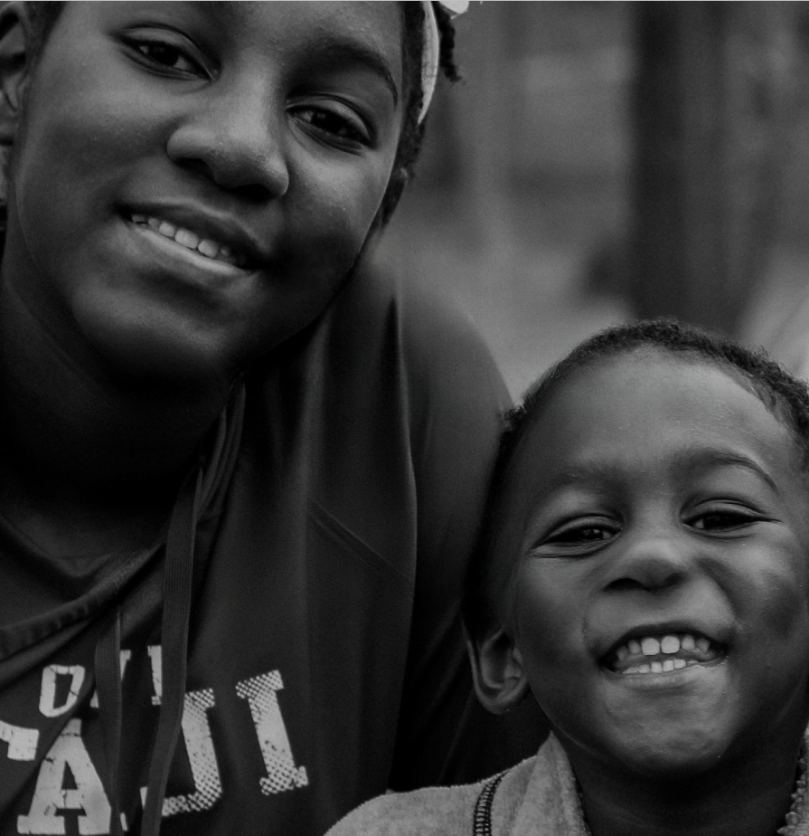


Realize the Dream is a monumental initiative that incorporates experiential service learning in your classroom to inspire students to become engaged citizens.
Together, we’ll ignite a nation-wide movement through a bold call to action - achieving 100 million hours of service by the 100th anniversary of Dr. King’s birth in 2029.
BE THE
CHANGE THAT MAKES
A DIFFERENCE.

Slide 4
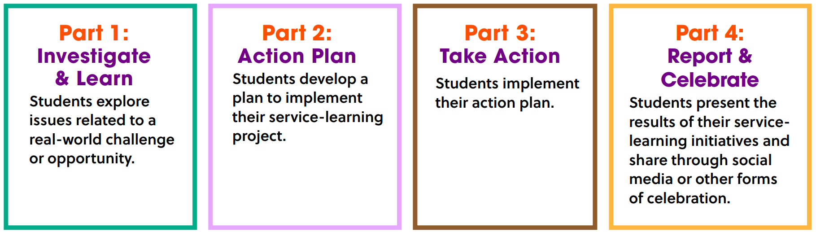


THE FOUR STEPS OF SERVICE LEARNING:

Slide 5
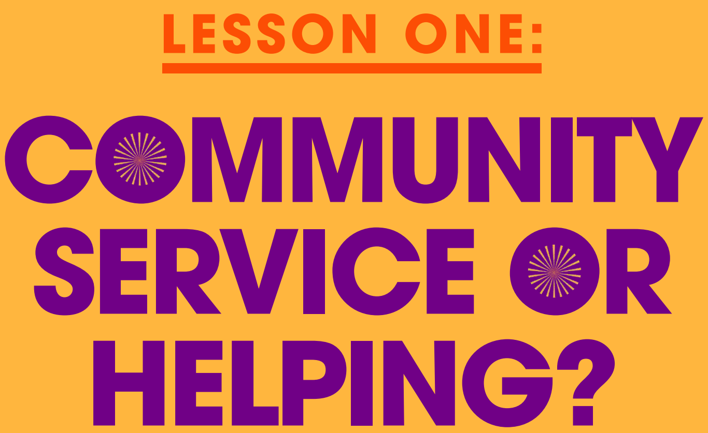

Slide 6

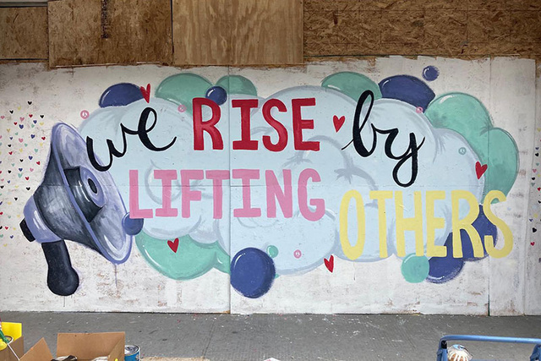
THINK-PAIR-SHARE:
What is the difference between helping and volunteering/community service?

Slide 7


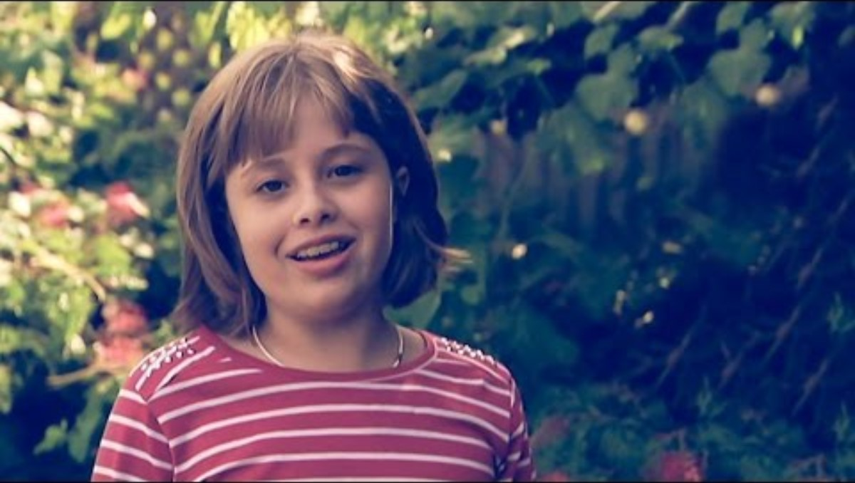
Kids Volunteering Behind the News
If video doesn’t work, click here!

Slide 8
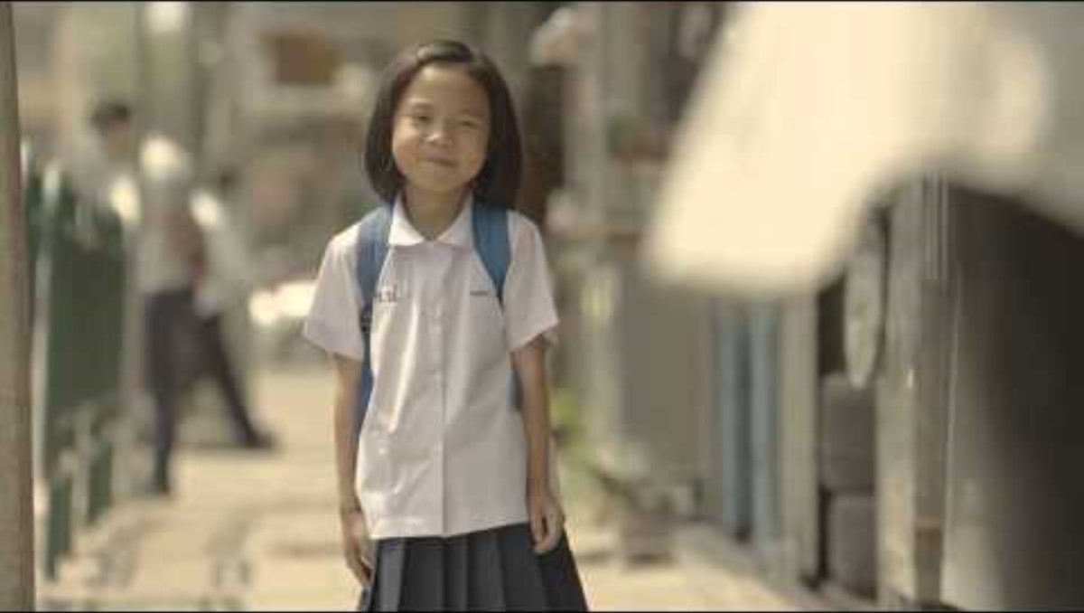
Happiness is Helping Others
If video doesn’t work, click here!

Slide 9
THINK-PAIR-SHARE:
Come up with definitions for the following:
Help
Community Service

Slide 10

So, what do you think?
Are these kids helping or doing community service?

Slide 11
GROUP WORK:
Create a list with two headings:
Helping
Community Service
Under each heading, list examples of each that you have done or would like to do.
THINK:
When you do community service, are you helping?

Slide 12
Helping:
Make easier/better
Community Service:
Work helping people in the local community that somebody does without being paid

Slide 13
Reflect
Write a reflection about a time that you helped someone and a time that you participated in community service.
How were the experiences different from each other?

Slide 14
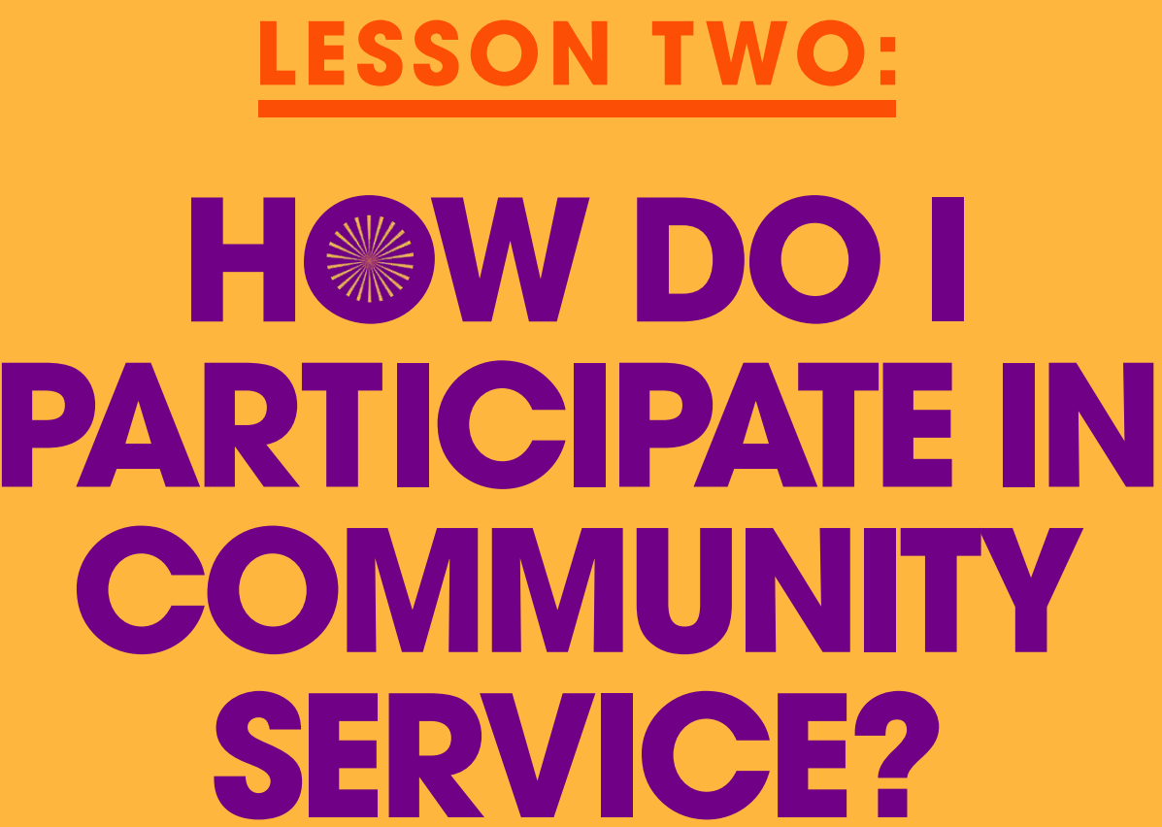

Slide 15
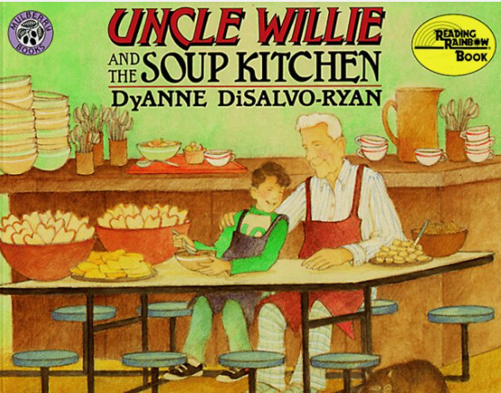
THINK-PAIR-SHARE
  Predict what the community service might be?
  Do you know organizations where people volunteer?
  Who do the organizations help and why are they helping?
  What specific activity is the organization doing to help?
We’ll be reading this story later in our lesson!

Slide 16
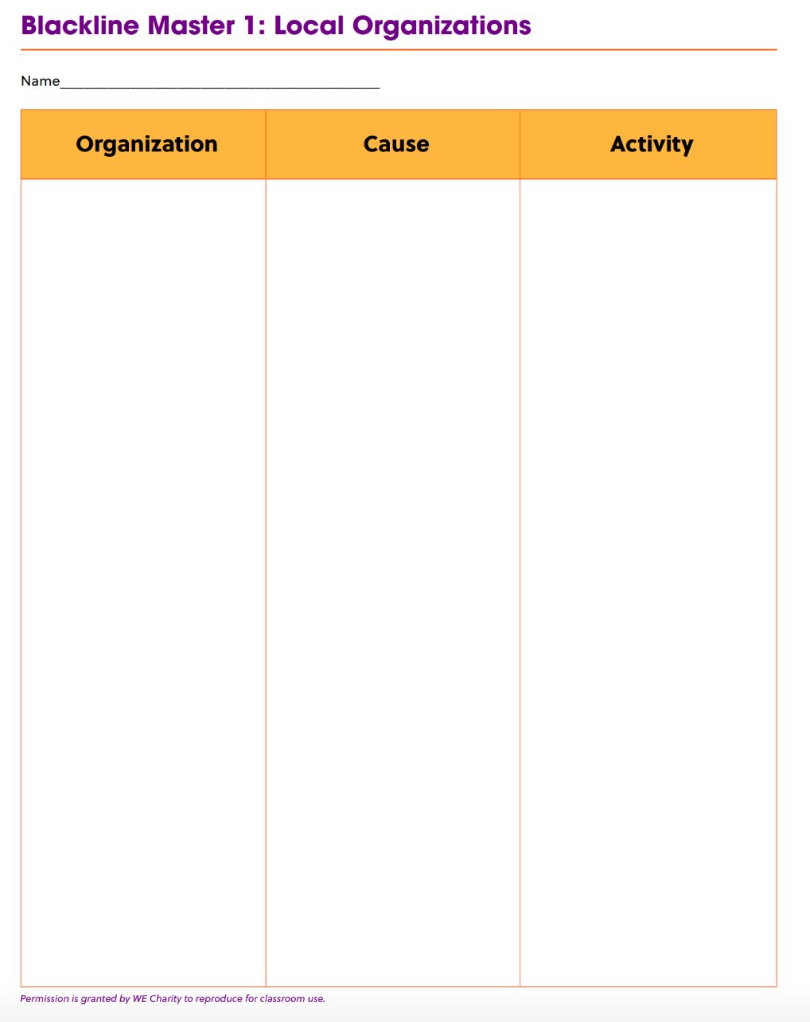
BLACKLINE MASTER 1: Local Organizations
Every organization has a purpose or cause they are working towards and activities they do to meet that cause.

Slide 17

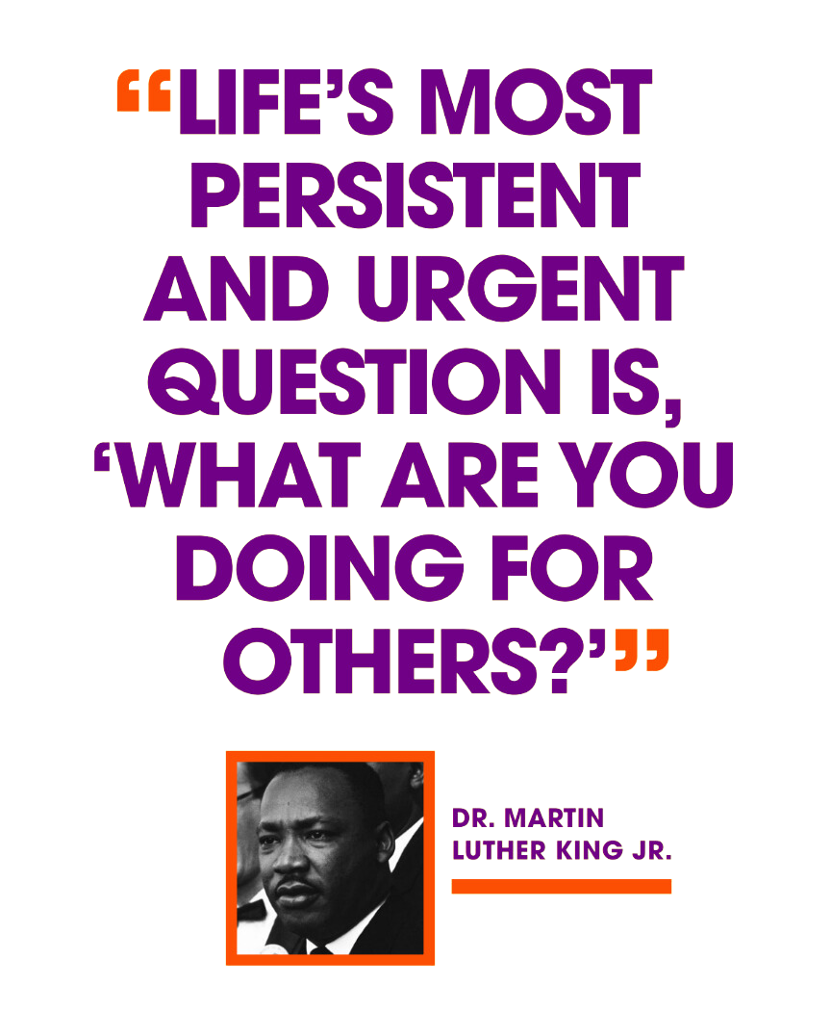
  Founded by Martin Luther King III, Arndrea Waters King and Yolanda Renee King
  Goal: 100 million hours of service by the 100th anniversary of Dr. Martin Luther King Jr.’s birth in January 2029
  5-year program with students across America
  Positive impacts on communities
Through a service-learning project, you can make a positive impact on the world around you.

Slide 18

If video doesn’t work, click here!
Uncle Willie and the Soup Kitchen

Slide 19

Reflect
To replay, click here!
  Why did the boy want to volunteer?
  Who did the boy help? How did it make a difference for the people he helped?
  Why was the boy uncomfortable around some people who came to the soup kitchen?
  What was the purpose of the organization that the boy volunteered for?

Slide 20
Independent Writing
Write a letter in the
voice of the boy to his Uncle Willie about his experience volunteering.
Describe how he felt before, during and after.
You can use an experience that you have had volunteering to help you with your letter.

Slide 21
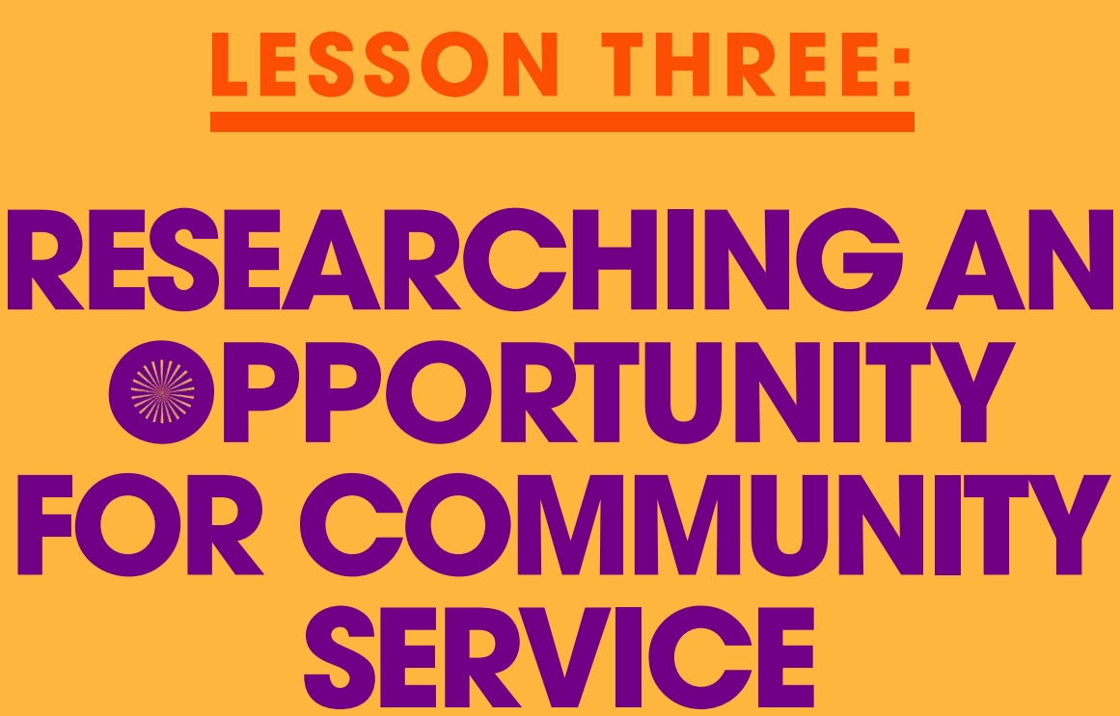

Slide 22

Making a World of Difference
If video doesn’t work, click here!

Slide 23
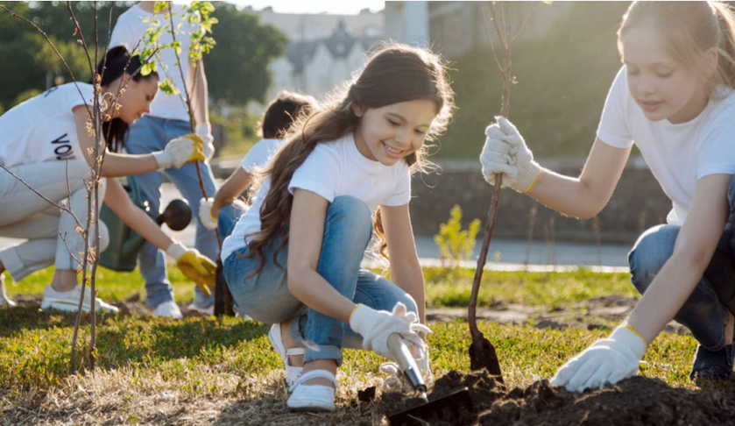
THINK-PAIR-SHARE
What does the quote mean to you?
How can you “donate” yourself?
Tell about an experience of when you have shared time and knowledge.
“Donate yourself,
not money.”
To replay, click here!

Slide 24
Let’s revisit –
Are there any more causes you can think of?
THINK-PAIR-SHARE
  How can we make a difference through doing community service ?
  What cause are you passionate about?

Slide 25
DISCUSS:
Do you know of an organization that holds the same interest and purpose that you are passionate about?
Is there an organization that believes in a similar idea and purpose to you?
Select one organization from the list that is aligned to your cause.

Slide 26

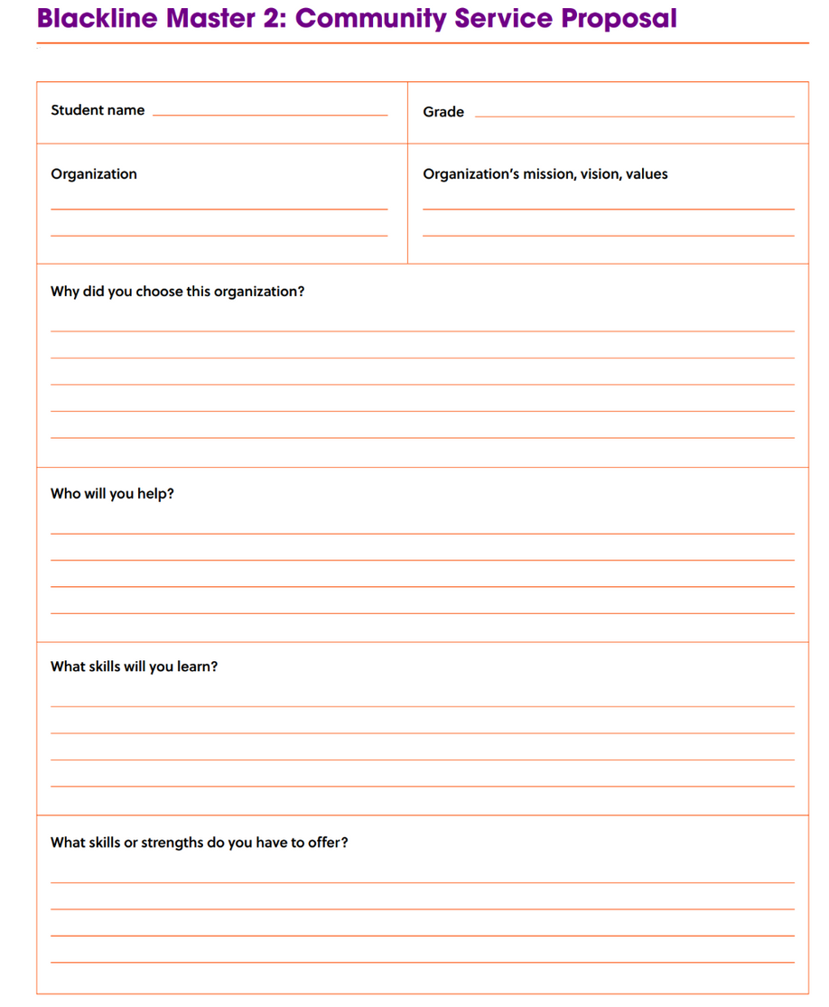
ACTION PLAN:
Research an Organization
How does your idea align to the cause and your selected organization?
Research your organization and
be ready to share with your classmates.

Slide 27
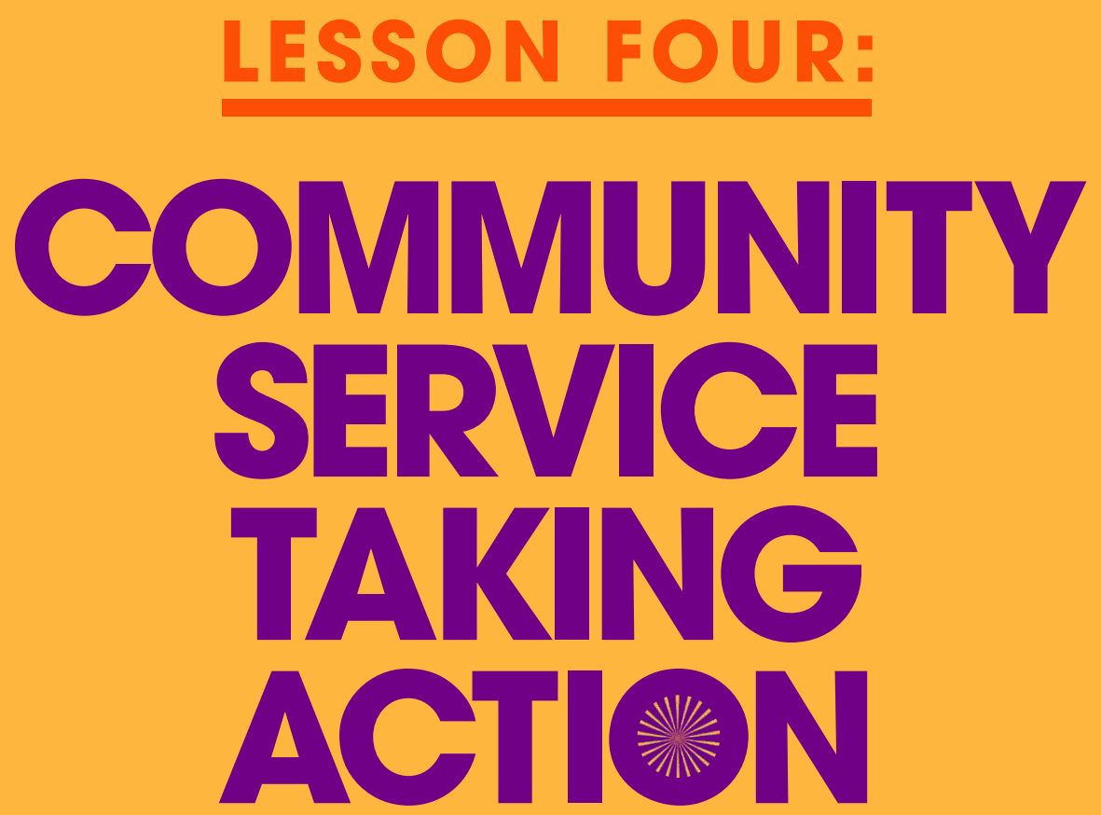

Slide 28
  Founded by Martin Luther King III, Arndrea Waters King and Yolanda Renee King
  Goal: 100 million hours of service by the 100th anniversary of Dr. Martin Luther King Jr.’s birth in January 2029
  5-year program with students across America
  Positive impacts on communities
Through a service-learning project, you can make a positive impact on the world around you.

Slide 29
GROUP WORK:
Develop a presentation to persuade the class to choose your organization for community service.
Focus on:
  the organization’s mission, vision, and values
  the central issue the organization is focused on addressing
  what skills you will contribute to the organization
  what you will gain from the experience
  how will the experience contribute to your big idea to change the world.

Slide 30

Realize the Dream
Ways to contribute:
  record your hours of community service
  share with your school and on social media

Slide 31
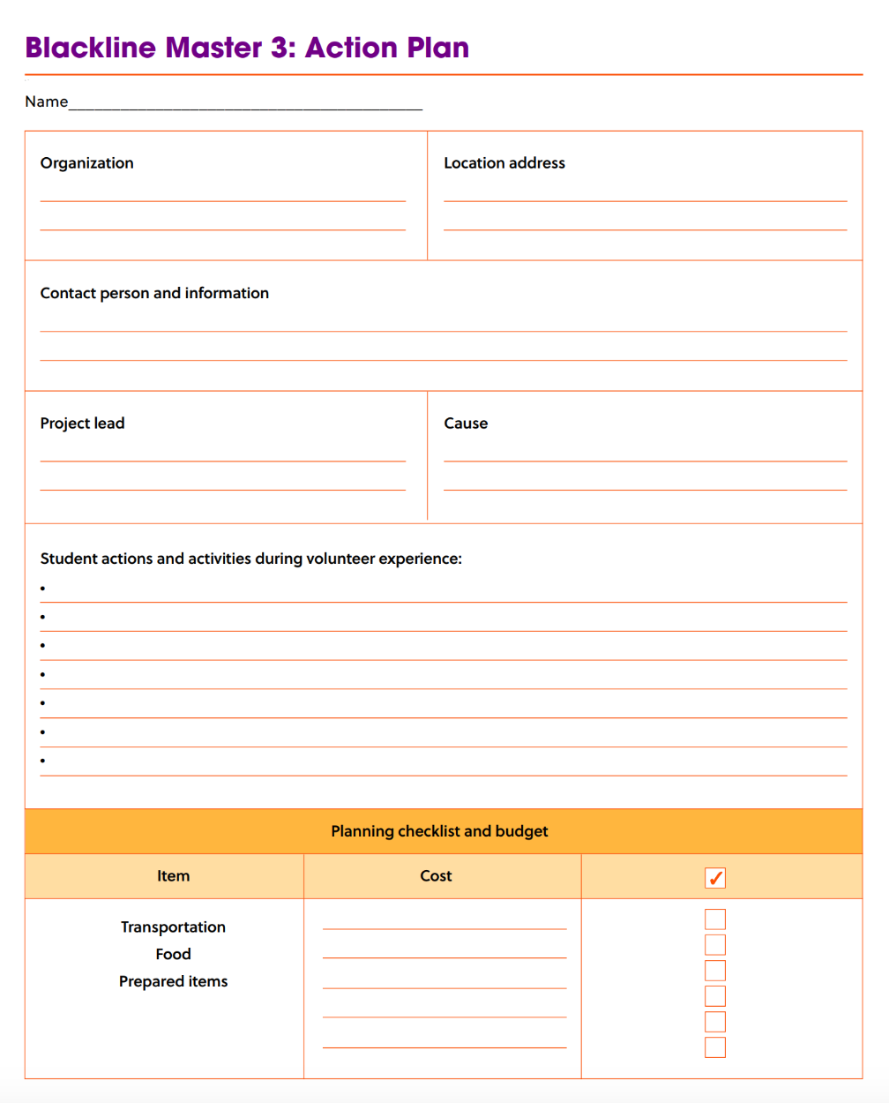
ACTION PLAN:
Sign up for a job so we can make sure that the runs smoothly and our goal is met.
Contact the organization to schedule a time and place to volunteer.
Find out how many students are needed to make the activity a success.
Create a list of resources needed to complete the activity. Find resources already in our school
Figure out costs - how will they be distributed?
Create a list of jobs that need to be completed while participating in the activity.
Create an assessment tool to measure if the contribution was beneficial.
Get permission from the principal and other administrators to conduct the activity
Record thoughts of students throughout the activity
Take pictures documenting the activity.

Slide 32
REPORT AND CELEBRATE
GROUP WORK:
  Create a video, blog or written visual reflection about
your experience doing community service.
  Explain how we can ensure our initiative will have a
lasting impact

Slide 33
CONGRATULATIONS!
Now that you have completed the service-learning, answer two of the questions:
  How will we ensure that the initiative that we started will continue?
  How might we support the initiative to spread to other schools or communities?
  How will we continue to seek feedback from others about additional ways we can make change in our community?
  How can we share our knowledge about the importance of community service and understand why we volunteer?
  Do schools have a duty or responsibility to teach students about the importance of community service?

Slide 34
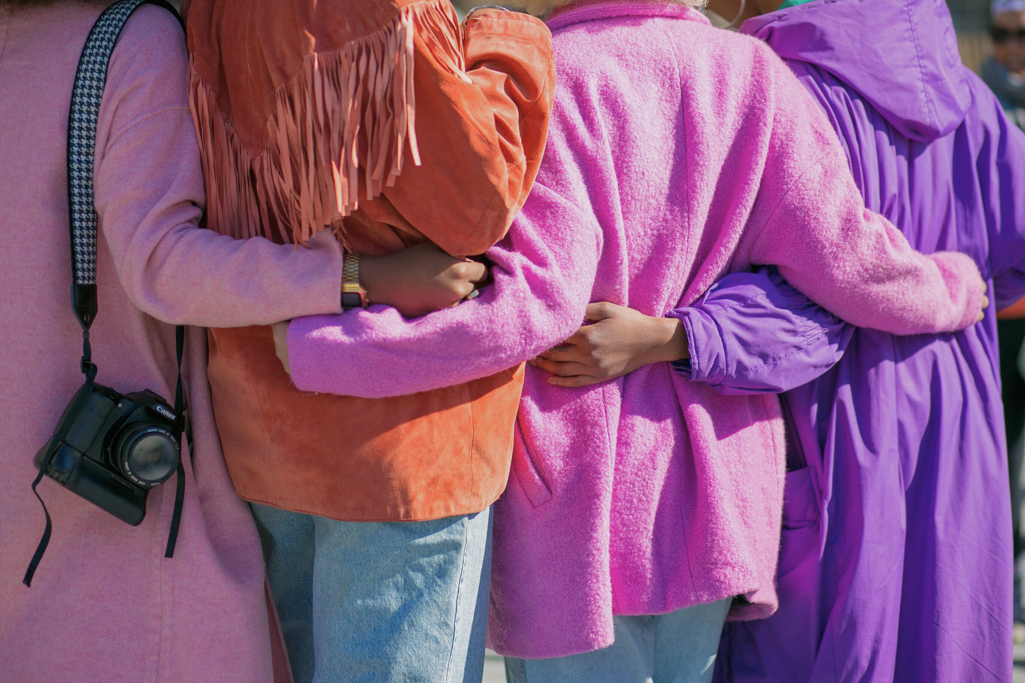


Thank you!

