Slide 1





Slide 2




Table of Contents:
1.
2.
3.
Lesson
Lesson
Lesson
We Express our
Gratitude
Slides 16-24
We Reflect on and Celebrate Gratitude Slides 26-30
We Have Gratitude
Slides 3-15
  Mindful Start
  Linking “thankful” to “gratitude”
  What gratitude is
  Benefits of gratitude
  Looking for gratitude
  Gratitude quiz
  Mindful Start
  Reflecting on gratitude
  Who could we be grateful for?
  How can we show gratitude?
  Gratitude tips
  Independent and collaborative reflection of gratitude experience
  Next Steps
  Thank you!

Slide 3




1.
Lesson
We Have Gratitude

Slide 4
A Mindful Start
Mindfulness is...
being fully in the present moment.
being aware of your thoughts and feelings.
being totally engaged in what you are doing.
trying not to get distracted.
If you do get distracted, that’s okay.
Just try to bring your mind back in the moment.

Slide 5




A Mindful Start
Why does
Think-Pair-Share
Mindfulness
Why do you think being mindful is important?
matter?

Slide 6
A Mindful Start
Why does
Being mindful helps us...
Mindfulness
Understand what we are learning
Better participate in discussions
Keep learning fun
matter?

Slide 7
Mindful Breathing
1.
find a comfortable seat.
2.
close your eyes or pick a spot on the floor to focus on.
3.
notice what you hear around you.
4.
after you settle into your comfy spot, focus on breathing in through your nose, out through your mouth.
5.
imagine your belly is a balloon. Fill up nice and round before you exhale.
Do this for 2 minutes.

Slide 8

Being Thankful
Think-Pair-Share
What are you
Thankful
What is something or someone you are thankful for?
for?
Use this sentence starter to write what you are
thankful for right now.
I am thankful for ______________ because _______________.

Slide 9
All About Gratitude
What is
Gratitude?
Think-Pair-Share
What do you already know about gratitude?

Slide 10

All About Gratitude
Gratitude is
feeling thankful to someone for...
teaching you
playing with you
making you feel better
encouraging you
helping you
taking care of you
taking care of your community
forgiving you
protecting you
challenging you
being friendly
What else can you think of?

Slide 11
Gratitude Share Out
What is it?
Who deserves it? Why?
How can we show it?
How does it feel when we show it?

Slide 12


Sparking Gratitude
Gratitude Detectives:
Watch and listen for examples of gratitude

Slide 13
The Science of Gratitude
.
Gratitude can help us to...
.
feel happier
.
sleep better
.
feel more connected to people and your community
.
feel better when we’re sad
.
be kinder and help others
Have healthier bodies (immune system)

Slide 14
Action Plan
.
Gratitude detectives
.
Detectives are always on the lookout for clues.
.
Over the next few days, we are going to be on the look for gratitude!
.
As a class, we will make our own gratitude jar (or journals).
Each day, watch for acts of gratitude or remember things you feel grateful for.
.
When you come back to school, write them down and we’ll share at the end of the week!

Slide 15
Gratitude Quiz!
True or False?
1. Gratitude can make you feel happier.
2. Gratitude takes a lot of time to practice.
3. Gratitude can help you sleep better.
4. Practicing gratitude helps your body heal when you’re sick.
5. Focusing on things we own, like toys, makes us happier.
6. Gratitude can help you feel closer to people in your life.
7. Gratitude can help prevent you from getting sick.
8. Gratitude can help when you’re feeling sad.
9. Gratitude can help people become more helpful to others.
10. Gratitude can help you feel more connected to your community.
11. Expressing thanks to others can boost your happiness.
12. Gratitude can change your brain.

Slide 16





2.
Lesson
We Express our Gratitude

Slide 17
Mindful Breathing
1.
find a comfortable seat.
2.
close your eyes or pick a spot on the floor to focus on.
3.
notice what you hear around you.
4.
after you settle into your comfy spot, focus on breathing in through your nose, out through your mouth.
5.
imagine your belly is a balloon. Fill up nice and round before you exhale.
Do this for 2 minutes.

Slide 18

Gratitude Review
Have you seen any
Think-Pair-Share
Gratitude?
Have you seen any examples of gratitude since yesterday?
Think-Pair-Share
How do you feel when you think about what you are grateful for?

Slide 19

We are Grateful to Others
Who are you
Grateful
Think-Pair-Share
for?
Who is someone at school, home, or in your community that...
.
.
.
protects you
.
.
smiles at you
makes you laugh
.
.
helps you
teaches you
.
.
has forgiven you
understands you
encourages you
listens to you

Slide 20

We are Grateful to Others
Class
Huddle
Think about who we could be grateful for as a class...
.
.
Some examples might be...
.
.
medical professionals
SPCA
.
.
community leaders
first responders
.
.
non-profit organizations
veterans
.
.
school staff
senior citizens
nursing home staff
friends or family

Slide 21

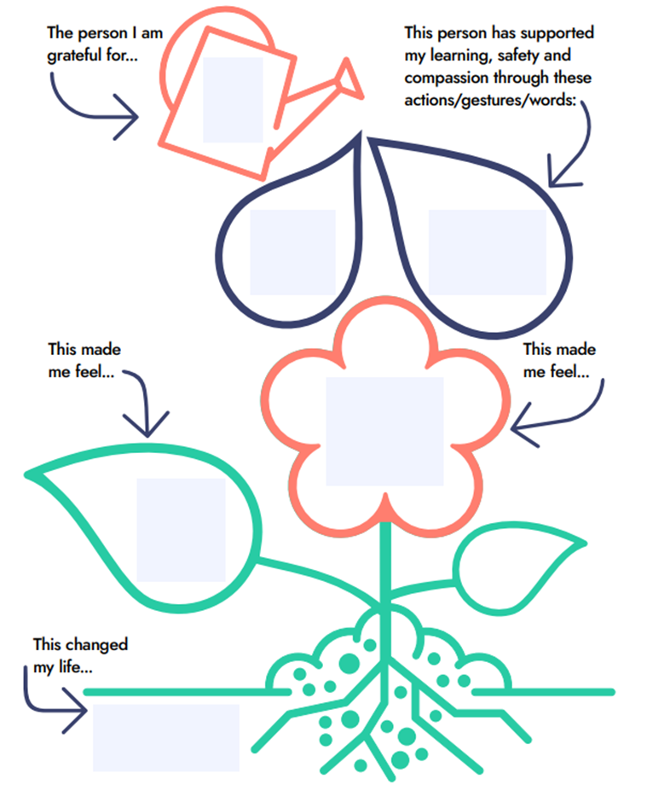
We are Grateful to Others
Independent
thought

Slide 22

Action Plan
How can we express
Gratitude?
Think-Pair-Share
How do you like to show your gratitude?

Slide 23
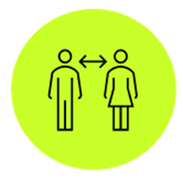


Action Plan
How can we express
There are many ways to express gratitude!
Gratitude?
In person:
•Visit them
•Meet with them
•Have a party!
From a Distance:
•Virtually
•Recording
•Personalized gift
•Letter
Get Creative!
•Artwork
•Poem
•Music
•Collage

Slide 24
Take Action!
Expression of gratitude tips...
.
.
take your time and try your best!
.
don’t worry about being perfect- they will love it!
.
help each other
.
have fun!
take the time for being mindful- feel good and happy about what you’re doing!

Slide 25




3.
Lesson
We Reflect on and Celebrate Gratitude

Slide 26
Mindful Breathing
1.
find a comfortable seat.
2.
close your eyes or pick a spot on the floor to focus on.
3.
notice what you hear around you.
4.
after you settle into your comfy spot, focus on breathing in through your nose, out through your mouth.
5.
imagine your belly is a balloon. Fill up nice and round before you exhale.
Do this for 2 minutes.

Slide 27

A Walk Down Memory Lane
First, we...
Then, we...
Our
Gratitude
Steps
Next, we...
Finally, we...

Slide 28

Reflect with Each Other
How did your
Gratitude
go?
Think-Pair-Share
How do you think we made people feel through our gratitude?
How did it make you feel?

Slide 29
Shared Reflection
What’s
Next?
Think-Pair-Share
How can we continue to show gratitude towards people we are grateful for?

Slide 30
Personal Reflection
How much
goodness
Take this time to reflect independently by...
came from your
.
gratitude?
drawing a picture
.
writing in your journal
.
closing your eyes and visualizing

Slide 31

Your gratitude brought goodness to the world!
Teachers- you can share photos of your gratitude projects with #SAYITNOW

