Slide 1


LET’S
Rally your friends to reduce waste.

Slide 2
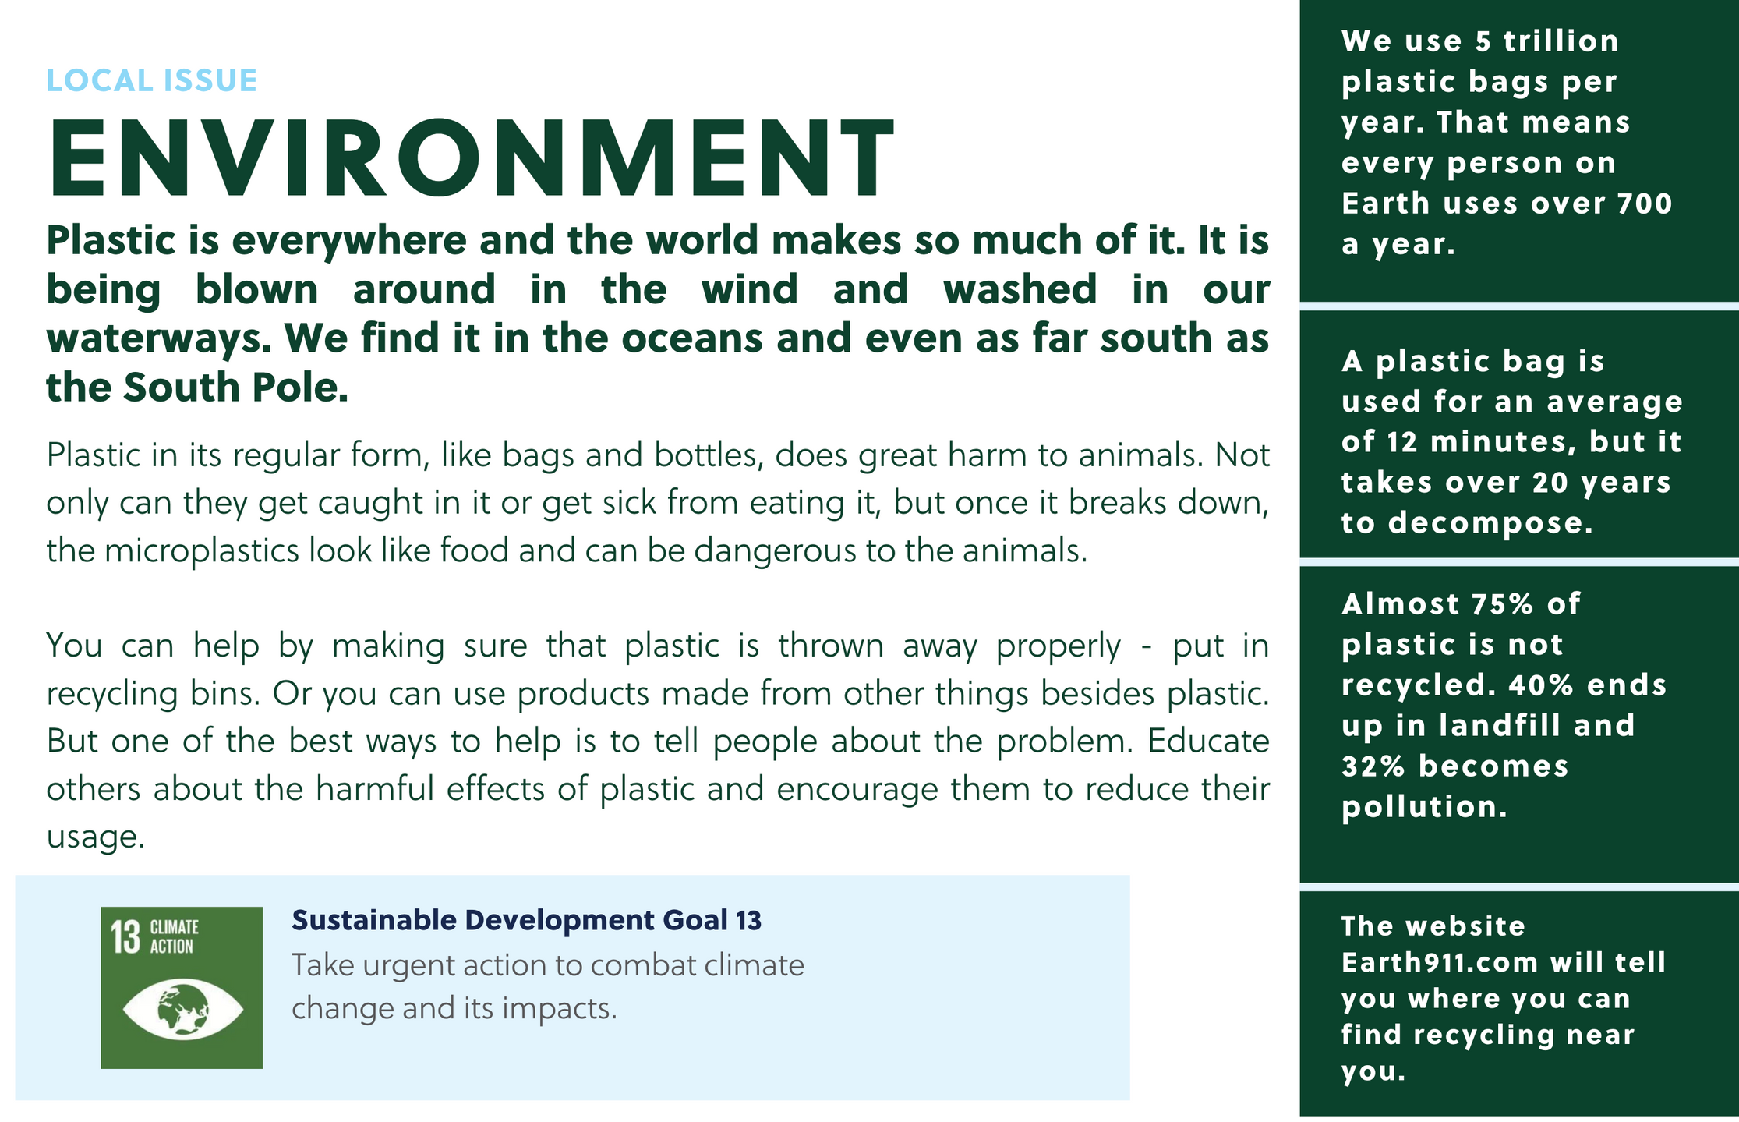
Grades k-6

Slide 3
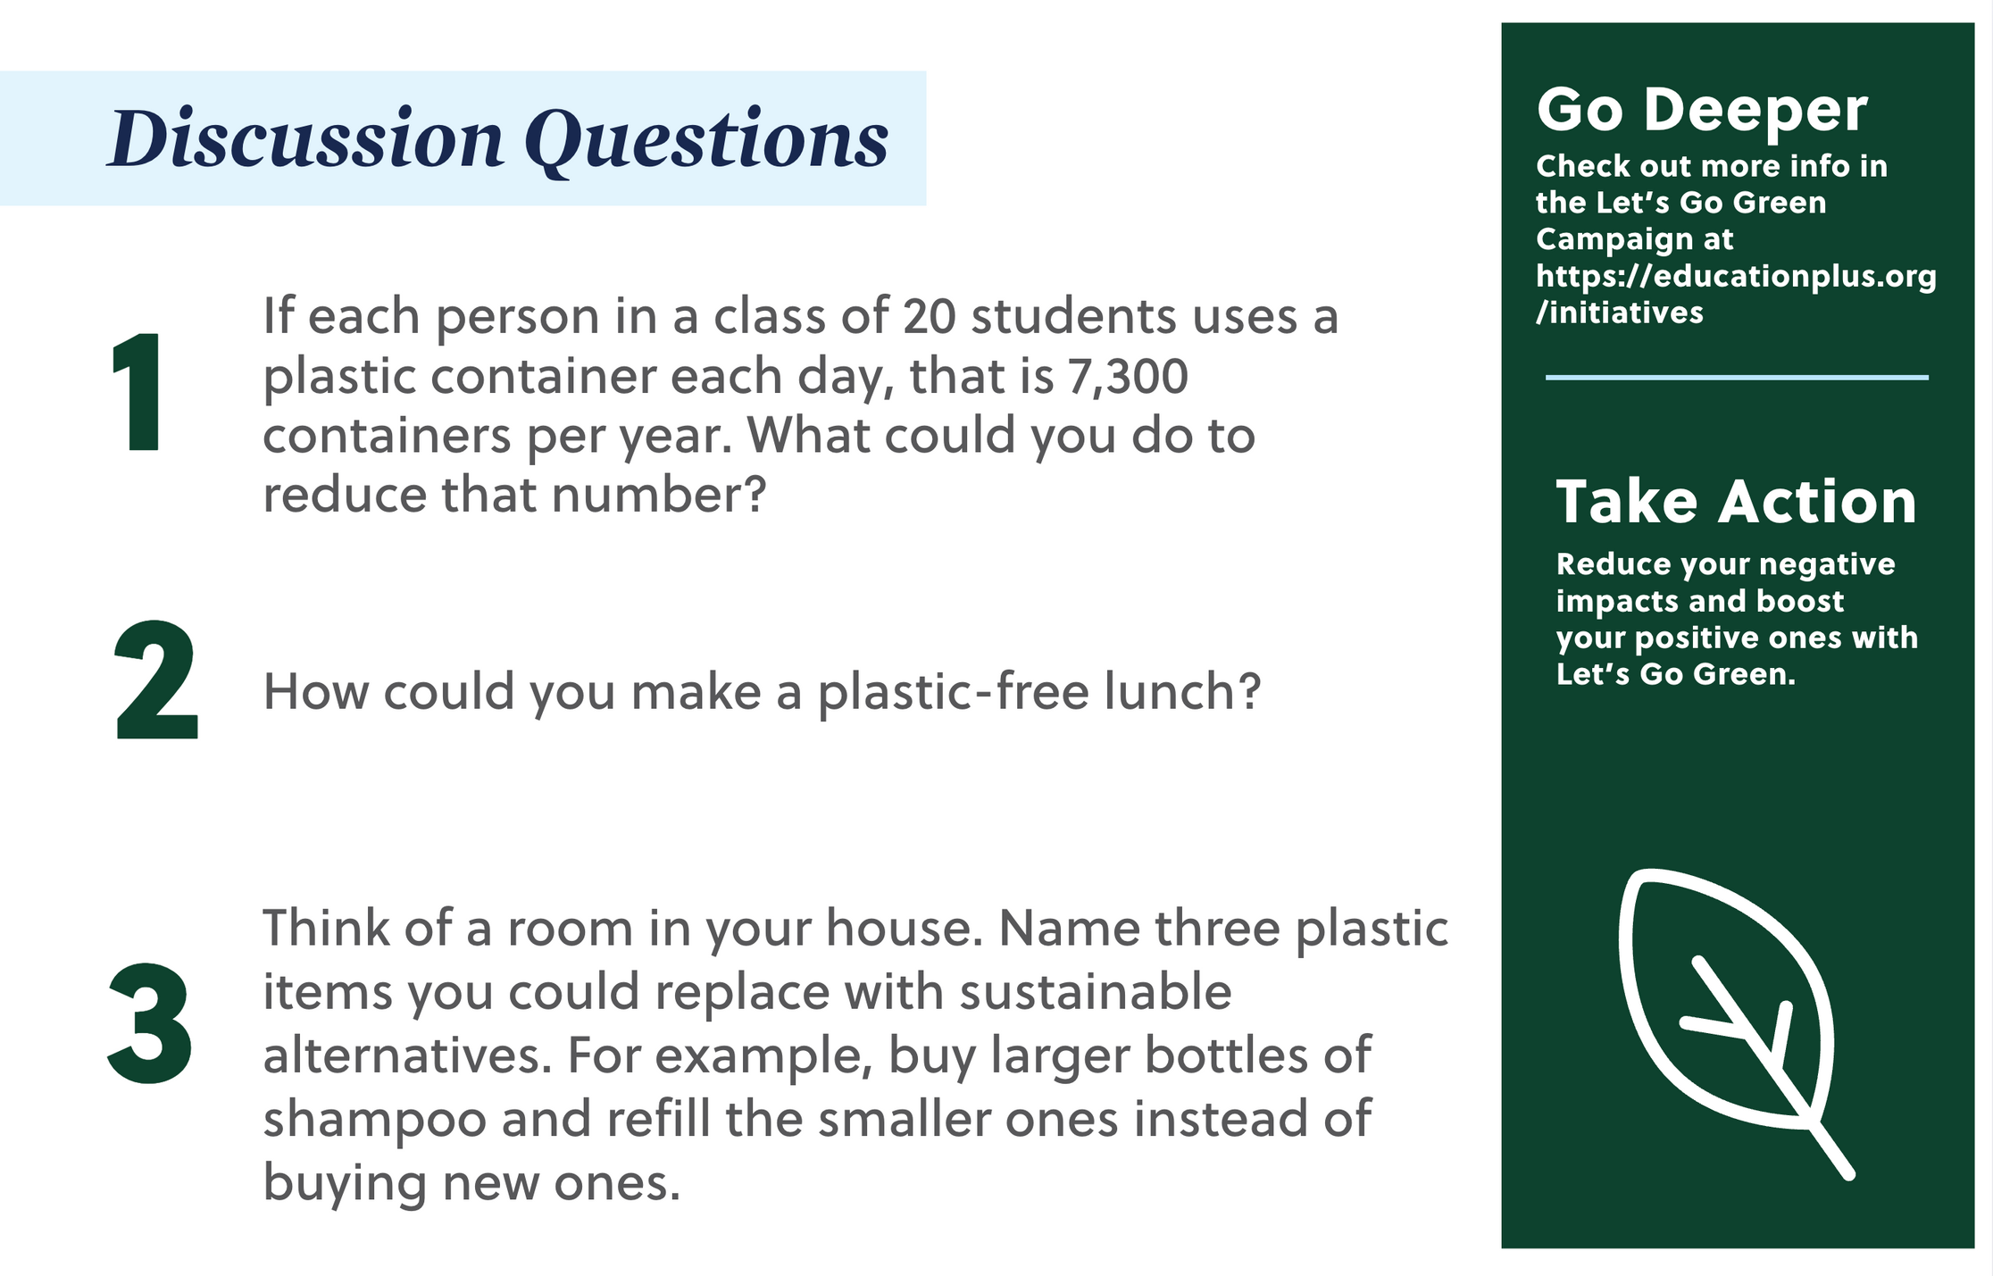
Grades k-6

Slide 4
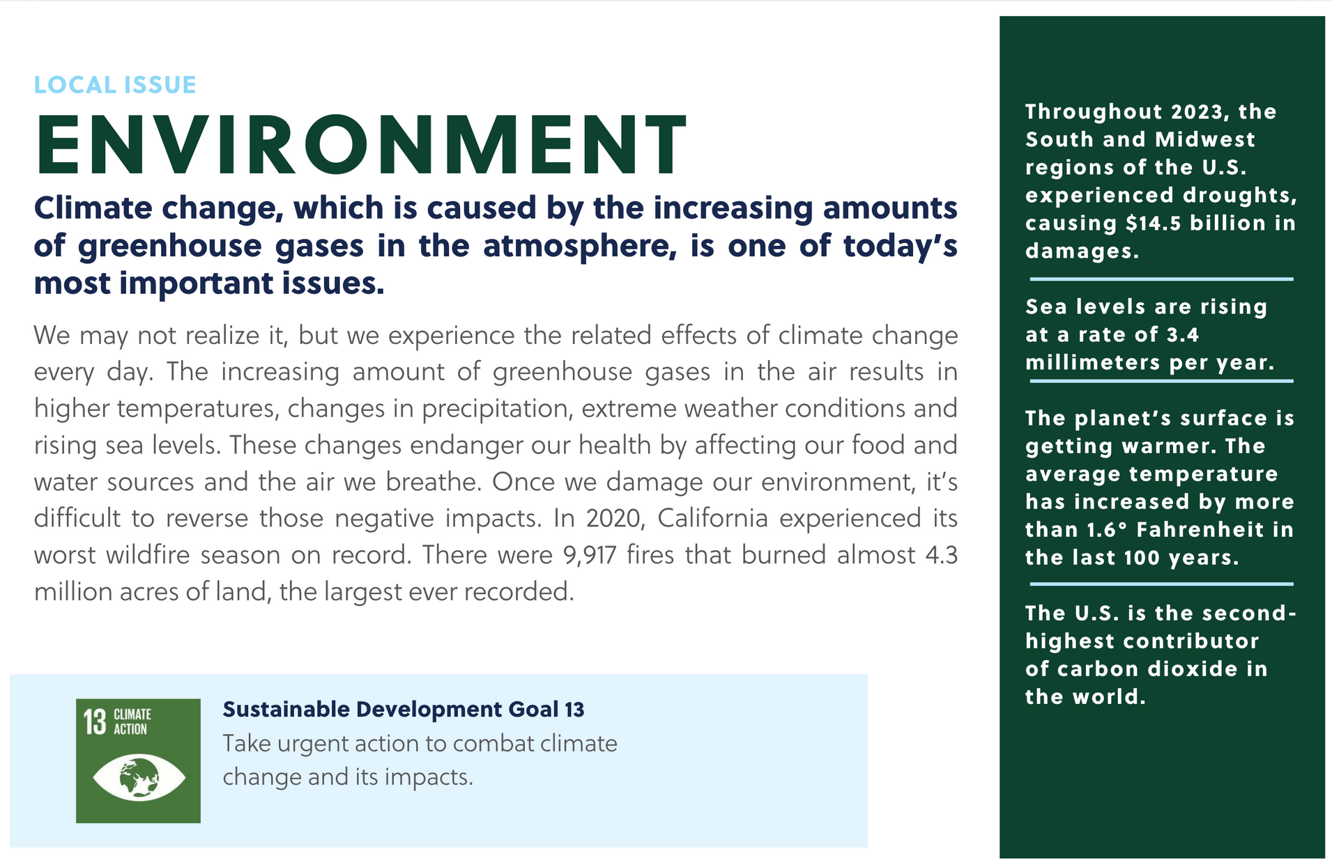
Grades 9-12

Slide 5
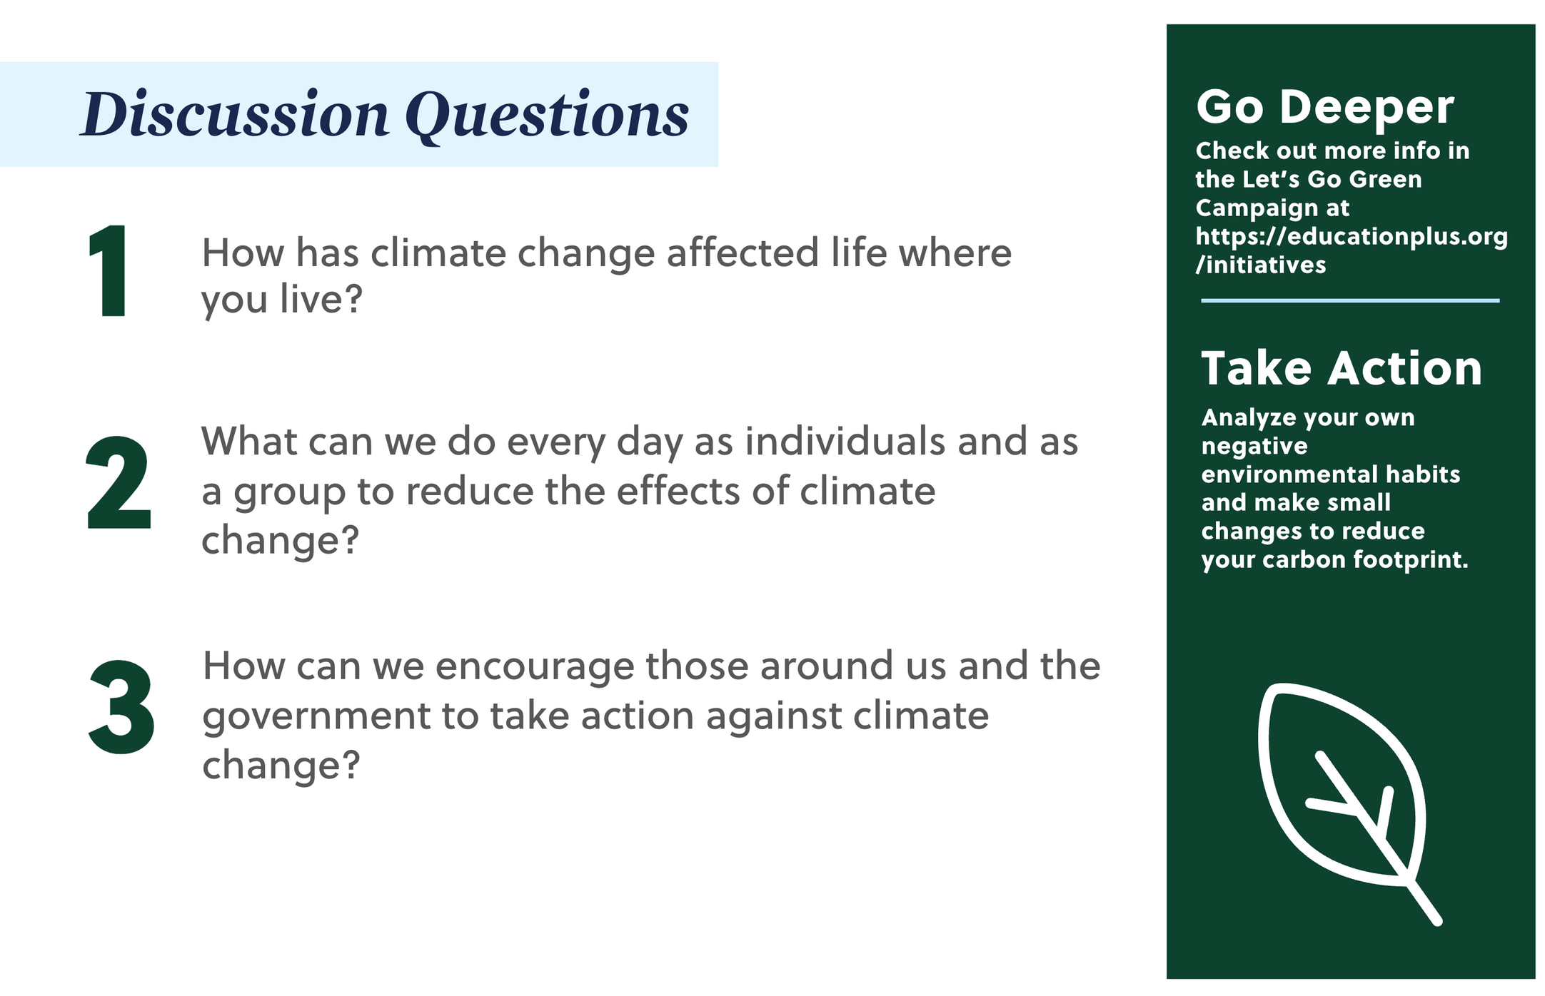
Grades 9-12

Slide 6
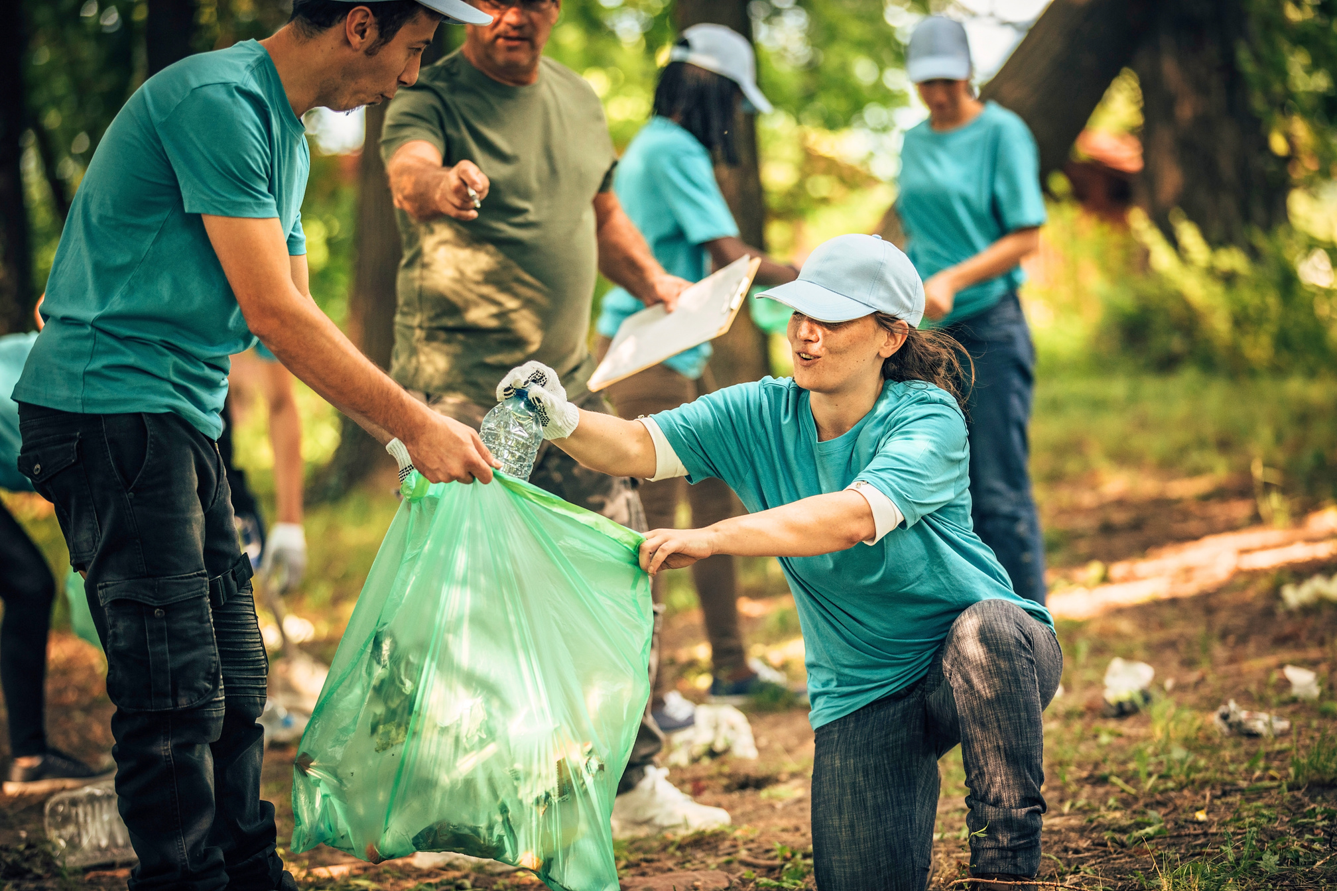
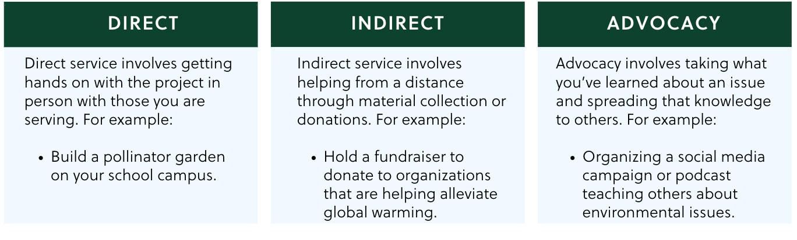
Ways to Take Action
Types of Service
Choose the type that works best for you!
DIRECT
INDIRECT
ADVOCACY
From local littering to global warming, there are so many ways to positively impact our environment!

Slide 7
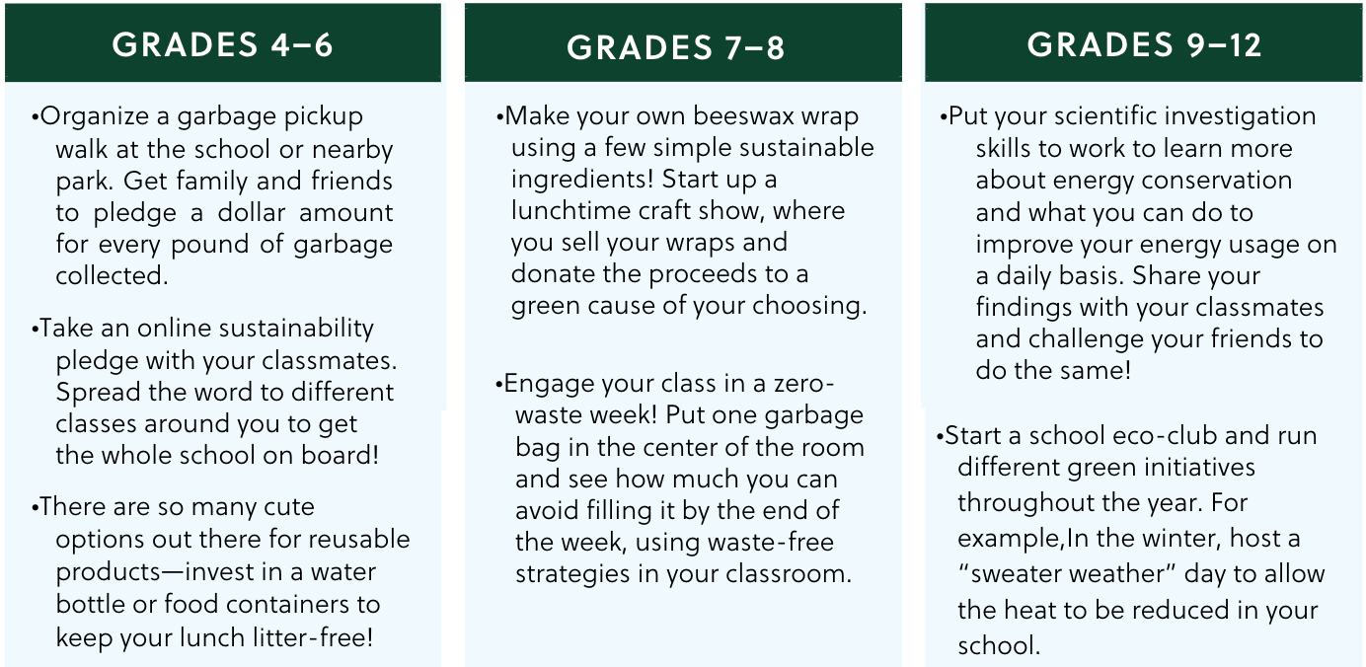
Suggestions by Grade Level

Slide 8
Get Doing
STEP 1:
Investigate and Learn
Start here to learn about issues relating to relationships on a local, or even global level!

Slide 9
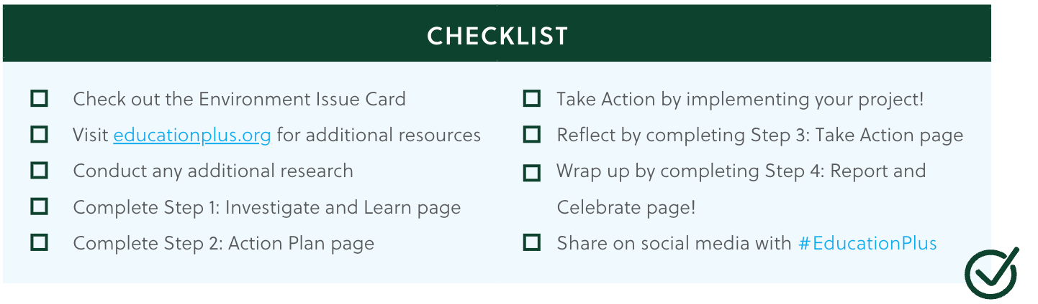
Checklist from Start to Finish

Slide 10
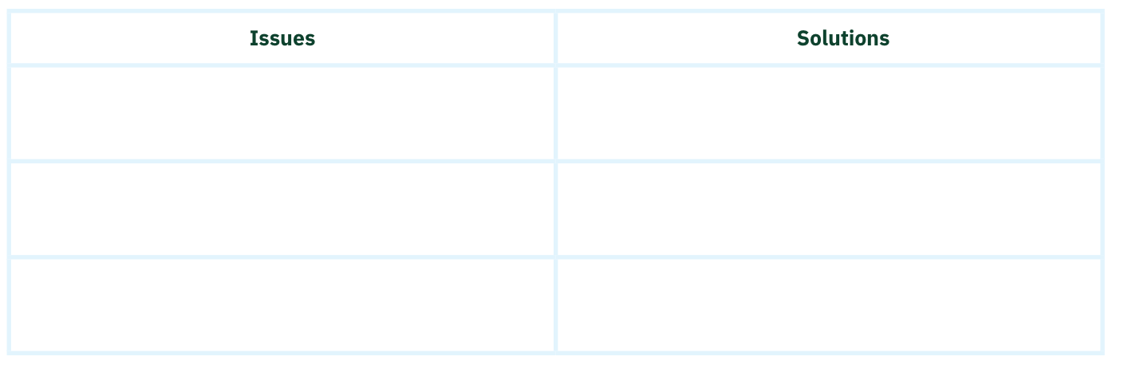
Community Mapping
Use the chart below as you take a walk. Look for signs of issues that have negative impacts (e.g., lack of recycling bins or overuse of electricity). Do you notice any obvious improvements you can make to your school or community?

Slide 11
As you Investigate, Record what you Learn:
  Which environmental issue would you like to focus on? Why?
  Why is addressing this topic important?
  What issues exist in your school or community (local or globally) concerning this topic?
  What actions have organizations or people taken to address these issues?
  What can you do as an individual or group to tackle this issue?

Slide 12
STEP 2:
Action Plan
Step 2 will walk you through the planning process of your service-learning project.
Be sure to work together - allow for everyone to have a voice at the table!

Slide 13
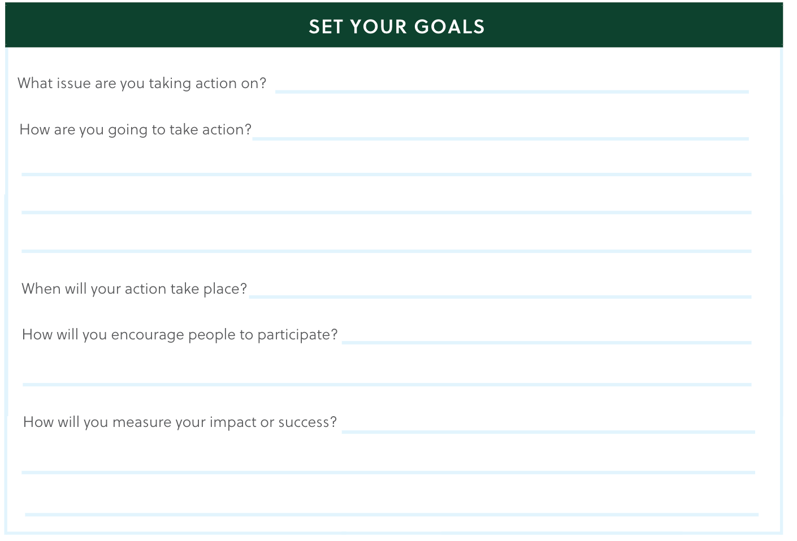

Slide 14
Create your Timeline or Steps
Create a timeline to help plan your actions! Plot the steps your group will take to gear up for your actions around the school or community.
1.
6.
2.
7.
3.
8.
4.
9.
5.
10.

Slide 15
Materials and Budget List
What supplies will you need? How much will the supplies cost?

Slide 16
Assign Roles
Task
Group Member(s) Responsible
ex. Collecting materials

Slide 17
STEP 3:
Take Action
Now that you’ve learned about the social issue and you’ve planned your service-learning project,
it’s time to make it happen! Use this section after you’re done to help you reflect on your experience.

Slide 18
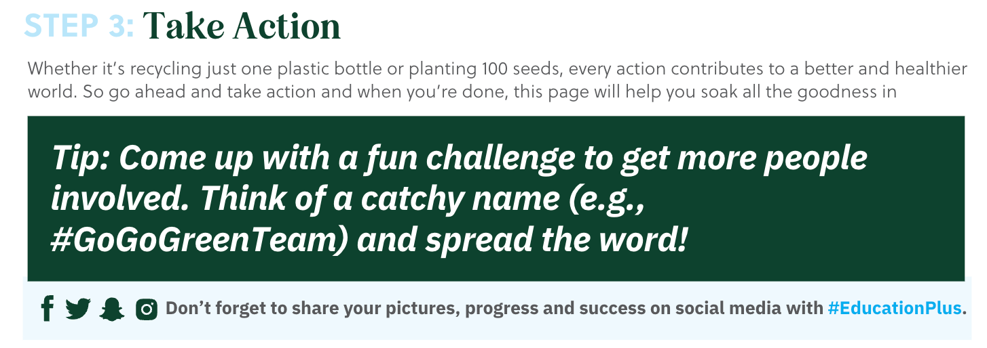

Slide 19
Reflect
What are some things you learned about your chosen issue?
How did your plan go? Did you run into any challenges? Is there anything you would do differently?
What did you learn about others through this experience?
What did you learn about yourself through this experience?
How did it feel to help make an impact?
How will you continue to raise awareness or make a further impact on this issue?

Slide 20
STEP 4:
Report and Celebrate

Slide 21
Report
1.How many people participated in the Let’s Go Green campaign?
2.How many people did you impact through your campaign?
3. What other measurable data or outcomes can you report?
4. Sharing about your project is so important and can inspire more action! How can you spread the word to others?
5. List key points from each step of the service-learning process you want to be sure to share with others:
  Investigate and Learn:
3. Take Action:
2. Action Plan:
4. Report and Celebrate:

Slide 22

Celebrate
While sharing with others is part of celebrating, be sure to celebrate as a team! Use the space below to brainstorm fun ideas to celebrate and also how you’d like to thank everyone who supported your campaign. Congratulations!
HOW DO YOU WANT TO CELEBRATE?
We love to hear your stories! Feel free to share with us at info@educationplus.org!

Slide 23
Thank you!
Use #EducationPlus to share your experience on social media or share with us at info@educationplus.org!

