Slide 1

Understanding Healthy Relationships
Grades 7-8
AN INITIATIVE OF

Slide 2

Understanding Healthy Relationships
These lessons are designed to help you with step 1 of the service-learning process: Investigate and Learn.
As we learn more about healthy relationships, be thinking about how we could take action with a Let’s Promote Respect Campaign!

Slide 3


Lesson 1:
The Many Forms of Relationships
Organization
Action Planning
Reflection

Slide 4
Learning Goals:
Students will:
  Understand the different qualities in relationships
  Apply their knowledge of the characteristics of healthy relationships to discussions of clear expectations

Slide 5
Group work:
shared goals
shared beliefs
shared experiences
humor
respect
communication
flexibility
Move around the room with your group to each relationship characteristic. Write under each one:
  what it looks like
  what it sounds like
  what it feels like
  why it is important
  an example that shows it

Slide 6
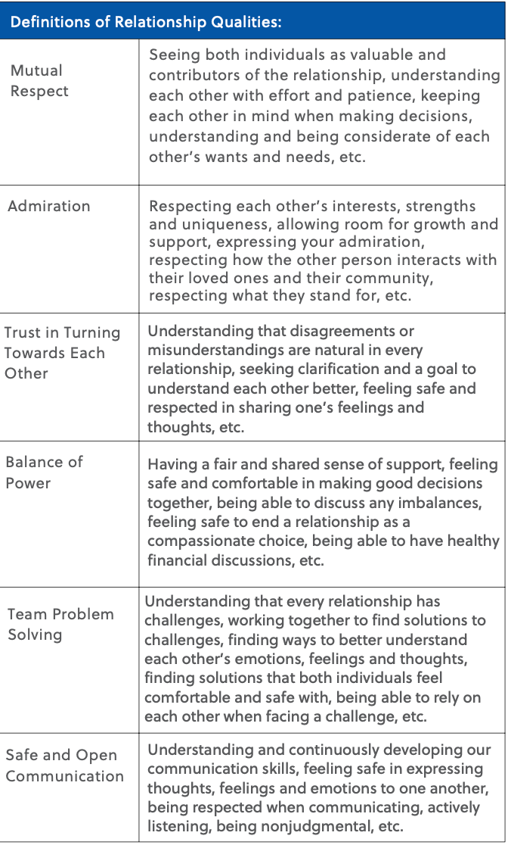
Class Discussion:
Rank the order of importance of
each quality to you.

Slide 7
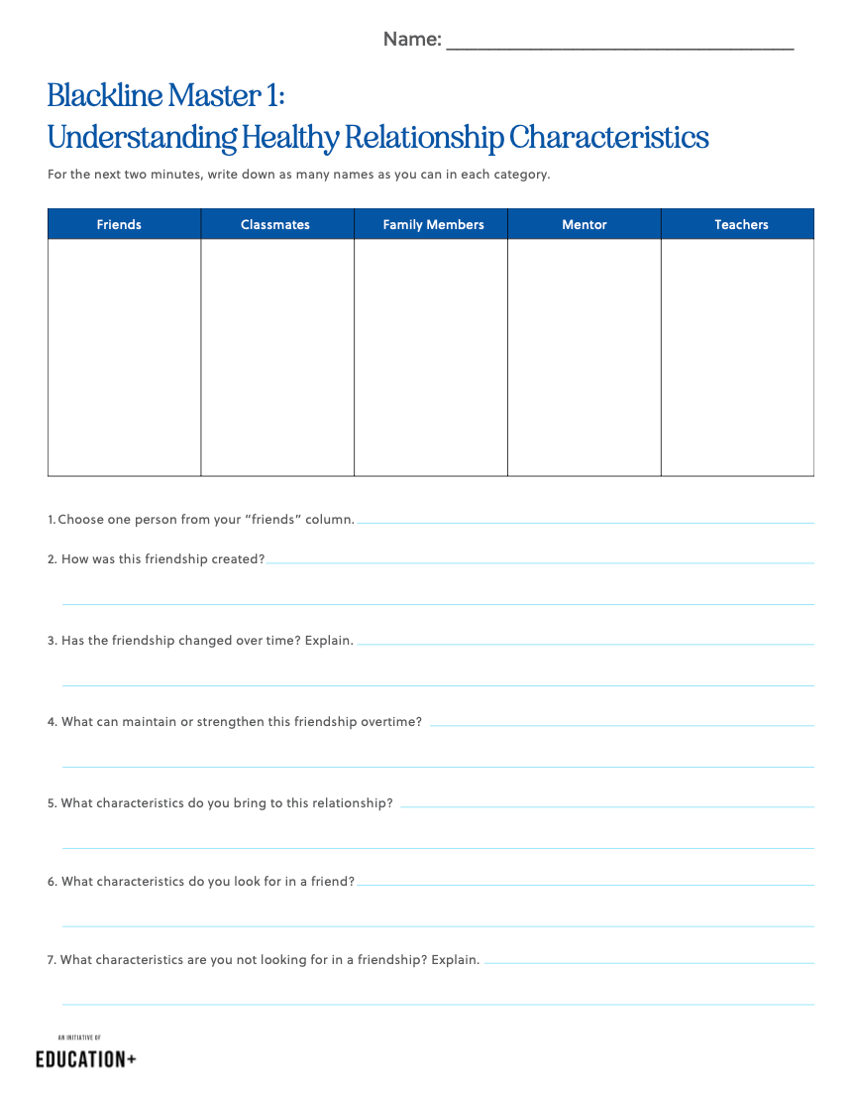
Understanding Healthy
Relationship Characteristics
Take two minutes to complete just the chart at the top of your paper. Write down as many names as you can of people you know in each category.
How are these relationships similar?
How are they different?

Slide 8
Think-Pair-Share
How do relationships change over time?
What factors may change relationships after middle school, high school, and graduation?

Slide 9
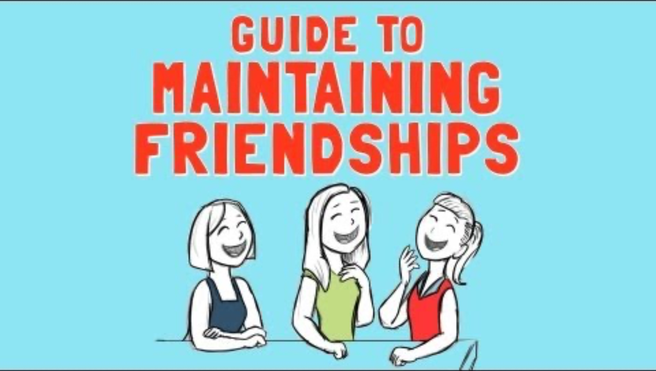
Guide to Maintaining Friendships Video

Slide 10
Healthy and Unhealthy Relationships
Think about someone you are friends with and complete the rest of Blackline Master 1.

Slide 11
Class Discussion:
Why do you enter different relationships?
What about the relationships we don’t choose, such as those with our family and teachers?
What makes a relationship that you choose different than a family relationship? Is there a difference?
How can we nurture those relationships?

Slide 12
Think-Pair-Share
Give a reason why healthy relationships are beneficial and important, whether it’s with a friend, family member, or teacher.

Slide 13
Having relationships with other people is important.
Connections with people, especially peers or people who are the same age, can provide support, encouragement, companionship, and more.

Slide 14
Healthy relationships are important because
  they can provide comfort and joy in difficult or happy moments
  they can help develop our social skills
  they can provide us with important and honest feedback
  they can help develop skills towards having a romantic relationship
  studies have shown that healthy relationships can improve our well-being and longevity.

Slide 15
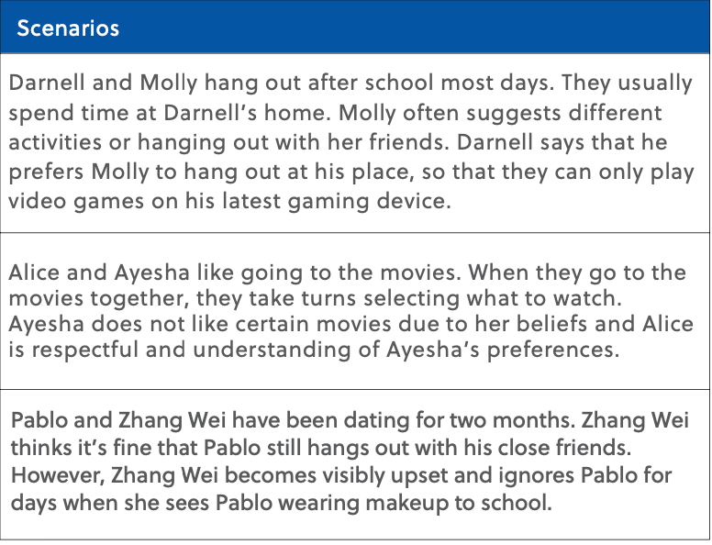
Balanced or Unbalanced?
Put your thumb up if you think the relationship is fair and balanced.
Put your thumb down if it is not.

Slide 16
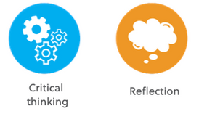
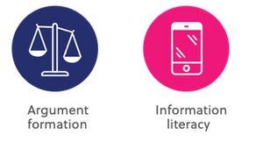
Lesson 2:
Communicating Core Values

Slide 17
Learning Goals:
Students will:
  Understand different styles of communication and
how they are used
  Be able to define core values and identify which are
important to them

Slide 18
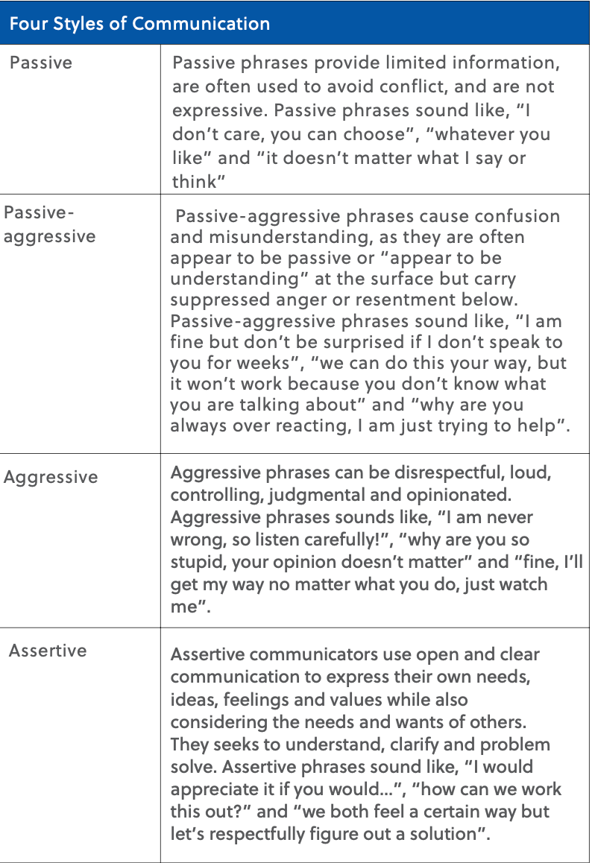
What does it mean to be
a good communicator?
  What are your thoughts on each style of communication?
  Have you used each style? How did it go?
  Have you had a time where a certain style of communication didn’t go well? If you could go back, how would you make things better?

Slide 19
Core Values
the characteristics you consider of utmost importance
  honesty
  loyalty
  humor
  trust
  respect
  security
  intelligence
  acceptance
  dependability
How we act and communicate with others stands as a reflection of our personal core values.

Slide 20
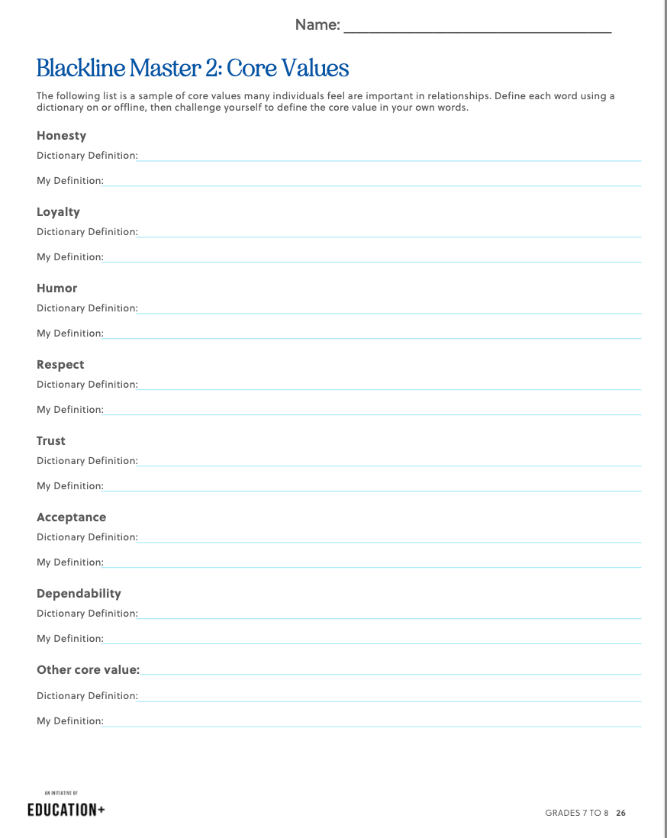
Core Values
Define each in your own words.
Then use a dictionary to confirm or
update your understanding.

Slide 21


What are your core values?
Write down your top 3 core values on the sticky notes.
Then stick them on the front board with others
of the same value. Let’s see which we value most as a class!

Slide 22
Reflections:
If you could improve on one core value, which one would it be? Why?

Slide 23
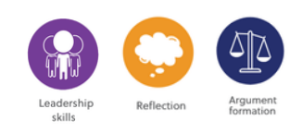
Lesson 3:
Abusive Relationships

Slide 24
Learning Goals:
Students will:
  Be able to recognize relationship violence and forms of abuse
  Know how to seek help about relationship violence and abuse

Slide 25
Independent Reflection:
What is an abusive relationship?

Slide 26
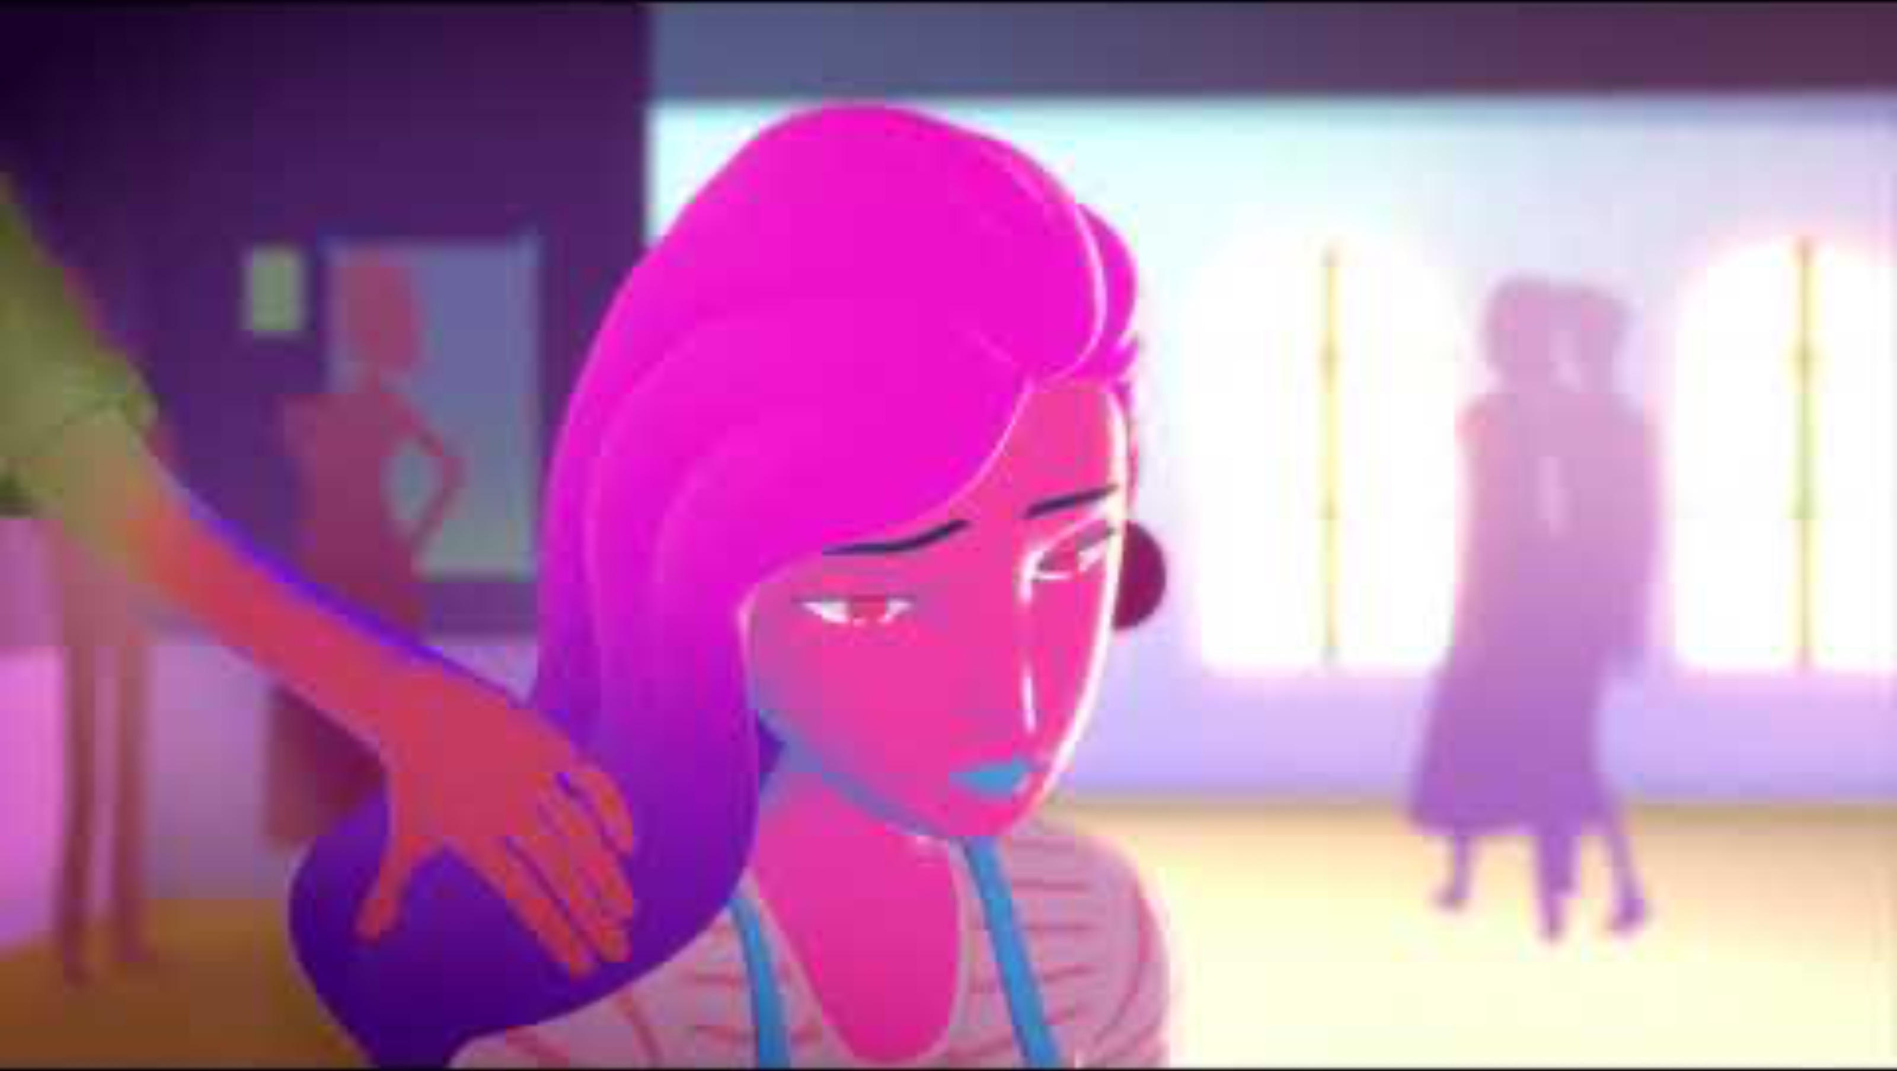
Sunshine- Don’t Confuse Love and Abuse Video

Slide 27
Independent Reflection:
  What was the first sign that the male character in the video
was showing abusive behaviors?
2. How are his behaviors abusive?
3. Why do you think the video is called “Don’t Confuse Love & Abuse”?
4. How do you think the female character’s feelings evolved over
the video? What words describe how you think she feels at the
end?
5. Do you think this type of abuse only exists in romantic relationships?

Slide 28
Class Discussion:
Think back to our discussion from Lesson 2 about core values.
How do you think a person’s core values are disregarded when emotional, mental, or physical abuse occurs?

Slide 29
Consequences of Relationship Abuse
Use this website to explore further about Abusive Relationships
https://youth.gov/youth- topics/teen-dating-violence/consequences

Slide 30
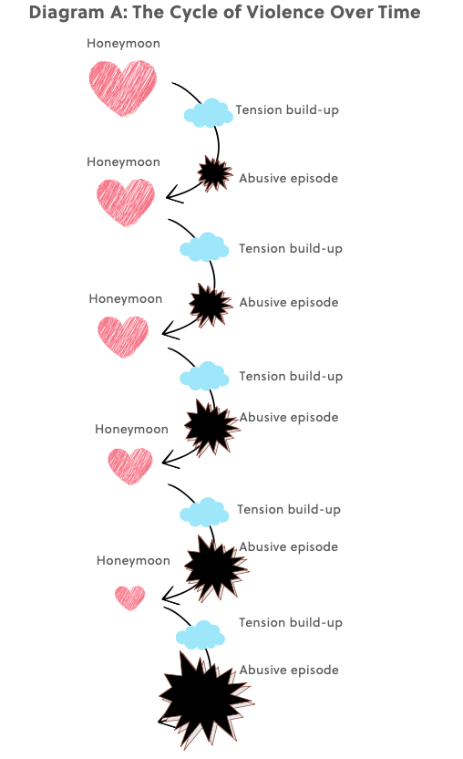
The Cycle of Relationship Violence
The cycle of relationship violence can occur over a long or short period of time, violence typically gets worse and eventually the honeymoon or denial phase will disappear.

Slide 31
Characteristics of Health and Unhealthy Relationships
Use this website to explore further about Healthy and Unhealthy Relationships:
https://youth.gov/youth-topics/teen-dating- violence/characteristics
Then with your group:
Design a poster about a characteristic of a healthy relationship vs.
a characteristic of an unhealthy or abusive relationship.

Slide 32
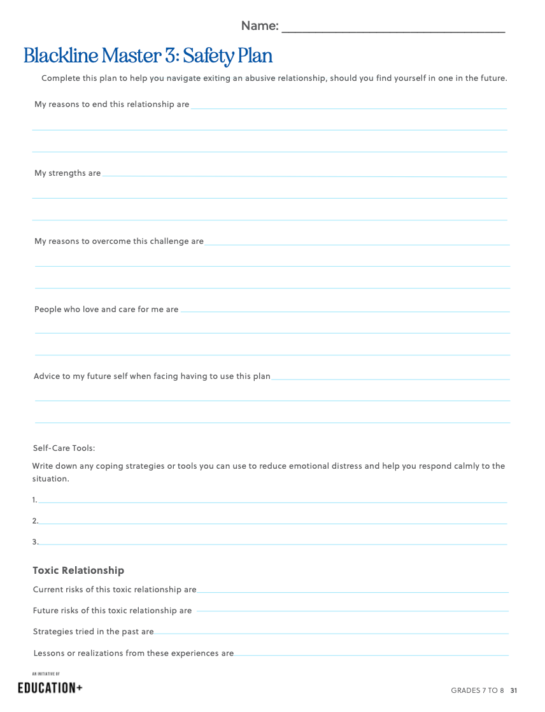
Safety Plan
Having a safety plan to escape an
abusive relationship can be a practical
way of being prepared and accessing
the right supports.
Here is a safety plan worksheet to help you get started.
Research and complete the resource section of the safety plan.

Slide 33


Lesson 4:
Setting Up Healthy Boundaries
Argument formation
Organization
Action Planning
Reflection

Slide 34
Learning Goals:
Students will:
  Understand what is meant by a “healthy” boundary and the positive impact this understanding can have on a relationship
  Learn how to create non-negotiables to protect themselves in relationships

Slide 35
Independent Reflection
Draw a large heart in the middle of a piece of paper. On the inside, write your core values and characteristics of a healthy relationship. On the outside, write characteristics of unhealthy relationships.
  Core Values
  Characteristics of healthy relationships
  Unhealthy relationship characteristics

Slide 36
Boundary:
A boundary is a divide that exists between two people.
When people establish boundaries, they are reaffirming what is important to them. Boundaries act as a set of standards for interactions and relationships people want to have in their lives.
There are 3 key areas linked to boundaries:
  Material—lending or giving money and items
  Time or relational—when you are available and for whom you are available
  Physical (personal space)

Slide 37
Group Brainstorm
  Brainstorm the benefits of healthy boundaries.
  Explore the benefits of boundary-setting by searching for online resources and by sharing individual experiences at your discretion.
  Discuss why it might be difficult for a person to establish boundaries.

Slide 38
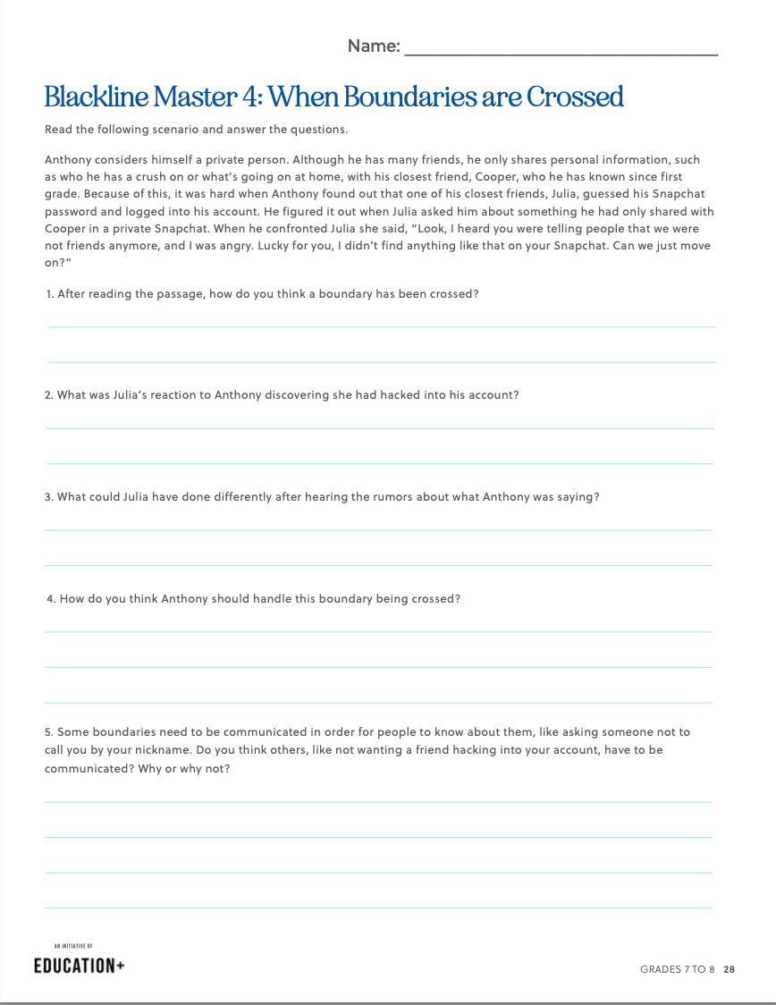
When Boundaries Are Crossed
Complete Blackline Master 4

Slide 39
Abuse and Boundaries
  There are many types of abuse, however abuse, in all its forms, is linked to a disregard of personal boundaries.
  If you feel your boundaries being crossed, or you feel abuse is present, you can start with the following steps:
  Don’t blame yourself. Verbal abuse is real. It is important to remember that you didn’t create a reason for the abuse, regardless of how you communicated with your partner.
  If you have a friend exhibiting abusive behaviors, suggest they seek appropriate help and/or reflect or research the impact of their actions.
  If you are a victim, you are not responsible for “fixing” your partner. Ending a relationship is hard. Abusive patterns won’t change unless a person gets help, and even then, the behavior might not stop.

Slide 40
Independent Reflection:
Write a list of “non-negotiables” of your boundaries.
Think about how you will respond if one of your non-negotiables is broken. For example, if one of your non-negotiables is you will not tolerate emotionally abusive language of any kind, think about how you would approach someone who infringes upon this non-negotiable.

Slide 41
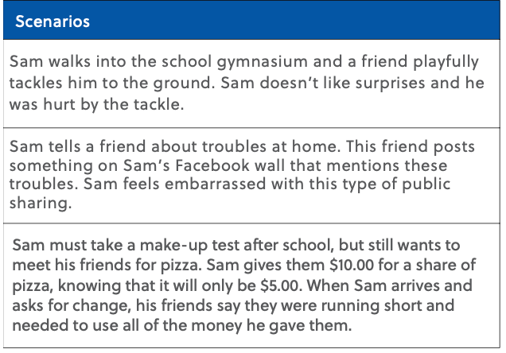
Think-Pair-Share
  What should Sam do in these situations?
  What should he say?
  Could he have done anything ahead of time, so that the situation would have been different?

Slide 42
I Statements
I feel ________ when you ________ . Please ________ .
I am willing to ________ . Please do not ________ .
I feel frustrated when you text me while I am spending time with my sister. Please wait until you know I am free to respond. I am willing to tell you when I will be available to talk. Please do not continue to text me after I have said that I am busy.

Slide 43
Lesson 5:
Dealing With Rejection
Organization
Critical
Thinking
Reflection

Slide 44
Learning Goals:
Students will:
  Identify roles and responsibilities within important relationships in their lives
  Understand feelings that occur with rejection and how to respond appropriately

Slide 45
Examples of Rejection:
  Think of fictional examples of rejection that could occur at school or after school.
Write examples here

Slide 46
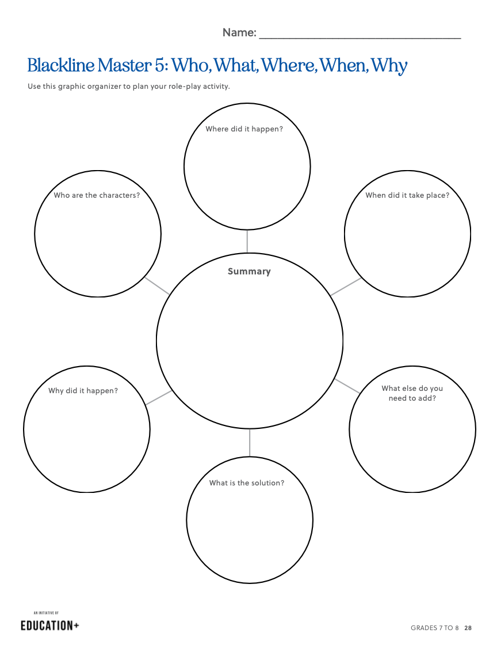
Group Work
Design a scene that
  focuses on rejection or the act of being rejected. It can be an outward “no” or one that is demonstrated through body language and non-verbal cues.
  has a person that is rejected by one of their friends or their peer groups.
  is three to five minutes.
  includes projected feelings and dialogue between individuals.
  has a beginning, middle and end.

Slide 47
Feedback:
How did each character feel and why?
How might you reconstruct this scene so that it reflects acceptance and inclusion rather than rejection?
What could have been done differently to provide a more positive outcome?

Slide 48
Independent Reflection
Describe what happened in your group’s scene. Include the point of view of your character, whether it be a main character or a bystander.
What happened to your character? How did you feel about the outcome of the situation? How could it be handled differently to ensure that people’s feelings were not hurt? What actions could your character take?

Slide 49
Optional Extension Activity
“You miss 100 percent of the shots you don’t take.”
-Wayne Gretsky

Slide 50
Lesson 5:
Understanding Healthy Relationship
Organization
Critical
Thinking
Reflection

Slide 51
Learning Goals:
Students will:
  Demonstrate an understanding of their approach to healthy relationships
  Raise awareness about healthy relationships.

Slide 52
Class Discussion
How will your needs within relationships change over the course of your life?
For example, how has your relationship changed with your parents, siblings or close friends over the years?

Slide 53
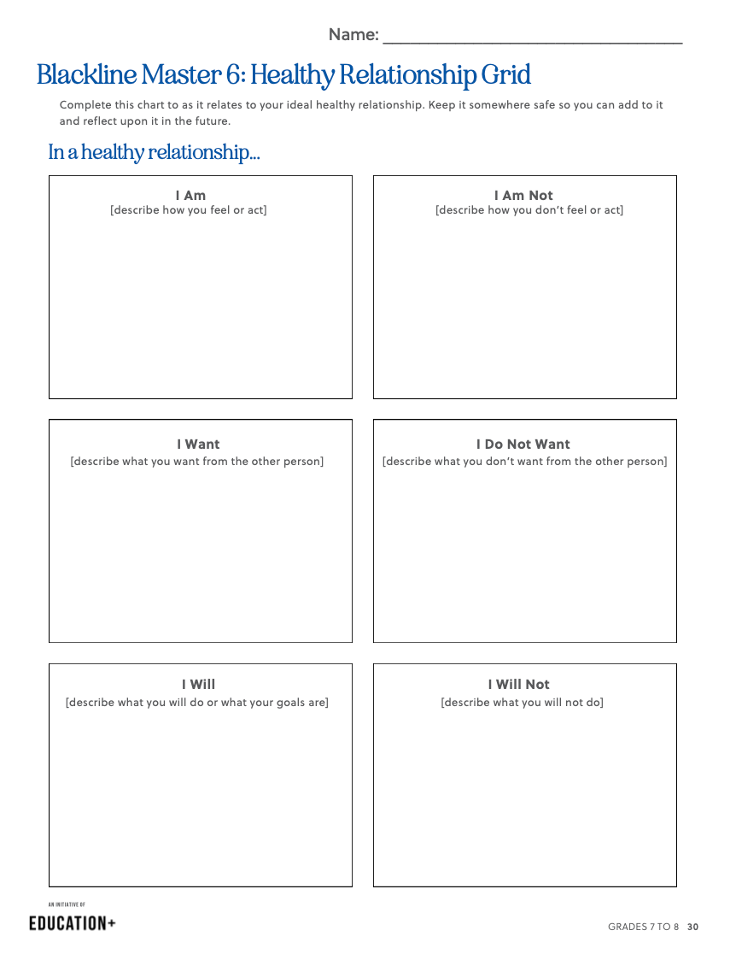
Healthy Relationship Grid
  Fill in the template with words or phrases that apply to you. Once the chart is completed with as much detail as you feel comfortable sharing, elaborate on the points in paragraph format, adding details where necessary.
  Keep the reflection somewhere safe so that you can add to it in the future.

Slide 54
Reflection
  How have your partners, friends and family reacted to your learning?
  Do you think these exercises and assignments will influence the way you behave in your relationships?
  How can work that involves self-assessment strengthen relationships?

Slide 55
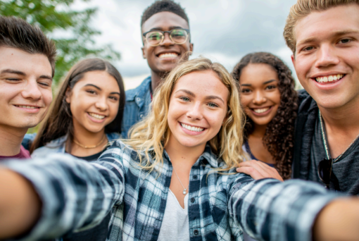
Congratulations -you’ve completed Step 1: Investigate and Learn!
Now it’s time to start planning how you can put your new knowledge into action through a service-learning campaign!

Slide 56
Class Discussion
  Why is it important to be aware of how to establish and
maintain a healthy relationship?
  Why is it important to understand the signs of an
unhealthy relationship?
  How can we share this knowledge with the people in our school and community?

Slide 57
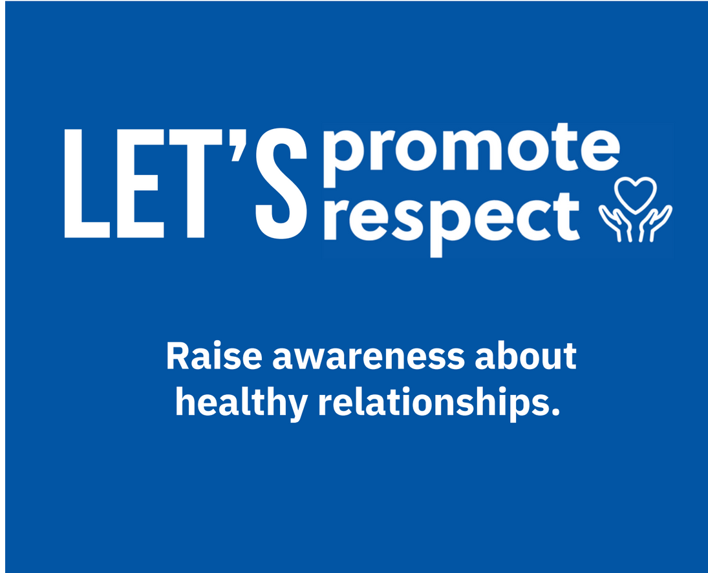
Action Plan
This campaign aims to give us the tools we need to spread awareness about this issue!

Slide 58
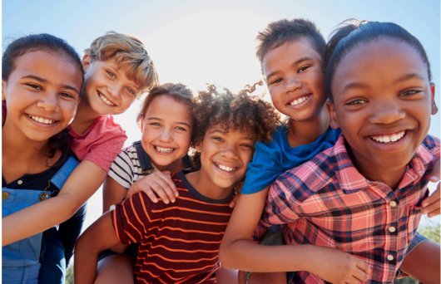
Brainstorm
How can we help people in our family and community raise awareness about healthy relationships?

Slide 59
Example Actions
  Create a short video that discusses what a healthy relationship is and the warning signs that can lead to an unhealthy or abusive relationship. Share this film as a public service announcement throughout the school and also on the school website to raise awareness.
  Organize an awareness-raising assembly about the diverse types of relationships and the characteristics of a healthy relationship.
  Invite a guest speaker who can highlight what constitutes healthy and unhealthy relationships and create a safe environment for questions.
  Create a safe space at school for students to share experiences and ask for help.

Slide 60
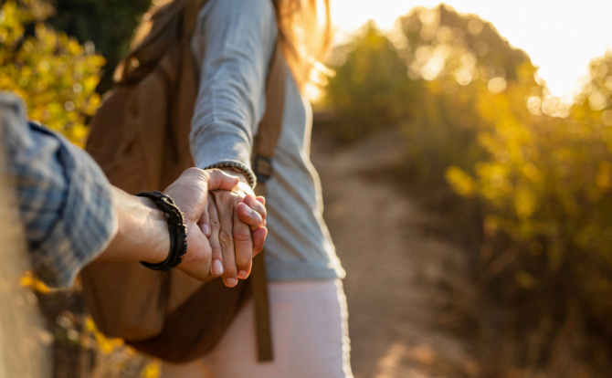
Take Action
Choose an action to raise awareness about healthy relationships and
participate in the
Let’s Promote Respect campaign.

Slide 61

Report and Celebrate
Share what you have learned and the actions you took with students from another class,
school or in the community.
Think about how you can continue to raise awareness about the
importance of healthy relationships for everyone.
Post photos or successes online with #EducationPlus

