Slide 1




Slide 2


F r Teachers
Use this slide deck to help you through the lesson package.
More resources are available on www.realizethedream.org
We recommend that you maintain a log of the service activities and hours along the way. Once the class is finished, you can use this form to submit the hours and your story.
Be sure to take photos and videos of students’ service—
we want to highlight their stories of service on our platforms!
Realize the Dream Service Hour & Story Form

Slide 3
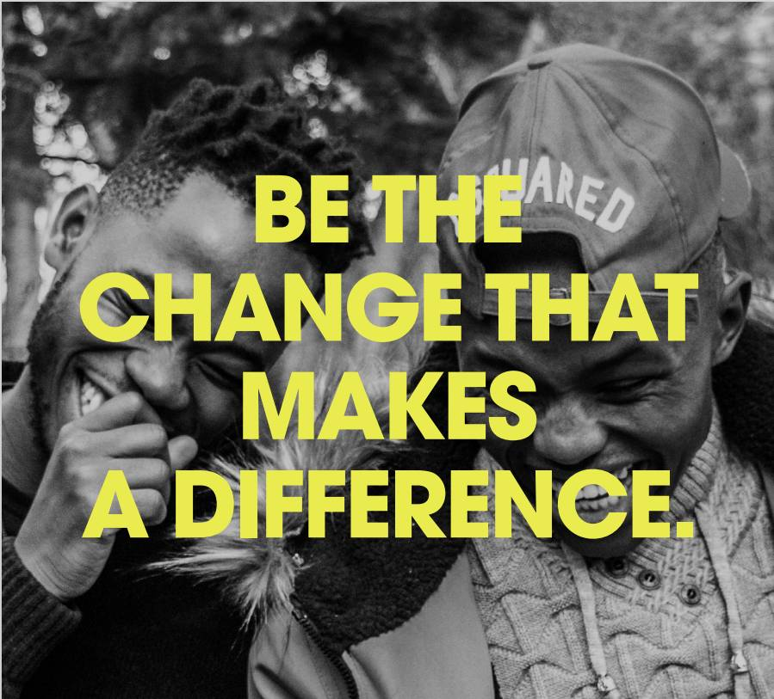


Realize the Dream is a monumental initiative that incorporates experiential service learning in your classroom to inspire students to become engaged citizens.
Together, we’ll ignite a nation-wide movement through a bold call to action - achieving 100 million hours of service by the 100th anniversary of Dr. King’s birth in 2029.

Slide 4
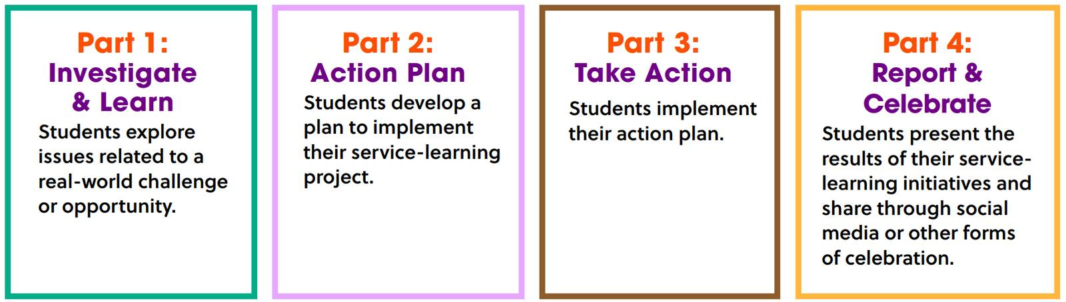


THE FOUR STEPS OF SERVICE LEARNING

Slide 5


Slide 6



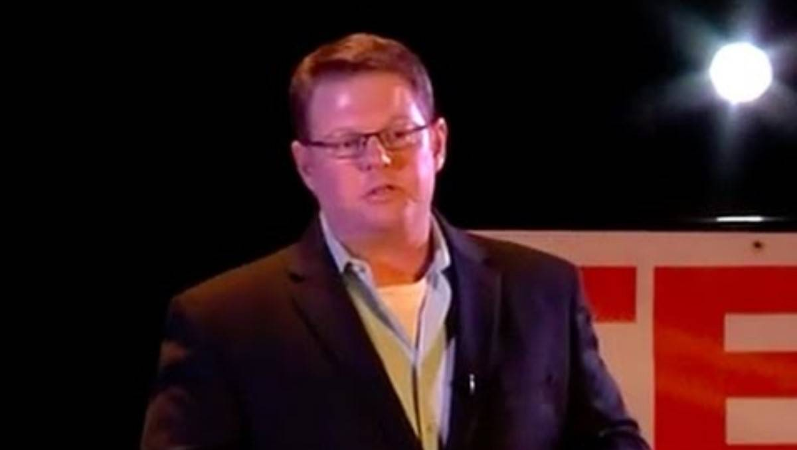
Be Selfish, Volunteer!
If video doesn’t work, click here!

Slide 7
GROUP WORK:
Discuss and write the answers to these questions:
  Why should volunteering be a selfish deed? Why is a selfish volunteer better?
  What makes an effective volunteer?
  Why is it important to effectively allocate time and talent when engaging in community service?
  Why should each person who volunteers align to the mission of the organization?
  What is intrinsic motivation vs. external motivation? Give examples of each.
  How does intrinsic motivation improve the community service experience for the organization and the individual?
  Why is there widespread decline in community service?
  What are the benefits of community service?

Slide 8
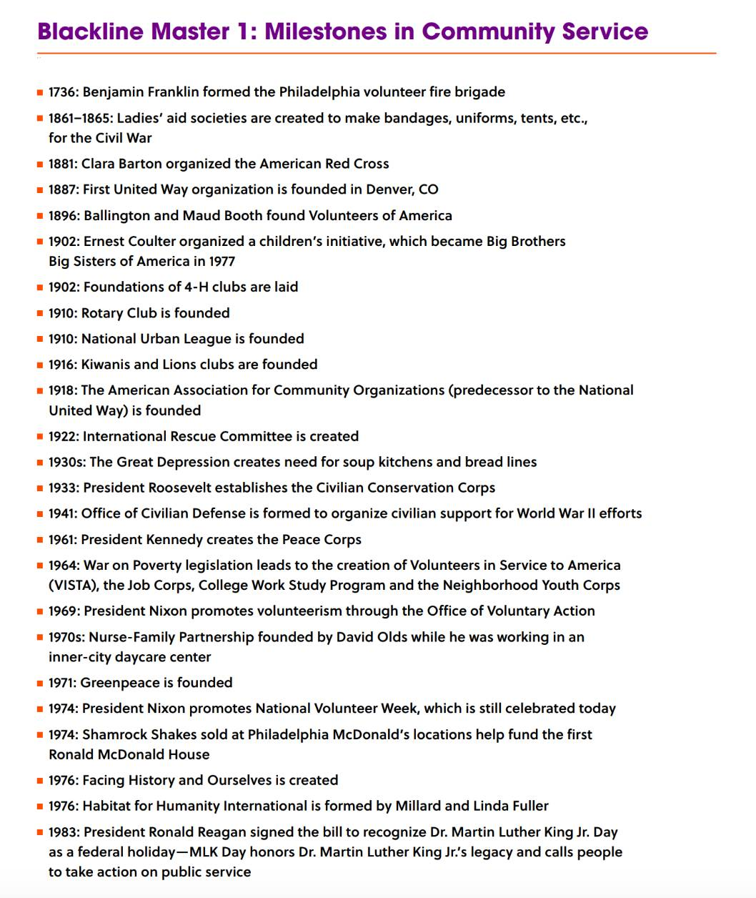
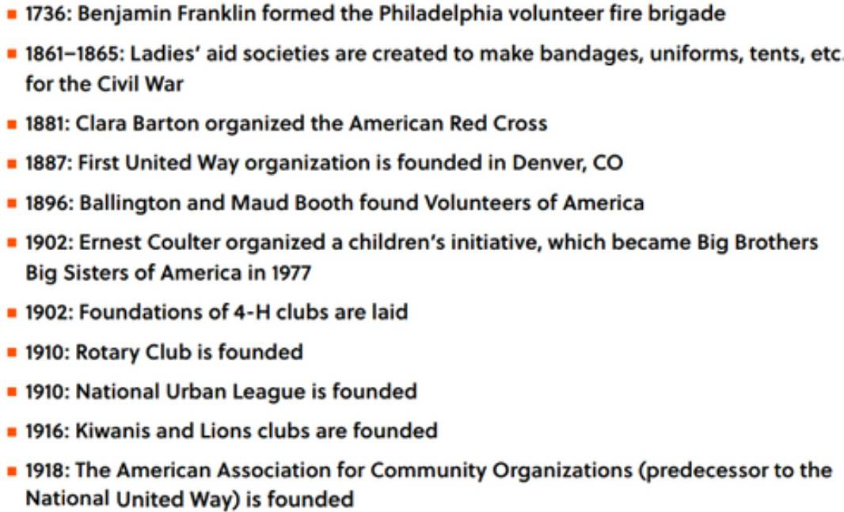
PARTNER WORK:
Select a milestone from the list

Slide 9
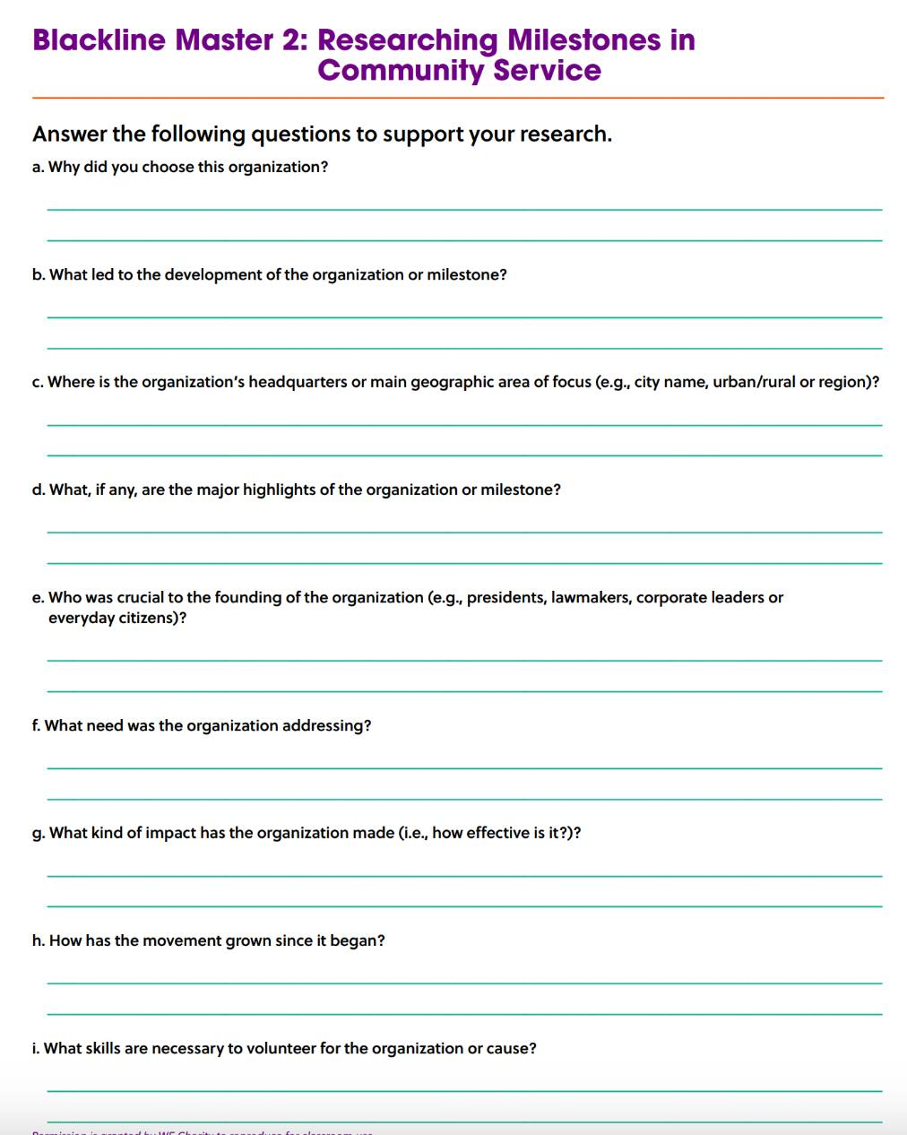
PARTNER WORK:
Answer as many questions as you can.

Slide 10
OPTIONAL ACTIVITY:
Create a presentation about your selected milestone.
Give a summary of the milestone including:
  when it began
  what impact it has made
  if it still is active

Slide 11
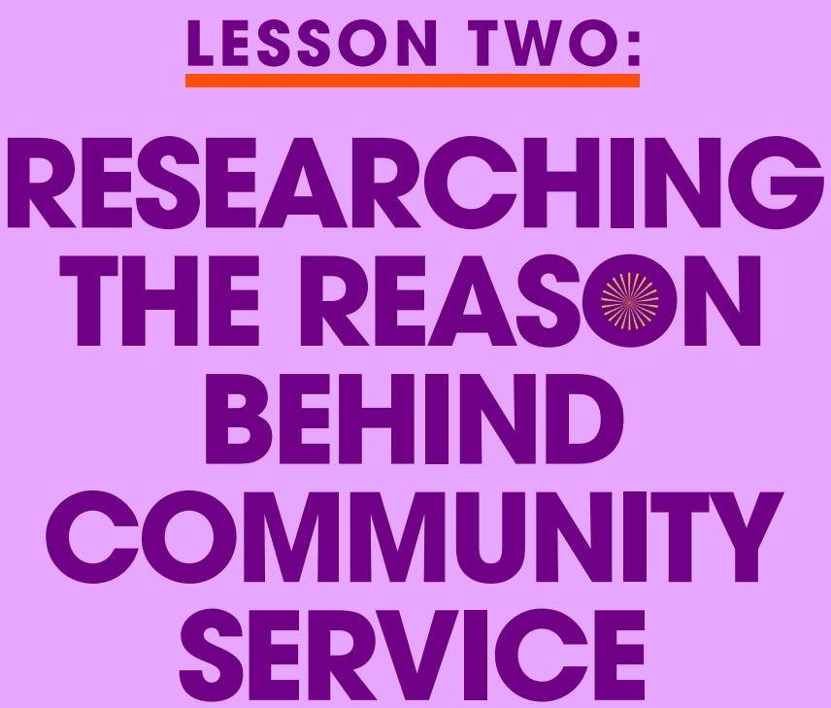

Slide 12
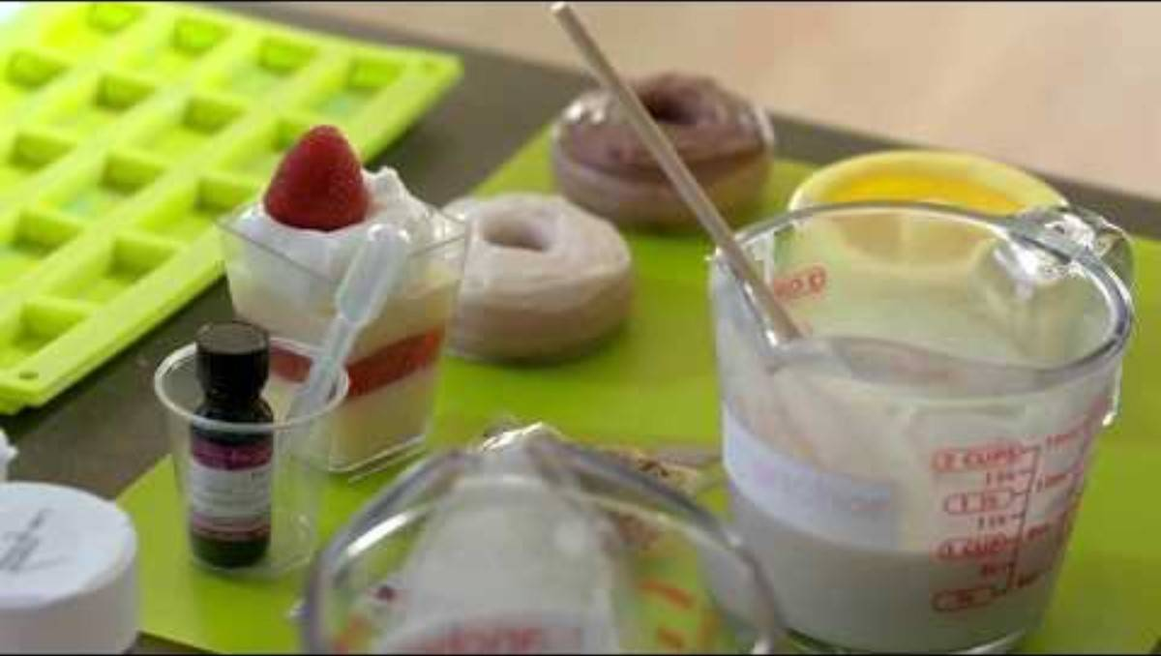
Suds for Change
If video doesn’t work, click here!

Slide 13
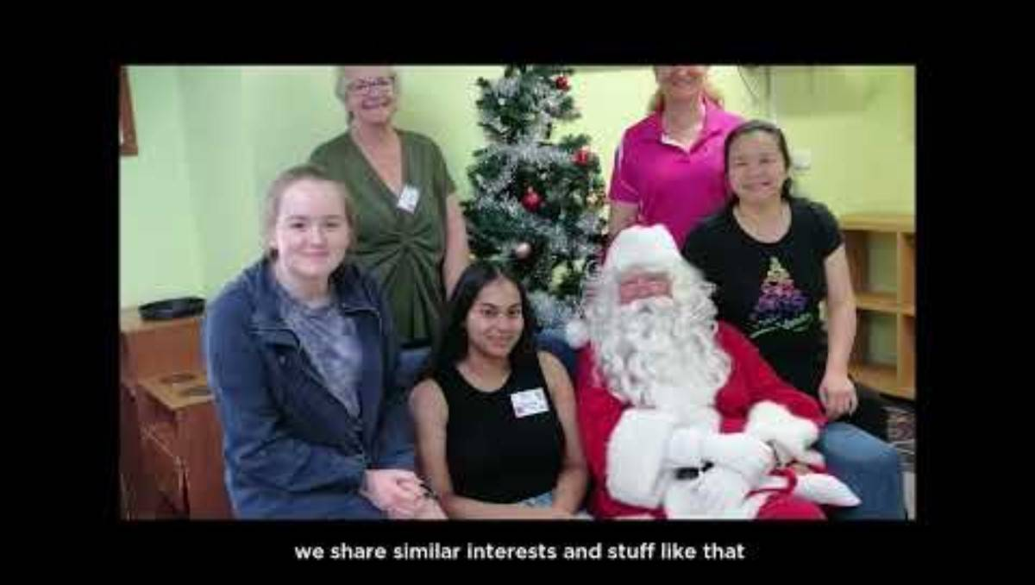
Dayna’s Volunteering Story
If video doesn’t work, click here!

Slide 14

DISCUSSION
Why did the people in the video want to volunteer and contribute their time and talent?
WRITE
If I were to engage in community service, what am I interested in dedicating my time and talent to? What am I passionate about?

Slide 15
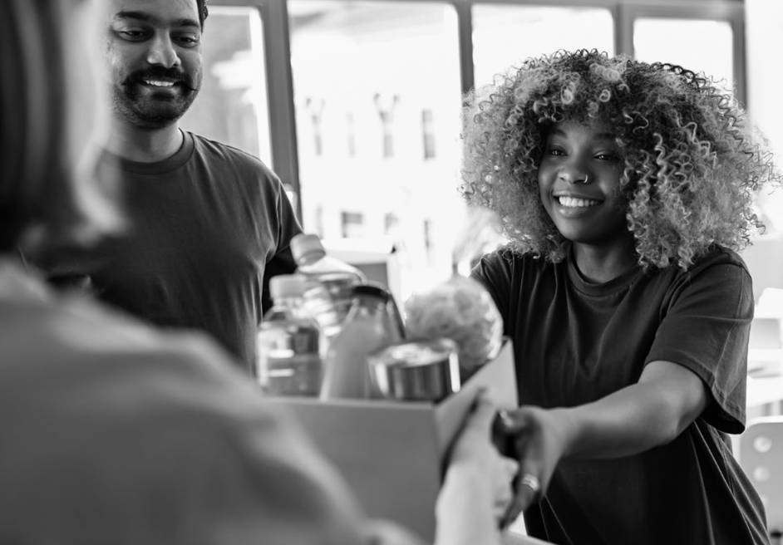
THINK...
Where would you volunteer your time and talents?
  Select an issue you are passionate about.
  Choose an organization we talked about or a new one.

Slide 16
Would You Rather:
Write down your answer to the following questions...
This will guide you in finding an organization that is important to you!

Slide 17
Would You Rather:
Local cause
or
National cause
Volunteer for a

Slide 18
Would You Rather:
Raise awareness
or
Raise funds

Slide 19
Would You Rather:
With an organization
or
Work in your community
work....

Slide 20
Would You Rather:
Time
or
Skills
Volunteer your...
(doing whatever is needed)
(offering a specific skill you posess?)

Slide 21
Would You Rather:
People
or
Animals
Work with...

Slide 22
Would You Rather:
Be a mentor
or
Paint the interior of a building

Slide 23
Would You Rather:
Do manual labor
or
Work with information

Slide 24
Would You Rather:
Work independently
or
Be part of a team

Slide 25

THINK-PAIR-SHARE
With a partner, write down as many ideas under each category. You have 3 minutes. Then, you will share with another partner group.
Demographic – type of people to work with or serve | Category – issue to work on | Skills – Manual labor, computer skills, gardening skills, etc
3-minute timer

Slide 26

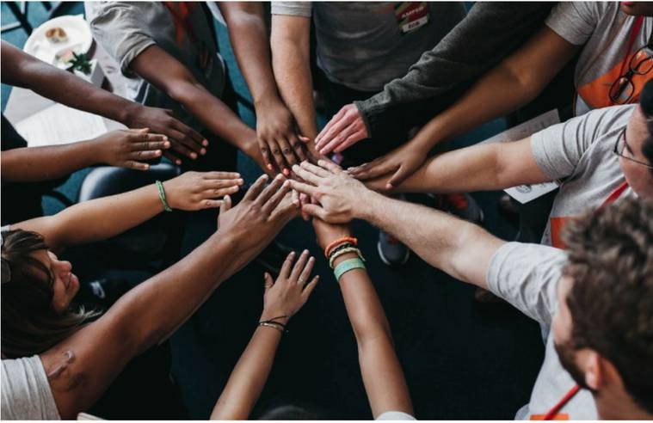
Forming Community Service Groups
With a partner or small group:
  think of a community service project
that you would like to engage in
  research the need and opportunity
  find out background information about the organization and things you need to know before beginning your service
  contact the organization to make sure you are able to
volunteer with them

Slide 27
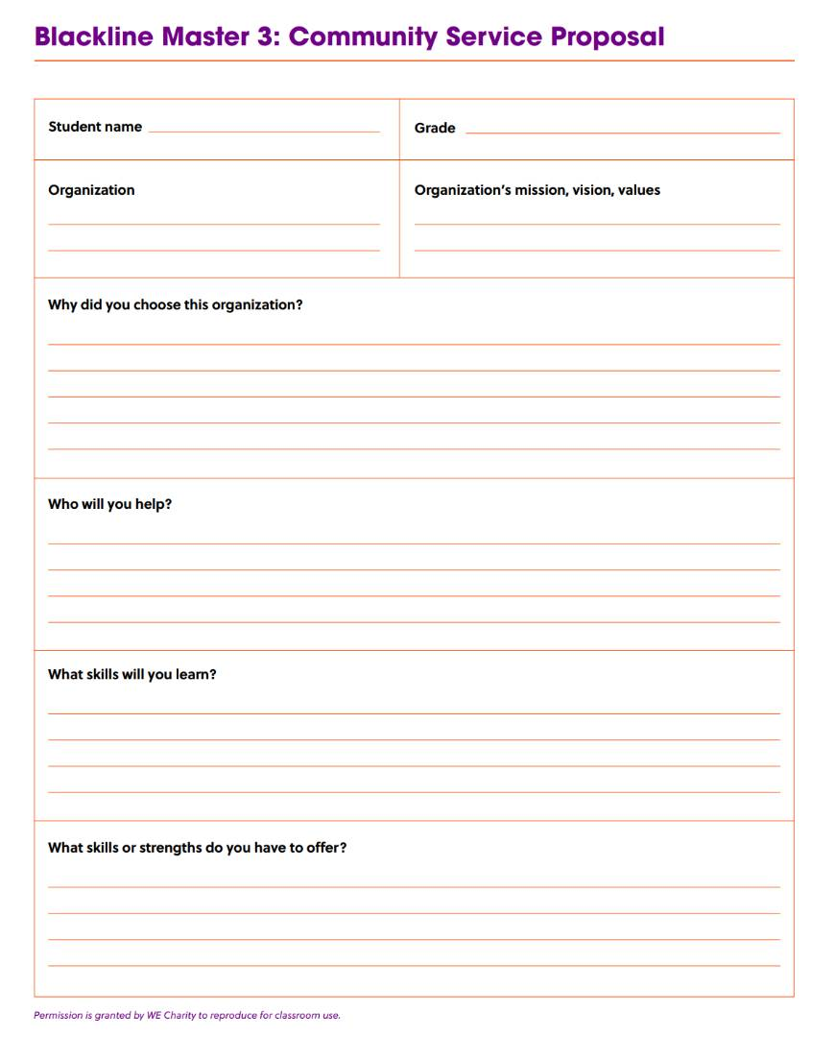
ACTION PLAN:
Research an Organization
Use Blackline Master 3
How does your idea align to the cause and your selected organization?
Research your organization and be ready to share with your classmates.

Slide 28
OPTIONAL ACTIVITY
In a group answer the following:
  What are my reasons for doing community service?
  What do I hope to gain from the community service experience?
Think about the new people you will meet, the skills you will develop, and the new experiences you will have.

Slide 29
OPTIONAL ACTIVITY
Think about the video Be Selfish,Volunteer!
Answer the following questions:
  Why is it important to volunteer your skills and knowledge?
  Why is motivation key to an effective volunteer experience?
  Why was Kevin White’s volunteer experience so successful?
  How did he measure success?
  How does volunteering affect the social, emotional, mental and physical well-being of the person who volunteers?
  What benefits can you gain by volunteering?

Slide 30
OPTIONAL ACTIVITY
Write or record a short reflection about what you hope to gain from your community service experience and what you are looking to achieve.
How will the experience change the way you think, feel or act?

Slide 31
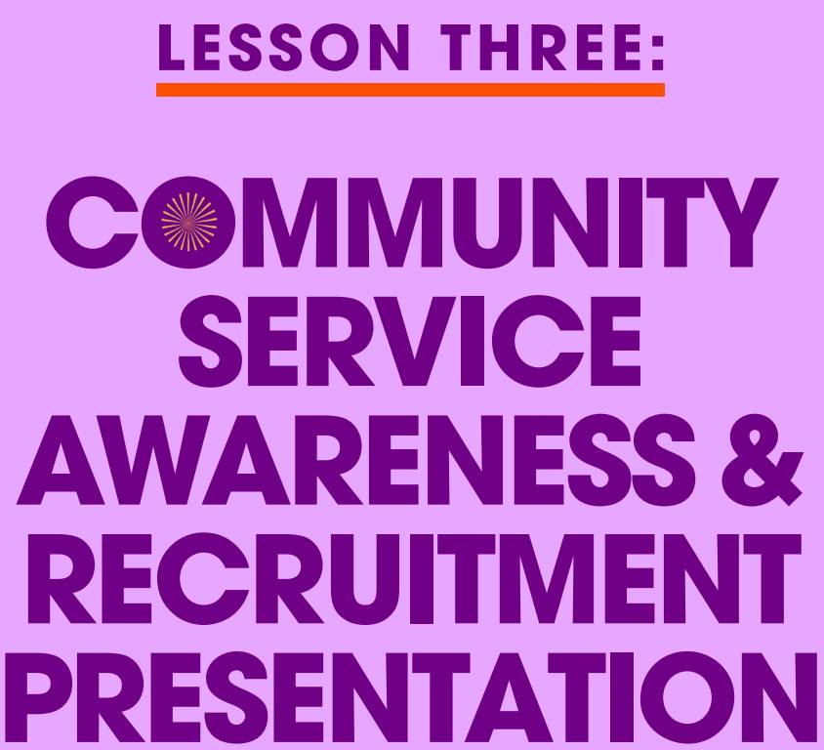

Slide 32
ACTION PLAN
CREATE A PERSUASIVE AND INFORMATIONAL PRESENTATION FOR COMMUNITY SERVICE AWARENESS AND RECRUITMENT.
Include:
  details about the cause you are passionate about and the need for community service in relation to that cause
  an explanation of why someone should volunteer with you

Slide 33

ACTION PLAN
BRAINSTORM
What are some other details that should be included in the presentation?

Slide 34
REFLECTION
  What was the most rewarding experience from creating the presentation and/or implementing this campaign? Explain why it was rewarding.
  What was the most challenging part of the experience?
  Did you get anyone signing up to volunteer with you?
  What could you do better next time?
  What kinds of connections did you make with the audience?
  What skills did you use in preparing your presentation and sharing it?
  Did you learn anything from the audience or volunteers?
  What advice would you give to someone who is starting a project?

Slide 35
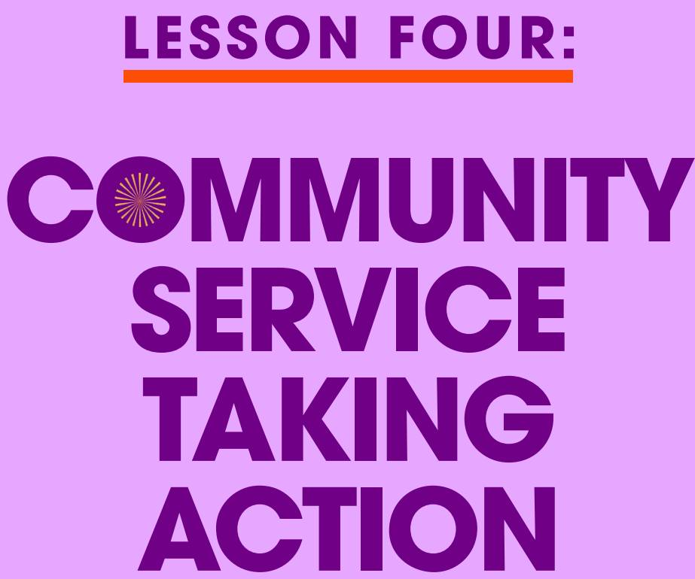

Slide 36
ACTION PLANNING REFLECTION
GROUP DISCUSSION:
  How can an individual be an effective volunteer?
  Why is it important to volunteer in your school or community?
  How does participating in community service assist in the development of your local community?
  Why is it important to research and learn about the organization you are contributing your time and skills to?

Slide 37

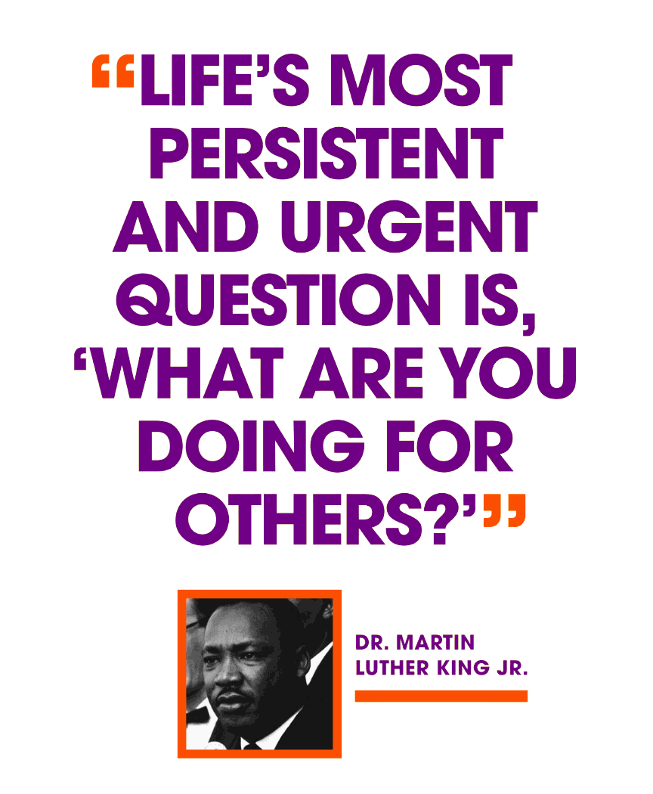
  Founded by Martin Luther King III, Arndrea Waters King and Yolanda Renee King
  Goal: 100 million hours of service by the 100th anniversary of Dr. Martin Luther King Jr.’s birth in January 2029
  5-year program with students across America
  Positive impacts on communities
Through a service-learning project, you can make a positive impact on the world around you.

Slide 38

  What are the goals of the
Realize the Dream initiative?
  Why is community service important?
  What impact can your participation in Realize the Dream have on your local, national or global communities?

Slide 39
ACTION PLANNING REFLECTION
DISCUSS AND SHARE:
What was the impact of your community service awareness and recruitment presentation?
Was the presentation an impactful experience to those who attended?
Were they more likely to volunteer their time and skills to the suggested organization?
Are there other actions that you can participate in?

Slide 40
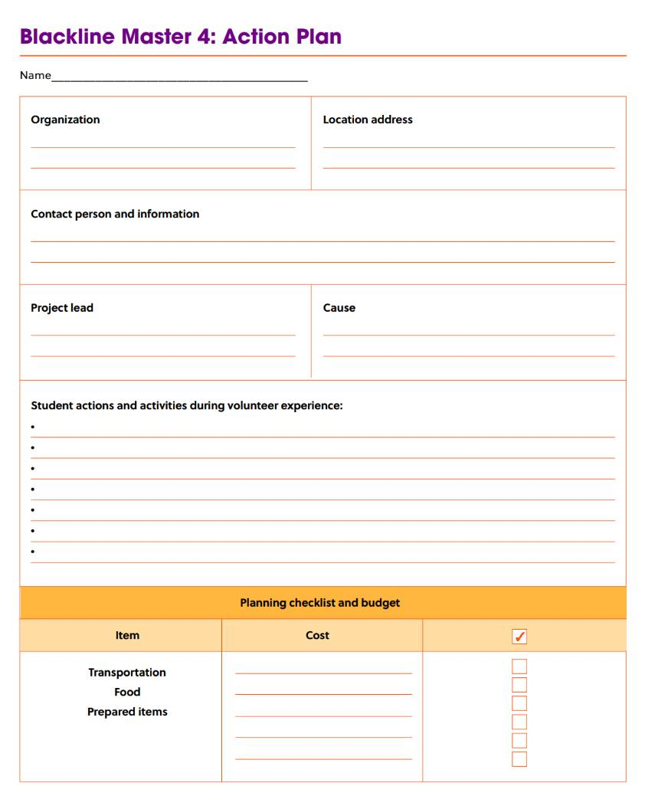
EXTENSION ACTIVITY
  Think about how you can continue to contribute to the Realize the Dream initiative.
  What are some ways or organizations where you can volunteer?
  Use Blackline master 4 to help you organize your actions.
Contact the organization to schedule a time and place to volunteer.
Record thoughts of students throughout the activity
Make a schedule of time to
work on the activity.
Take pictures documenting the activity.

Slide 41
REPORT AND CELEBRATE
Once you complete an act of service :
  Report your hours of community service to your teacher
  Create a presentation with video and pictures to show the world your impact with Realize the Dream initiative. Include tips and tricks to help others be responsible users with social media.
  Post the link of your presentation on social media using the hashtag #RealizetheDream
  See if the presentation can be displayed in the library or at an assembly to raise further awareness about the action and the issue.

Slide 42
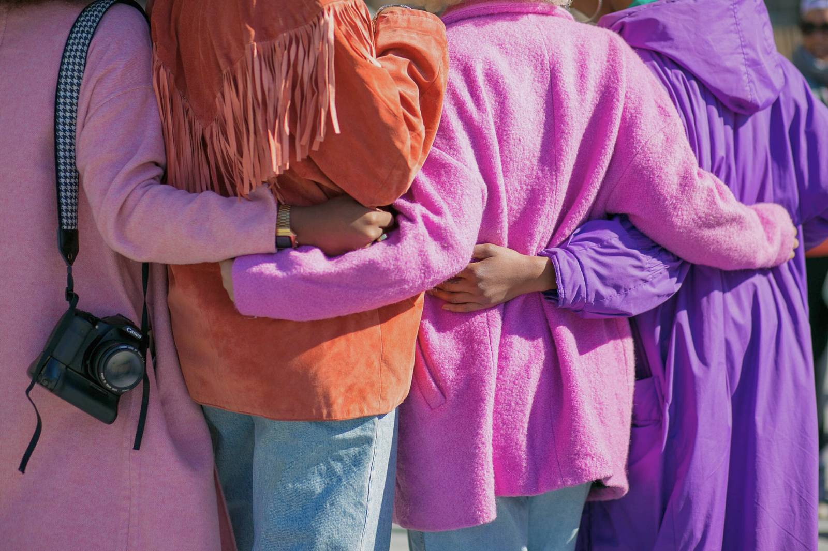


Thank you!

