Slide 1

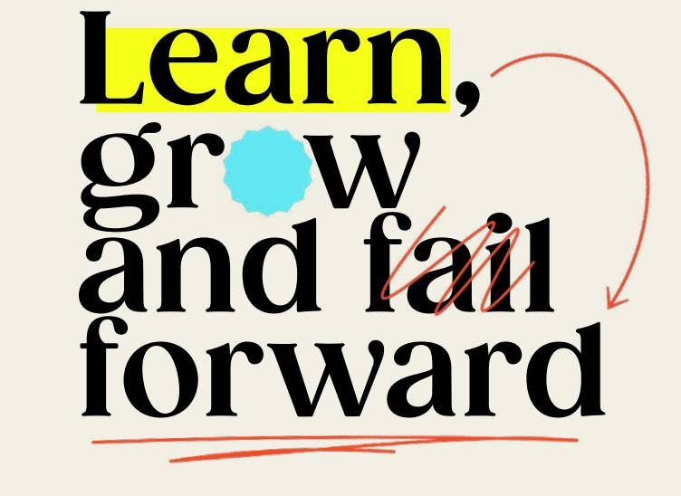
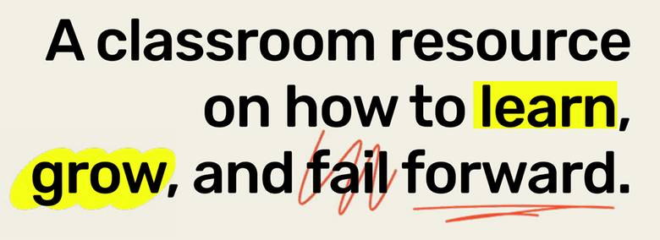

Notes:
1

Slide 2



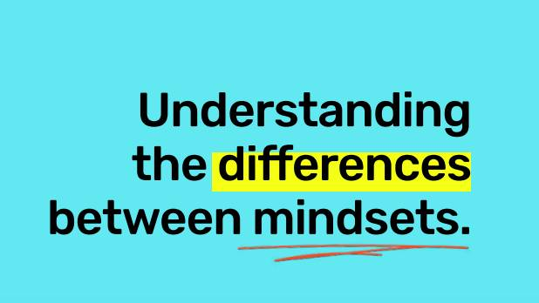
LESSON ONE

Slide 3
Learning Goals:
    Understand and articulate the differences between
    a “growth” and “fixed” mindset
    Reflect on how failing is an opportunity to grow and learn
    Identify times in your life where you failed and
    how this became an opportunity to learn

Slide 4


Teamwork (option 1)
As you can see, there are balloons at the ceiling of the classroom!
Work with your team to strategies how you can get a balloon down while keeping your feet on the ground at all times.
You can only use the tools provided to you and you must follow classroom safety rules
Once you come up with a strategy, test it out. If it doesn’t work, go back to the drawing board together and try again!

Slide 5
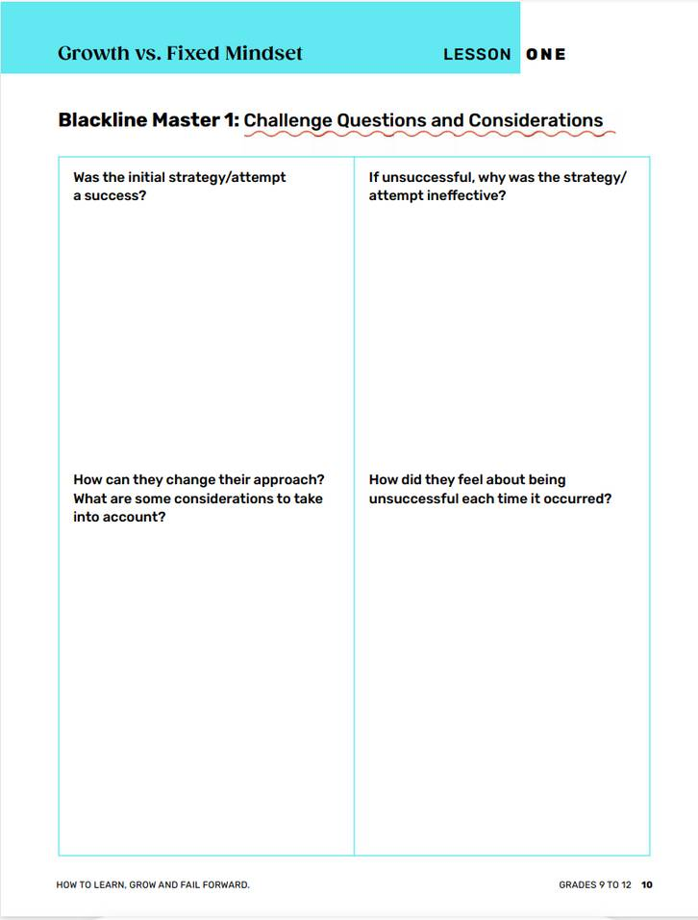
How’d it Go?
    Was your strategy a success? Were you able to retrieve the balloon?
    If you were unsuccessful, why was the strategy ineffective?
    How can you change your approach?
    How did you feel about being unsuccessful?

Slide 6
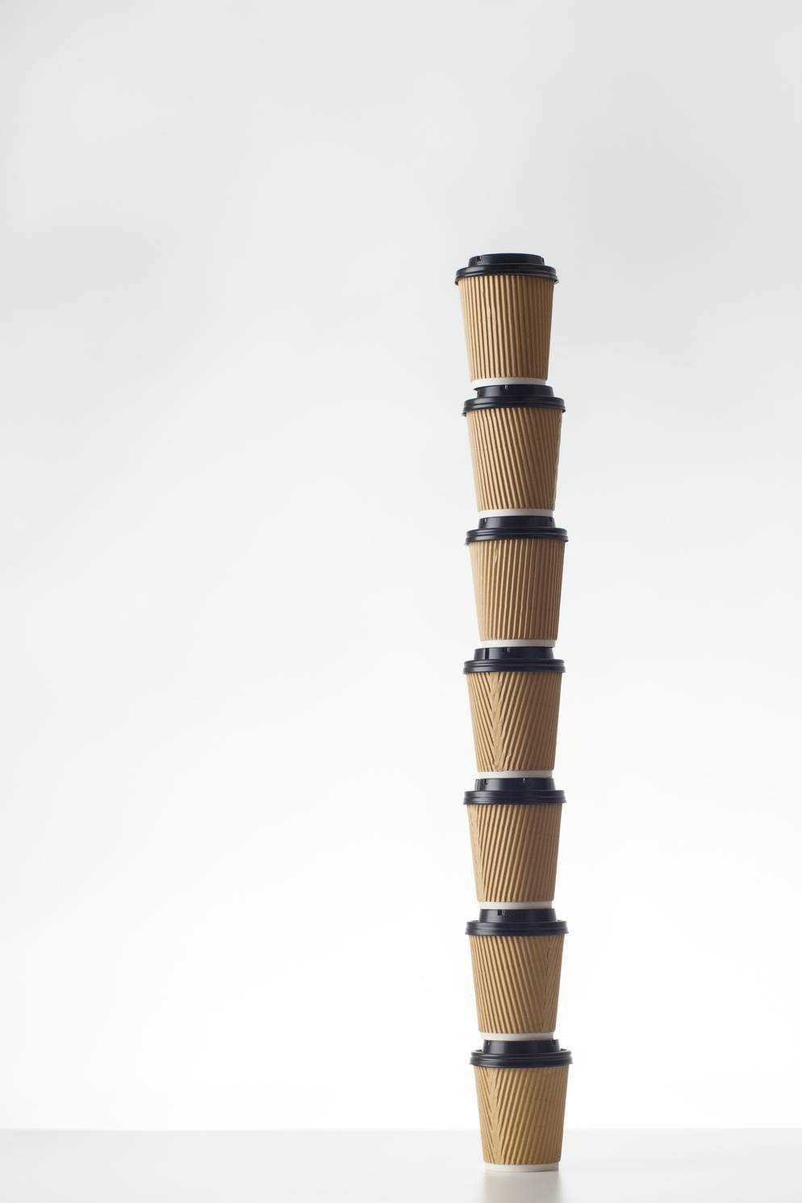
Teamwork
With the provided materials, you and your team will try to build the highest tower
Once you’ve built your tower as high as possible, come up with an estimate together of how tall it is
You have 4 minutes to complete this challenge start to finish
The group with the tallest tower AND has the closest estimate is the winner and shall receive bragging rights!
4 minute timer

Slide 7
How’d it Go?
    How successful was your tower? Was it as tall as you could make it?
    Did you estimate the correct height?
    What will you change when you have another attempt to build the tower?
    What considerations are you thinking about?
    How will you change your approach and method of execution?

Slide 8

Think-Pair-Share
    How does continuous failure feel?
    How can you change your perspective to consider failure, as either a teachable moment or an opportunity to try again?
    Why is it important to learn from potential failures?

Slide 9


Learning to do something is a process. You have to be open to trying, even if you fail.

Slide 10
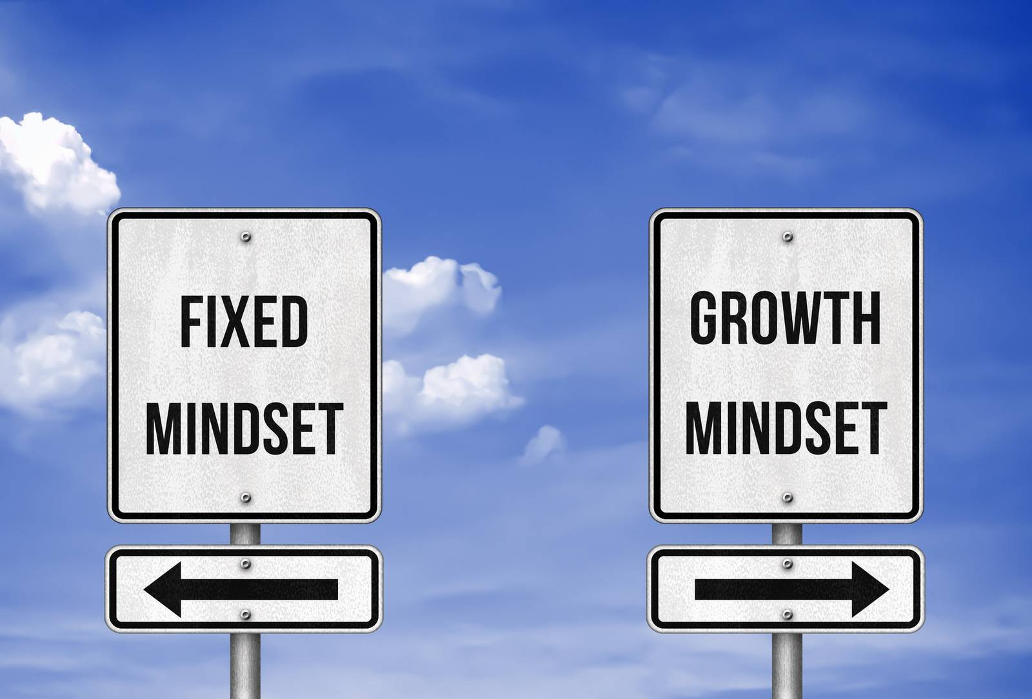
What is a mindset?

Slide 11
Mindset
a set of beliefs that shape how you make sense of the world and yourself
The mind:
    can change the way you look, move and think about the world around you
    influences how you think, feel and behave

Slide 12


What you believe about yourself impacts your success and failure.

Slide 13
Write one or two sentences describing each word on a sticky note and put it on the poster.
Fixed Mindset
Growth Mindset

Slide 14

Think about these questions as you watch the following video:
    How do you change your mindset from fixed to growth?
    How does having a growth mindset allow for continual development?
    How does embracing challenges enable learning?
    Is failure important?
    How does failure lead to learning?

Slide 15
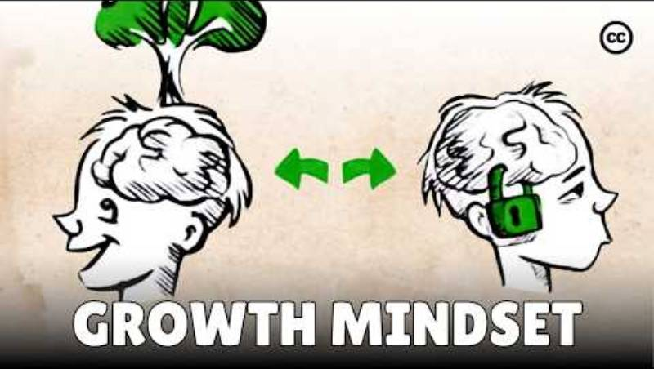

Slide 16
Together, let’s come up with a definition for each.
Fixed Mindset
Growth Mindset

Slide 17

Think about these questions as you watch the following video:
    Why is ‘not yet’ significant for growth?
    How is a growth mindset and fixed mindset described?
    How does one engage with error?
    How can you use words of praise to change your mindset?

Slide 18
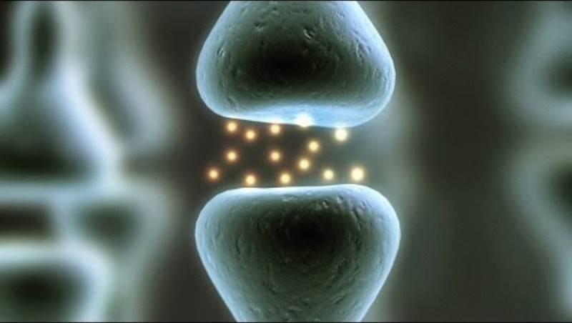

Slide 19
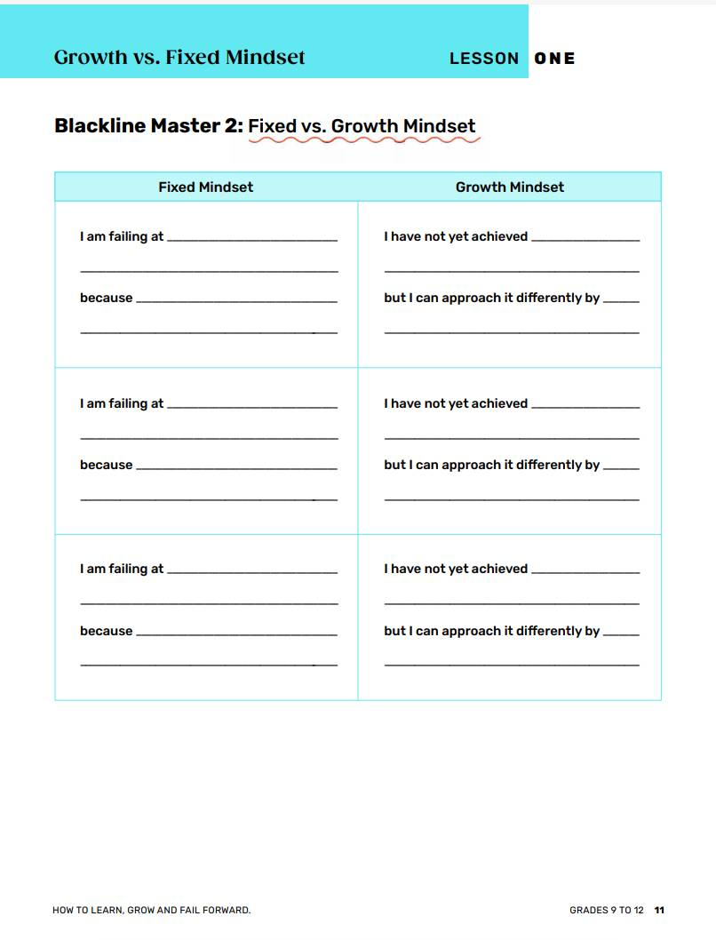
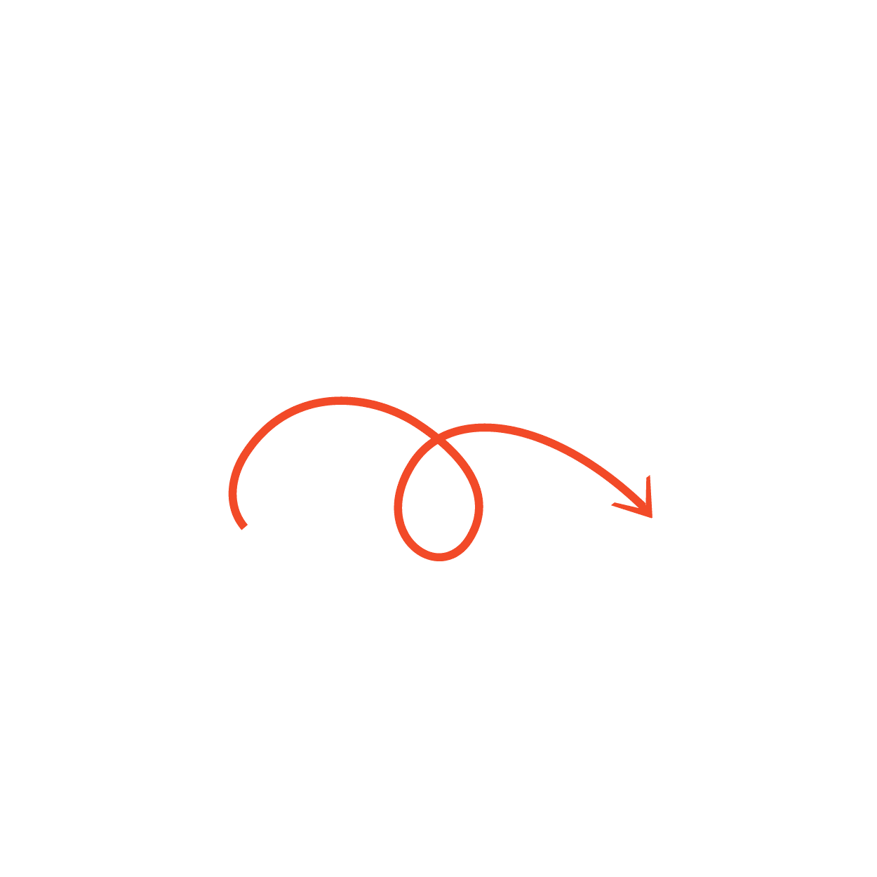

Shift your thinking!
Failure is an opportunity to grow
Use your errors to continue to grow and learn!

Slide 20
Thinking About a Growth Mindset
    Why is a growth mindset a valuable skill set?
    How can having a fixed mindset hinder a person’s success?

Slide 21


Canadian Connection
Connor Bedard, one of Canada’s youngest hockey superstars, faced enormous pressure and high expectations long before joining the NHL. Despite being told he was too small and not ready, he stayed focused, worked tirelessly, and turned every setback into motivation to improve.
Now a leader for the Chicago Blackhawks and a role model for young athletes, he shows that perseverance and self-belief matter as much as talent.
“You learn more from a bad game than a perfect one.”

Slide 22


“We learn most through trial, error, and the courage to keep trying.”- David Suzuki

Slide 23
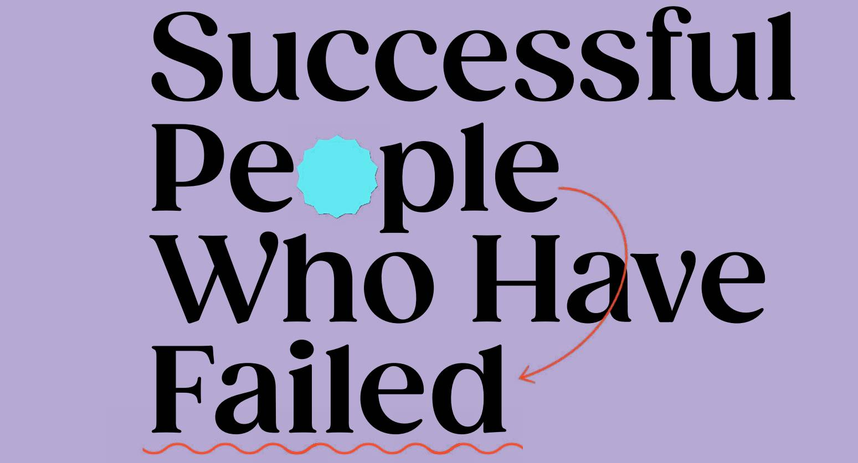
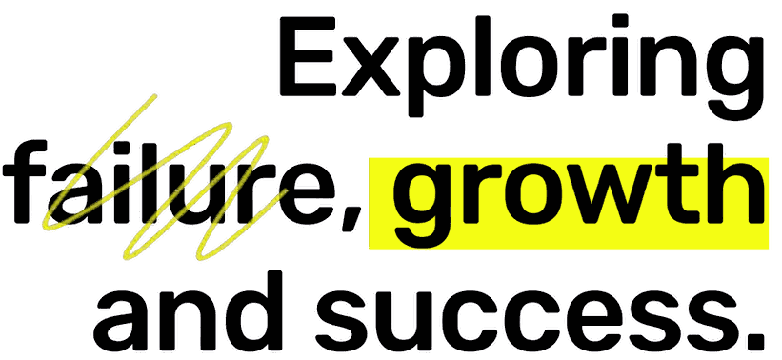
LESSON TWO

Slide 24
Learning Goals:
    Understand that failure is not a negative, but an opportunity to learn and grow.
    Explore famous personalities whose failures have led to successes and see that their failure was an opportunity to learn.
    Reflect on your own failures and evaluate how
    those can be created into growth opportunities.

Slide 25
Things I Have Failed At
Write down tasks or goals
that you set for yourself over the past year,
but have failed at.

Slide 26
Failure may be tied to:
Self-worth
Self-esteem
Self-acceptance
internal sense of
being good enough and worthy of loving and belonging
confidence in one’s own worth, abilities or morals -
beliefs about oneself
embracing every part of yourself - all your attributes positive
or negative
The expectation we fail to meet may be the one we created in our own mind.

Slide 27
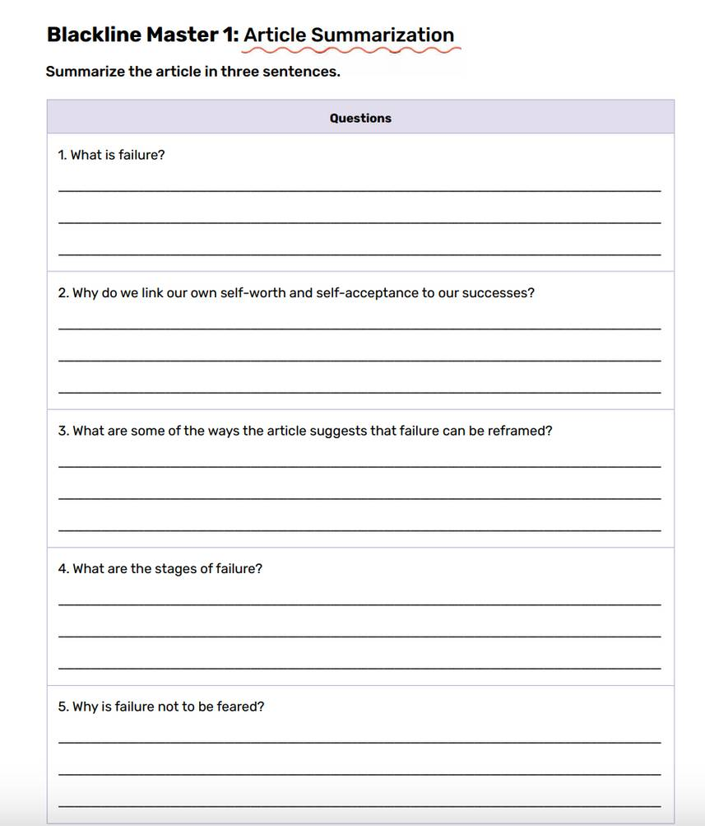


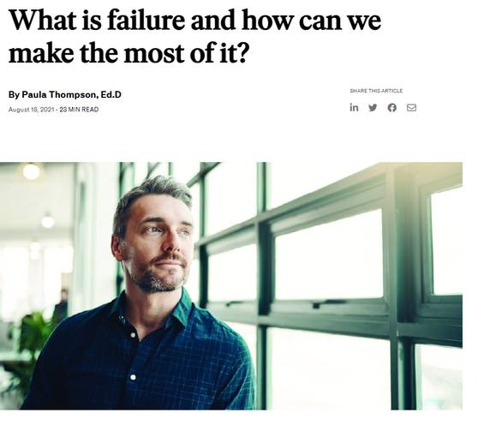
What is Failure and How Can We Make the Most of It?
Read this article and then summarize it on the sheet.

Slide 28
Turn and Talk
Why do we connect self-worth, self-esteem and
self-acceptance to success?
Why does failing feel difficult?
How can success after failure lead to personal growth?

Slide 29
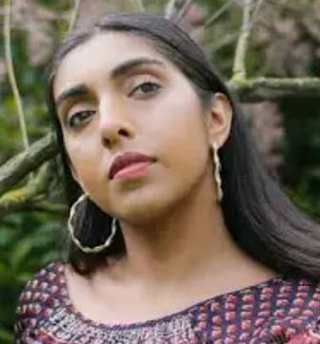

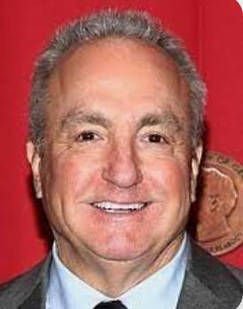

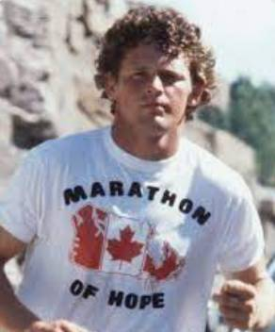

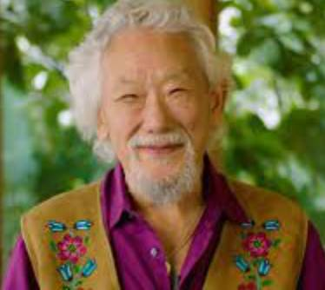
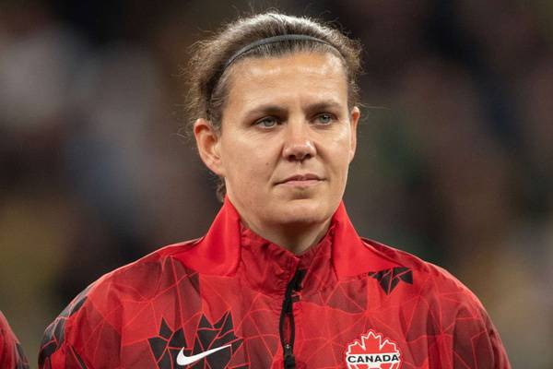
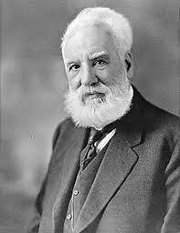
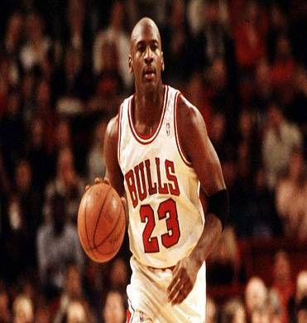
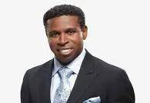





What do each of these individuals have in common?
Simu Liu
Alessia Cara
Terry Fox
Christine Sinclair
Michael Jordan
Lady Gaga
Dwayne “The Rock” Johnson
Simone Biles

Slide 30
What do each of these individuals have in common?
Simu Liu
Alessia Cara
Terry Fox
Christine Sinclair
Michael Jordan
Lady Gaga
Dwayne “The Rock” Johnson
Simone Biles

Slide 31
Each of them have had some form of failure in their lives that they have had to work to overcome.
Simu Liu
Alessia Cara
Terry Fox
Christine Sinclair
Michael Jordan
Lady Gaga
Dwayne “The Rock” Johnson
Simone Biles

Slide 32
Time to Create!!!
Create a 3-minute presentation highlighting the stories of the famous person you researched.
    What is this person famous for achieving?
    What is this person’s story about achieving fame?
    What failures did this person encounter in their life?
    How did they overcome this failure?
    Why do you think this failure led to their eventual success?
    Put yourself in this person’s shoes: what would you have done when you encountered failure?
    What advice would you give to this person when an inevitable failure occurred?

Slide 33
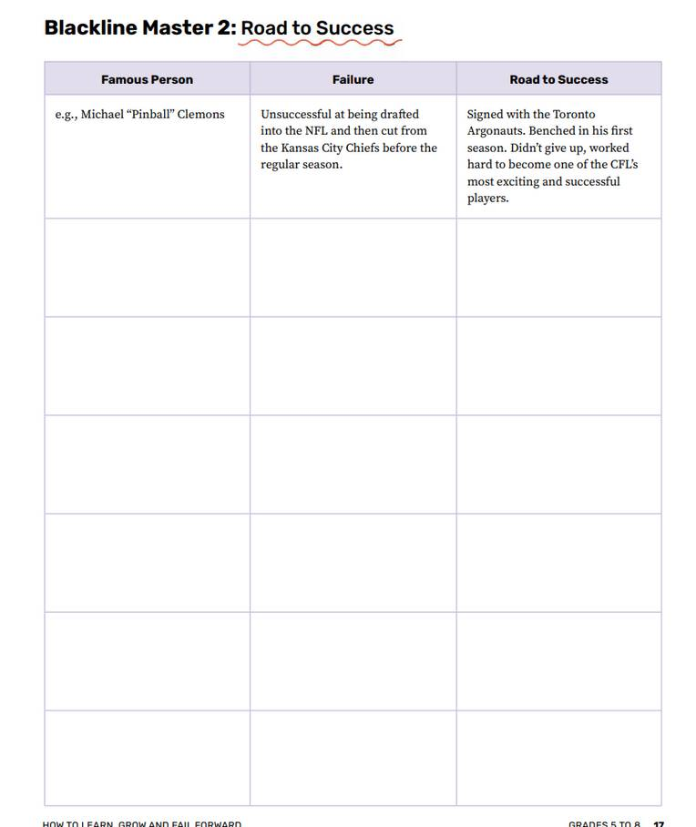
During the Presentations
Take notes and fill in the table with the failure the person encountered
and how they overcame it.
After the presentations, add yourself to the table and reflect on your own personal failures.

Slide 34
Self Reflection
How can you grow your failures into success stories?
Remember -
NO FAILURE IS TOO BIG TO GROW FROM

Slide 35

Canadian Connection
Autumn Peltier, a young Indigenous water-rights advocate from Wiikwemkoong First Nation, faced criticism and doubt but used her voice to inspire global action for clean water.
“One day I will be an ancestor, and I want my descendants to know I used my voice so they could have clean water.” – Autumn Peltier

Slide 36


“There is no failure except in no longer trying.”
- Elbert Hubbard

Slide 37

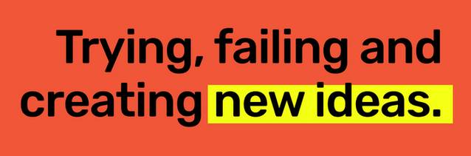
LESSON THREE

Slide 38
Learning Goals:
    Understand the concept of innovative thinking
    Apply the agile methodology to games to demonstrate learning
    Recognize that failure leads to growth, which is fostered in the agile way of thinking

Slide 39
Game Time
The goal of the game is to pass the ball around the table.
Each person needs to touch the ball once.
When the ball makes it all the way around the table, the group gets one point.
There are a few rules
IT'S FINE TO CELEBRATE SUCCESS, BUT IT IS MORE IMPORTANT TO HEED THE LESSONS OF FAILURE."
-Bill Gates

Slide 40

Game Time
The game will be played in 3-minute sprints -
    1st min. - write down how many points you
    expect to earn and plan your approach.
    2nd min. - pass the ball around the table
    3rd min. - write down the number of points you earned
    as well as what you learned
You will play 3 rounds
1 minute timer

Slide 41
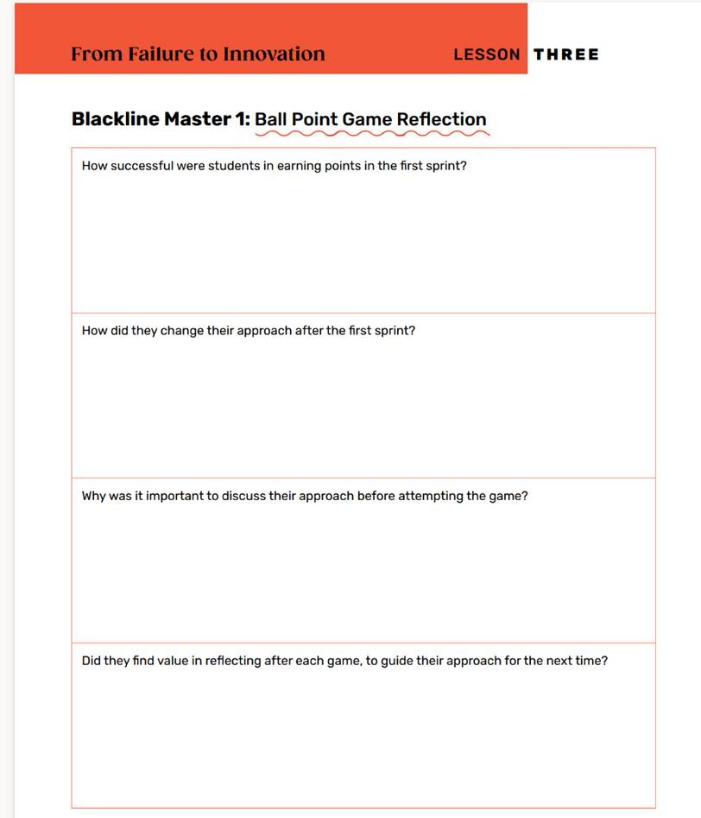
Game Reflection
Reflect on the process you used during each sprint.

Slide 42
The Agile Approach
    able to change your strategy quickly to optimize the way you played the game, for an improved outcome
    a thought process that involves understanding, collaborating, learning and staying flexible to achieve high-performing results
    helps adapt to change, rather than struggle around it
    focuses on learning from failures and working to make the end goal better from those learning

Slide 43


Growth Mindset
Think about these questions as you watch the following video:
    Why it’s important to continuously learn from the mistakes that we make?
    How can the shift in our thinking lead towards successful outcomes?

Slide 44


Slide 45
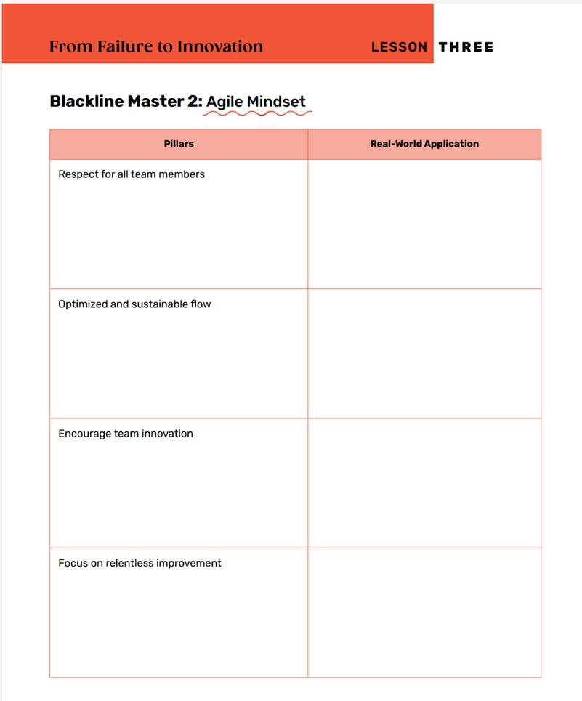
4 Pillars of the Agile Mindset
RESPECT FOR ALL TEAM MEMBERS
OPTIMIZED AND SUSTAINABLE FLOW
ENCOURAGE TEAM INNOVATION
FOCUS ON RELENTLESS IMPROVEMENT
How do these pillars relate to the work you do in the classroom?
How can they be applied to your daily life?
Notes:
1.7.2013
Review this lesson
https://www.atlassian.com/agile/advantage/agile-mindset
‹#›

Slide 46
Game Time
The goal of the game is to create the most effective paper airplanes.
Build as many as possible - but each member of your team can only make one-fold at a time before passing the paper to the next person on the team.
Your team only gets a point if the plane can fly a minimum distance determined by your team.
There are a few rules

Slide 47
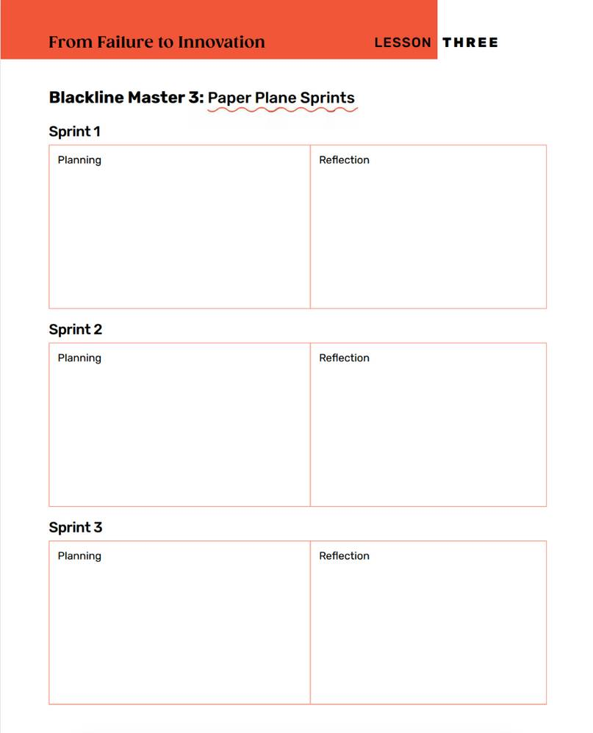
Game Time
The game is divided into 9-minute sprints:
3 min. for planning - estimate how many planes you plan on flying
3 min. for building and testing - create your planes
3 min. to reflect - review if you were successful in creating the number of planes you estimated. What would you do differently?

Slide 48

Reflection
Post your ideas on the board
How effective is having an agile approach in quickly developing ideas?

Slide 49
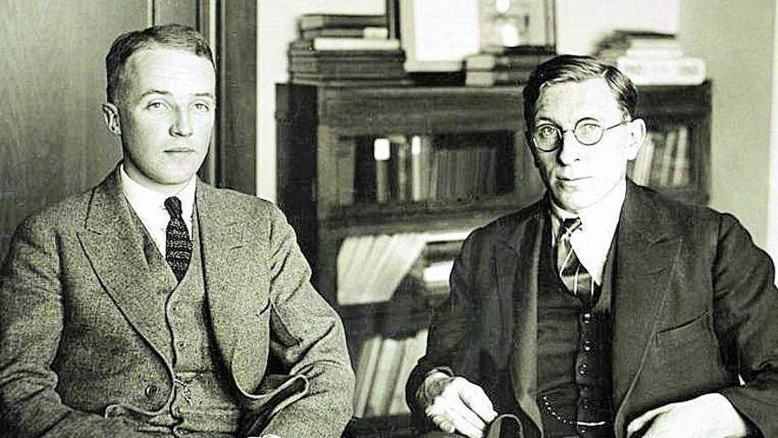
Canadian Connection
Dr. Frederick Banting and Charles Best, two Canadian scientists at the University of Toronto, set out in the early 1920s to find a treatment for diabetes — a disease that was once deadly. In July 1921, their persistence finally paid off with the discovery of insulin, a breakthrough that has saved millions of lives around the world.

Slide 50


“Success is not final; failure is not fatal: It is the courage to continue that counts.”
- Winston Churchill

Slide 51


LESSON FOUR

Slide 52
Learning Goals:
    Identify a current issue/challenge within the school environment
    Create a solution for the issue/challenge
    Implement the solution
    Reflect on your failure during the implementation

Slide 53
Think About Our School Environment
What are some issues/challenges that we face?
    How do we ensure that each student feels a sense of acceptance and belonging?
    How do we ensure that each student has access to all the resources they need to be successful? (books, supplies, teachers, methods of research)
    How can we create an environment that meets the parameters of inclusive design, which creates an accessible environment for all students?
Notes:
1.7.2013
refer to teacher's manual for other ideas besides doing research
‹#›

Slide 54
The Challenge
CREATING AN ACTION PLAN
You will choose one issue/challenge currently present within your school and do your best to solve it.
Remember....it may be hard, you may be unsuccessful the first few times, but you will learn from each failure.
Notes:
1.7.2013
see teachers manual page 28 for alternative ideas or projects
‹#›

Slide 55
Research Process Overview
Once you have selected your issue/challenge:
Create some NEED TO KNOW questions -
    What do you NEED TO KNOW to understand the issue indepth?
    What research do you NEED TO CONDUCT to learn more?
Try to come up with at least 5 questions.

Slide 56
Conducting Research
There are many sources you can use to help you:
    Books
    Internet
    Talking to people - both students and teachers
    Contacting experts in the field

Slide 57

Generating Ideas
You will have 8 minutes to
generate as many solutions to your issues as possible.
Think of BIG ideas!
Each person will put their
ideas on a different
sticky note.
8 minute timer

Slide 58
Categorize Your Ideas
    Organize the sticky notes based on similarities.
    Come up with categories of BIG ideas based on how your sticky notes fit together.
    Vote on 1 or 2 that your group would like to develop
    as a solution to address the issue identified.
    You can add more ideas as you develop your solution.

Slide 59
Research Process
Creating an Outline:
    Outline a step-by step process of how you will solve the issue/challenge
    What obstacles do you think you might encounter?
Remember - you may fail the first few times you try to solve your problem,
but reflect and adapt based on what you learned.

Slide 60
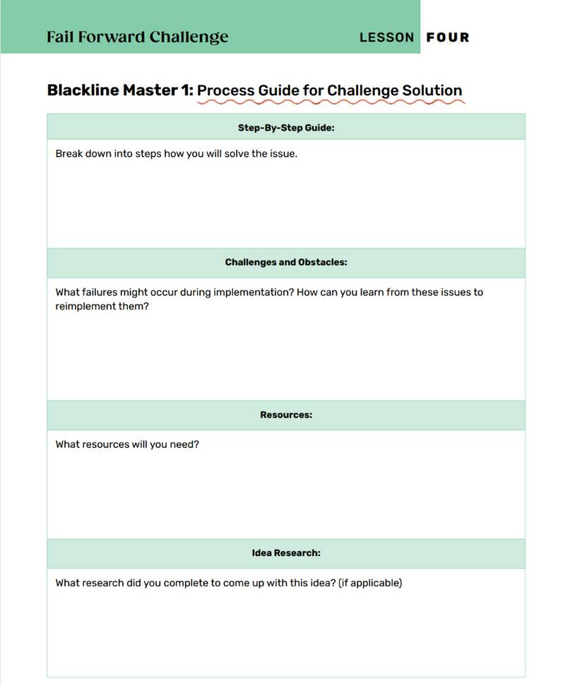
Make a Plan
Making it work
Can your solution be implemented in school? Is it realistic?

Slide 61
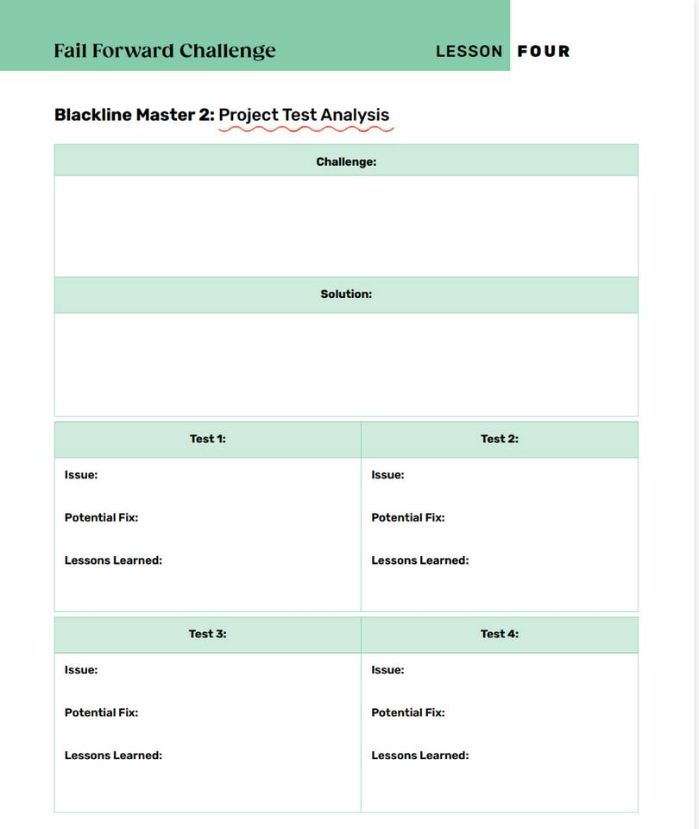
Let’s Do It!
Making it work
Are there any more resources you need? Is the result what you wanted?

Slide 62
Presenting Your Research
You will create a 5-minute presentation about your project. You can use any method that your group agrees on:
    Microsoft Power Point , Sway or Google Slides
    Prezi
    Poster
    Tik Tok or QuickTime video
    Blog Post
    Play, Readers Theatre or Mock Debate

Slide 63
What to Include in Your Presentation
What was the issue/challenge your group decided to solve?
What solution was created? Explain your step-by-step process.
What obstacles came up during the solution?
Did you expect these?
What did you learn each time you tried to solve the issue?
Did you update your initial solution idea after learning from each attempt?
Did the solution work the first time?
How does failing create an opportunity to grow?

Slide 64
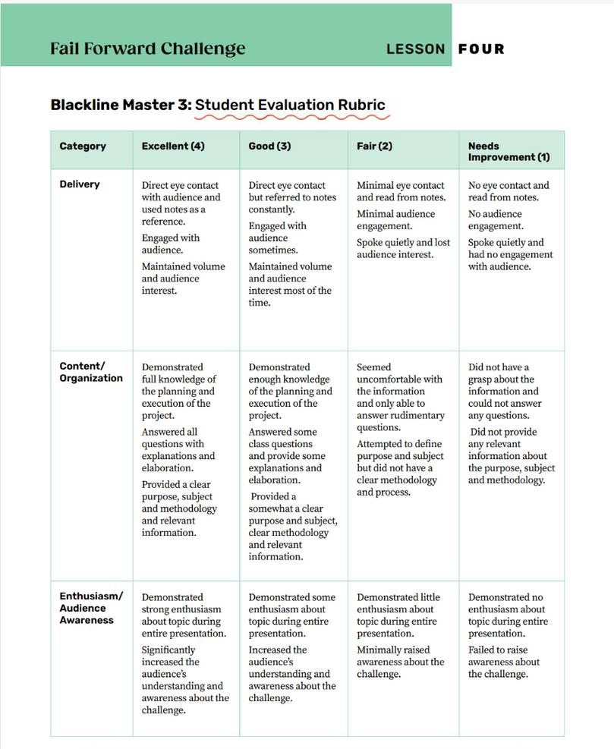
The Rubric
What makes a successful presentation:
    Delivery
    Content/organization
    Enthusiasm/audience awareness

Slide 65
Learning From Others
What to listen for:
As you listen to the other groups present:
What did each group learn from the failure of their initial attempt?

Slide 66
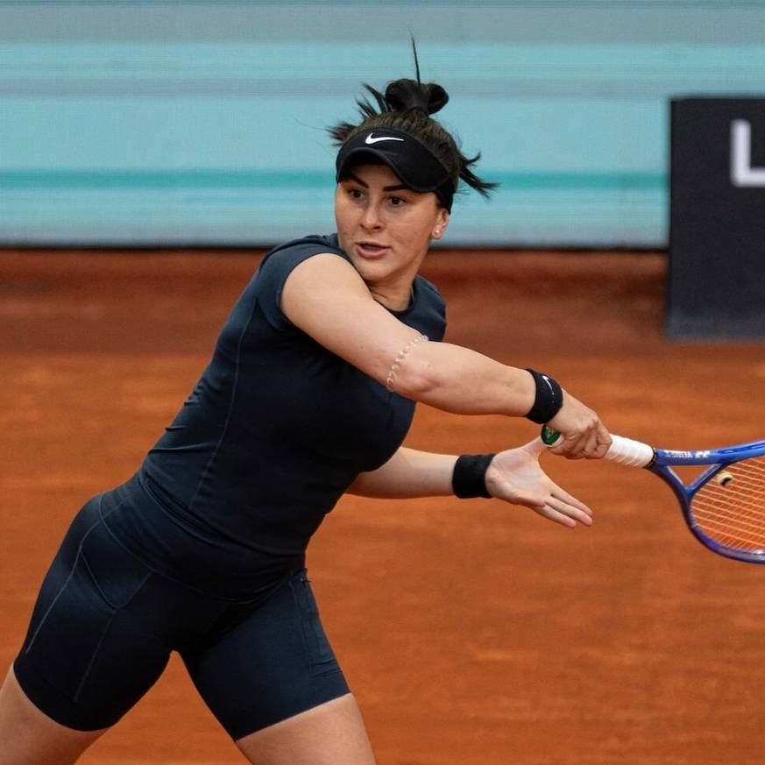
Canadian Connection
Bianca Andreescu, one of Canada’s top tennis players, rose to fame after winning the U.S. Open in 2019 — but her journey hasn’t been easy. After her historic win, she faced multiple injuries and long breaks from competition that tested her confidence and patience. Bianca often speaks about how setbacks helped her grow, showing young people that success is not about avoiding failure, but learning from it.
“Every setback is a setup for a comeback”

Slide 67


“You grow the most in the uncomfortable places — the moments when things don’t go as planned.”- Sandra Oh

Slide 68

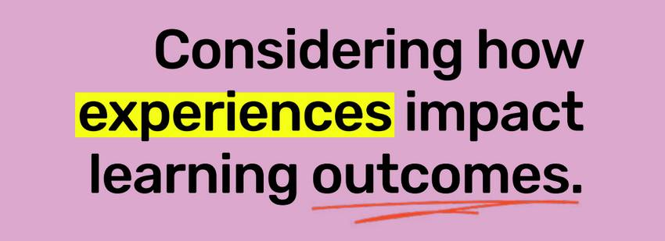
LESSON FIVE

Slide 69
Learning Goals:
    Reflect on how failure can create opportunities of growth and personal development
    How can your own personal strength and traits lead to creating success from failure?
Consider how experiences impact learning outcomes.

Slide 70
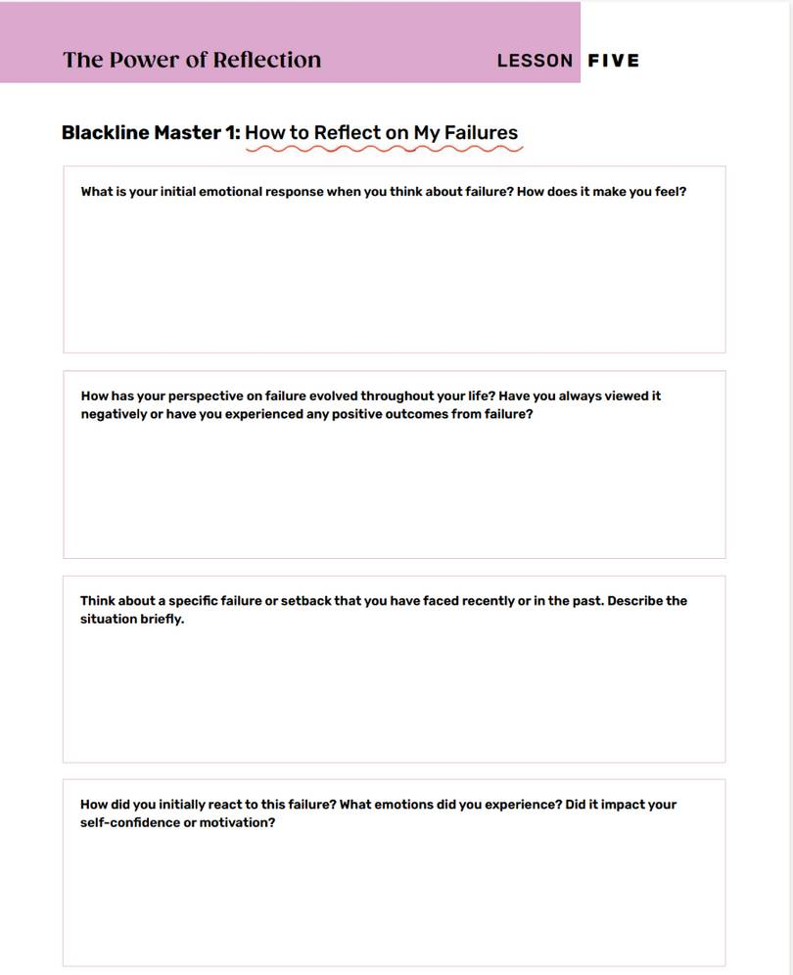
Reflect and Respond
Find a quiet spot in the room to answer the questions.
Read the questions and think about how failure can be a catalyst for personal growth and development.

Slide 71
Share
    Have each person in your group share their answers.
    As a group, discuss:
    Instead of viewing failure as a negative outcome, consider it an opportunity for growth and learning.
    How does this shift in mindset make you feel?
    Does it open any new possibilities in how you turn your failure into a success?

Slide 72
https://youtu.be/ShHPif24Yj8

Slide 73
As you watch the following video, think about...
    What was Vera Wang's first failure in her career?
    How did Vera Wang combine her love of skating and fashion?
    How did Vera Wang overcome her failure in her fashion career?
    How did Vera Wang use her failure to create success?
    What are the benefits of failure?
    What words would you use to describe Vera Wang and her ability to recover from failure?

Slide 74
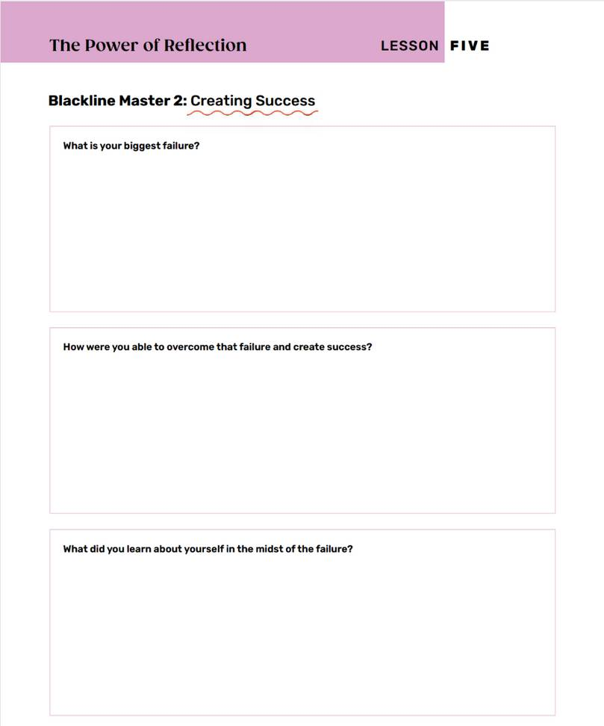
Reflection
Reflect on the biggest failure you have had in your life.
Complete both sides of the page.

Slide 75
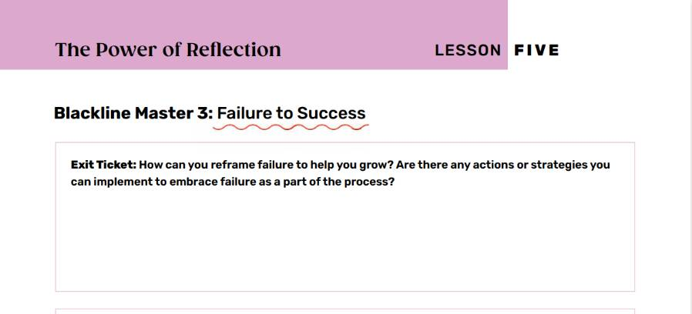
Exit Ticket
Think:
What is a current challenge or goal
that you are working towards?
Answer the questions on the exit ticket.

Slide 76


“Failure is the key to success; each mistake teaches us something.”
- Morihei Ueshibi

Slide 77



Thank you
for learning to fail forward with us!

