Slide 1
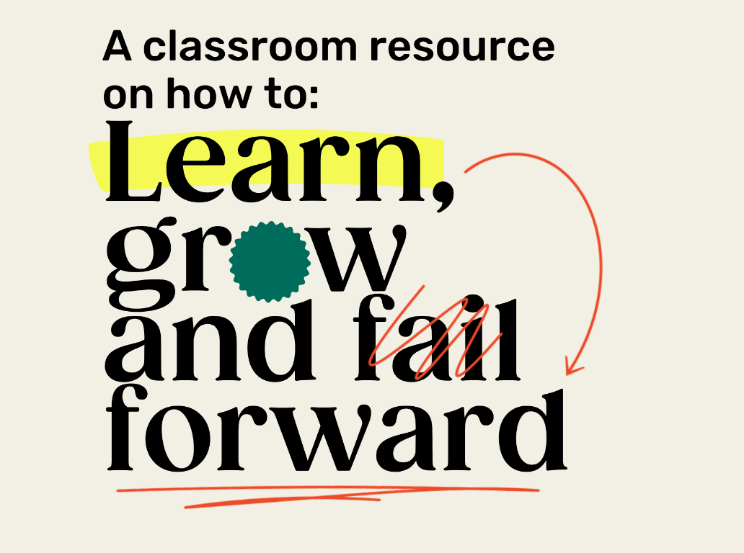

SHIFT FAILURE · A CLASSROOM RESOURCE
GRADES 9-12
Lesson Package · Lessons 1–5 · grounded in experiential and social-emotional learning.
MIIGWECH · MERCI · THANK YOU
Notes:
Shift Failure — a free, bilingual classroom resource that helps students in Grades 5–8 learn, grow and fail forward.

Slide 2
BEFORE WE BEGIN
We invite you to learn whose land your school is on.
Find your territory at native-land.ca . This resource honours Canada's Truth and Reconciliation journey and centres Indigenous voices, stories, and ways of knowing throughout.
Miigwech. Merci. Thank you.
Notes:
PDF p.5. Learn and share your school-specific land acknowledgement before Lesson 1. Find your territory at native-land.ca; see TRC Call to Action 62.

Slide 3
FOR EDUCATORS · BEFORE YOU TEACH FAILURE
Every student's story matters — failure is not equally distributed.
·
SENSITIVITY
Discussions of failure may carry deeper meaning for some students. Personal sharing is never required — silence is a valid form of participation.
·
Indigenous knowledge is knowledge.
·
Newcomers and English Language Learners belong here.
·
No student should feel their identity is a failure.
DIVERSITY · EQUITY · INCLUSION
Notes:
PDF p.4 & p.7. Every student's story matters; failure is not equally distributed; Indigenous knowledge is knowledge; newcomers and ELLs belong; no student should feel their identity is a failure. Discussions of failure may carry deeper meaning for some students — never require personal sharing; silence is a valid form of participation.

Slide 4
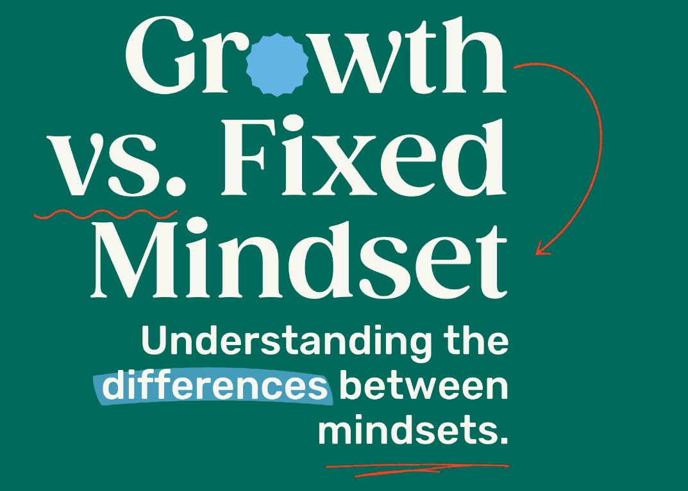
LESSON ONE
LESSON ONE
Notes:
Lesson 1: Growth vs. Fixed Mindset. Estimated time 60 minutes.

Slide 5
LESSON 1 · GROWTH VS. FIXED MINDSET
60 MIN
Learning Goals
1
Understand and articulate the differences between a “growth” and “fixed” mindset.
2
Reflect on how failing is an opportunity to grow and learn.
3
Identify times in your life where you failed and how this became an opportunity to learn.
4
Reflect on how personal challenges impact community and relationships, and how collective support aids growth.
LESSON ONE
Notes:
PDF p.10. Four learning goals — the fourth is the relational/community goal.

Slide 6
LESSON 1 · ACTIVITY
Investigate & Learn
Teamwork
As you can see, there are balloons at the ceiling of the classroom!
Work with your team to strategies how you can get a balloon down while keeping your feet on the ground at all times.
You can only use the tools provided to you and you must follow classroom safety rules
Once you come up with a strategy, test it out. If it doesn’t work, go back to the drawing board together and try again!
LESSON ONE
Notes:
Investigate & Learn. Students recreate the origami from an image only, no instructions. Invite a culturally meaningful shape — Indigenous ribbon-work patterns or rangoli designs — as the reference image. Learning through trial and observation is itself a valued form of knowledge in many Indigenous and oral traditions.

Slide 7
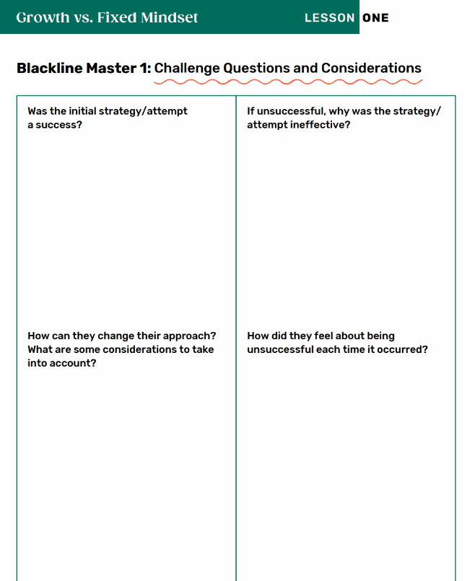
LESSON 1 · REFLECT
How'd it Go?
    Was your strategy a success? Were you able to retrieve the balloon?
    If you were unsuccessful, why was the strategy ineffective?
    How can you change your approach?
    How did you feel about being unsuccessful?
LESSON ONE
Notes:
Reflection Moment: discuss frustrations about the process and what could have made it more achievable.

Slide 8
LESSON 1 · ACTIVITY
Teamwork- Option 2
With the provided materials, you and your team will try to build the highest tower
Once you’ve built your tower as high as possible, come up with an estimate together of how tall it is
You have 4 minutes to complete this challenge start to finish
The group with the tallest tower AND has the closest estimate is the winner and shall receive bragging rights!
5 minute timer
LESSON ONE
Notes:
Second piece of paper — improve on the first design.

Slide 9
LESSON 1 · REFLECT
How'd it Go?
    How successful was your tower? Was it as tall as you could make it?
    Did you estimate the correct height?
    What will you change when you have another attempt to build the tower?
    What considerations are you thinking about?
    How will you change your approach and method of execution?
LESSON ONE
Notes:
Reflection Moment: discuss frustrations about the process and what could have made it more achievable.

Slide 10
LESSON 1 · REFLECT
Think- Pair – Share
    How does continuous failure feel?
    How can you change your perspective to consider failure, as either a teachable moment or an opportunity to try again?
    Why is it important to learn from potential failures?
LESSON ONE
Notes:
Repeat the reflection. Ask a partner what went well for them.

Slide 11
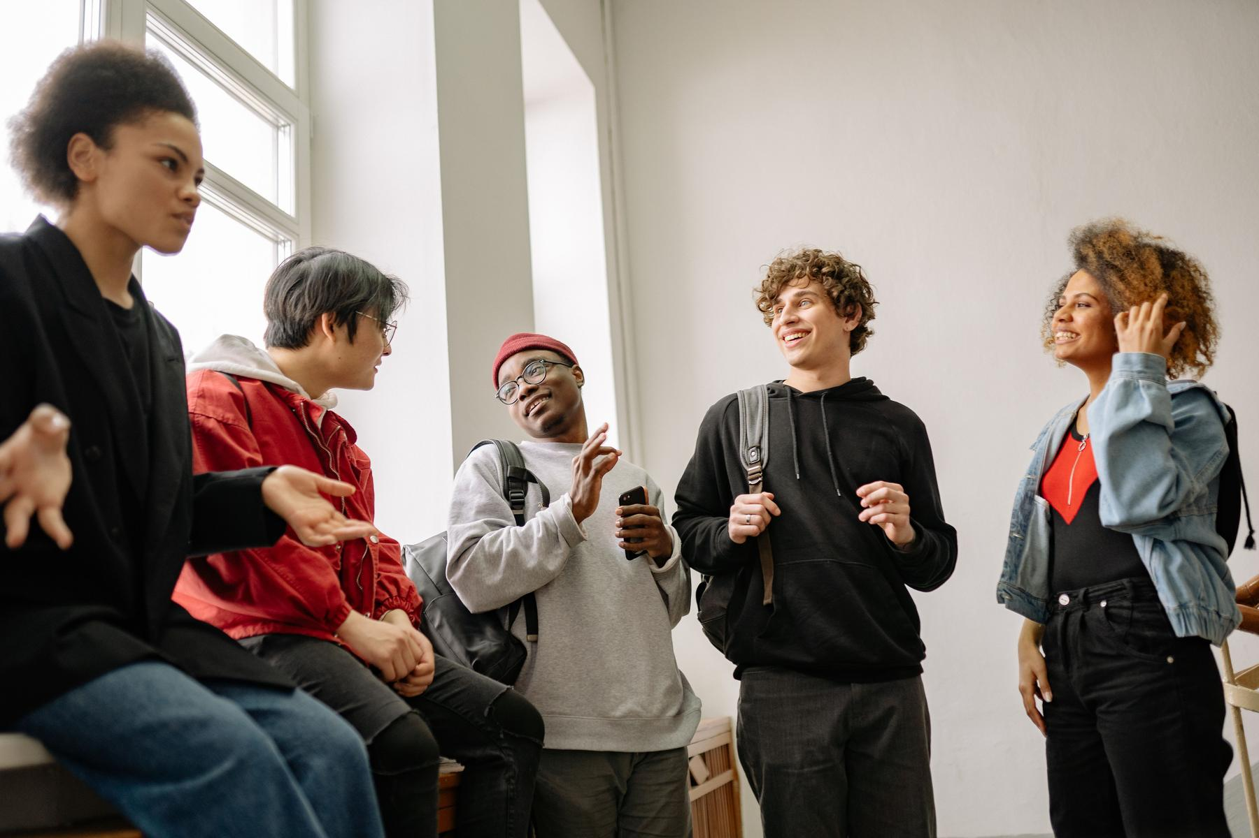
Learning to do something is a process. You have to be open to trying, even if you fail.
LESSON ONE
Notes:
Third round: provide clear instructions + teacher demonstration. Reference origami swan: https://youtu.be/iLthkCU-92U

Slide 12
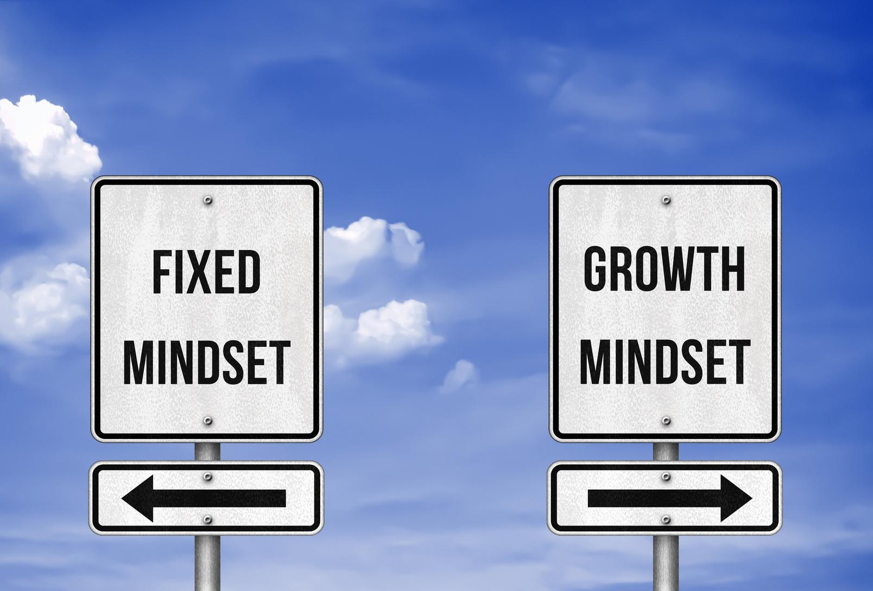
LESSON 1 · DISCUSS
What is a mindset?
LESSON ONE
Notes:
Brainstorm: what is a mindset?

Slide 13
LESSON 1 · MINDSET
Mindset
A set of beliefs that shape how you make sense of the world and yourself.
The mind
can change the way you look, move and think about the world around you.
It influences how you think, feel and behave.
How our growth contributes to the health of our community.
LESSON ONE
Notes:
A mindset is a set of beliefs that shape how you make sense of the world and yourself. In a relational context, mindset also involves understanding how our growth contributes to the health of our community.

Slide 14
LESSON ONE
What you believe about yourself impacts your success and failure.
LESSON ONE
Notes:
What you believe about yourself impacts your success and failure.

Slide 15
LESSON 1 · BRAINSTORM
Fixed Mindset
Growth Mindset
What is a fixed mindset?
What is a growth mindset?
Are there any similarities?
LESSON ONE
Notes:
Create a Venn diagram. Ask: what does a fixed mindset mean? a growth mindset? Are there similarities? What are the differences?

Slide 16
LESSON 1 · EXAMPLES
Fixed vs. Growth Mindset
Fixed Mindset
Growth Mindset
Either I'm good at it or I'm not.
I can learn to do anything I want.
That's just who I am. I can't change it.
I'm a constantly evolving work in progress.
If you have to work hard, you don't have the ability.
The more you challenge yourself, the smarter you become.
People like me don't succeed at things like this.
My background and identity are strengths I bring to every challenge.
LESSON ONE
Notes:
Fixed vs. Growth mindset examples (PDF p.12), including the identity/background row.

Slide 17
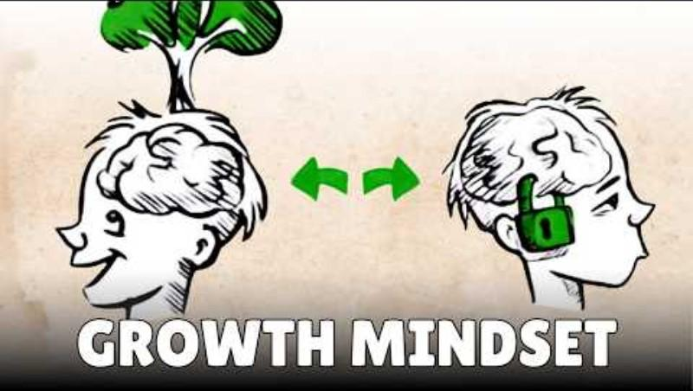
LESSON 1 · WATCH
What is Growth Mindset?
As you listen, think about how you can adopt a growth mindset in your life.
LESSON ONE
Notes:
Video: “What is Growth Mindset?” As you listen, think about how you can adopt a growth mindset in your life.

Slide 18
LESSON 1 · TURN AND TALK
Turn and Talk
How does one change their mindset from fixed to growth?
How does a growth mindset allow for continual development?
How does embracing challenges enable learning?
Is failure important? How does failing lead to learning?
LESSON ONE
Notes:
Turn and Talk discussion questions after the video.

Slide 19
LESSON 1 · CULTURAL PERSPECTIVES
Cultural Perspectives on Growth and Learning
Growth mindset comes from Western psychology and focuses on the individual. Many cultures have their own frameworks — companions to growth mindset, not alternatives.
Indigenous relational learning
Ubuntu — Southern/Central Africa
Learning happens with Elders, the land, and community. Mistakes are part of a longer conversation with shared knowledge.
“A person is a person through other people.” Growth is never purely personal.
East Asian traditions
South Asian traditions
Persistent effort through difficulty is a form of respect for family and community.
“Jugaad” — creative problem-solving with limited resources; innovation born from constraint.
Notes:
PDF p.13. Growth mindset (Carol Dweck, Western psychology) is a companion to other cultural frameworks, not the only valid frame.

Slide 20
LESSON 1 · DISCUSS
Your turn
Failure in your culture
Does your family or cultural background have its own way of thinking about mistakes, learning, and trying again?
Are there words, sayings, or stories in your home language or tradition that speak to this?
LESSON ONE
Notes:
PDF p.13 discussion prompt. Treat student contributions as valuable knowledge, not just personal anecdotes.

Slide 21
LESSON 1 · REFLECTION
Think of a time you failed or were unsuccessful at something.
How big was the failure? Are you still pursuing the activity?
If so, why did you continue — and what was the outcome? If not, what feelings made you abandon it?
What did you learn about the process itself, even if you didn't reach a “successful” outcome?
You are never required to share something personal aloud. You may write privately, or simply listen.
LESSON ONE
Notes:
PDF p.14. Students are never required to share aloud — they may write on a sticky note and keep it private, or simply listen.

Slide 22
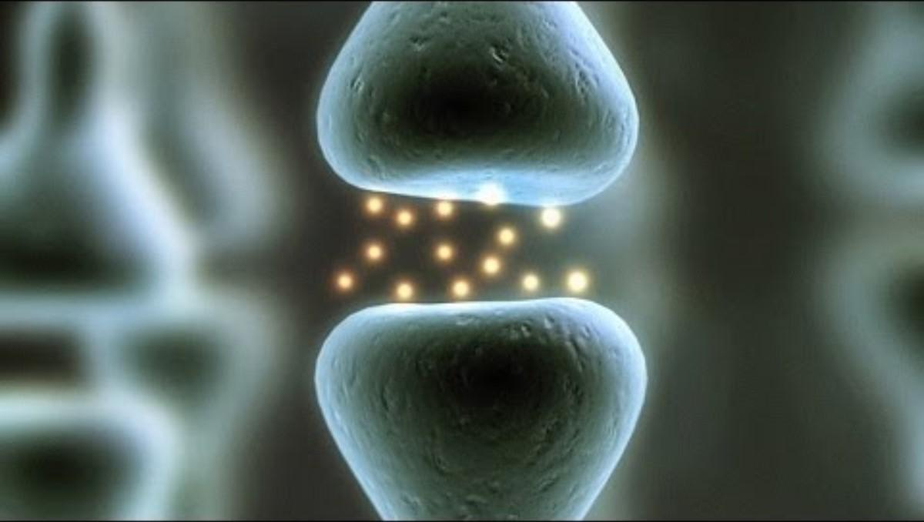
LESSON 1 · WATCH
Consider these Questions as you watch:
    Why is ‘not yet’ significant for growth?
    How is a growth mindset and fixed mindset described?
    How does one engage with error?
    How can you use words of praise to change your mindset?
LESSON ONE
Notes:
Video: “What is Growth Mindset?” As you listen, think about how you can adopt a growth mindset in your life.

Slide 23
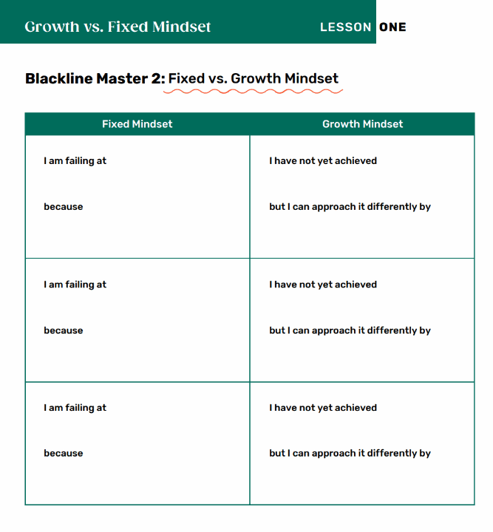
LESSON 1 · ACTIVITY
Shift your Mindset!
Use your errors to continue to grow and learn!
LESSON ONE
Notes:
Blackline Master 2. Students write down fixed-mindset phrases and shift them into growth-mindset thinking.

Slide 24

LESSON 1 · CANADIAN CONNECTION
One of Canada's youngest hockey superstars, Connor Bedard faced enormous pressure and was told he was too small and not ready. He stayed focused, worked tirelessly, and turned every setback into motivation, showing that perseverance and self-belief matter as much as talent.
“You learn more from a bad game than a perfect one.”
Connor Bedard
LESSON ONE
Notes:
PDF p.15. Connor Bedard.

Slide 25
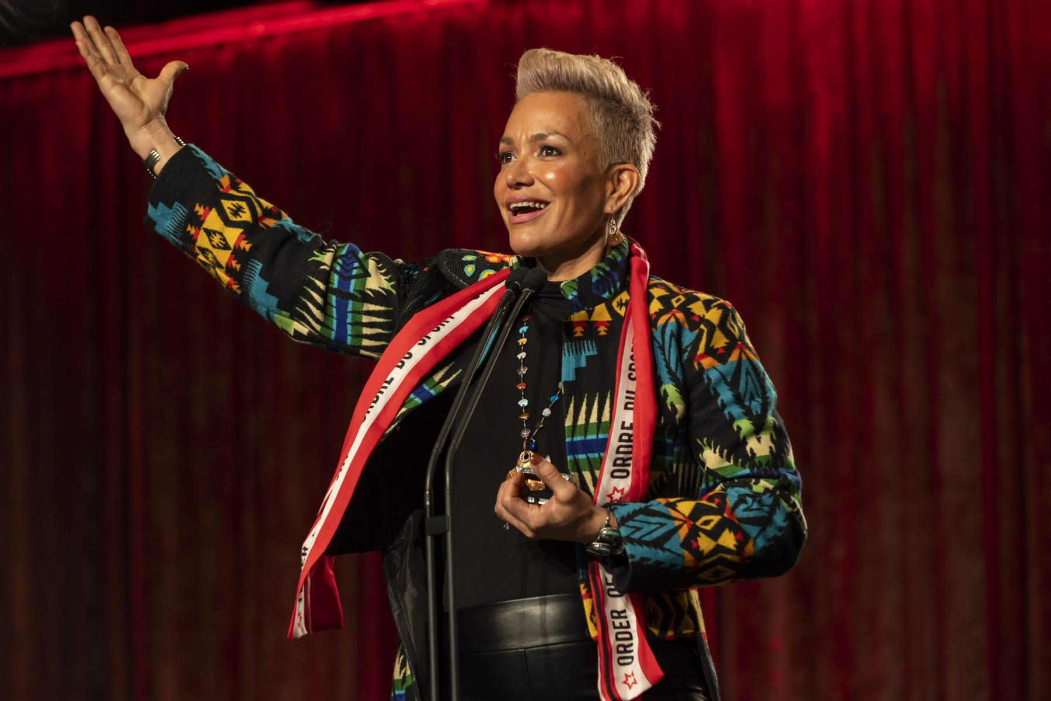
LESSON 1 · CANADIAN CONNECTION
A Mohawk woman from Akwesasne, Waneek Horn-Miller co-captained Canada's first Olympic water polo team in 2000. Seriously injured as a teenager during the 1990 Oka Crisis, she used sport as healing, showing that perseverance can be an act of cultural pride and survival.
“Sport saved my life. It gave me purpose when everything felt broken.”
Waneek Horn-Miller
LESSON ONE
Notes:
PDF p.15. Waneek Horn-Miller.

Slide 26
LESSON ONE
“We learn most through trial, error, and the courage to keep trying.”- David Suzuki
LESSON ONE
Notes:
Closing reflection quote.

Slide 27
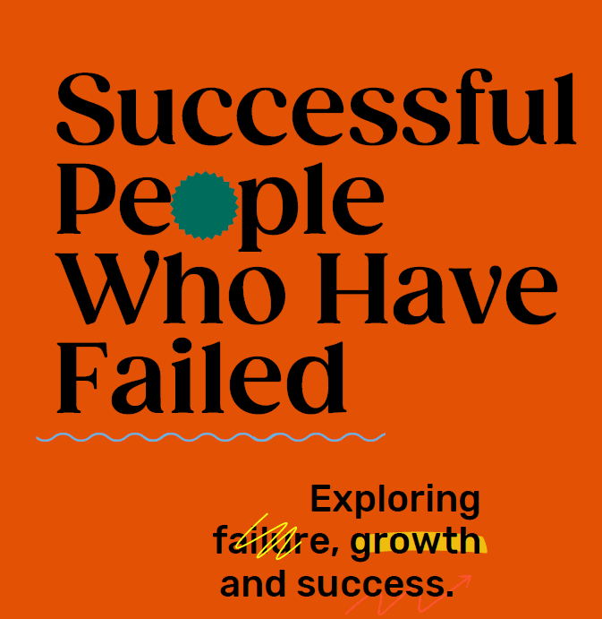
LESSON TWO
LESSON TWO
Notes:
Lesson 2: Successful People Who Have Failed. Estimated time 75 minutes.

Slide 28
LESSON 2 · SUCCESSFUL PEOPLE WHO HAVE FAILED
75 MIN
Learning Goals
1
Understand that failure is not a negative, but an opportunity to learn and grow.
2
Examine the experiences of well-known figures whose failures led to later success.
3
Reflect on your own failures and evaluate how those can be created into growth opportunities.
LESSON TWO
Notes:
PDF p.19.

Slide 29
LESSON 2 · INDIVIDUAL & COLLECTIVE
Resilience is personal, and collective
Famous individuals show resilience. So do entire communities — often across generations and without recognition.
Indigenous communities have kept languages, ceremonies, and knowledge alive despite colonial policies designed to erase them.
Newcomer and refugee families have rebuilt entire lives in a new country and language.
Racialized communities have organized and persisted for rights and recognition.
Think about:
What community in your life has faced setbacks together and kept going? That is also failing forward.
Notes:
PDF p.19. Resilience is not only a personal trait — entire communities demonstrate it, often across generations and without recognition.

Slide 30
LESSON 2 · DISCUSS
Exploring Failure, Growth & Success
What does it feel like when you receive a poor grade?
When you're unsuccessful at a task or goal you set, how do you feel?
How do you feel when your sports team loses a game?
LESSON TWO
Notes:
Open with feelings around failure.

Slide 31
LESSON 2 · REFLECT
Failure may be tied to…
Self-worth
Self-esteem
Self-acceptance
An internal sense of being good enough and worthy of loving and belonging.
Confidence in one's own worth, abilities or morals.
Embracing every part of yourself — all your attributes, positive or negative.
The expectation we fail to meet may be the one we created in our own mind.
LESSON TWO
Notes:
Often the expectation we fail to meet is the one we created in our own mind.

Slide 32
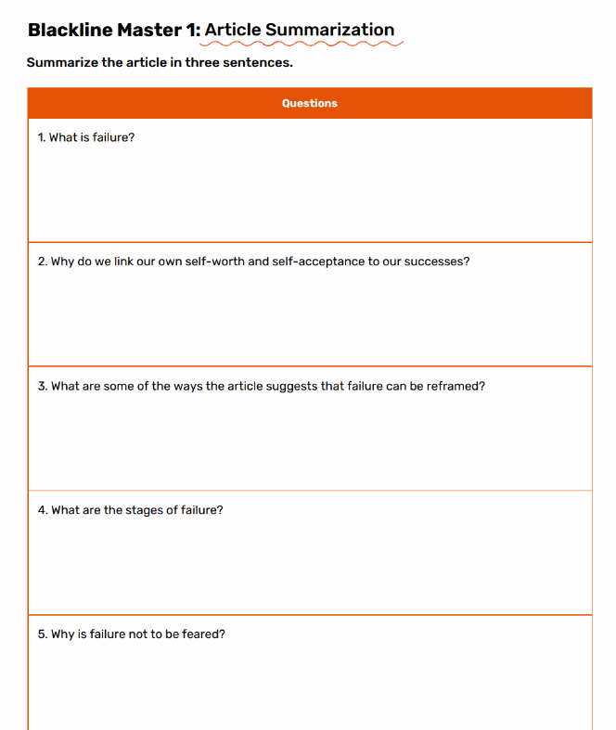
LESSON 2 · ACTIVITY
What is Failure and How Can We Make the Most of It?
Read this article and then fill in the corresponding sheet
What Is Failure and How Can We Make the Most of It?
LESSON TWO
Notes:
Blackline Master 1. Then circle the failures you tried again — how did it feel to try again?

Slide 33
LESSON 2 · TURN AND TALK
Turn and Talk
·
Why do we connect self-worth, self-esteem and
self-acceptance to success?
Why does failing feel difficult?
How can success after failure lead to personal growth?
·
·
LESSON TWO
Notes:
Small-group discussion after the video.

Slide 34
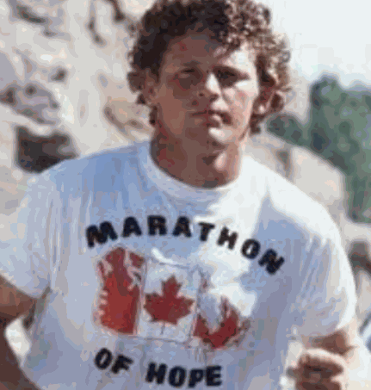
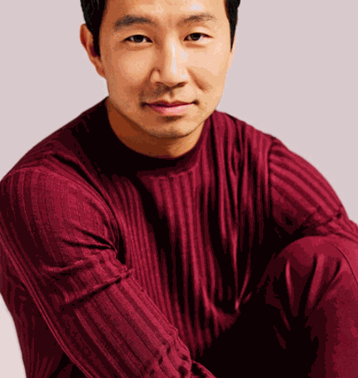

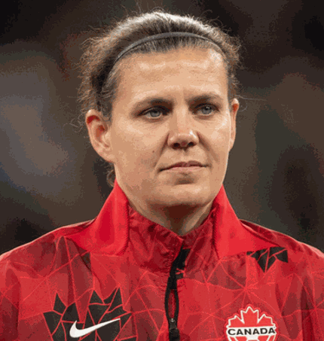
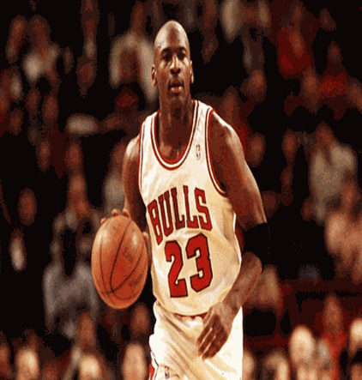


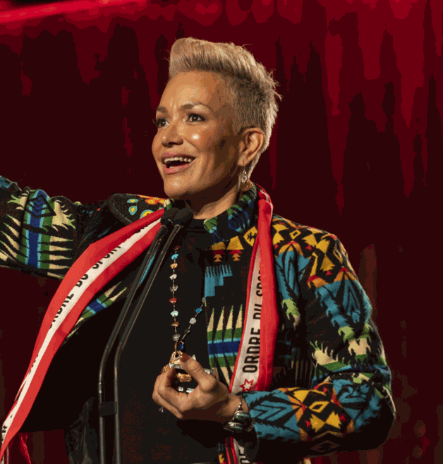
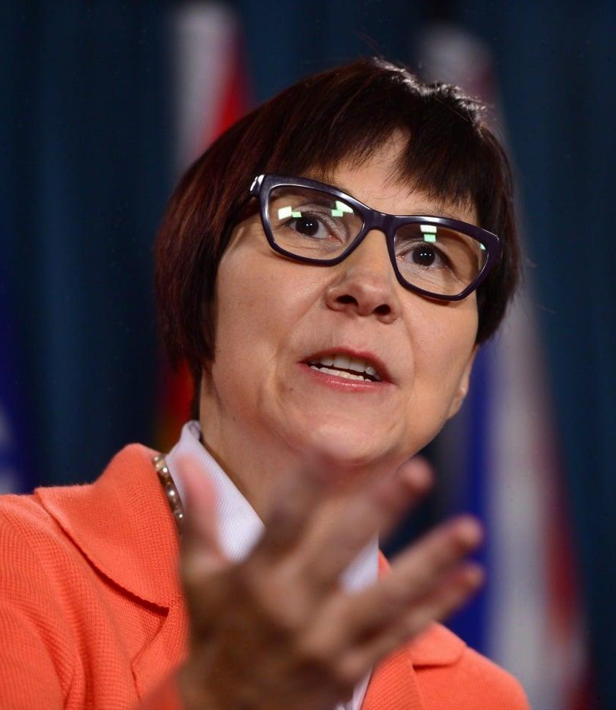
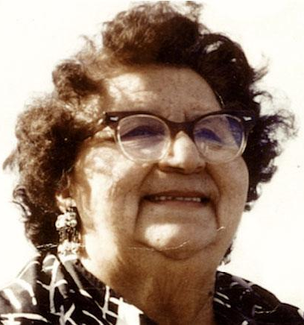

LESSON 2 · FAMOUS FAILURES
What do these individuals have in common?
Terry Fox
Simu Liu
Alessia Cara
Christine Sinclair
Michael Jordan
Lady Gaga
Simone Biles
Waneek Horn-Miller
Cindy Blackstock
Mary Two-Axe Earle
Dwayne “The Rock” Johnson
LESSON TWO
Notes:
PDF p.20. Write these names on the board. Ask: what do they have in common?

Slide 35
LESSON 2 · FAMOUS FAILURES
Each achieved greatness through hard work and pursuing their goals.
Terry Fox
Simu Liu
Alessia Cara
Christine Sinclair
Michael Jordan
Lady Gaga
Simone Biles
Waneek Horn-Miller
Cindy Blackstock
Mary Two-Axe Earle
Dwayne “The Rock” Johnson
LESSON TWO
Notes:
PDF p.20. Write these names on the board. Ask: what do they have in common?

Slide 36
LESSON 2 · FAMOUS FAILURES
Each has had some form of failure they've had to work to overcome.
Terry Fox
Simu Liu
Alessia Cara
Christine Sinclair
Michael Jordan
Lady Gaga
Simone Biles
Waneek Horn-Miller
Cindy Blackstock
Mary Two-Axe Earle
Dwayne “The Rock” Johnson
LESSON TWO
Notes:
PDF p.20. Write these names on the board. Ask: what do they have in common?

Slide 37
LESSON 2 · GROUP WORK
Time to create — a 3-minute presentation on the famous person you chose.
What is this person famous for achieving? What is their story?
What failures did they encounter — and how did they overcome them?
Why do you think this failure led to their eventual success?
What would you have done? What advice would you give them?
How did their work create a positive collective impact, or support the wellbeing of their community and the land?
What advice would you give to this person when an inevitable failure occurred?
LESSON TWO
Notes:
PDF p.21. Groups create a 3-minute presentation on 1–2 famous people. The final question (collective impact / wellbeing of community and land) is the new addition.

Slide 38
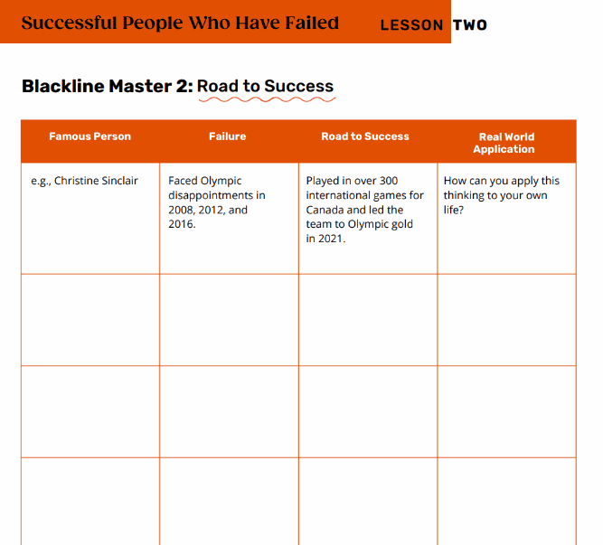
LESSON 2 · PRESENTATIONS
During the presentations
·
Take notes and fill in the table: the failure each person encountered and how they overcame it.
·
After the presentations, add yourself to the table and reflect on your own personal failures.
LESSON TWO
Notes:
Blackline Master 2: Road to Success. After, add yourself to the table and reflect on your own failures.

Slide 39
LESSON 2 · SELF REFLECTION
How can you grow your failures into success stories?
No failure is too big to grow from.
LESSON TWO
Notes:
Remind students no failure is too big to grow from.

Slide 40
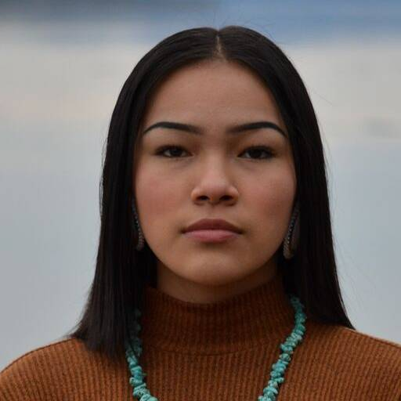
LESSON 2 · CANADIAN CONNECTION
Autumn Peltier
An Indigenous water-rights advocate from Wiikwemkoong First Nation, now Chief Water Commissioner of the Anishinabek Nation. She has spoken many times at the United Nations and been nominated three times for the International Children's Peace Prize.
SYSTEMIC NOTE
Many First Nations communities in Canada still don't have safe drinking water. Some failures are not hers — they belong to others.
“Keep going, don't look back, and if you have an idea, just do it.”
LESSON TWO
Notes:
PDF p.22. Autumn Peltier — note that many First Nations communities still lack safe drinking water; some failures belong to governments, not to her.

Slide 41
LESSON TWO
“I failed a lot. I've made a lot of mistakes. But that's how I learn.”
— Billie Eilish
LESSON TWO
Notes:
Closing reflection quote.

Slide 42

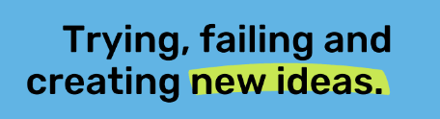
LESSON THREE
LESSON THREE
Notes:
Lesson 3: From Failure to Innovation. Estimated time 75 minutes + 45 minutes (second day).

Slide 43
LESSON 3 · FROM FAILURE TO INNOVATION
Learning Goals
1
Understand the concept of innovative thinking.
2
Apply the agile methodology to games to demonstrate learning
3
Recognize that failure leads to growth, which is fostered in the agile way of thinking
LESSON THREE
Notes:
PDF p.26.

Slide 44
LESSON 3 · INVESTIGATE & LEARN
Great ideas are sometimes created from bad or weird ones.
Innovation is about trying new things and taking risks — which inevitably involves mistakes. Many people fear the consequences of failure.
Indigenous peoples have been innovating for thousands of years — developing medicines, agricultural systems, navigation tools, and governance structures.
Innovation is not new, and it doesn't belong to any one culture.
LESSON THREE
Notes:
PDF p.26. Innovation is not new, and it does not belong to any one culture.

Slide 45
LESSON 3 · BRAINSTORM
Game Time
The goal of the game is to pass the ball around the table.
Each person needs to touch the ball once.
When the ball makes it all the way around the table, the group gets one point.
LESSON THREE
Notes:
A creative twist — brainstorm deliberately bad ideas, then extend to real community challenges.

Slide 46
LESSON 3 · GROUP WORK
Game Time
The game will be played in 3-minute sprints – 3 Rounds
    1st min. - write down how many points you
    expect to earn and plan your approach.
    2nd min. - pass the ball around the table
    3rd min. - write down the number of points you earned
    as well as what you learned
1 minute timer
LESSON THREE
Notes:
In small groups, come up with one really bad idea.

Slide 47
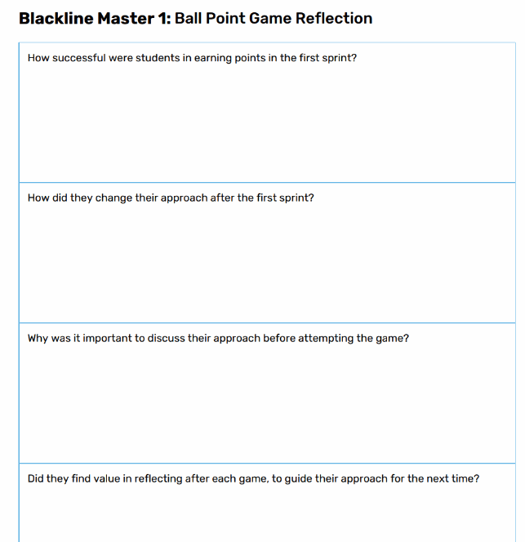
LESSON 3 · GROUP WORK
Game Time- Reflection
Reflect on the process during each sprint
LESSON THREE
Notes:
In small groups, come up with one really bad idea.

Slide 48
LESSON 3 · DISCUSS
The Agile Approach
    able to change your strategy quickly to optimize the way you played the game, for an improved outcome
    a thought process that involves understanding, collaborating, learning and staying flexible to achieve high-performing results
    helps adapt to change, rather than struggle around it
    focuses on learning from failures and working to make the end goal better from those learning
LESSON THREE
Notes:
Class discussion of similarities across the famous failures.

Slide 49
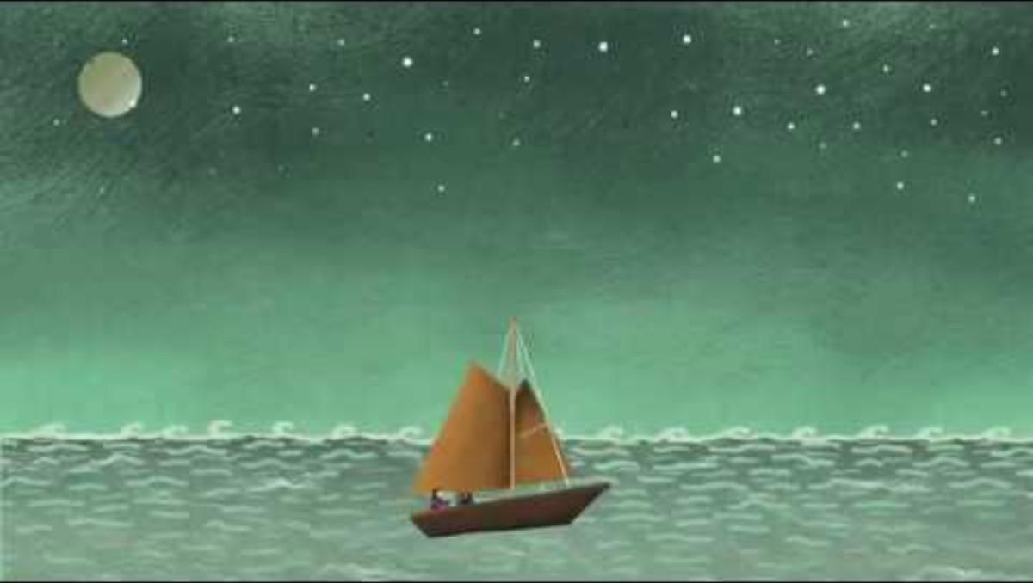
LESSON 3 · REFLECT
Growth Mindset
Think about these questions as you watch the following video:
    Why it’s important to continuously learn from the mistakes that we make?
    How can the shift in our thinking lead towards successful outcomes?
LESSON THREE
Notes:
Each person tried and continued to create even though they encountered failure — they had an innovative mindset.

Slide 50
LESSON 3 · INDIGENOUS INNOVATION
Thousands of years of failing forward
Three Sisters agriculture
Inuit kayak design
Corn, beans, and squash grown together — refined over countless seasons of trial and error.
Refined over thousands of years for Arctic waters; still among the most efficient watercraft ever made.
Haudenosaunee Confederacy
Traditional Ecological Knowledge
The Great Law of Peace — governance built on diplomacy, consensus, and accountability.
Systems for managing fisheries, forests, and waterways that Western science now studies and adopts.
Notes:
PDF pp.27–28. Documented, living knowledge — the same try–fail–learn–improve cycle this lesson teaches.

Slide 51
LESSON 3 · DISCUSSION
Whose innovation gets celebrated?
What innovations from your own cultural background can you identify — food, medicine, building, navigation, language, governance?
·
·
Who in your family or community has solved problems creatively without being recognized publicly?
·
If innovation has happened across all cultures for thousands of years, why do we celebrate only certain kinds? What does that tell us about whose knowledge gets valued?
LESSON THREE
Notes:
PDF p.28 discussion prompts.

Slide 52
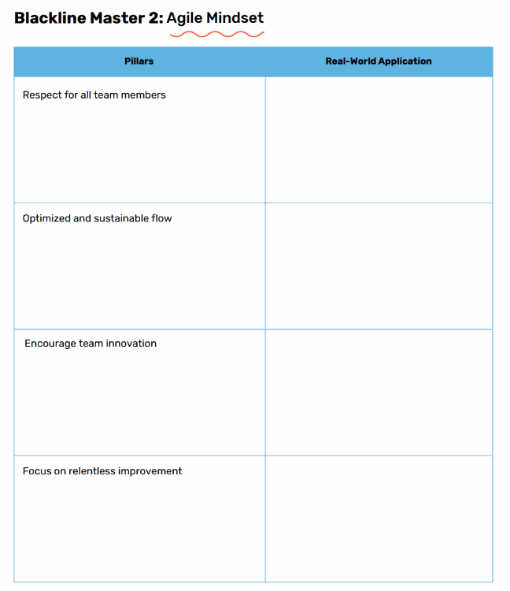
LESSON 3 · INNOVATIVE MINDSET
4 Pillars of Agile Mindset
RESPECT FOR ALL TEAM MEMBERS
OPTIMIZED AND SUSTAINABLE FLOW
ENCOURAGE TEAM INNOVATION
FOCUS ON RELENTLESS IMPROVEMENT
How do these pillars relate to the work you do in the classroom?
How can they be applied to your daily life?
LESSON THREE
Notes:
What we call 'design thinking' echoes values that are ancient and cross-cultural.

Slide 53
LESSON THREE · GROUP WORK
Game Time
The goal of the game is to create the most effective paper airplanes.
Build as many as possible - but each member of your team can only make one-fold at a time before passing the paper to the next person on the team.
Your team only gets a point if the plane can fly a minimum distance determined by your team.
LESSON THREE
Notes:
Blackline Master 2: Design a Catapult. Groups of three design a catapult to launch a ping pong ball the furthest.

Slide 54
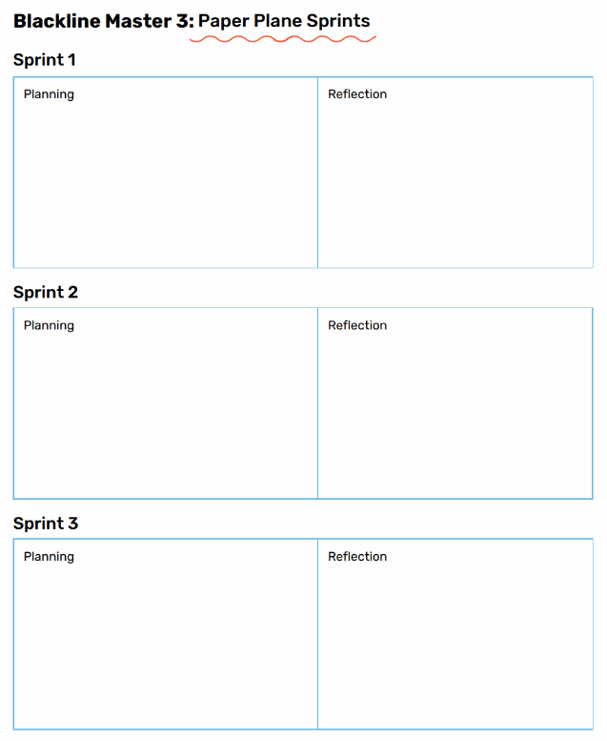
LESSON THREE
Game Time
The game is divided into 9-minute sprints:
3 min. for planning - estimate how many planes you plan on flying
3 min. for building and testing - create your planes
3 min. to reflect - review if you were successful in creating the number of planes you estimated. What would you do differently?
LESSON THREE
Notes:
Reflection on the iterative process.

Slide 55
LESSON 3 · REFLECT
Reflect:
How effective is having an agile approach in quickly developing ideas?
LESSON THREE
Notes:
Trying, failing and creating new ideas — that's innovation.

Slide 56
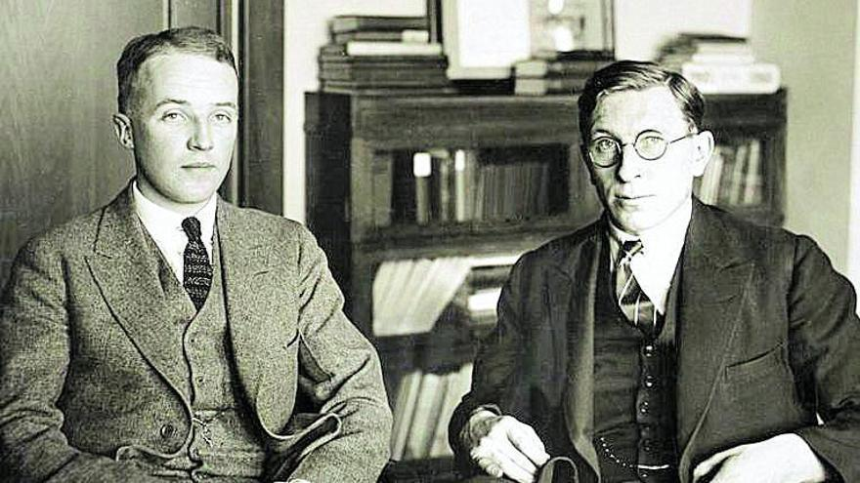
LESSON 3 · CANADIAN CONNECTION
Banting & Best — the discovery of insulin
After more than 400 failed attempts, two Canadian scientists used every failed experiment as a lesson — and discovered insulin in 1921, saving millions of lives.
“Insulin belongs to the world, not to me.” — Dr. Frederick Banting
LESSON THREE
Notes:
PDF p.30. Banting & Best discovered insulin after more than 400 attempts. Note the systemic-equity reflection on who innovation reaches.

Slide 57

LESSON THREE
“Every mistake is just part of getting better. You learn, you adjust, and you keep going.”
— Connor McDavid
LESSON THREE
Notes:
Closing reflection quote.

Slide 58
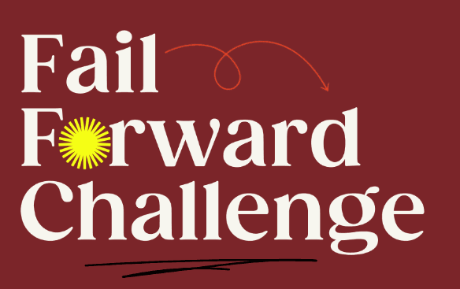
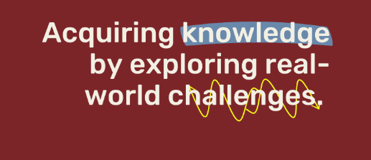
LESSON FOUR
LESSON FOUR
Notes:
Lesson 4: Fail Forward Challenge. Total time approximately 13 hours.

Slide 59
LESSON 4 · FAIL FORWARD CHALLENGE
Learning Goals
    Identify a current issue/challenge within the school environment
    Create a solution for the issue/challenge
    Implement the solution
    Reflect on your failure during the implementation
1
2
3
4
LESSON FOUR
Notes:
PDF p.37. Goals written in relational, community-centred language.

Slide 60
LESSON 4 · INVESTIGATE & LEARN
What challenges does our school face?
Can everyone learn in a way that works for them?
Does everyone feel safe and free to express their opinions?
How can we create an environment that meets the parameters of inclusive design, which creates an accessible environment for all students?
How can we make our school welcoming for students and families who are newcomers to Canada or learning English?
How can we respect the Indigenous history of the land our school is built on,
and help Indigenous students feel they truly belong?
LESSON FOUR
Notes:
PDF p.37. Brainstorm school challenges — the last two (newcomers/ELL and Indigenous belonging) are the inclusion-focused additions.

Slide 61

LESSON 4 · THE CHALLENGE
Choose one challenge in your school and do your best to solve it.
It may be hard, and you may be unsuccessful the first few times — but you'll learn from each failure.
LESSON FOUR
Notes:
Each group chooses one challenge to solve.

Slide 62
LESSON 4 · RESEARCH PROCESS
Need-to-know questions
What do you need to know to understand the issue in depth?
What research do you need to conduct to learn more?
Try to come up with at least 5 questions.
LESSON FOUR
Notes:
Create 'need-to-know questions' to understand the issue in depth.

Slide 63
LESSON 4 · RESEARCH PROCESS
Generate Ideas
You will have 8 minutes to generate as many solutions to your issues as possible.
Think of BIG ideas!
Each person will put their ideas on a different sticky note.
8 minute timer
LESSON FOUR
Notes:
Create 'need-to-know questions' to understand the issue in depth.

Slide 64
LESSON 4 · RESEARCH PROCESS
Categorize your Ideas
    Organize the sticky notes based on similarities.
    Come up with categories of BIG ideas based on how your sticky notes fit together.
    Vote on 1 or 2 that your group would like to develop as a solution to address the issue identified.
    You can add more ideas as you develop your solution.
LESSON FOUR
Notes:
Create 'need-to-know questions' to understand the issue in depth.

Slide 65
LESSON 4 · RESEARCH
Conducting research
    Outline a step-by step process of how you will solve the issue/challenge
    What obstacles do you think you might encounter?
Remember - you may fail the first few times you try to solve your problem,
but reflect and adapt based on what you learned.
LESSON FOUR
Notes:
Research sources.

Slide 66
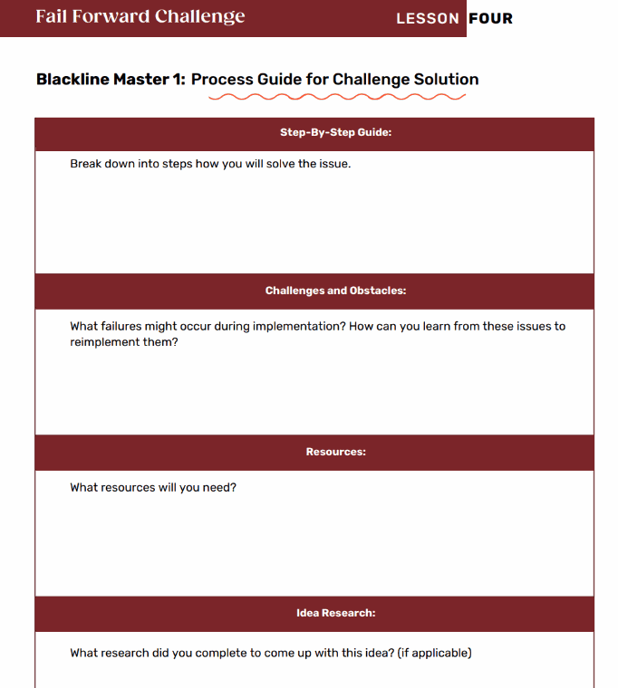
LESSON 4 · MAKE IT WORK
Make a plan
Can your solution be implemented in school? Is it realistic?
LESSON FOUR
Notes:
PDF p.39. A 'feasible' solution is one built on mutual respect and shared success — prioritize relational accountability over technical complexity.

Slide 67
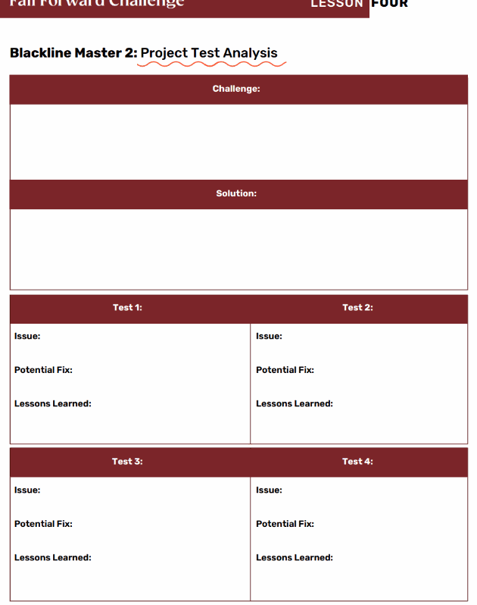
LESSON 4 · MAKE IT WORK
Let's do it!
Are there any more resources you need? Is the result what you wanted? Remember — you may not succeed the first or second time.
LESSON FOUR
Notes:
Over a week, implement the solution. Complete a test analysis each attempt.

Slide 68
LESSON 4 · PRESENT
Presenting your research
Create a 5-minute presentation using any method your group agrees on:
PowerPoint / Sway
Prezi
Poster
TikTok video
Blog post
Play / Mock Debate
LESSON FOUR
Notes:
Create a 5-minute presentation using any method the group agrees on.

Slide 69
LESSON 4 · PRESENT
What to include
What challenge did you choose? What solution did you create?
What issues came up? Were they in line with what you expected?
Did the solution work the first time? What did you learn each attempt?
Did you update your idea after learning from each attempt?
How does failing create an opportunity to learn and grow?
LESSON FOUR
Notes:
Presentation questions (PDF p.40).

Slide 70
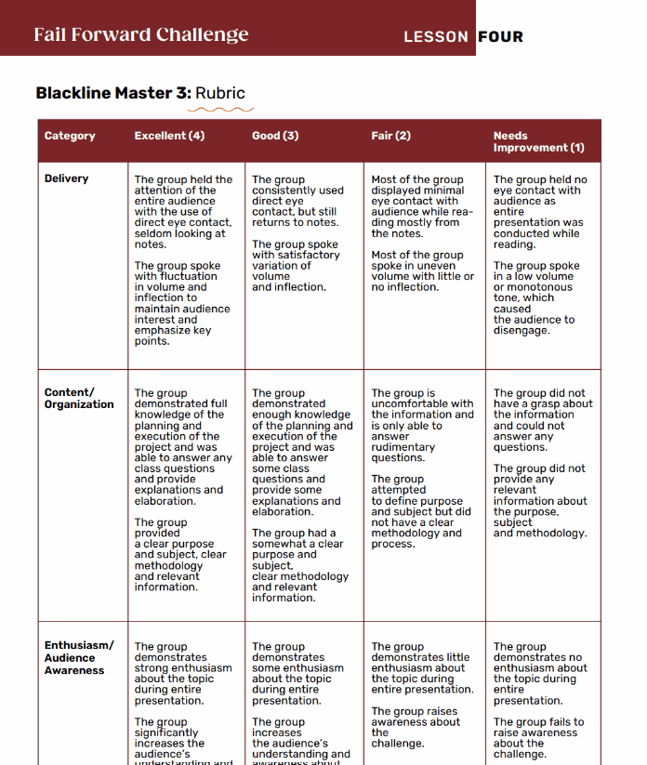
LESSON 4 · ASSESSMENT
What makes a successful presentation?
Delivery
Content / Organization
Enthusiasm / Audience Awareness
LESSON FOUR
Notes:
Blackline Master 3: Rubric — what makes a successful presentation.

Slide 71
LESSON 4 · REFLECT
Learning from others
As you listen to other groups present: what did each group learn from the failure of their initial attempt?
LESSON FOUR
Notes:
As you listen to other groups present.

Slide 72

LESSON 4 · CANADIAN CONNECTION
One of Canada's top tennis players, Bianca Andreescu won the U.S. Open in 2019 — then faced injuries and long breaks that tested her confidence. She used reflection, mindfulness, and perseverance to rebuild, showing that success is not about avoiding failure, but learning from it.
“Every setback is a setup for a comeback.”
Bianca Andreescu
LESSON FOUR
Notes:
PDF p.40. Bianca Andreescu.

Slide 73
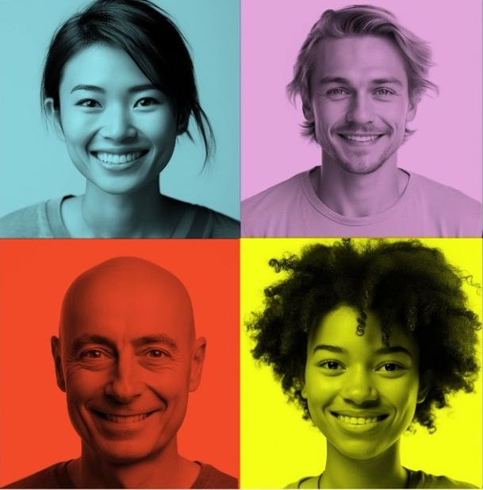
LESSON FOUR
“You grow the most in the uncomfortable places — the moments when things don't go as planned.”
— Sandra Oh
LESSON FOUR
Notes:
Closing reflection quote.

Slide 74

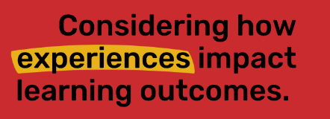
LESSON FIVE
LESSON FIVE
Notes:
Lesson 5: The Power of Reflection. Estimated time 60 minutes.

Slide 75
LESSON 5 · THE POWER OF REFLECTION
60 MIN
Learning Goals
1
    Reflect on how failure can create opportunities of growth and personal development
    How can your own personal strength and traits lead to creating success from failure?
2
LESSON FIVE
Notes:
PDF p.45.

Slide 76
LESSON 5 · NAMING FAILURE
Two Kinds of Failure
PERSONAL FAILURE
SYSTEMIC FAILURE
Falling short of a goal or challenge within your own ability to influence. You tried out for a team and didn't make it — yet . A growth mindset is a powerful tool here.
Being failed by institutions, policies, or systems because of your identity, background, or circumstances. These require systemic solutions , not just a better mindset.
Why it matters:
Both kinds can be grown from — but naming which one you face is the first, most important step.
Notes:
PDF pp.45–46. The core distinction this lesson now hinges on.

Slide 77
LESSON 5 · DISCUSSION
Name the failure
Think about a setback you've experienced. Was it personal (within your control) — or was part of it systemic , connected to something outside of you?
How does naming that difference change how you feel? What would “failing forward” look like in each case?
LESSON FIVE
Notes:
PDF p.46 discussion prompt. If students name systemic failures, do not redirect toward personal responsibility — acknowledge and validate, then explore collective action.

Slide 78
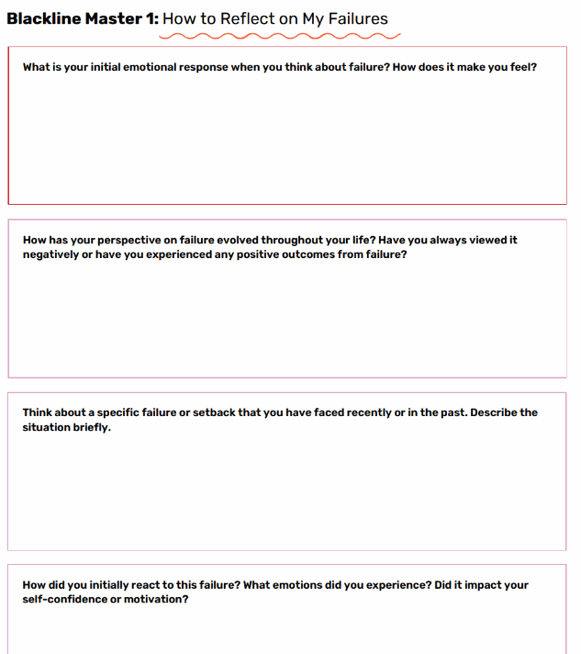
LESSON 5 · REFLECT
Reflect and Respond
Take a moment to respond on your own, then we'll share in small groups.
LESSON FIVE
Notes:
Blackline Master 1: Reflection entry ticket.

Slide 79
LESSON 5 · SHARE
Share with your group
    Have each person in your group share their answers.
    As a group, discuss:
    Instead of viewing failure as a negative outcome, consider it an opportunity for growth and learning.
    How does this shift in mindset make you feel?
    Does it open any new possibilities in how you turn your failure into a success?
LESSON FIVE
Notes:
In groups of four, read your response verbatim, then answer collectively.

Slide 80
LESSON FIVE · WATCH
The Rise and Fall of Vera Wang
https://youtu.be/ShHPif24Yj8​
LESSON FIVE
Notes:
Video: “How I Overcame Failure | Jack Ma.”

Slide 81
LESSON 5 · DISCUSS
Discuss
    What was Vera Wang's first failure in her career?
    How did Vera Wang combine her love of skating and fashion?
    How did Vera Wang overcome her failure in her fashion career?
    How did Vera Wang use her failure to create success?
    What are the benefits of failure?
    What words would you use to describe Vera Wang and her ability to recover from failure?
LESSON FIVE
Notes:
Blackline Master 2: Failure to Success – Jack Ma.

Slide 82
LESSON 5 · FAILING FORWARD, CANADIAN STYLE
Cindy Blackstock, a Gitxsan social worker, spent over a decade fighting the Canadian government for equity in First Nations child welfare — and won.
Her story shows that failing forward can mean refusing to accept a system's answer of “no.”
Cindy Blackstock
LESSON FIVE
Notes:
PDF p.46. A Canadian-rooted companion to the Jack Ma story.

Slide 83
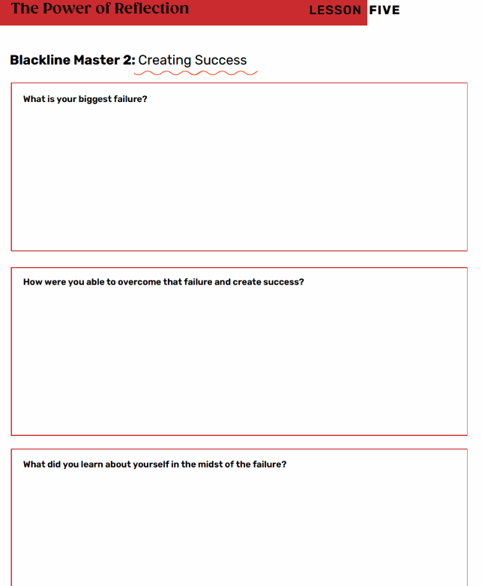
LESSON 5 · WITH A PARTNER
Reflection
Reflect on the biggest failure you have had in your life.
Complete both sides of the page.
LESSON FIVE
Notes:
Pair reflection on the video.

Slide 84
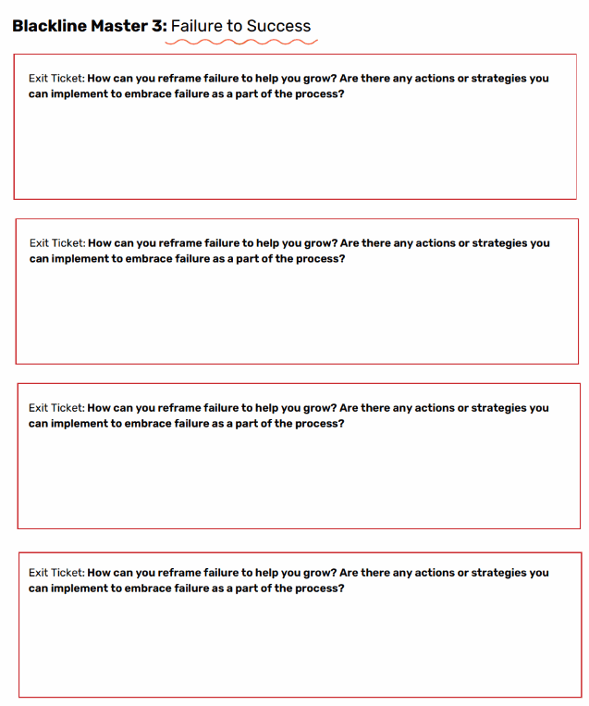
LESSON 5 · YOUR TURN
Exit Ticket
Think:
What is a current challenge or goal
that you are working towards?
Answer the questions on the exit ticket.
LESSON FIVE
Notes:
Select 3–5 of the Steps to Failing Forward and outline how you'll change your failure to success.

Slide 85

LESSON FIVE
“Failure is the key to success; each mistake teaches us something.”
— Morihei Ueshiba
LESSON FIVE
Notes:
Closing reflection quote.

