Slide 1
Anaphylaxis Management: Twice-Yearly Briefing
For all Victorian Schools
Last updated January 2026
Notes:
According to Ministerial Order 706, Part D under the heading Communication Plan all Victorian schools have to undertake a twice-yearly briefing in the management of anaphylaxis. Ideally the first briefing should occur at the start of the year. The Order is very specific as to what needs to be contained in this briefing and the following areas need to be covered:
The identities of the students diagnosed at risk of anaphylaxis and where their medication is located
The causes, signs & symptoms and treatment of anaphylaxis
Training options for staff
How to use an autoinjector, including hands-on practice with a trainer
The school’s first aid and emergency response procedures
Talk about your school’s Anaphylaxis Management Policy, what it details and where it can be located.
This briefing should be delivered by a School Anaphylaxis Supervisor.
Suggested Speaking Notes:
Commence the briefing by introducing yourself as the School Anaphylaxis Supervisor who is:
Trained to undertake adrenaline device competency checks.
The contact for anaphylaxis management requirements in the school, including leading this twice-yearly school briefing.

Slide 2
(insert name of school)
The children that are diagnosed at risk of anaphylaxis at our school are:
Insert
picture of child here
please
Insert
picture of child here
please
Insert
picture of child here
please
Insert
picture of child here
please
Insert
picture of child here
please
Insert
picture of child here
please
Notes:
Spend some time talking about your own school and the relevant plans that exist within your policy.
Show the staff photos of all the children with ASCIA Action Plans at your school. Name the children in your school who have been diagnosed as at risk of anaphylaxis.
Ensure all the child’s teachers are aware of his/her condition, where their medication is located and how to administer the adrenaline including:
Who are they?
In what year level are they?
What are their allergens?
Who has responsibility for this child in their class, playground?
What risks are they exposed to at school?
What risks are they exposed to on special days at school E.g. swimming, sports days, special days
What risks are they exposed to on excursions this year?
What can we as a staff team do to support these children?
Have a quick discussion about the risks this child is exposed to whilst at school and they ways to minimise the risks (for example if the allergen is bee venom – take responsibility for ensuring there are no bee hives in the school area – ensure plants are grown that don’t attract bees – if bees are in the school area ensure that the child with anaphylaxis does not play in the area – all staff to be made aware of the location of autoinjectors for general use and the guidelines for using them.

Slide 3
Signs & symptoms of anaphylaxis
Anaphylaxis is the most severe form of allergic reaction.
It involves a change to BREATHING and / or CIRCULATION
Symptoms and signs of anaphylaxis:
Difficult/noisy breathing
Swelling of the tongue
Swelling/tightness in throat
Difficulty talking and/or hoarse voice
Wheeze or persistent cough
Persistent dizziness or collapse
Pale and floppy (young children)
www.allergy.org.au/anaphylaxis
Notes:
An allergy is when the immune system reacts to something in the environment which is usually harmless, e.g. food proteins, pollens, dust mite.
Allergic reactions can be mild – moderate or severe.
Anaphylaxis is the most severe reaction.
Anaphylaxis involves changes to breathing and/or circulation
Anaphylaxis is potentially life-threatening.
Symptoms of anaphylaxis: A child who presents with any one of these signs or symptoms is deemed anaphylactic and in need of adrenaline.
The causes of anaphylaxis are certain foods, insect stings, medications and latex.
The most common foods are peanuts, tree nuts, egg, cow’s milk, wheat, soy, sesame, fish and shellfish.

Slide 4



ASICA Anaphylaxis e-training
Legislation and policy sets out that all Victorian school staff working with a child or young person who is at risk of an anaphylactic reaction are required to undertake anaphylaxis training.
All Victorian school staff can access online anaphylaxis training, funded by the department, at their own convenience.
Once staff have completed the online training, they will need to have their competency in using an adrenaline device tested in person.
Every school is asked to provide the names of 2 staff members (per campus) to undertake funded adrenaline device competency check training, so they can verify the competency of all staff in their school who have undertaken the online training.
Notes:
Legislation and policy sets out that all Victorian school staff working with a child or young person who is at risk of an anaphylactic reaction are required to undertake anaphylaxis training.
All Victorian school staff can access Departmentally funded online training at their own convenience – the ASCIA Anaphylaxis e-training for Victorian schools, which can be accessed via https://etrainingvic.allergy.org.au
Once staff have completed the online training they will need to have their competency in using an adrenaline device tested in person. Every school will be asked to nominate two School Anaphylaxis Supervisors from each campus to undertake funded adrenaline device competency check training, so they can verify the competency of all staff in their school who have undertaken the online training.

Slide 5


ASCIA Anaphylaxis e-training – cont.
In our school (INSERT NAMES OF STAFF TRAINED TO UNDERTAKE ADRENALINE DEVICE COMPETENCY CHECKS) have been trained to undertake adrenaline device competency check training.
ALL staff are asked to undertake the ASCIA e-training course.
You will need to have your competency in using an adrenaline device tested within 30 days of completing the online course.
Insert details on how your school will undertake the in-person adrenaline device competency checks.
i.e. [School Anaphylaxis Supervisor’s Name] will be undertaking competency checks in the school staff room on [insert date]
Notes:
As a minimum, under the legislation, staff who are working with a student who is deemed at risk of an anaphylactic reaction are required to undertake training. The principal may nominate additional staff to complete training based on their assessment of the risk of an anaphylactic reaction occurring while a student is under their care, for example yard duty staff, first aid officers, education support staff, canteen supervisors etc.
It is the Department’s recommendation that ALL staff undertake the ASCIA e-training course and have their competency in using an adrenaline device checked.
If your School Anaphylaxis Supervisors have not yet been trained to undertake an adrenaline device competency check training, please advise staff of when this training is likely to take place and when your school will move to the online training approach.

Slide 6
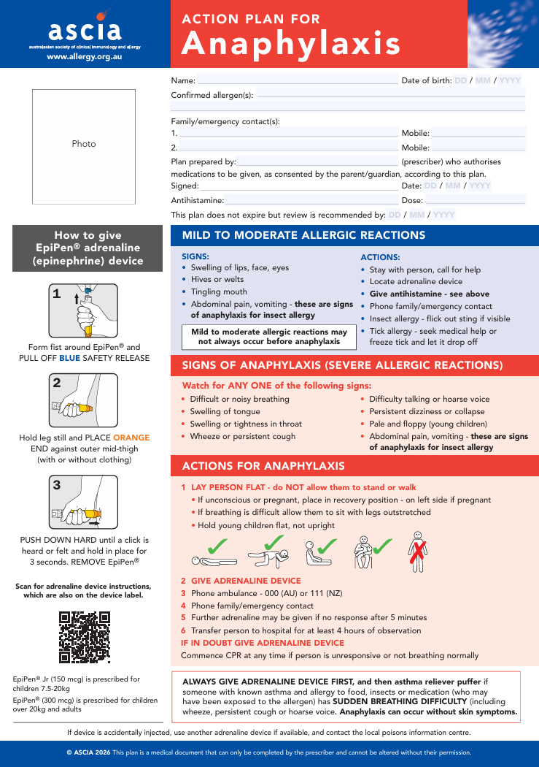
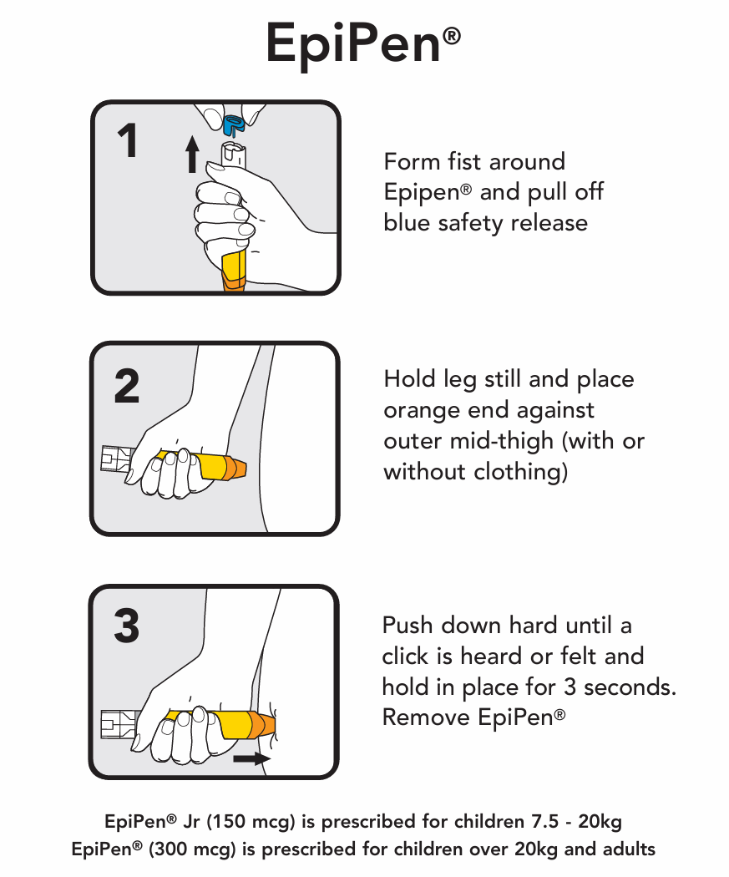
ASCIA Action Plan for Anaphylaxis (Red) (Epipen®)
Notes:
Provide an overview the Epipen Action Plan for Anaphylaxis, highlighting the role you play in testing competency in using an autoinjector.

Slide 7
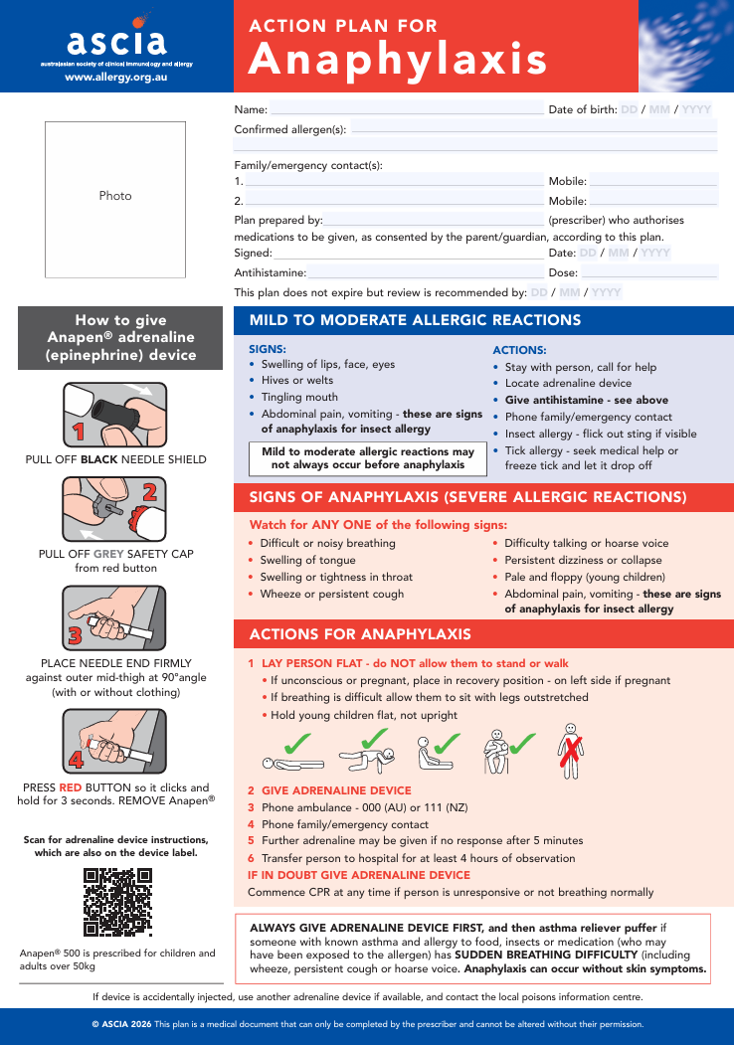
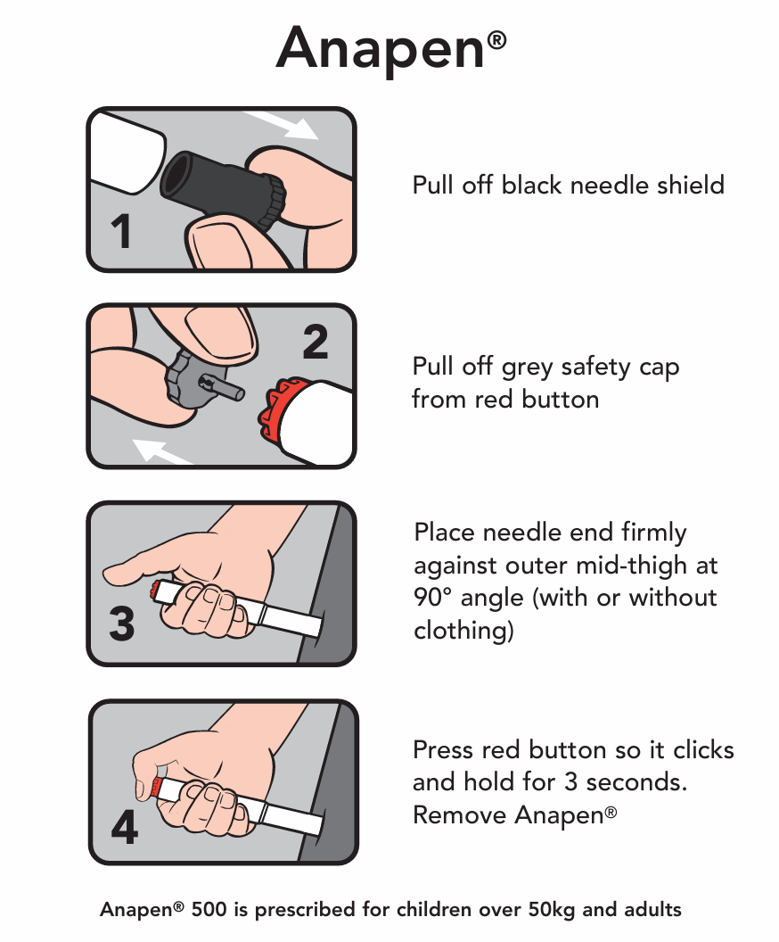
ASCIA Action Plan for Anaphylaxis (Red) (Anapen®)
Notes:
Provide an overview the Anapen Action Plan for Anaphylaxis, highlighting the role you play in testing competency in using an autoinjector. New Plan now requires the injection to be inserted for only 3 seconds.

Slide 8
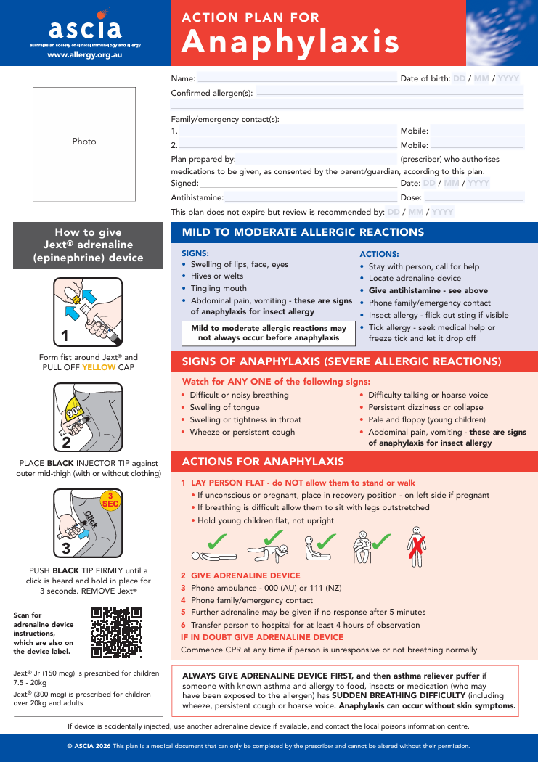
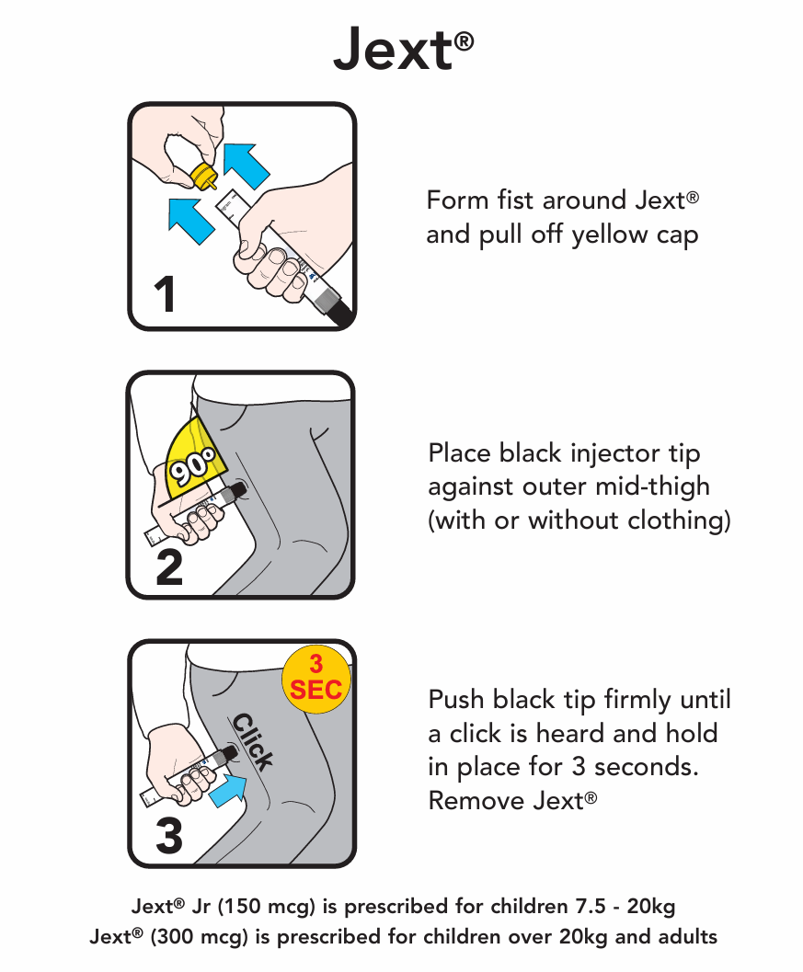
ASCIA Action Plan for Anaphylaxis (Red) (Jext®)

Slide 9
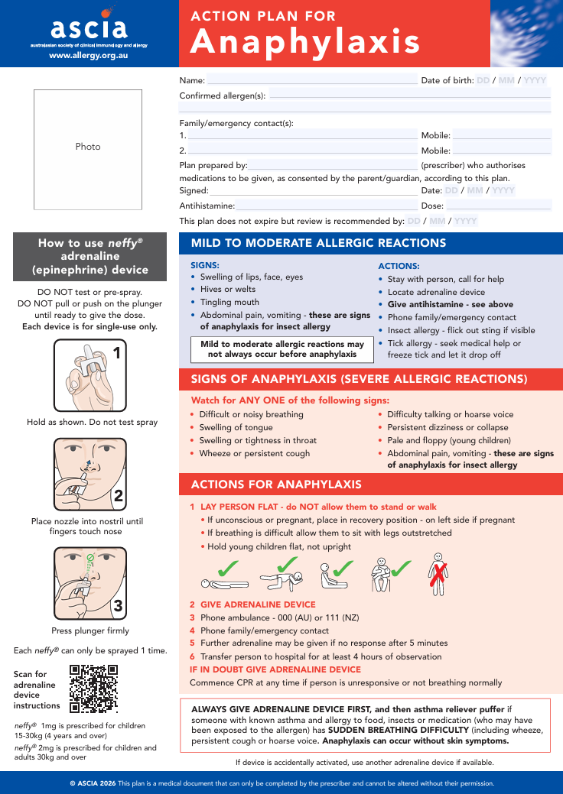
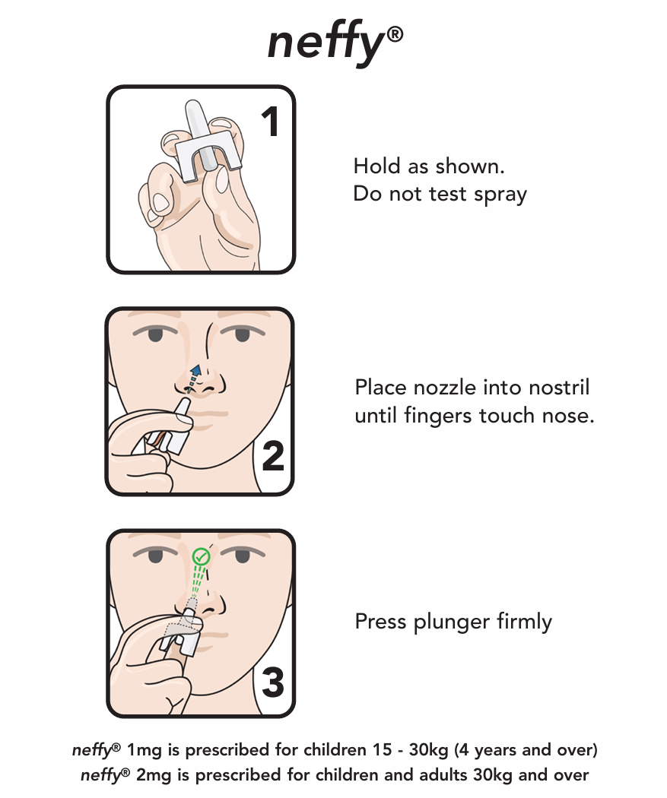
ASCIA Action Plan for Anaphylaxis (Red) (neffy®)

Slide 10
First Aid and Emergency Response
All staff need to know the school’s Anaphylaxis Policy and Emergency Procedures
The student’s ASCIA Action Plan For Anaphylaxis must be followed if responding to an anaphylactic reaction
Using the adrenaline (trainer) devices, practice scenarios requiring treatment
Notes:
Conduct a brief discussion concerning your School’s First Aid Policy. Include detail on:
which staff have their Apply First Aid qualification.
who needs to do a CPR Refresher?
how long before Anaphylaxis Training Certificates expire?
identifying who keeps training records and how they are maintained
Discuss the Emergency response at your school. Include detail on:
who rings the ambulance? (In some schools the Office Admin do it, in other schools it is the responsibility of the School Nurse. Discuss what is appropriate in your own school.)
what methods will be used to transfer information from one point of the school to another as quickly as possible? (suggestions include card system, walkie talkies, mobile phone)
are all the student’s emergency details up to date? who has this responsibility?
Using the adrenaline (trainer) devices, practice an emergency situation requiring anaphylaxis treatment for example:
A bee sting occurs on school grounds and the student is conscious
An allergic reaction where the child has collapsed on school grounds and the student is not conscious
Please refer to the School Anaphylaxis Supervisor Checklist for the necessary observations that should be followed. A copy of this checklist is available at:
https://www2.education.vic.gov.au/pal/anaphylaxis/resources

Slide 11
Ongoing support and training resources
Anaphylaxis Policy and Guidelines: | published by Department of Education at: www2.education.vic.gov.au/pal/anaphylaxis/policy
Anaphylaxis Advice Line: | 1300 725 911 or 93454235 email: anaphylaxisadviceline@rch.org.au
ASCIA Action Plans for Anaphylaxis: | can be downloaded from the ASCIA website: www.allergy.org.au/hp/anaphylaxis/ascia-action-plan-for-anaphylaxis
ASCIA Action Plans e-Training Course for Victoria Schools: | https://training.ascia.org.au/
Department of Allergy & Immunology, Royal Children’s Hospital: | www.rch.org.au/allergy
Allergy & Anaphylaxis Australia: | website or phone line support 1300 728 000 or www.allergyfacts.org.au
Notes:
For further information on anaphylaxis management read through the resources:
Anaphylaxis Guidelines – should be located at your school – let staff know where it is kept for their own further needs.
The Anaphylaxis Advice Line (run by the Royal Children’s Hospital) – is for Principals, staff and parents to access for information regarding Anaphylaxis, Anaphylaxis guidelines, Anaphylaxis Management Plans, ASCIA Action Plans, EpiPens® and Anapens®, Communication Plans, Risk Minimisation Plans.
ASCIA – Australasian Society of Clinical Immunology and Allergy – can download ASCIA Action Plans and access the e-training course.
Royal Children’s Hospital – Dept of Allergy and Immunology – website has community education and training in the accredited course 22579VIC First aid Management of Anaphylaxis.
Allergy & Anaphylaxis Australia – is an organisation that supports children and families of those diagnosed with anaphylaxis. It has resources on the website and materials for sale.

