Slide 1

The Go-To-Market Framework
A structured approach to launching with precision — aligning strategy, teams, and execution to maximize market impact and revenue growth.
STRATEGY
EXECUTION
GROWTH

Slide 2
Agenda
01
02
03
What Is a GTM Framework?
Key Concepts & Terminology
The Cost of No Alignment
Definition, purpose, and why it matters for every organization
Aligning on the language of product launches, marketing releases, and orchestration
Real risks and data-backed consequences of launching without a framework
04
05
Three Pillars of GTM Strategy
Recommendations & Best Practices
The core components that drive successful market entry and sustained growth
Actionable guidance for building and executing a collaborative GTM process

Slide 3

What Is a GTM Framework?
A Go-To-Market Framework is the structured plan that guides how a product, service, or announcement reaches its intended audience — coordinating strategy, messaging, channels, and team readiness.
Product Launch
New or improved products and services introduced to the market
Non-Product Launch
Price changes, deprecations, market pivots, and business decisions
Orchestration
Streamlining cross-functional collaboration for agility and speed
Internal & External Comms
Coordinated messaging to customers, partners, analysts, and employees

Slide 4
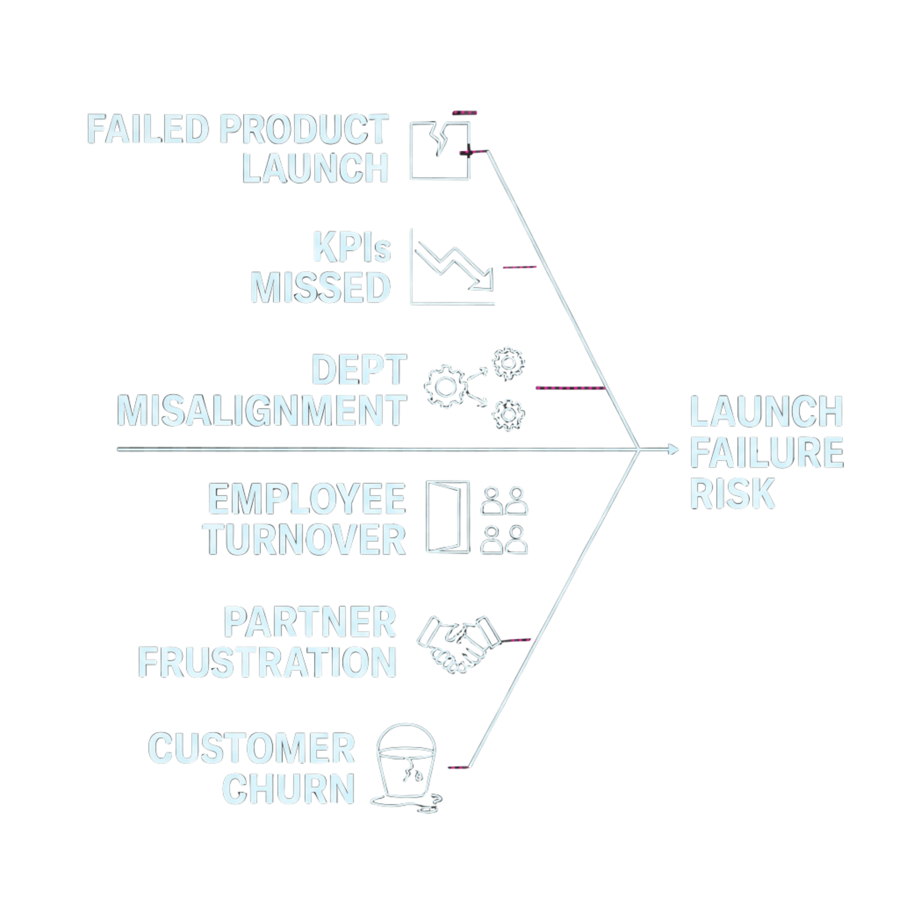
The Cost of No Alignment
Without a structured GTM framework, even well-resourced organizations face compounding risks that undermine launch success and long-term growth.
Studies show that up to 90% of businesses fail at GTM execution without a framework in place.

Slide 5
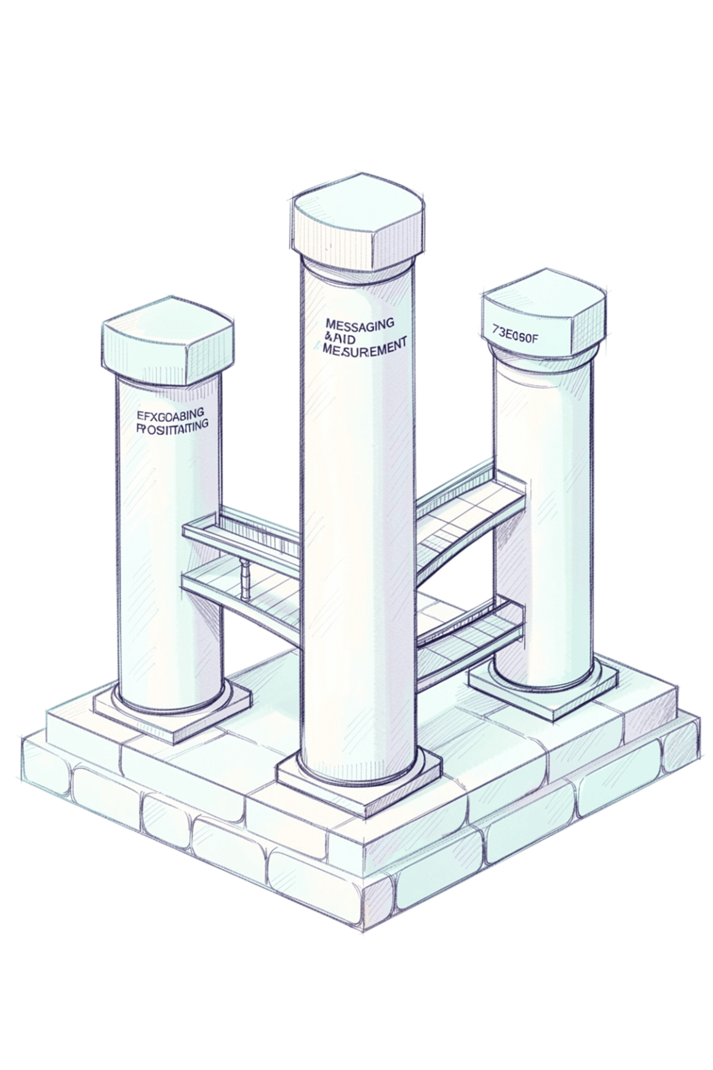
Three Pillars of a Successful GTM Strategy
Market Understanding
1
Deep knowledge of target segments, customer needs, competitive landscape, and product-market fit. Define ICPs, personas, and unique value propositions.
Messaging & Positioning
2
Craft compelling narratives that communicate benefits and differentiators. Ensure every customer understands the "why" behind the offering.
Execution & Measurement
3
Select the right channels, establish KPIs, build sales enablement materials, and continuously measure performance across conversion, CAC, and satisfaction.

Slide 6
The Business Case: Numbers That Matter
Organizations that invest in collaborative GTM strategy consistently outperform those that don't. The data is clear.
72%
208%
Align Sales & Marketing
Revenue Increase
of businesses consider aligning sales and marketing as critical for GTM success
Increased revenue resulting from internal alignment between teams
67%
25%
Market Share Growth
Faster Revenue Growth
Increased market share through structured GTM execution
Faster revenue and profit growth over 3 years
61%
30%
Goal Achievement
Retention Boost
Increase in obtaining goals with a defined GTM framework
Increased retention when strategy is collaborative and aligned

Slide 7
Baseline Components of a Solid GTM Strategy
Strategic Foundations
Contributing Roles
Customer, partner, and prospect feedback loops
ICPs and target personas defined
Impact analysis for every release type
Competitive analysis and differentiators
Value proposition and pricing strategy
Deep market understanding
Product Marketing (PMM)
Sales Leaders & Demand Gen
Product & Operations
Customer Success & Support
Analyst Relations & PR
Finance, Events, Social Media & Academy

Slide 8
Short & Long-Term Benefits
A well-executed GTM strategy delivers compounding returns across the business.
Product-Market Fit
Customer & Partner Loyalty
Honed fit through continuous iteration and market feedback
Satisfaction, retention, and partner confidence at every stage
Accelerated Time-to-Market
Brand Recognition
Streamlined processes reduce delays and increase launch velocity
Increased awareness, influencer recommendations, and market presence
Revenue & Market Share
Team Collaboration
Sustained growth, optimized sales processes, and budget alignment
Internal readiness, employee retention, and growing talent

Slide 9

Recommendations & Best Practices
1
Assign Clear Ownership
Every release needs a Release Driver (who triggers the process) and a Release Owner (who drives the GTM plan). These roles may shift based on release type.
2
Build a Cross-Functional Task Force
Include one representative from every function. All members attend kickoff — those not involved in a specific release can step back after alignment.
3
Standardize Your Release Timeline
Follow a consistent 7-phase flow: Discovery → Kickoff → Orchestration → Go/No-Go → Launch → Internal Comms → Post-Launch Tracking.
4
Document Everything
Maintain a single source of truth. Use templates for GTM plans, RACI matrices, internal announcements, and customer/partner communications.

Slide 10

Key Takeaways
The Foundation
The Mindset
A GTM framework is not optional — it is the backbone of every successful launch. 90% of businesses fail at GTM execution without one.
The most important ingredients are team collaboration, incorporation of market insights, proactive launch planning, and growing talent across every function.
The Formula
Iterate, improve, and optimize — GTM strategy is a living process, not a one-time event.
Market understanding + clear messaging + cross-functional alignment = sustained revenue growth and competitive advantage.

