Slide 1

building blocks of a business
Business 101 – Managing a Business and Turning a Profit: Getting Started
Kemp Anderson Consulting
www.KempAnderson.com

Slide 2
Business 101 – Managing a Business and Turning a Profit: Getting Started
Customer Segments
Value Propositions
Channels for the business
Customer Relationships
Revenue Streams
Key Resources
Key Activities
Key Partners
Cost Structure, COG’s and PROFIT………….

Slide 3


Residential and Commercial Maintenance Services – Attractiveness
Pest Control Services is among the more attractive maintenance services markets – characterized by relatively high growth and profitability, and by significant recurring and appointment-based revenue streams
Revenue, $ Billions
Growth
2%
3%
4%
3%
4%
3%
3%
Profitability
Recurring
Appointment
Mix
#1 share
5%
Small
20%
Small
19%
20%
Small
Small
Small
Small

Slide 4
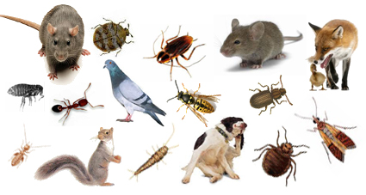
The Need For Pest Control
The Pest Control Services industry exists to mitigate the substantial economic and human health impacts that are associated with pests such as ants, termites, cockroaches, mice and rats and others
Pests destroy homes, buildings and contents – termites alone cause $5B in damage annually
Pests can transmit disease-causing organisms, including West Nile , Lyme disease, malaria, plague, encephalitis and hantavirus
Insect stings force ½ million Americans to emergency rooms annually
Rodents consume or contaminate 20% of the world’s food supply
Bedbugs have recently made a significant resurgence in the United States
Rats bite more than 45,000 people each year; rats can cause fires by chewing wires and transmit disease organisms
Source: National Pest Management Association (NPMA)

Slide 5


Threat of Entry
The ‘basic’ building blocks of new entry are readily available – equipment, licenses and personnel; however, it is challenging to establish the brand strength, capabilities and customer base required for material long-term success; in particular, high customer contract renewal rates inhibit rapid organic customer growth
Requirements for Successful Entry
Contract Renewal Rates
Equipment
  Trucks
  Sprayers
Licenses
  Operator
  Applicator
Personnel
  Managers
  Technicians
Brand Strength
  Awareness
  Reputation
Capabilities
  Systems
  People
Customer Base
  Route density
  Critical mass
It is challenging to establish a new pest control operation – particularly as an independent proprietor – and expect to rapidly grow to a material size and level of profitability so as to seriously challenge an existing local market leader
Not a significant entry barrier
A significant entry barrier to most new entrants

Slide 6
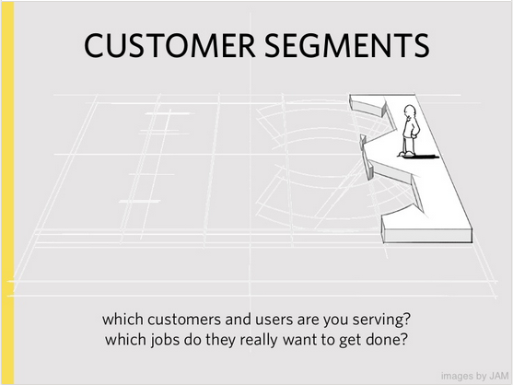

Slide 7
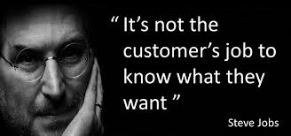
Who are you serving? What do they want?
Who:
  Residential versus Commercial
What do they want (SELL what you are good at delivering!)
  Pest
    inside versus outside services.
    What is included?
  Lawn, Tree, Shrub
  Termite
  OTHER: bedbug, mosquito, rodent, animal control, flea and tick, birds other
Renewals and Retention are critical

Slide 8
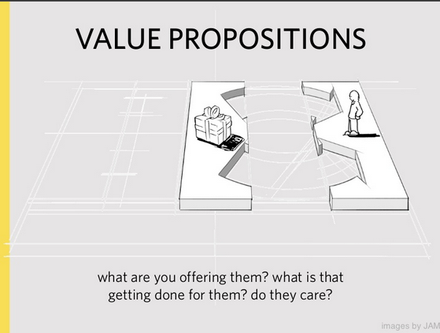

Slide 9

Value: What are you offering? Do they want it? Does the customer even care?
Focus on Customer “wants and needs”
What do you offer and what are you good at:
  Pest
  Lawn & Ornamental
  Termite
  Fume – Commodity, Furniture, Other
  Other: bedbug, mosquito, rodent, animal, flea and tick and so on
Common Sense should rule:
  Are you matching the service with the market need?
  Are your service offerings competitive in terms of scope and price?
  Are you staying focused on RETENTION?
  Does your sales team and technical team or technicians interact?

Slide 10
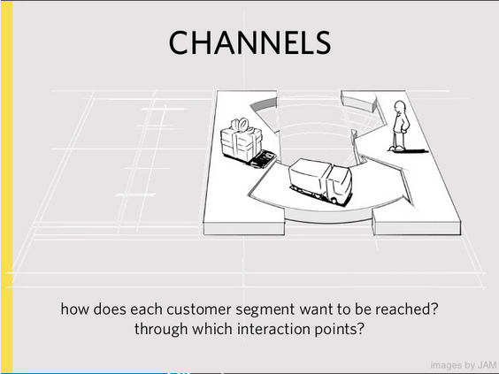

Slide 11

How does your customer base want to be reached?
Do you communicate with INNOVATION and TECHNOLOGY?
Communication “FORM” is critical in today’s market:
  Paper
  Email
  Text
  Chat
  Company Website
Customer Communication Matters:
  Commercial Customers: Blended approach –
    some paper (billing and service work) and
    some email and text (service calls, follow ups, general communication)
  Residential Customers: Blended approach but mostly dictated by PCO not customer
    Ipad’s: sign new customers at the door, email completions, email work LIVE, Customer Presentations….
    Smart Phones: Company to employee communication, mapping, emails, texting and so on
    Websites: EZ PAY, company to customer communications and so on….
    GOOD OLE PAPER…..?
What does your costumer want?
Do you know the demographics of your customer base? GOOGLE……..

Slide 12
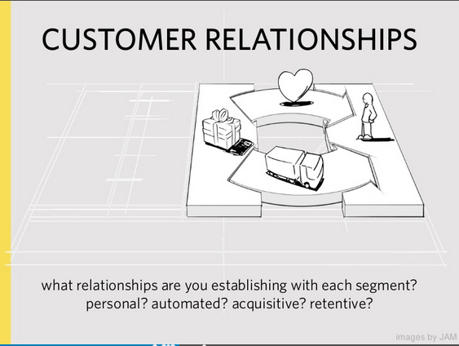

Slide 13
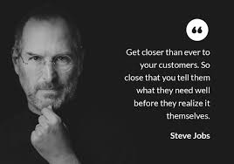
Customer Relationships: personal, automated, acquisitive, retentive….
How have you structured the Customer Relationship?
  Personal: you call them, they call you. Friends, Family, Neighbors, Professional Acquaintances and so on
  Automated: Websites, Emails, Text, EZ PAY, BRAND BASED NOT EMPLOYEE BASED….
  Acquisitive: based simply on need and One Time
  RETENTIVE: did you build the business around renewal based service and customer retention? Got Customer Agreements?
      TYPICAL RETENTION BY SEGMENT:
      Pest Control: Residential – 80%+, Commercial – 90%+
      Lawn and Ornamental – 60%+
      Termite – 90%+

Slide 14
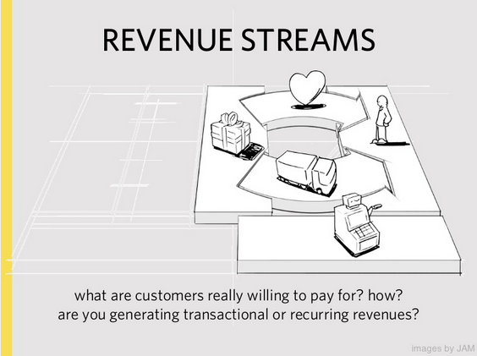

Slide 15
Revenue Streams: what will they pay for? How do you retain?
What will they pay for?
  Do you create the need? Free Inspections
  Do you make the “Transaction Process” easy? Automate
  Is the Process Transparent? Communicate
How do you Retain Customer?
  Agreements
  EZ PAY
  VALUE
  SATISFACTION
DO WHAT YOU ARE GOOD AT DOING……..
Employee Retention = Customer Retention in the Pest Control Industry…
Content builds relationships.
Relationships are built on trust.
TRUST drives REVENUE.
Andrew Davis - Author

Slide 16
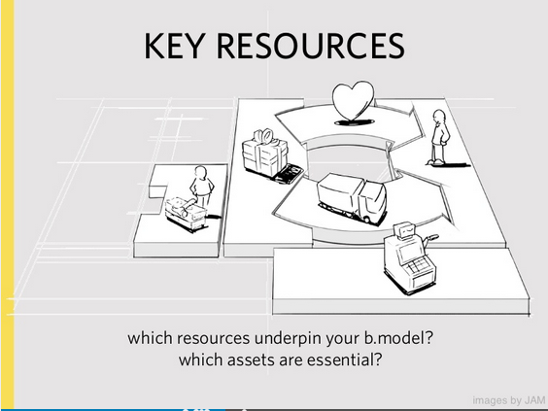

Slide 17
Resources: What resources assets are key?
COG’s = 70% of the “costs” on a P&L or Income Statement are in 3 buckets….
  Inventory – usually 10% total blended, brand v. generic, efficacy.
  Fleet – usually 10% or less - Own or lease, debt v. cash, buy used? Marketing instrument and image.
  Labor – typically 50% or less “loaded” (benefits)- It is a people business…People serving People. Standards and Employee Tenure??? LOGIC: The longer an employee stays, the more they know, the better the service, the longer your company retains customers = PROFIT
    Drug Free workplace – at hiring, random and annually?
    MVR checks annually?
    Physical for Technicians – at hiring or injury?
    Criminal background – at hiring or checks annually?
    Constant Training and investment?

Slide 18
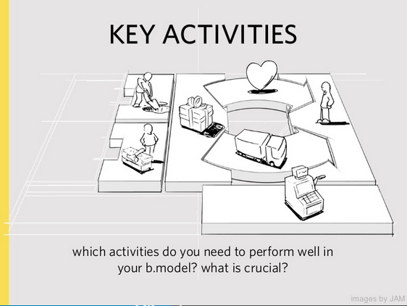

Slide 19
Key Activities for Profit….
People
  Hire Right with thorough standards that are not negotiable
  Train Right initially and weekly at a minimum
  Reward and Keep employees
  Sometimes employees don’t work out….terminate with dignity and professionalism.
Offer the right services at the right price with the technical expertise.
Annual Price Increases…if they are reasonable, they are your friend.
Focused Marketing = Route Density = PROFIT

Slide 20
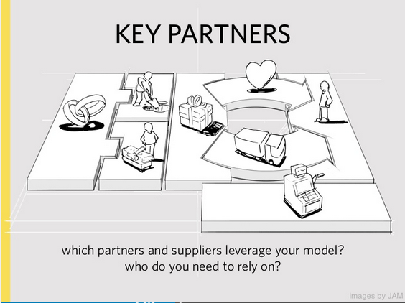

Slide 21
Key Partners: who do you rely on, who is critical?
Banking
Software and technology
Payroll
Fleet
Chemical Vendors
Landlords

Slide 22
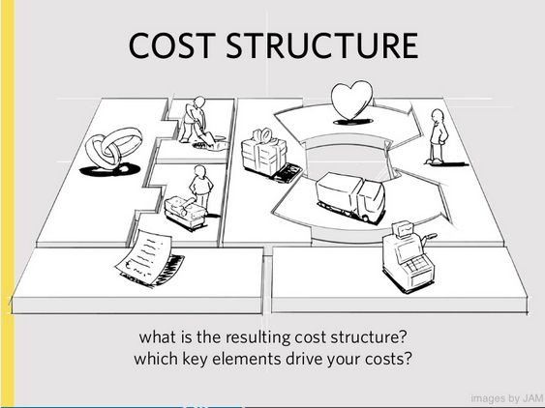

Slide 23
Control what drives cost = Profit
COG’s = 70% of the “costs” on a P&L or Income Statement are in 3 buckets….
  Inventory – usually 10% total blended, service mix, brand v. generic, efficacy.
  Fleet – usually 10% or less - Own or lease, debt v. cash, buy used? Marketing instrument and image.
  Labor – typically 50% or less “loaded” (benefits)- It is a people business…People serving People. Standards and Employee Tenure??? LOGIC: The longer an employee stays, the more they know, the better the service, the longer your company retains customers = PROFIT
Employee Retention creates Customer Retention. Control Employee Tenure…

Slide 24
Conclusion: Key Building Blocks to focus on for VALUE
People: Customers and Employees
Route Density
Price versus Value Leader
COG’s: Fleet, Payroll, and Inventory
Technology: Smart Technology (smart phones, IPad’s, EZ Pay, Paperless, etc.) and Website
Renewing Services and Retention

Slide 25
Thank you…..
Kemp Anderson and
Kemp Anderson Consulting www.KempAnderson.com

