Slide 1
Work Portfolio
Michael A. Napier
1

Slide 2
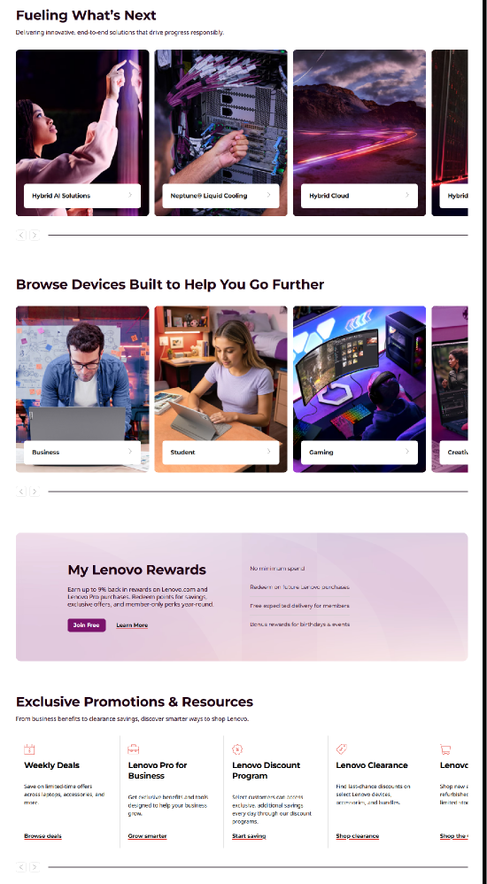
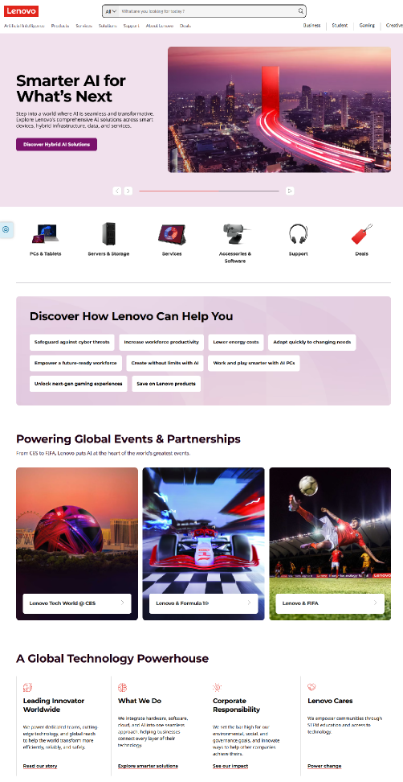
AEM DEVELOPMENT
Lenovo Home Page
My last project at Lenovo was contributing to the development of a new marketing codebase in Adobe Experience Manager. The first release of the codebase was a new Lenovo.com home page, which debuted on October 1, 2025.
I developed several components based on guidelines from vendor designer Code & Theory.
2

Slide 3
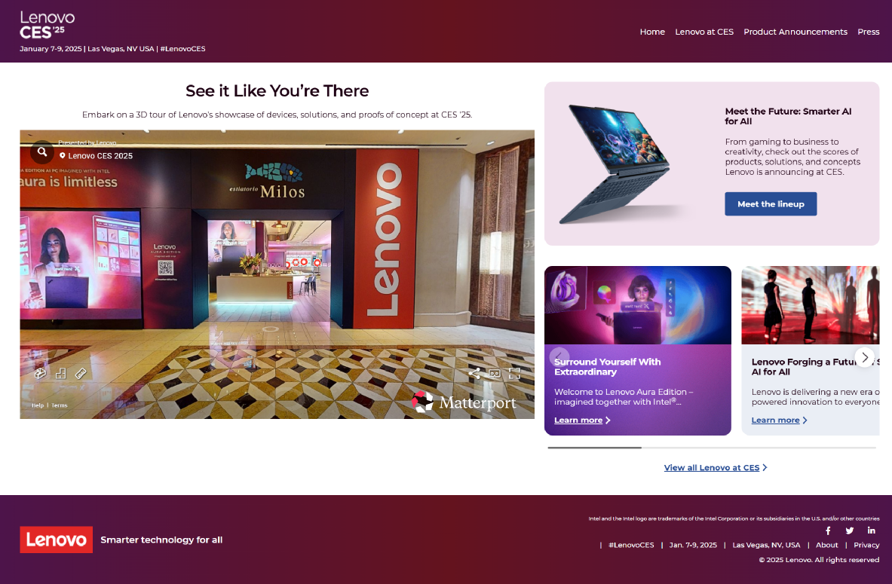
AEM DEVELOPMENT
Lenovo at CES
I developed Lenovo's web sites for major events in AEM, such as the Consumer Electronics Show (CES), Mobile Web Congress (MWC), and Lenovo Innovation World, in coordination with design and content teams.
This example is the landing page for the 2025 CES, which had over 129,000 unique visitors and over 209,000 page views.
In addition to authoring these experiences, I developed components and templates for Lenovo's AEM code base using Java-based Sling models, Javascript (including jQuery libraries), and CSS (LESS preprocessor).
3

Slide 4
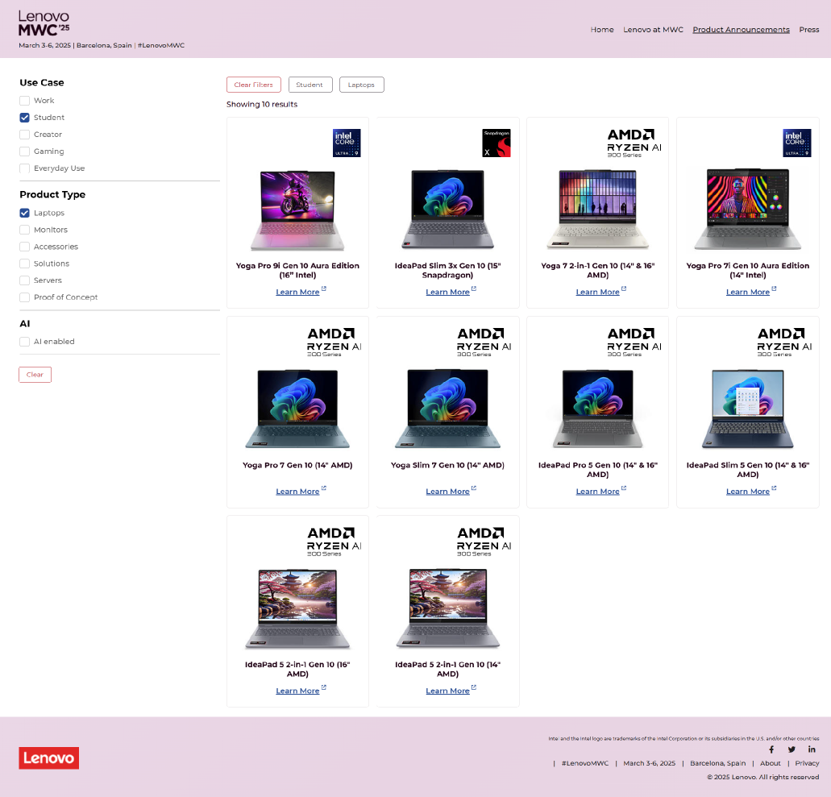
AEM DEVELOPMENT
Lenovo at MWC
This example is the product announcements page for Lenovo’s 2025 Mobile Web Congress site.
Here, I customized a content filter component in AEM to display selected new products releases revealed at the event. Each product card revealed a modal with a product description and an image carousel. All components were developed with accessibility in mind as well as Adobe analytics implementation.
Over 62,000 unique visitors engaged with the MWC site.
4

Slide 5
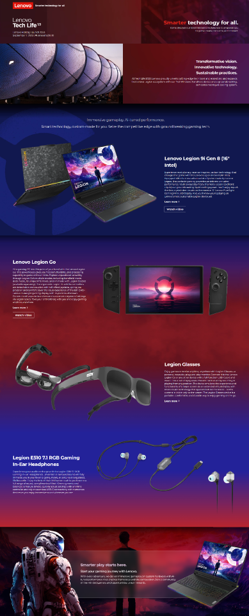
AEM DEVELOPMENT
Lenovo at IFA
With any landing page in AEM, I worked with designers and content producers to develop the experience to their specifications, providing feedback on practicality, accessibility, and performance.
This example is Lenovo’s 2023 Tech Life at IFA page, which had over 1.1 million unique visitors with an average of 3 minutes of time on the site.
5

Slide 6
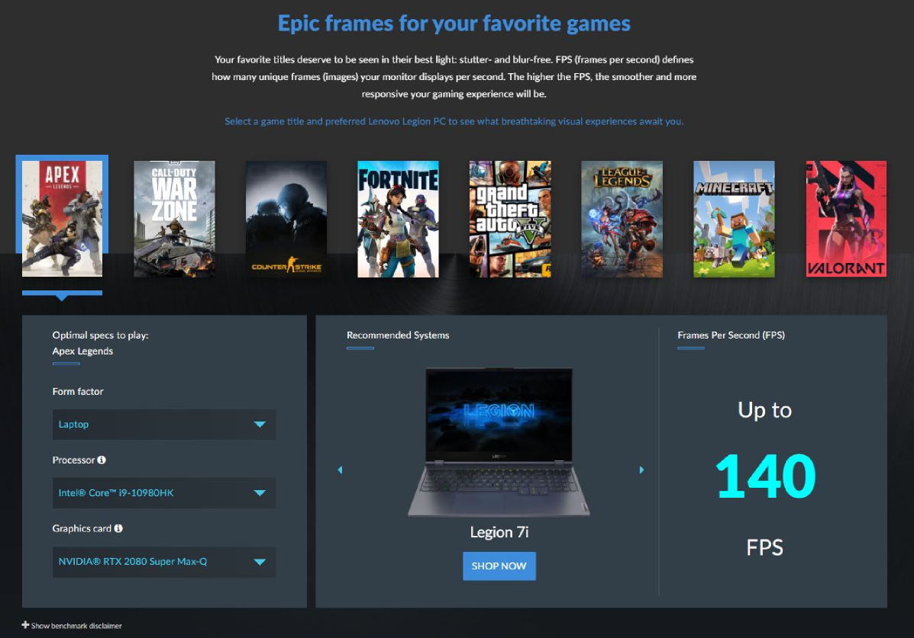
FRONT-END DEVELOPMENT
Lenovo Legion
This is a segment of the Legion gaming brand page on Lenovo.com. This was a special user experience project created in 2020.
Users would select a game, form factor, processor, and graphics card, and in return get gaming system recommendations from Lenovo and an estimate of the frames per second (FPS) for that system. The FPS data was retrieved from a RESTful API hosted by UL Solutions.
I created this section with an open HTML component inside the Hybris WCMS, the system used prior to Lenovo’s adoption of AEM. I developed the CSS and the Javascript.
6

Slide 7
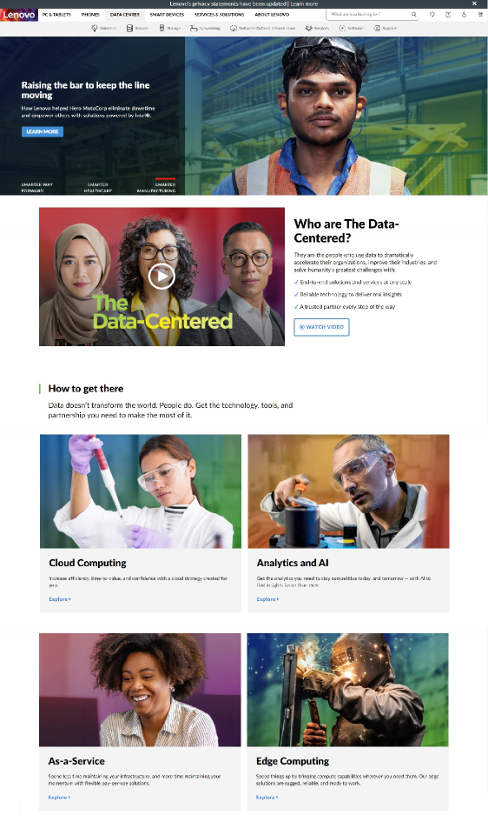
DRUPAL DEVELOPMENT
Lenovo Data Center
This is the Lenovo Data Center home page after it was redesigned using a Drupal-based content management system in 2020. My responsibilities included:
Working with design and project management to scope the layout of the site using available components.
Creating those components based on design assets and marketing copy and constructing the page to established style guidelines.
Working with IT in the testing and implementation of new components or improving existing components during sprint cycles.
7

Slide 8
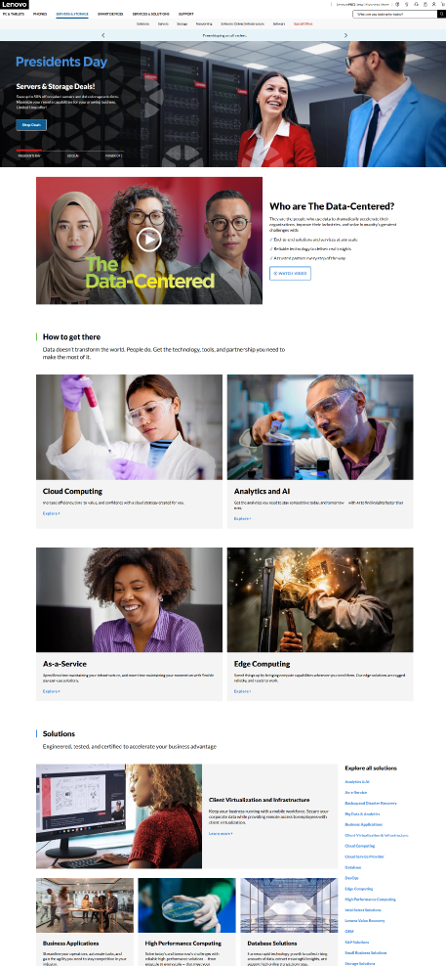
FRONT-END DEVELOPMENT
Lenovo Servers & Storage
In 2022, the Lenovo Data Center site was migrated again to an in-house content management system before Lenovo adopted AEM. I directed the migration of the site under the banner of “Servers & Storage.”
There was no redesign of the components, so what is shown here are free-form components containing the HTML generated from the Drupal site, along with a banner template. Global CSS and Javascript were also carried over.
8

Slide 9
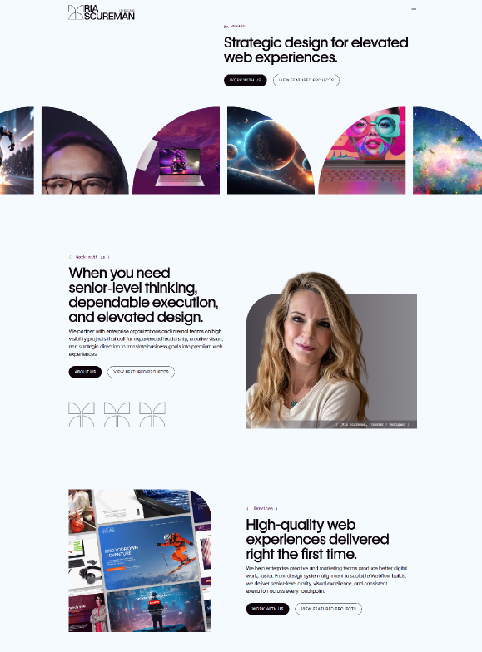
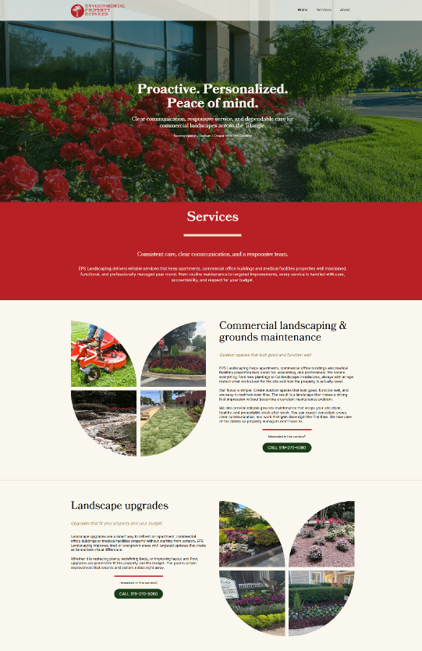
riascureman.com
epslandscape.com
WEBFLOW DEVELOPMENT
Ria Scureman Designs
Currently, I do web development with Ria Scureman Designs, a freelance partnership building premium web experiences in the Webflow CMS. I am a certified Webflow Practitoner.
Here are two sites that I built to specs in Figma: riascureman.com and epslandscape.com. Both use custom components, CSS, and Javascript in the native Webflow CMS.
9

Slide 10
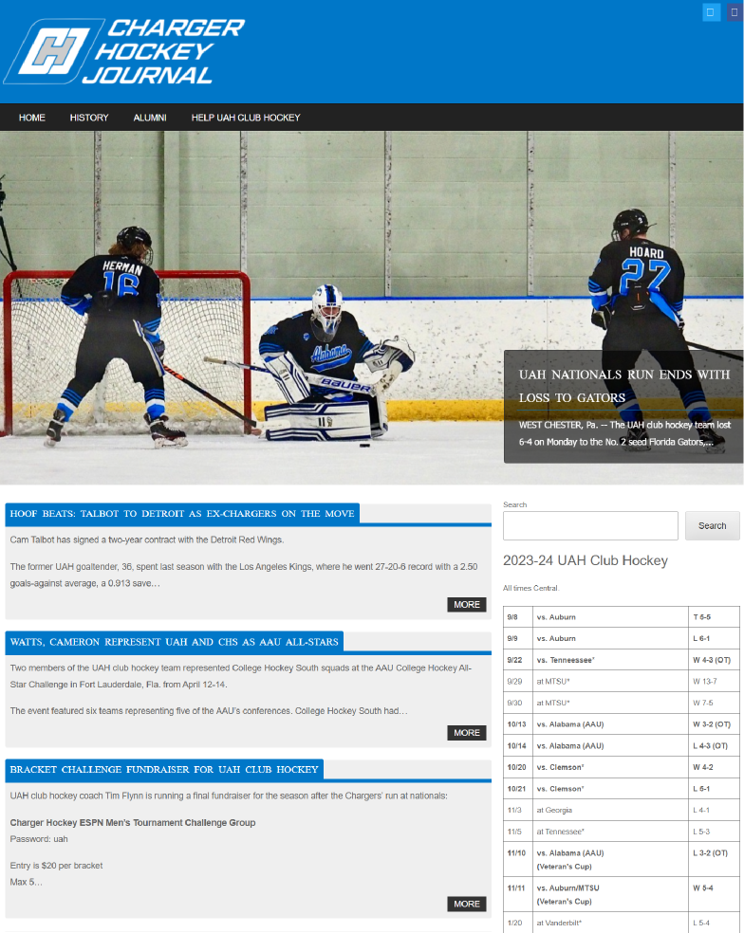
SIDE PROJECT
Charger Hockey Journal
Charger Hockey Journal was an independent web site covering the ice hockey program at The University of Alabama in Huntsville. I wrote game recaps, news updates, and historical features.
The site ran on WordPress using a custom theme. I added extra CSS and Javascript for further customization.
10

Slide 11
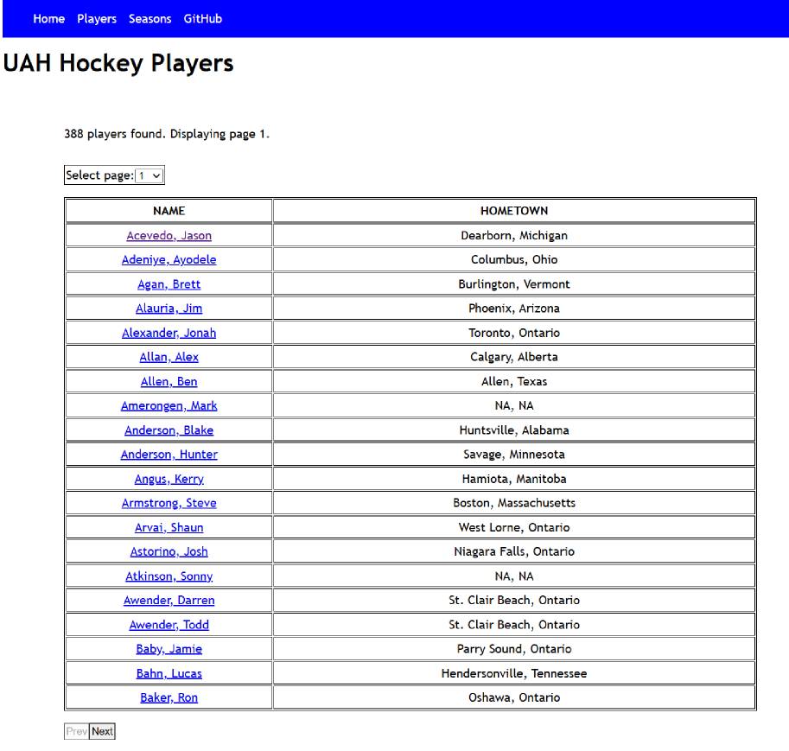
Thank you!
I appreciate you taking the time to look through my portfolio. For code examples, I have a GitHub account where I am practice and demonstrate my coding skills, particularly in React and back-end development. I’ve started a small project where I’ve created a React app that fetches hockey data from an SQL Database.
My GitHub site is at: https://github.com/minapier
Please message me if you have any questions:
Email: mnapier74@gmail.com
LinkedIn: https://www.linkedin.com/in/minapier/
11

